Slide 1
Chapter 4 :: Hardware Description Languages
Digital Design and Computer Architecture
David Money Harris and Sarah L. Harris
Copyright © 2007 Elsevier
4-<<number>>

Slide 2
Chapter 4 :: Topics
Introduction
Combinational Logic
Structural Modeling
Sequential Logic
More Combinational Logic
(optional)Finite State Machines
(optional)Parameterized Modules
(optional)Testbenches
Copyright © 2007 Elsevier
4-<<number>>

Slide 3
Introduction
Hardware description language (HDL): allows designer to specify logic function only. Then a computer-aided design (CAD) tool produces or synthesizes the optimized gates.
Most commercial designs built using HDLs
Two leading HDLs:
  Verilog
    developed in 1984 by Gateway Design Automation
    became an IEEE standard (1364) in 1995
  VHDL
    Developed in 1981 by the Department of Defense
    Became an IEEE standard (1076) in 1987
Copyright © 2007 Elsevier
4-<<number>>

Slide 4
HDL to Gates
Simulation
  Input values are applied to the circuit
  Outputs checked for correctness
  Millions of dollars saved by debugging in simulation instead of hardware
Synthesis
  Transforms HDL code into a netlist describing the hardware (i.e., a list of gates and the wires connecting them)
IMPORTANT:
When describing circuits using an HDL, it’s critical to think of the hardware the code should produce.
Copyright © 2007 Elsevier
4-<<number>>

Slide 5
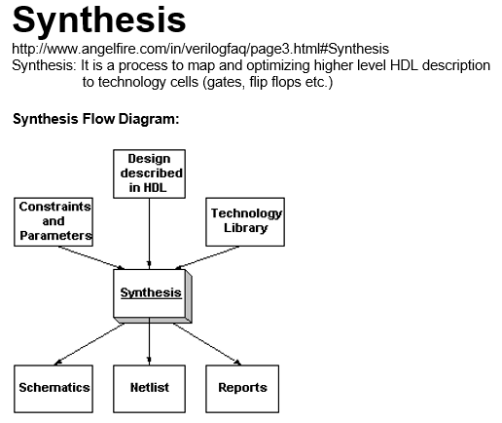

Copyright © 2007 Elsevier
4-<<number>>

Slide 6
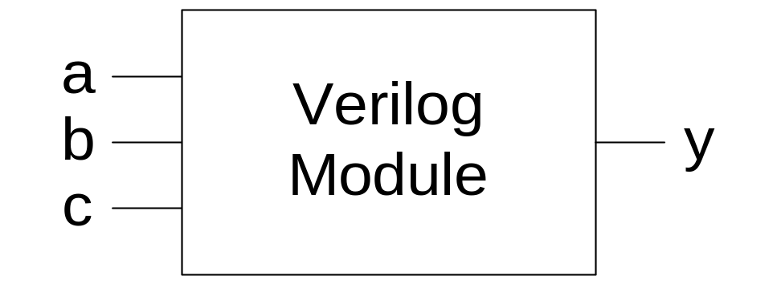
Verilog Modules
Two types of Modules:
  Behavioral: describe what a module does
  Structural: describe how a module is built from simpler modules
Copyright © 2007 Elsevier
4-<<number>>

Slide 7
Behavioral Verilog Example
Verilog:
module example(input a, b, c,
output y);
assign y = ~a & ~b & ~c | a & ~b & ~c | a & ~b & c;
endmodule
Copyright © 2007 Elsevier
4-<<number>>

Slide 8
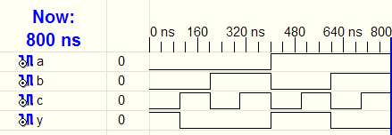
Behavioral Verilog Simulation
Verilog:
module example(input a, b, c,
output y);
assign y = ~a & ~b & ~c | a & ~b & ~c | a & ~b & c;
endmodule
Copyright © 2007 Elsevier
4-<<number>>

Slide 9
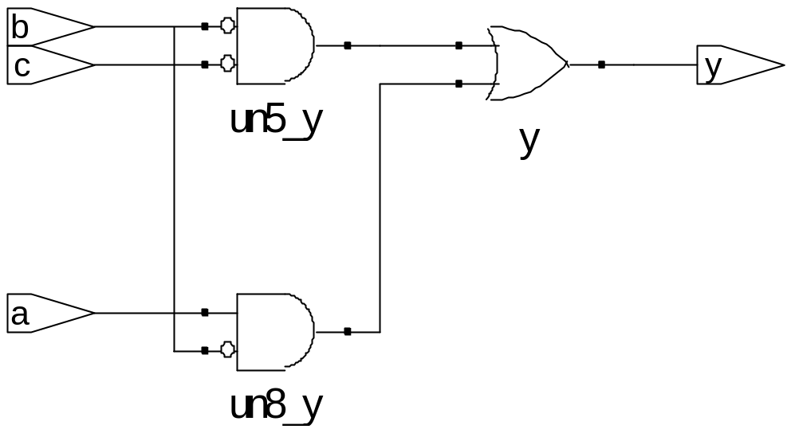
Behavioral Verilog Synthesis
Verilog:
module example(input a, b, c,
output y);
assign y = ~a & ~b & ~c | a & ~b & ~c | a & ~b & c;
endmodule
Synthesis:
Copyright © 2007 Elsevier
4-<<number>>

Slide 10
Verilog Syntax
Case sensitive
  Example: reset and Reset are not the same signal.
No names that start with numbers
  Example: 2mux is an invalid name.
Whitespace ignored
Comments:
  // single line comment
  /* multiline
  comment */
Copyright © 2007 Elsevier
4-<<number>>

Slide 11
Structural Modeling - Hierarchy
module and3(input a, b, c,
output y);
assign y = a & b & c;
endmodule
module inv(input a,
output y);
assign y = ~a;
endmodule
module nand3(input a, b, c,
output y);
wire n1; // internal signal
and3 andgate(a, b, c, n1); // instance of and3
inv inverter(n1, y); // instance of inverter
endmodule
Copyright © 2007 Elsevier
4-<<number>>

Slide 12
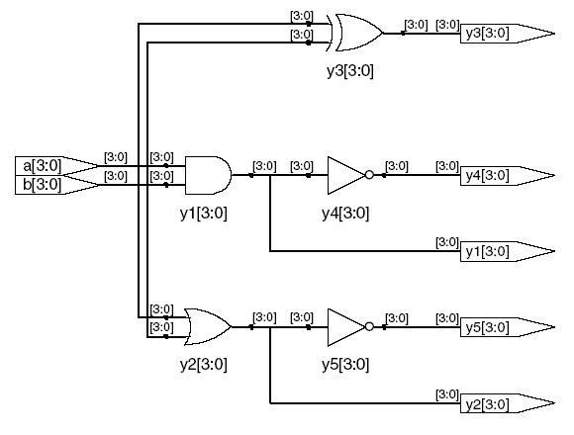
Bitwise Operators
module gates(input [3:0] a, b,
output [3:0] y1, y2, y3, y4, y5);
/* Five different two-input logic
gates acting on 4 bit busses */
assign y1 = a & b; // AND
assign y2 = a | b; // OR
assign y3 = a ^ b; // XOR
assign y4 = ~(a & b); // NAND
assign y5 = ~(a | b); // NOR
endmodule
a[3:0]: little endian. A[3],a[2],a[1],a[0]
assign: continuous assignment. Anytime the inputs on the right side change, the output is recomputed.
// single line comment
/*…*/ multiline comment
Copyright © 2007 Elsevier
4-<<number>>

Slide 13
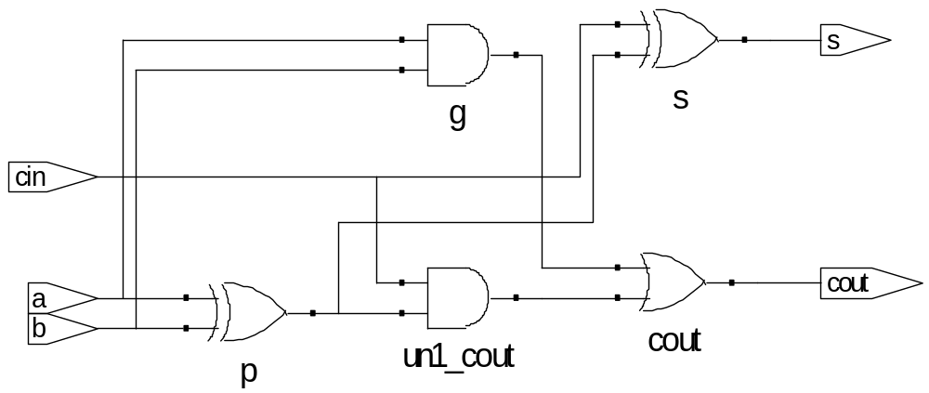
Internal Variables
module fulladder(input a, b, cin, output s, cout);
wire p, g; // internal nodes
assign p = a ^ b;
assign g = a & b;
assign s = p ^ cin;
assign cout = g | (p & cin);
Endmodule
Note:Like hardware, HDL assignment, ‘assign’, are evaluated any time the inputs change, regardless of the order in which the assignments appear in a module
Copyright © 2007 Elsevier
4-<<number>>

Slide 14
Precedence
Defines the order of operations
Highest
~ | NOT
*, /, % | mult, div, mod
+, - | add,sub
<<, >> | shift
<<<, >>> | arithmetic shift
<, <=, >, >= | comparison
==, != | equal, not equal
&, ~& | AND, NAND
^, ~^ | XOR, XNOR
|, ~| | OR, XOR
?: | ternary operator
Lowest
Copyright © 2007 Elsevier
4-<<number>>

Slide 15
Numbers
Format: N'Bvalue
N = number of bits, B = base
N'B is optional but recommended (default is decimal)
Number | # Bits | Base | Decimal Equivalent | Stored
3’b101 | 3 | binary | 5 | 101
‘b11 | unsized | binary | 3 | 00…0011
8’b11 | 8 | binary | 3 | 00000011
8’b1010_1011 | 8 | binary | 171 | 10101011
3’d6 | 3 | decimal | 6 | 110
6’o42 | 6 | octal | 34 | 100010
8’hAB | 8 | hexadecimal | 171 | 10101011
42 | Unsized | decimal | 42 | 00…0101010
Copyright © 2007 Elsevier
4-<<number>>

Slide 16
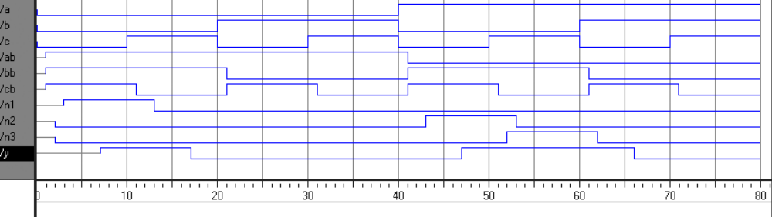
Delays
module example(input a, b, c,
output y);
wire ab, bb, cb, n1, n2, n3;
assign #1 {ab, bb, cb} = ~{a, b, c}; // #1: delay 1 timeunit
assign #2 n1 = ab & bb & cb; // #2:delay 2 time unit
assign #2 n2 = a & bb & cb;
assign #2 n3 = a & bb & c;
assign #4 y = n1 | n2 | n3;
endmodule
Copyright © 2007 Elsevier
4-<<number>>

Slide 17
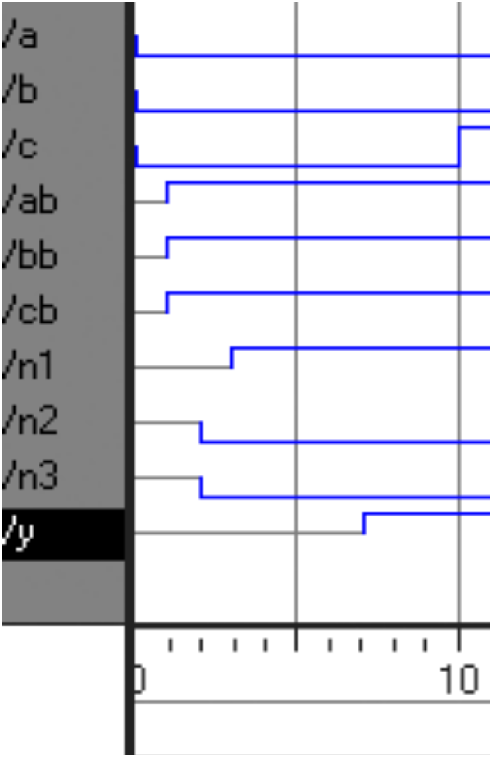
Delays
module example(input a, b, c,
output y);
wire ab, bb, cb, n1, n2, n3;
assign #1 {ab, bb, cb} =
~{a, b, c};
assign #2 n1 = ab & bb & cb;
assign #2 n2 = a & bb & cb;
assign #2 n3 = a & bb & c;
assign #4 y = n1 | n2 | n3;
endmodule
Copyright © 2007 Elsevier
4-<<number>>

Slide 18
Example
Write Verilog code to implement the following
function in hardware:
y = bc + ab
Name the module sillyfunction
Verilog
module sillyfunction(input a, b, c,
output y);
assign y = ~b & ~c | a & ~b;
endmodule
Copyright © 2007 Elsevier
4-<<number>>

Slide 19
Simple Testbench
module testbench1();
reg a, b, c; //note: must declare as reg since they will be assigned a value in initial block
wire y;
// instantiate device under test
sillyfunction dut(a, b, c, y);
// apply inputs one at a time
initial begin
a = 0; b = 0; c = 0; #10; # stay 10 time unit
c = 1; #10;
b = 1; c = 0; #10;
c = 1; #10;
a = 1; b = 0; c = 0; #10;
c = 1; #10;
b = 1; c = 0; #10;
c = 1; #10;
end
endmodule
4-<<number>>

Slide 20
Sequential Logic
Verilog uses certain idioms to describe latches, flip-flops and FSMs
Other coding styles may simulate correctly but produce incorrect hardware
Copyright © 2007 Elsevier
4-<<number>>

Slide 21
Always Statement
General Structure:
always @ (sensitivity list)
statement;
Whenever the event in the sensitivity list occurs, the statement is executed
Copyright © 2007 Elsevier
4-<<number>>

Slide 22
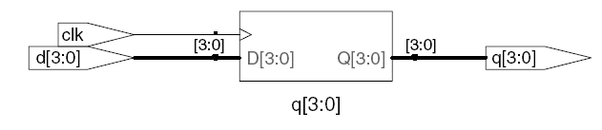
D Flip-Flop
module flop(input clk,
input [3:0] d,
output reg [3:0] q);
always @ (posedge clk)
q <= d; // pronounced “q gets d”
endmodule
Any signal assigned in an always statement must be declared reg. In this case q is declared as reg
Be aware: A variable declared reg is not necessarily a registered output.
We will show examples of this later.
Copyright © 2007 Elsevier
4-<<number>>

Slide 23
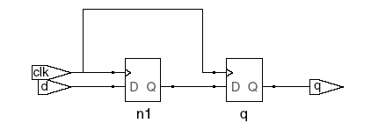

Blocking vs. Nonblocking Assignments
<= is a “nonblocking assignment”
  Occurs simultaneously with others; used instead of “assign ” in always block.
= is a “blocking assignment”
  Occurs in the order it appears in the file
// Good synchronizer using
// nonblocking assignments
module syncgood(input clk,
input d,
output reg q);
reg n1;
always @(posedge clk)
begin
n1 <= d; // nonblocking
q <= n1; // nonblocking
end
endmodule
// Bad synchronizer using
// blocking assignments
module syncbad(input clk,
input d,
output reg q);
reg n1;
always @(posedge clk)
begin
n1 = d; // blocking
q = n1; // blocking
end
endmodule
Copyright © 2007 Elsevier
4-<<number>>

Slide 24
Rules for Signal Assignment
Use always @(posedge clk) and nonblocking assignments (<=) to model synchronous sequential logic
always @ (posedge clk)
q <= d; // nonblocking
Use continuous assignments (assign …)to model simple combinational logic.
assign y = a & b;
Use always @ (*) and blocking assignments (=) to model more complicated combinational logic where the always statement is helpful.
Do not make assignments to the same signal in more than one always statement or continuous assignment statement.
Copyright © 2007 Elsevier
4-<<number>>

Slide 25
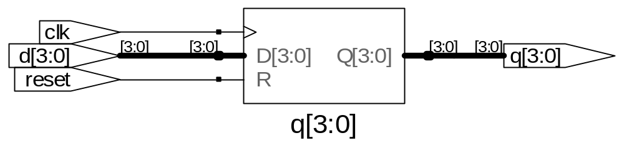
Resettable D Flip-Flop
module flopr(input clk,
input reset,
input [3:0] d,
output reg [3:0] q);
// synchronous reset
always @ (posedge clk)
if (reset) q <= 4'b0;
else q <= d;
endmodule
Copyright © 2007 Elsevier
4-<<number>>

Slide 26
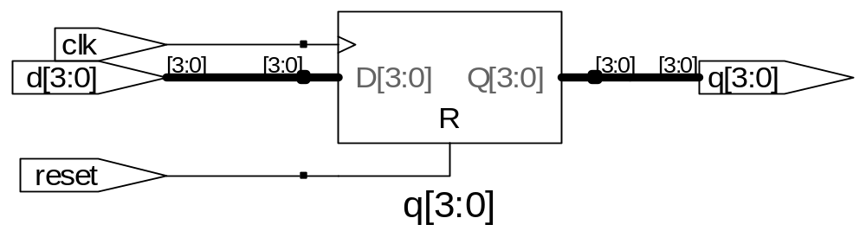
Resettable D Flip-Flop
module flopr(input clk,
input reset,
input [3:0] d,
output reg [3:0] q);
// asynchronous reset
always @ (posedge clk, posedge reset)
if (reset) q <= 4'b0;
else q <= d;
endmodule
Copyright © 2007 Elsevier
4-<<number>>

Slide 27
Other Behavioral Statements
Statements that must be inside always statements:
  if / else
  case, casez
Reminder: Variables assigned in an always statement must be declared as reg (even if they’re not actually registered!)
Copyright © 2007 Elsevier
4-<<number>>

Slide 28
Combinational Logic using always
// combinational logic using an always statement
module gates(input [3:0] a, b,
output reg [3:0] y1, y2, y3, y4, y5);
always @(*) // need begin/end because there is
begin // more than one statement in always
y1 = a & b; // AND
y2 = a | b; // OR
y3 = a ^ b; // XOR
y4 = ~(a & b); // NAND
y5 = ~(a | b); // NOR
end
endmodule
This hardware could be described with assign statements using fewer lines of code, so it’s better to use assign statements in this case.
Copyright © 2007 Elsevier
4-<<number>>

Slide 29
The following pages are Appendix
Copyright © 2007 Elsevier
4-<<number>>

Slide 30
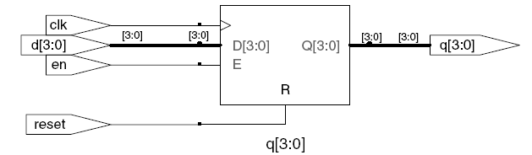
D Flip-Flop with Enable
module flopren(input clk,
input reset,
input en,
input [3:0] d,
output reg [3:0] q);
// asynchronous reset and enable
always @ (posedge clk, posedge reset)
if (reset) q <= 4'b0;
else if (en) q <= d;
endmodule
Copyright © 2007 Elsevier
4-<<number>>

Slide 31
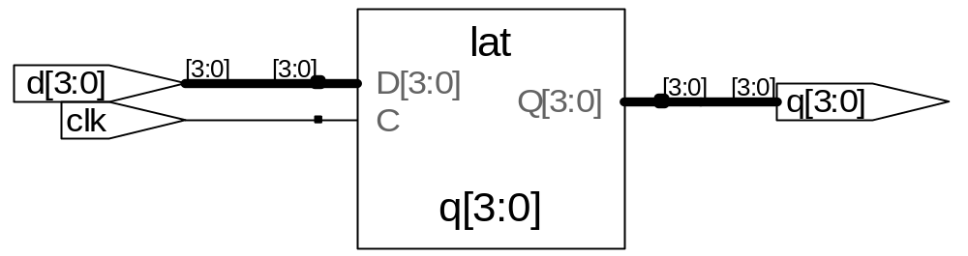
Latch
module latch(input clk,
input [3:0] d,
output reg [3:0] q);
always @ (clk, d)
if (clk) q <= d;
endmodule
Warning: We won’t use latches in this course, but you might write code that inadvertently implies a latch. So if your synthesized hardware has latches in it, this indicates an error.
Copyright © 2007 Elsevier
4-<<number>>

