Slide 1
Chapter 2 :: Combinational Logic Design
Digital Design and Computer Architecture
David Money Harris and Sarah L. Harris
Copyright © 2007 Elsevier
2-<<number>>

Slide 2
Chapter 2 :: Topics
Introduction
Boolean Equations
Boolean Algebra
From Logic to Gates
Multilevel Combinational Logic
X’s and Z’s, Oh My
Karnaugh Maps
Combinational Building Blocks
Timing
Copyright © 2007 Elsevier
2-<<number>>

Slide 3

Introduction
A logic circuit is composed of:
Inputs
Outputs
Functional specification
Timing specification
Copyright © 2007 Elsevier
2-<<number>>

Slide 4
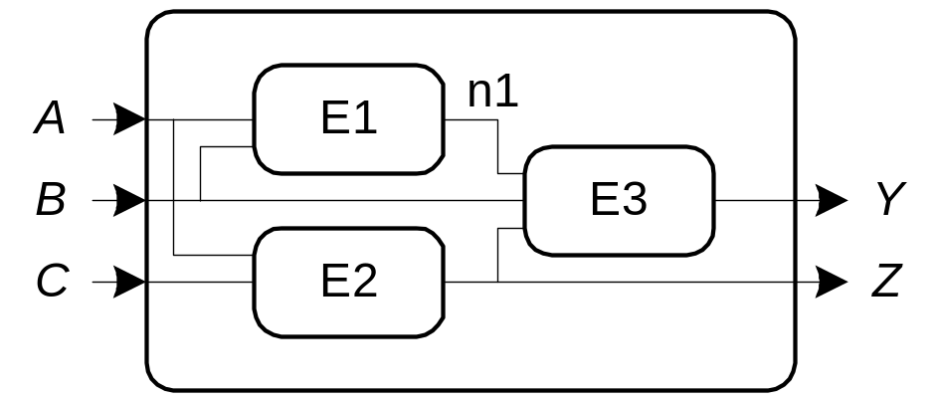
Circuits
Nodes
  Inputs: A, B, C
  Outputs: Y, Z
  Internal: n1
Circuit elements
  E1, E2, E3
  Each a circuit
Copyright © 2007 Elsevier
2-<<number>>

Slide 5
Types of Logic Circuits
Combinational Logic
  Memoryless
  Outputs determined by current values of inputs
Sequential Logic
  Has memory
  Outputs determined by previous and current values of inputs
Copyright © 2007 Elsevier
2-<<number>>

Slide 6
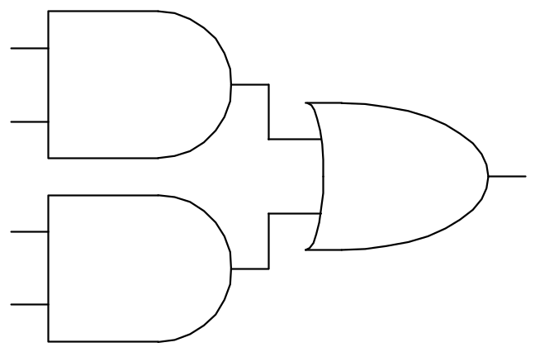
Rules of Combinational Composition
Every circuit element is itself combinational
Every node of the circuit is either designated as an input to the circuit or connects to exactly one output terminal of a circuit element
The circuit contains no cyclic paths: every path through the circuit visits each circuit node at most once
Example:
Copyright © 2007 Elsevier
2-<<number>>

Slide 7
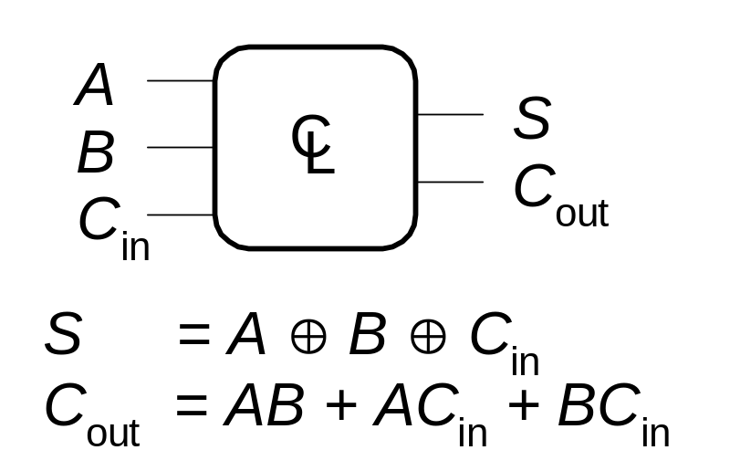
Boolean Equations
Functional specification of outputs in terms of inputs
Example:
S = F(A, B, C_{in})
C_{out} = F(A, B, C_{in})
Copyright © 2007 Elsevier
2-<<number>>

Slide 8
Some Definitions
Complement: variable with a bar over it
A, B, C
Literal: variable or its complement
A, A, B, B, C, C
Implicant: product of literals
ABC, AC, BC
Minterm: product that includes all input variables
ABC, ABC, ABC
Maxterm: sum that includes all input variables
(A+B+C), (A+B+C), (A+B+C)
Copyright © 2007 Elsevier
2-<<number>>

Slide 9
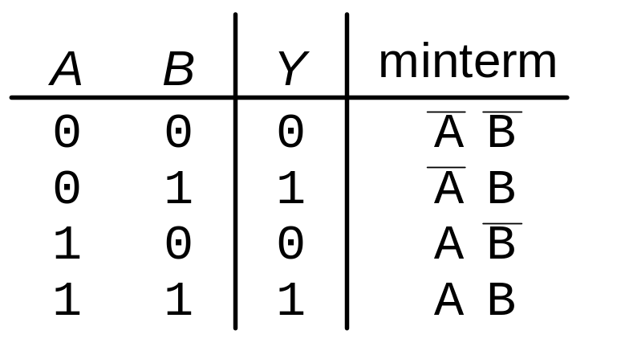
Sum-of-Products (SOP) Form
All Boolean equations can be written in SOP form
Each row in a truth table has a minterm
A minterm is a product (AND) of literals
Each minterm is TRUE for that row (and only that row)
The function is formed by ORing the minterms for which the output is TRUE
Thus, a sum (OR) of products (AND terms)
Copyright © 2007 Elsevier
Y = F(A, B) =
2-<<number>>

Slide 10
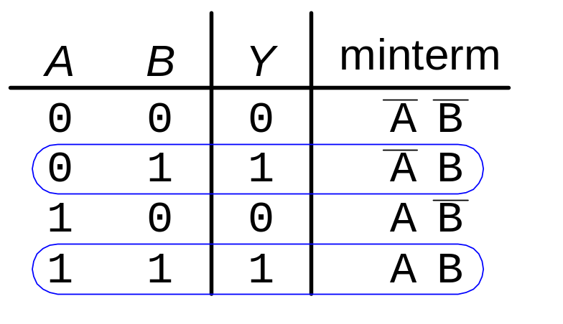
Sum-of-Products Form
Sum-of-Products (SOP) Form
All Boolean equations can be written in SOP form
Each row in a truth table has a minterm
A minterm is a product (AND) of literals
Each minterm is TRUE for that row (and only that row)
The function is formed by ORing the minterms for which the output is TRUE
Thus, a sum (OR) of products (AND terms)
Copyright © 2007 Elsevier
Y = F(A, B) =
2-<<number>>

Slide 11
Sum-of-Products Form
Sum-of-Products (SOP) Form
All Boolean equations can be written in SOP form
Each row in a truth table has a minterm
A minterm is a product (AND) of literals
Each minterm is TRUE for that row (and only that row)
The function is formed by ORing the minterms for which the output is TRUE
Thus, a sum (OR) of products (AND terms)
Copyright © 2007 Elsevier
Y = F(A, B) = AB + AB
2-<<number>>

Slide 12
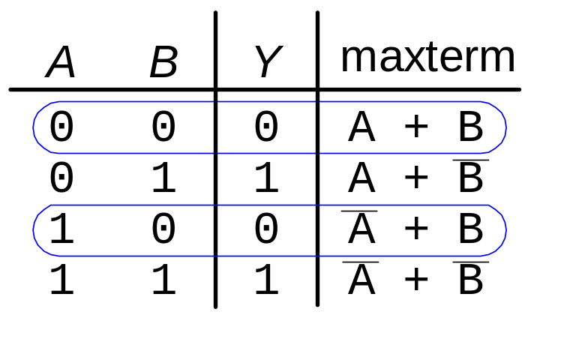
Product-of-Sums (POS) Form
All Boolean equations can be written in POS form
Each row in a truth table has a maxterm
A maxterm is a sum (OR) of literals
Each maxterm is FALSE for that row (and only that row)
The function is formed by ANDing the maxterms for which the output is FALSE
Thus, a product (AND) of sums (OR terms)
Y = F(A, B) = (A + B)(A + B)
Copyright © 2007 Elsevier
2-<<number>>

Slide 13
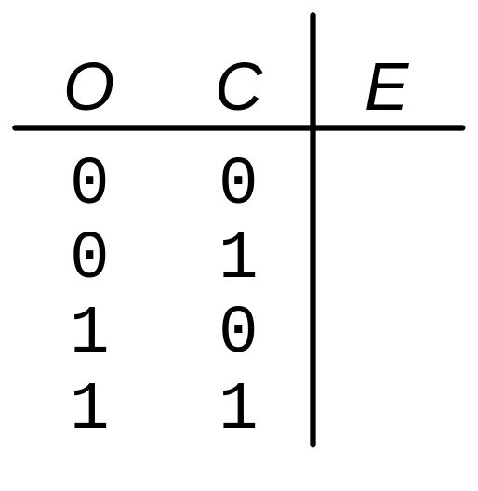
Boolean Equations Example
You are going to the cafeteria for lunch
  You won’t eat lunch (E)
  If it’s not open (O) or
  If they only serve corndogs (C)
Write a truth table for determining if you will eat lunch (E).
Copyright © 2007 Elsevier
2-<<number>>

Slide 14
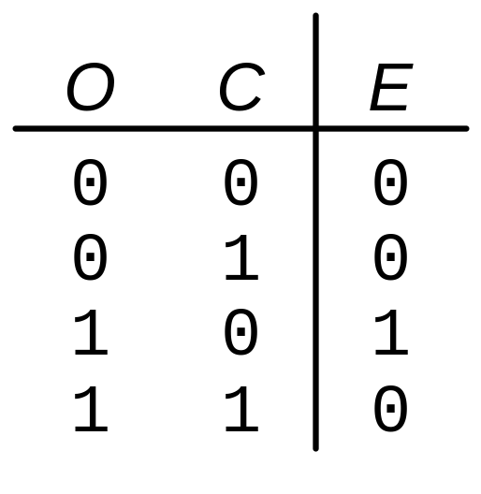
Boolean Equations Example
You are going to the cafeteria for lunch
  You won’t eat lunch (E)
  If it’s not open (O) or
  If they only serve corndogs (C)
Write a truth table for determining if you will eat lunch (E).
Copyright © 2007 Elsevier
2-<<number>>

Slide 15
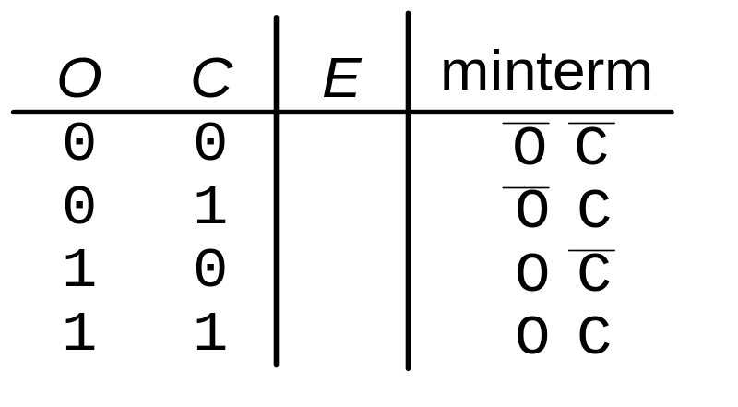
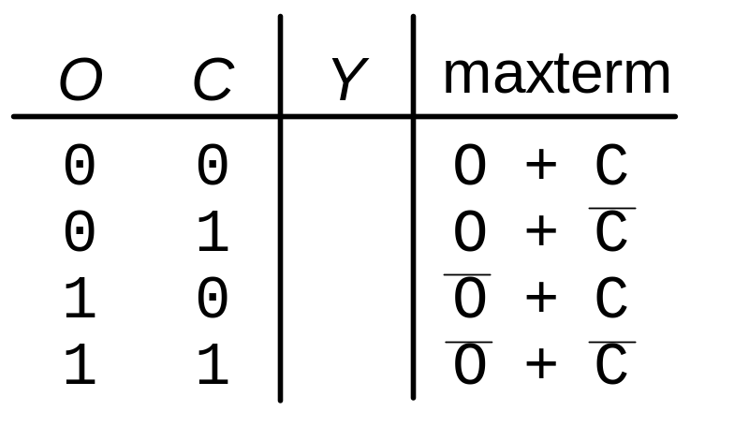
SOP & POS Form
SOP – sum-of-products
POS – product-of-sums
Copyright © 2007 Elsevier
2-<<number>>

Slide 16
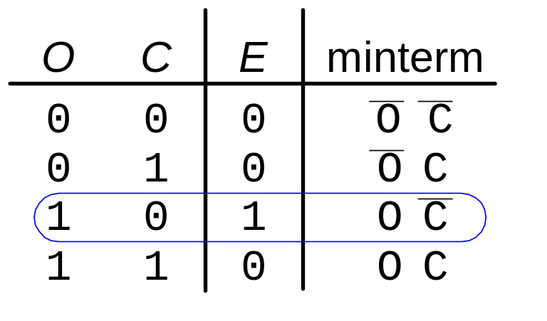
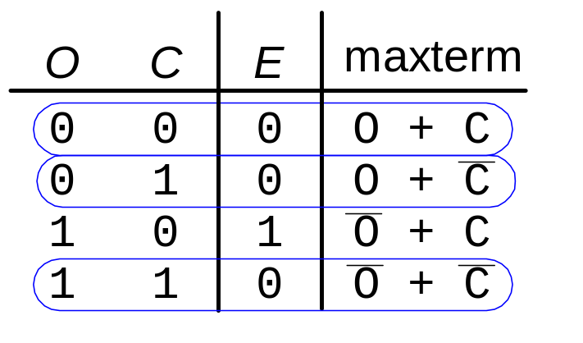
SOP & POS Form
SOP – sum-of-products
POS – product-of-sums
Y = OC
Y = (O + C)(O + C)(O + C)
Copyright © 2007 Elsevier
2-<<number>>

Slide 17
Boolean Algebra
Set of axioms and theorems to simplify Boolean equations
Like regular algebra, but in some cases simpler because variables can have only two values (1 or 0)
Axioms and theorems obey the principles of duality:
  ANDs and ORs interchanged, 0’s and 1’s interchanged
Copyright © 2007 Elsevier
2-<<number>>

Slide 18
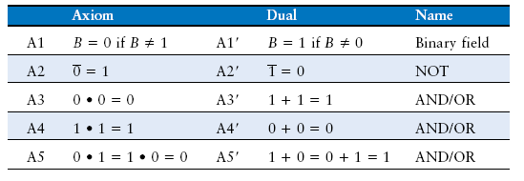
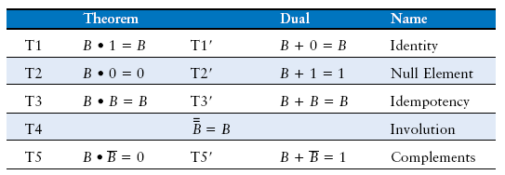
Boolean Axioms
Copyright © 2007 Elsevier
2-<<number>>

Slide 19
T1: Identity Theorem
B 1 =
B + 0 =
Copyright © 2007 Elsevier
2-<<number>>

Slide 20
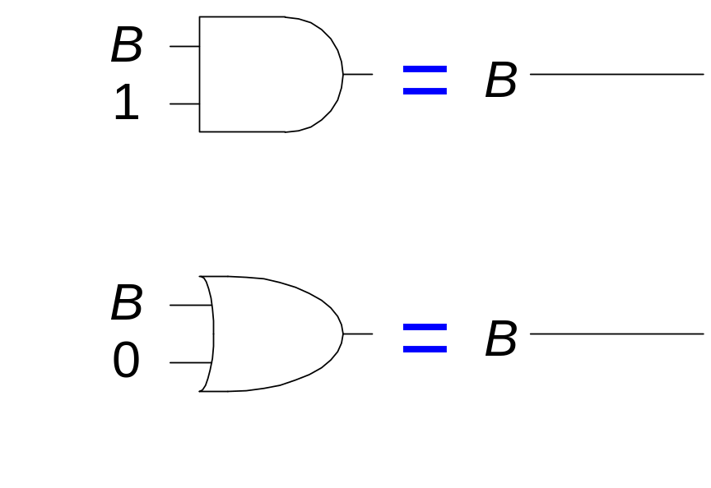
T1: Identity Theorem
B 1 = B
B + 0 = B
Copyright © 2007 Elsevier
2-<<number>>

Slide 21
T2: Null Element Theorem
B 0 =
B + 1 =
Copyright © 2007 Elsevier
2-<<number>>

Slide 22
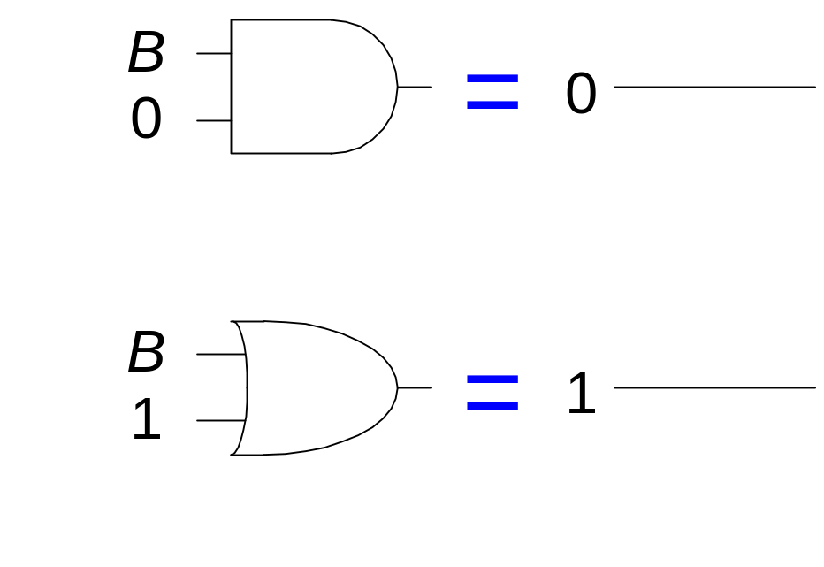
T2: Null Element Theorem
B 0 = 0
B + 1 = 1
Copyright © 2007 Elsevier
2-<<number>>

Slide 23
T3: Idempotency Theorem
B B =
B + B =
Copyright © 2007 Elsevier
2-<<number>>

Slide 24
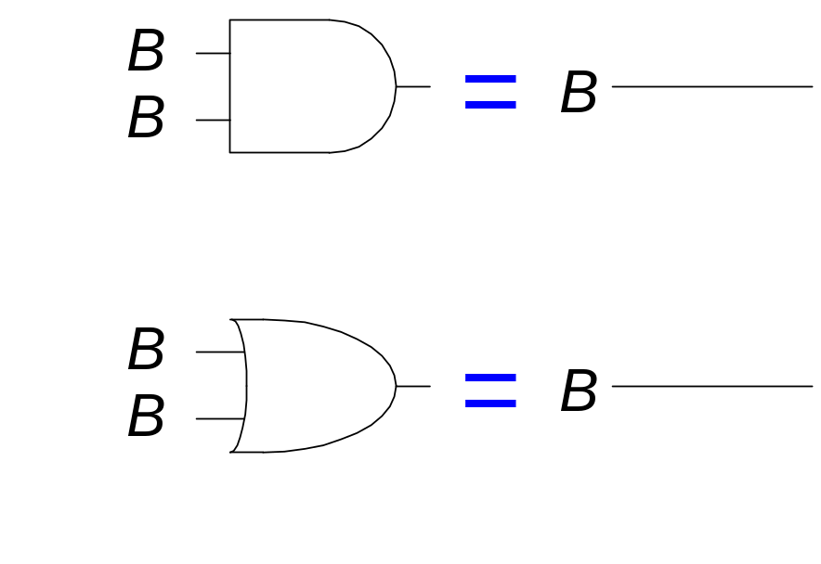
T3: Idempotency Theorem
B B = B
B + B = B
Copyright © 2007 Elsevier
2-<<number>>

Slide 25
T4: Identity Theorem
B =
Copyright © 2007 Elsevier
2-<<number>>

Slide 26
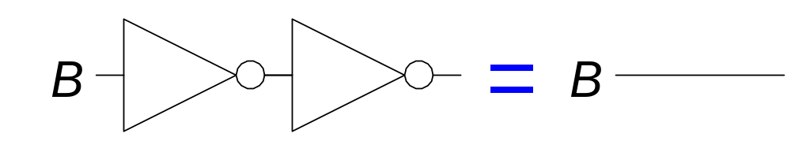
T4: Identity Theorem
B = B
Copyright © 2007 Elsevier
2-<<number>>

Slide 27
T5: Complement Theorem
B B =
B + B =
Copyright © 2007 Elsevier
2-<<number>>

Slide 28
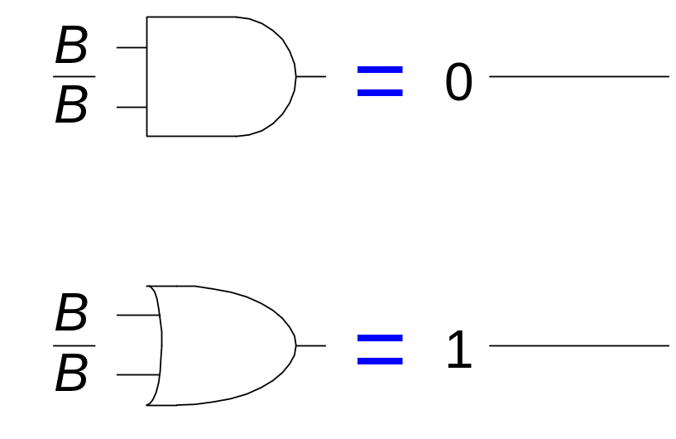
T5: Complement Theorem
B B = 0
B + B = 1
Copyright © 2007 Elsevier
2-<<number>>

Slide 29
Boolean Theorems: Summary
Copyright © 2007 Elsevier
2-<<number>>

Slide 30
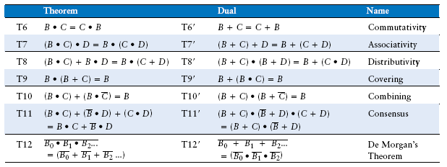
Boolean Theorems of Several Variables
Copyright © 2007 Elsevier
2-<<number>>

Slide 31
Simplifying Boolean Expressions: Example 1
Y = AB + AB
Copyright © 2007 Elsevier
2-<<number>>

Slide 32
Simplifying Boolean Expressions: Example 1
Y = AB + AB
= B(A + A) T8
= B(1) T5’
= B T1
Copyright © 2007 Elsevier
2-<<number>>

Slide 33
Simplifying Boolean Expressions: Example 2
Y = A(AB + ABC)
Copyright © 2007 Elsevier
2-<<number>>

Slide 34
Simplifying Boolean Expressions: Example 2
Y = A(AB + ABC)
= A(AB(1 + C)) T8
= A(AB(1)) T2’
= A(AB) T1
= (AA)B T7
= AB T3
Copyright © 2007 Elsevier
2-<<number>>

Slide 35
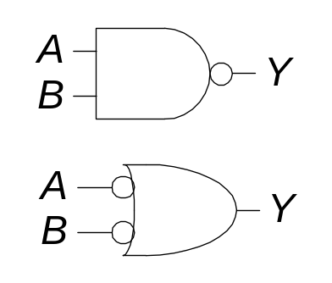
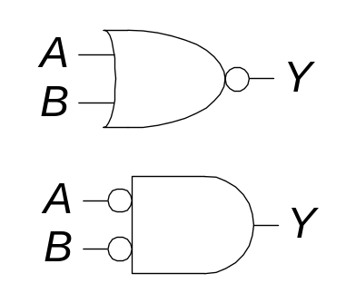
DeMorgan’s Theorem
Y = AB = A + B
Y = A + B = A B
Copyright © 2007 Elsevier
2-<<number>>

Slide 36
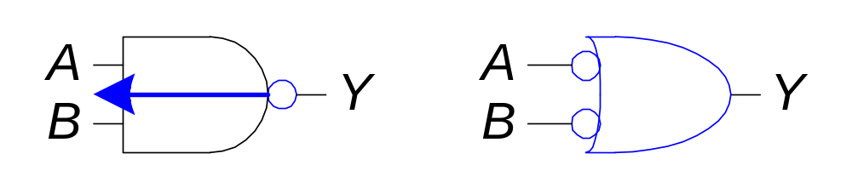
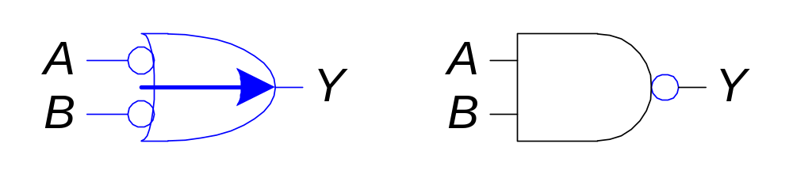
Bubble Pushing
Pushing bubbles backward (from the output) or forward (from the inputs) changes the body of the gate from AND to OR or vice versa.
Pushing a bubble from the output back to the inputs puts bubbles on all gate inputs.
Pushing bubbles on all gate inputs forward toward the output puts a bubble on the output and changes the gate body.
Copyright © 2007 Elsevier
2-<<number>>

Slide 37
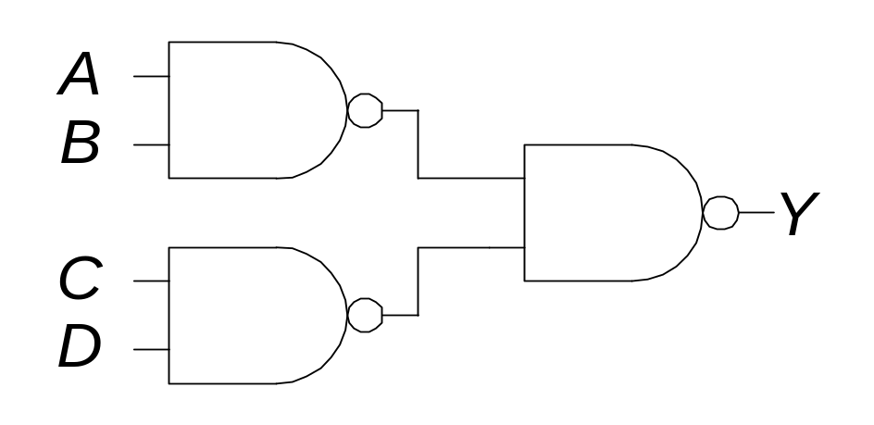
Bubble Pushing
What is the Boolean expression for this circuit?
Copyright © 2007 Elsevier
2-<<number>>

Slide 38
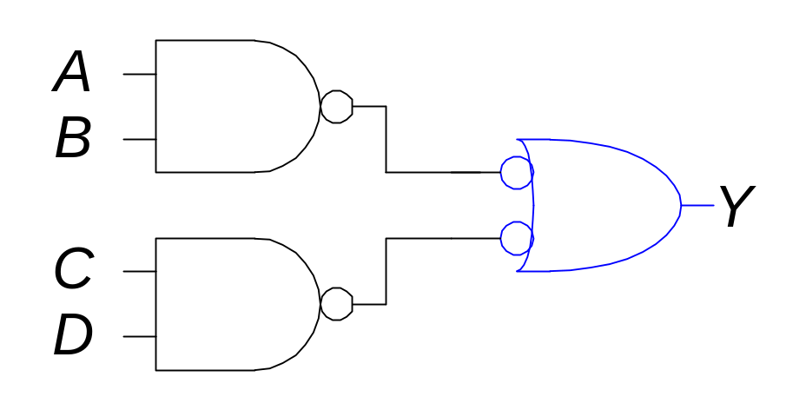
Bubble Pushing
What is the Boolean expression for this circuit?
Y = AB + CD
Copyright © 2007 Elsevier
2-<<number>>

Slide 39
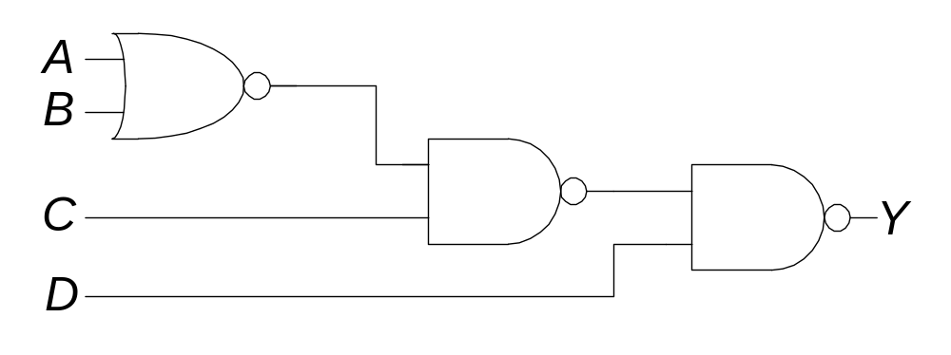
Bubble Pushing Rules
Begin at the output of the circuit and work toward the inputs.
Push any bubbles on the final output back toward the inputs.
Draw each gate in a form so that bubbles cancel.
Copyright © 2007 Elsevier
2-<<number>>

Slide 40
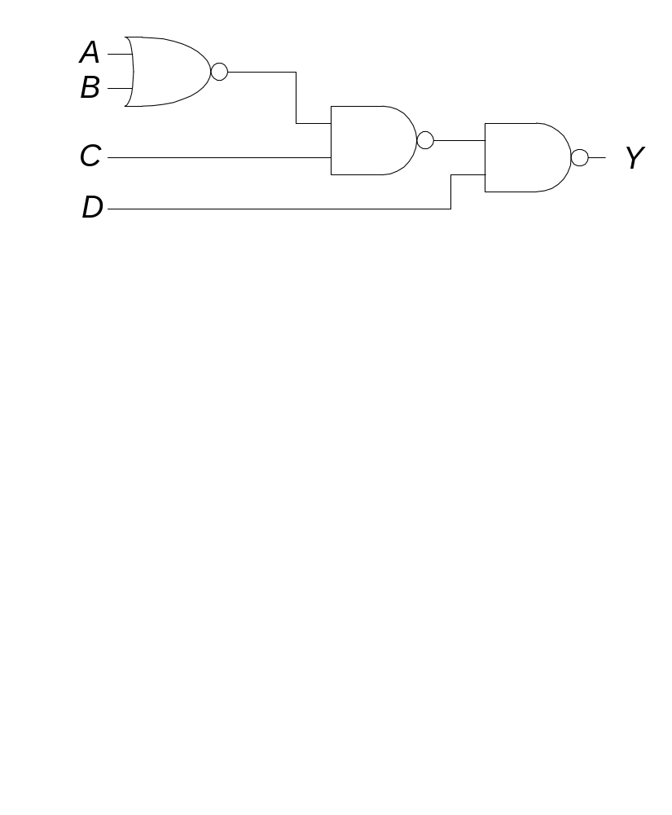
Bubble Pushing Example
Copyright © 2007 Elsevier
2-<<number>>

Slide 41
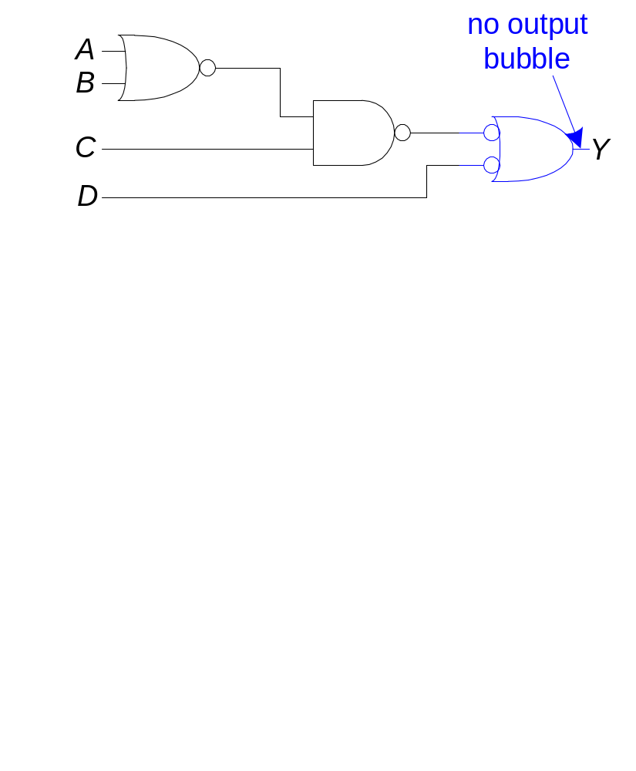
Bubble Pushing Example
Copyright © 2007 Elsevier
2-<<number>>

Slide 42
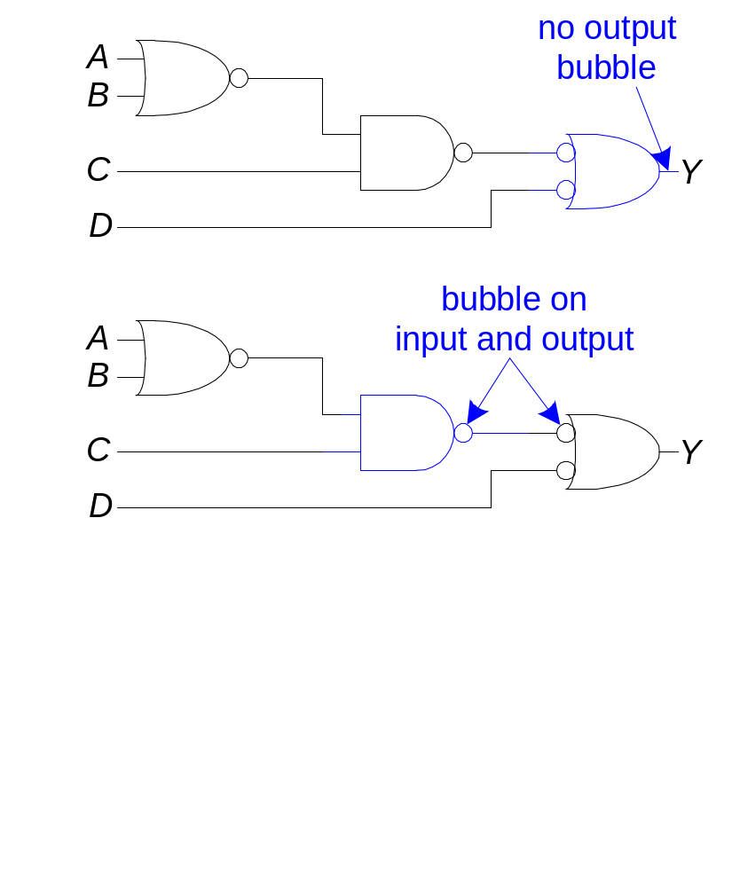
Bubble Pushing Example
Copyright © 2007 Elsevier
2-<<number>>

Slide 43
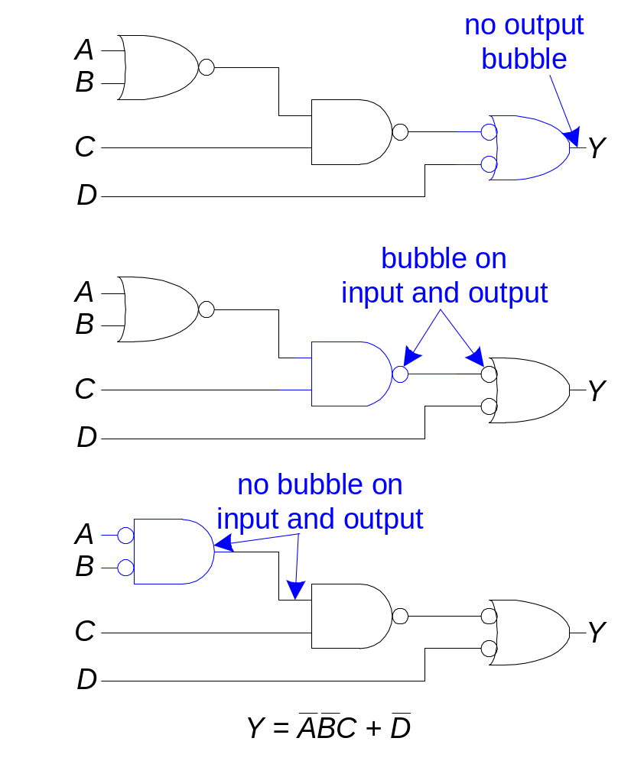
Bubble Pushing Example
Copyright © 2007 Elsevier
2-<<number>>

Slide 44
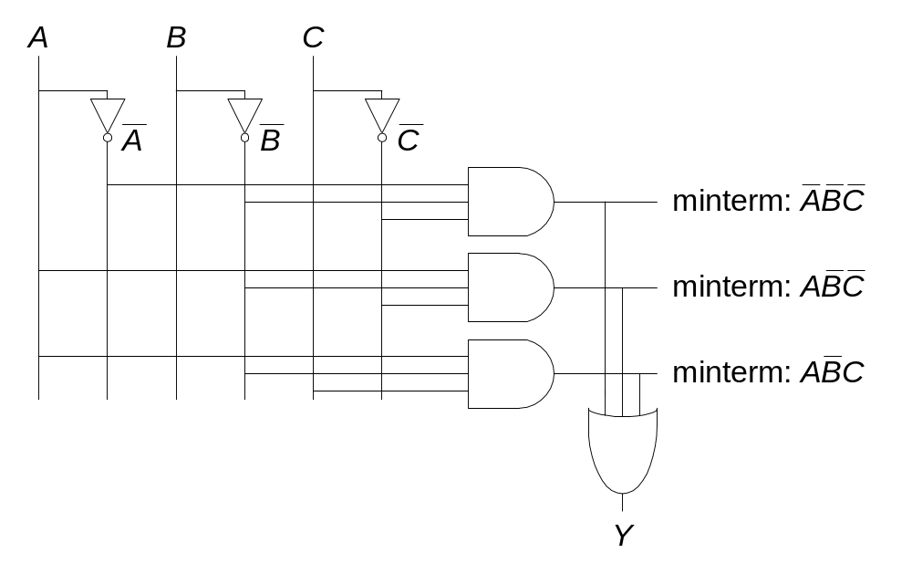
From Logic to Gates
Two-level logic: ANDs followed by ORs
Example: Y = ABC + ABC + ABC
Copyright © 2007 Elsevier
2-<<number>>

Slide 45
Circuit Schematics with Style
Inputs are on the left (or top) side of a schematic
Outputs are on the right (or bottom) side of a schematic
Whenever possible, gates should flow from left to right
Straight wires are better to use than wires with multiple corners
Copyright © 2007 Elsevier
2-<<number>>

Slide 46
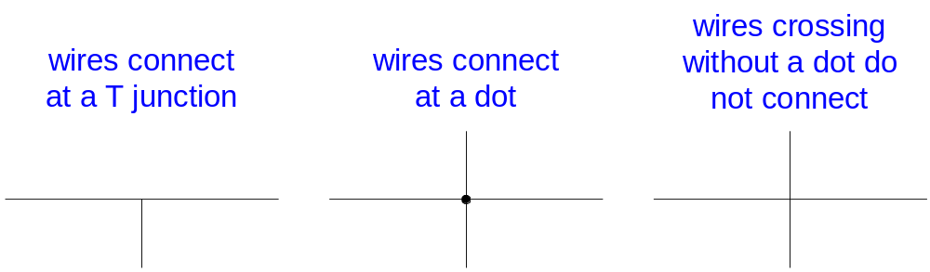
Circuit Schematic Rules (cont.)
Wires always connect at a T junction
A dot where wires cross indicates a connection between the wires
Wires crossing without a dot make no connection
Copyright © 2007 Elsevier
2-<<number>>

Slide 47
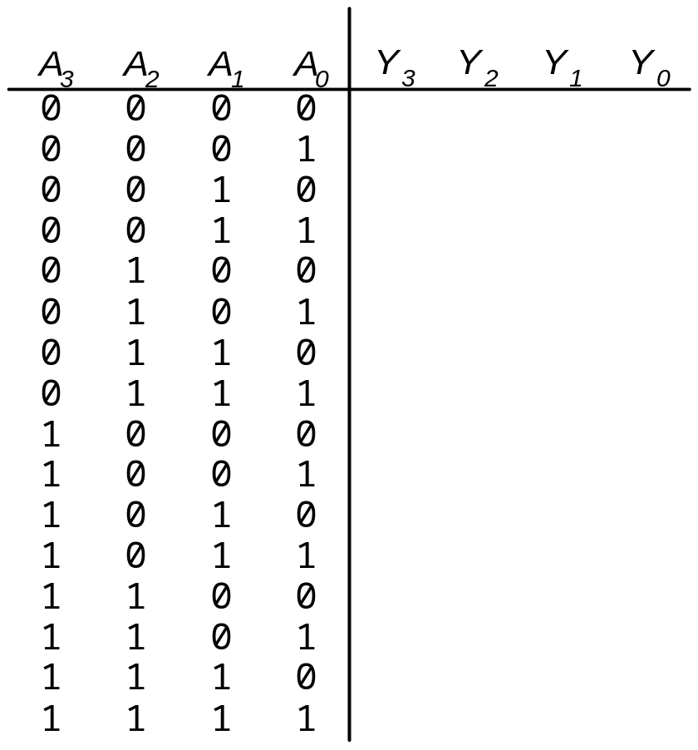
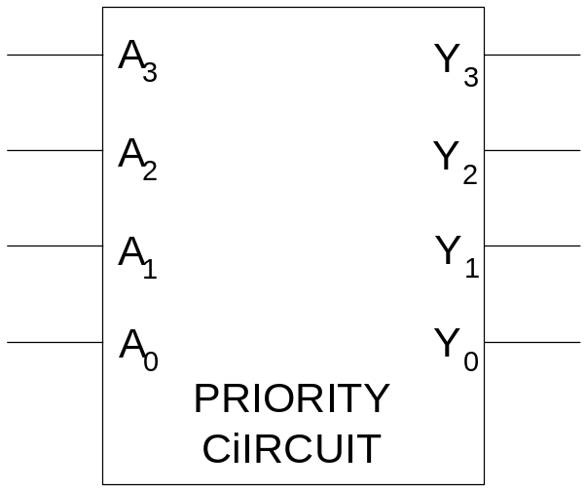
Multiple Output Circuits
Output asserted
corresponding to
most significant
TRUE input
Copyright © 2007 Elsevier
2-<<number>>

Slide 48
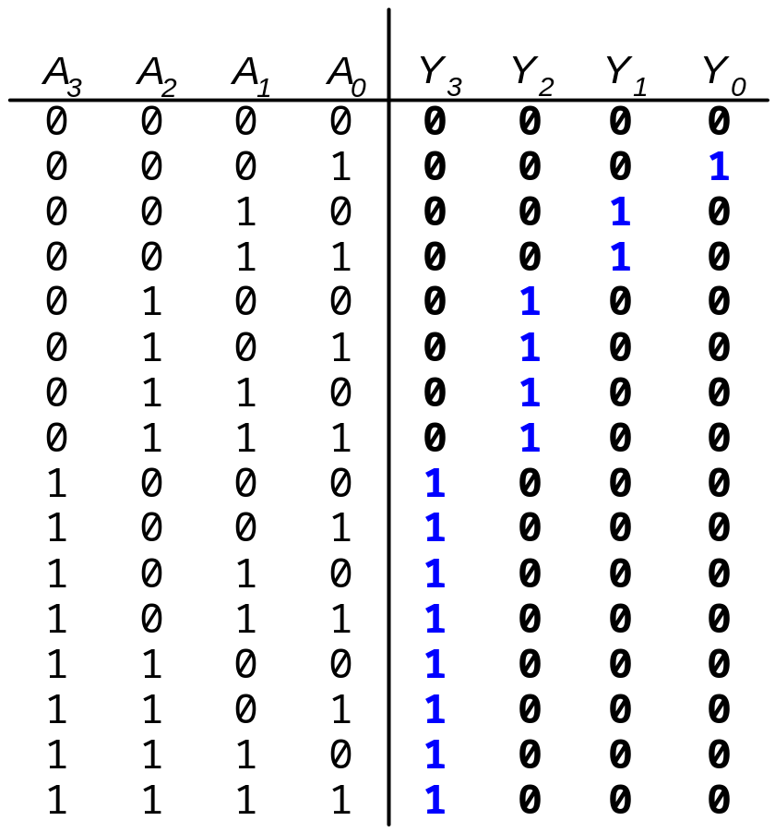
Multiple Output Circuits
Output asserted
corresponding to
most significant
TRUE input
Copyright © 2007 Elsevier
2-<<number>>

Slide 49
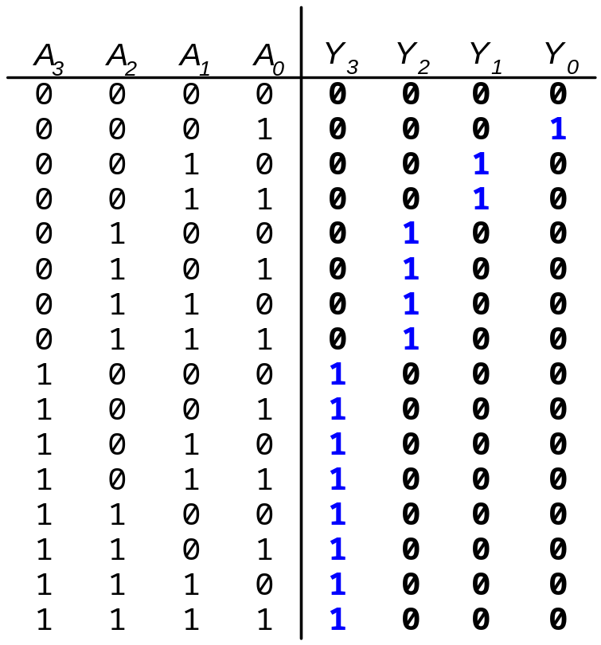
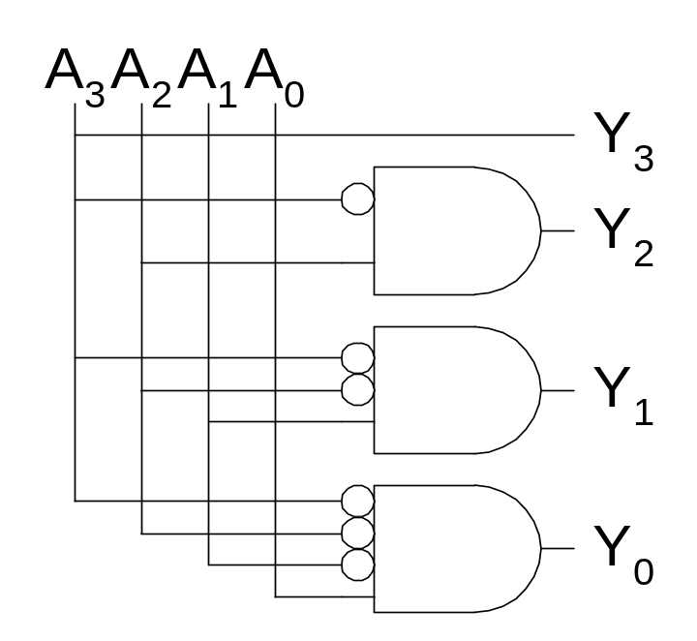
Priority Encoder Hardware
Copyright © 2007 Elsevier
2-<<number>>

Slide 50
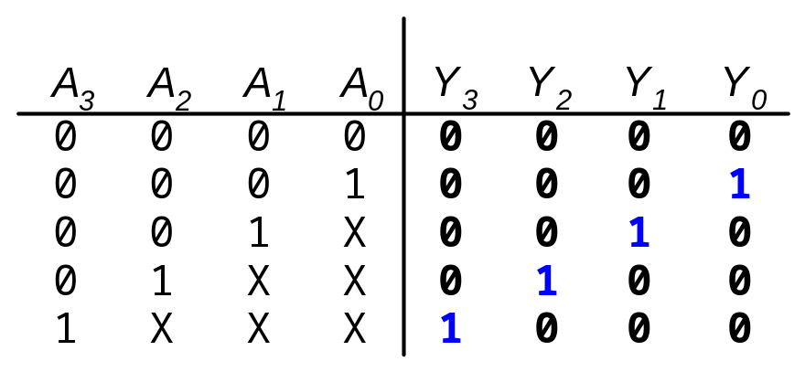
Don’t Cares
Copyright © 2007 Elsevier
2-<<number>>

Slide 51
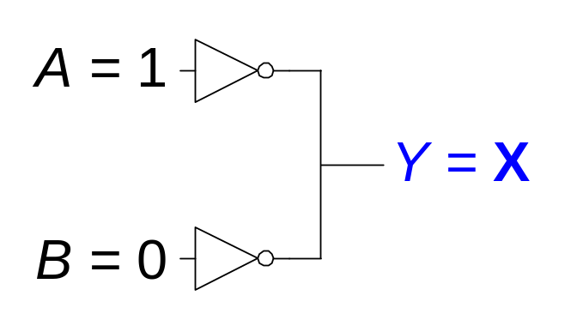
Contention: X
Contention: circuit tries to drive the output to 1 and 0
  Actual value may be somewhere in between
  Could be a legal 0, a legal 1, or in the forbidden zone
  Might change with voltage, temperature, time, noise
  Often causes excessive power dissipation
Contention usually indicates a bug.
  Fix it unless you are sure you know what you are doing.
Warning: X is used for “don’t care” and contention
  Note the same thing
  Look at the context to tell them apart
Copyright © 2007 Elsevier
2-<<number>>

Slide 52
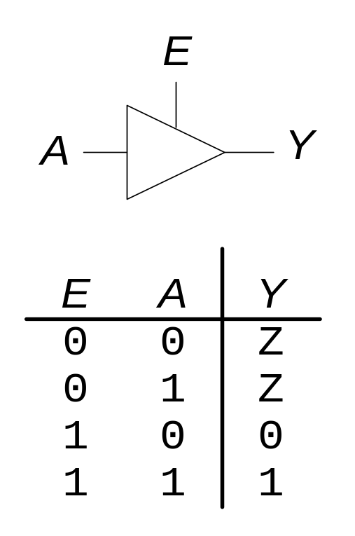
Floating: Z
Floating, high impedance, open, high Z
Floating output might be 0, 1, or somewhere in between
  A voltmeter won’t indicate whether a node is floating
Tristate Buffer
Copyright © 2007 Elsevier
2-<<number>>

Slide 53
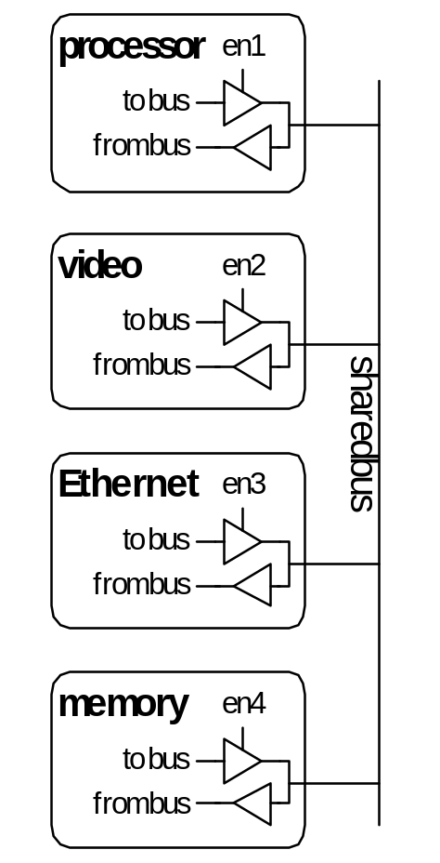
Tristate Busses
Floating nodes are used in tristate busses
  Many different drivers
  Exactly one is active at any time
Copyright © 2007 Elsevier
2-<<number>>

Slide 54
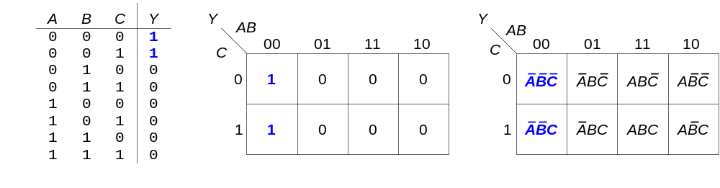
Karnaugh Maps (K-Maps)
Boolean expressions can be minimized by combining terms
K-maps minimize equations graphically
PA + PA = P
Copyright © 2007 Elsevier
2-<<number>>

Slide 55
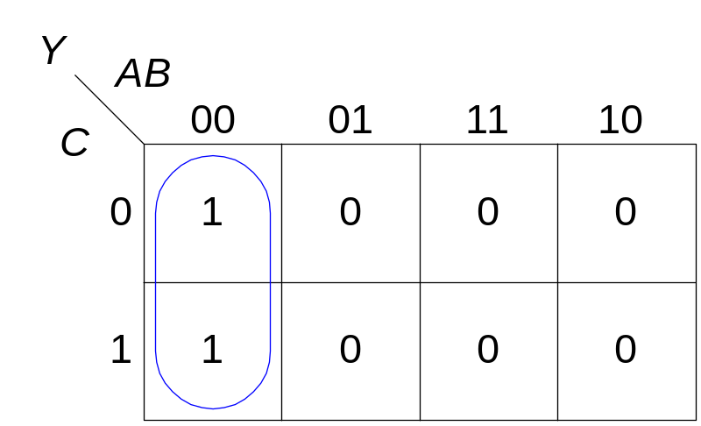
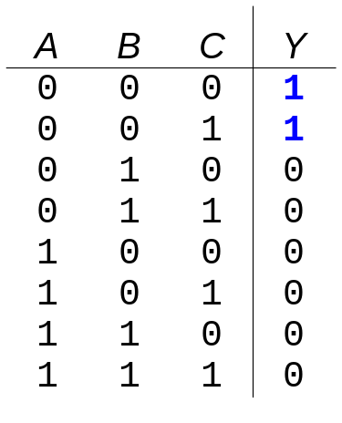
K-map
Circle 1’s in adjacent squares
In the Boolean expression, include only the literals whose true and complement form are not in the circle
Y = AB
Copyright © 2007 Elsevier
2-<<number>>

Slide 56
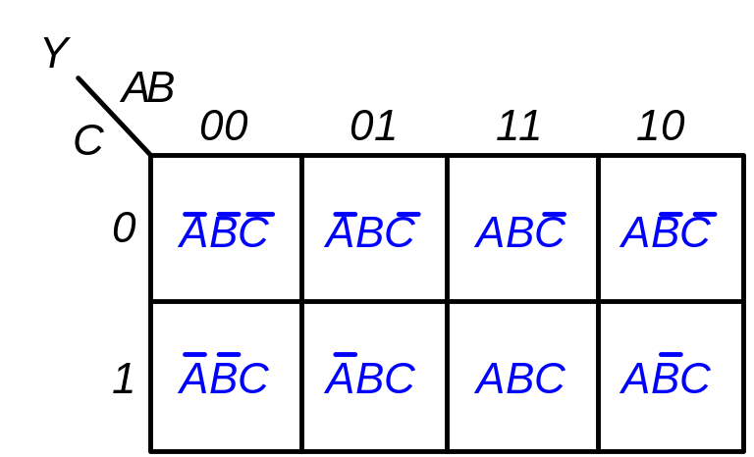
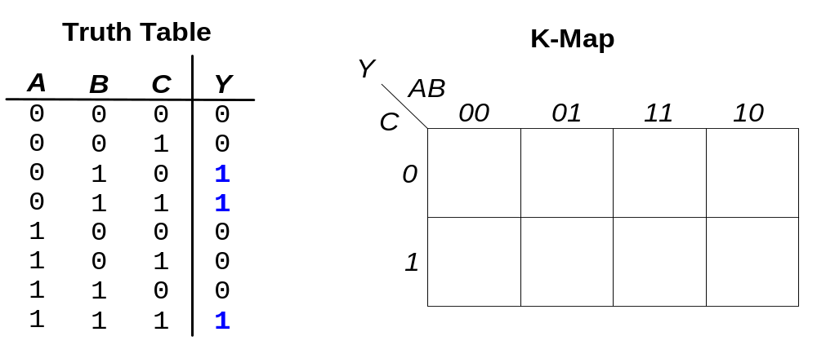
3-input K-map
Copyright © 2007 Elsevier
2-<<number>>

Slide 57
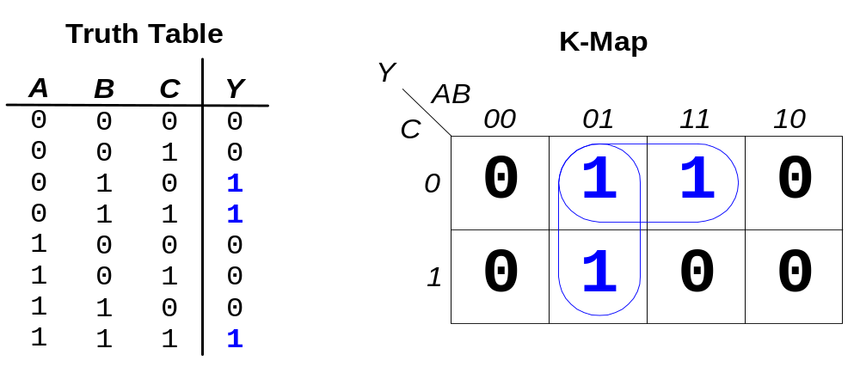
3-input K-map
Y = AB + BC
Copyright © 2007 Elsevier
2-<<number>>

Slide 58
K-map Definitions
Complement: variable with a bar over it
A, B, C
Literal: variable or its complement
A, A, B, B, C, C
Implicant: product of literals
ABC, AC, BC
Prime implicant: implicant corresponding to the largest circle in a K-map
Copyright © 2007 Elsevier
2-<<number>>

Slide 59
K-map Rules
Every 1 in a K-map must be circled at least once
Each circle must span a power of 2 (i.e. 1, 2, 4) squares in each direction
Each circle must be as large as possible
A circle may wrap around the edges of the K-map
A “don't care” (X) is circled only if it helps minimize the equation
Copyright © 2007 Elsevier
2-<<number>>

Slide 60
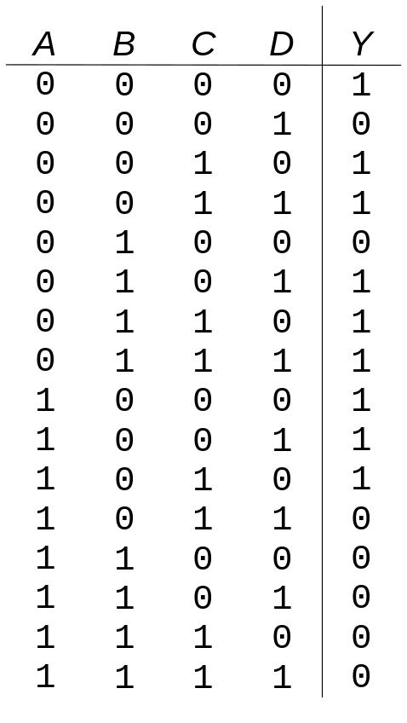
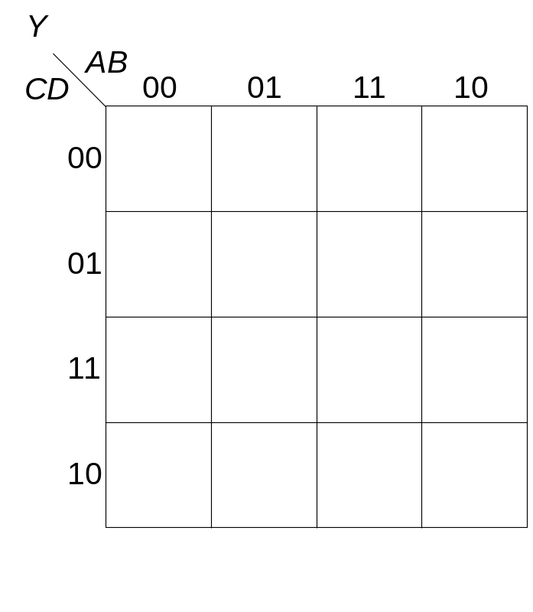
4-input K-map
Copyright © 2007 Elsevier
2-<<number>>

Slide 61

4-input K-map
Copyright © 2007 Elsevier
2-<<number>>

Slide 62

4-input K-map
Copyright © 2007 Elsevier
2-<<number>>

Slide 63


K-maps with Don’t Cares
Copyright © 2007 Elsevier
2-<<number>>

Slide 64

K-maps with Don’t Cares
Copyright © 2007 Elsevier
2-<<number>>

Slide 65

K-maps with Don’t Cares
Copyright © 2007 Elsevier
2-<<number>>

Slide 66
Combinational Building Blocks
Multiplexers
Decoders
Copyright © 2007 Elsevier
2-<<number>>

Slide 67

Multiplexer (Mux)
Selects between one of N inputs to connect to the output.
log₂N-bit select input – control input
Example: 2:1 Mux
Copyright © 2007 Elsevier
2-<<number>>

Slide 68

Multiplexer (Mux)
Selects between one of N inputs to connect to the output.
log₂N-bit select input – control input
Example: 2:1 Mux
Copyright © 2007 Elsevier
2-<<number>>

Slide 69


Multiplexer Implementations
Logic gates
  Sum-of-products form
Tristates
  For an N-input mux, use N tristates
  Turn on exactly one to select the appropriate input
Copyright © 2007 Elsevier
2-<<number>>

Slide 70

Logic using Multiplexers
Using the mux as a lookup table
Copyright © 2007 Elsevier
2-<<number>>

Slide 71

Logic using Multiplexers
Reducing the size of the mux
Copyright © 2007 Elsevier
2-<<number>>

Slide 72

Decoders
N inputs, 2^{N} outputs
One-hot outputs: only one output HIGH at once
Copyright © 2007 Elsevier
2-<<number>>

Slide 73

Decoder Implementation
Copyright © 2007 Elsevier
2-<<number>>

Slide 74

Logic using Decoders
OR minterms
Copyright © 2007 Elsevier
2-<<number>>

Slide 75

Timing
Delay between input change and output changing
How to build fast circuits?
Copyright © 2007 Elsevier
2-<<number>>

Slide 76

Propagation & Contamination Delay
Propagation delay: t_{pd} = max delay from input to output
Contamination delay: t_{cd} = min delay from input to output
Copyright © 2007 Elsevier
2-<<number>>

Slide 77
Propagation & Contamination Delay
Delay is caused by
  Capacitance and resistance in a circuit
  Speed of light limitation
Reasons why t_{pd} and t_{cd} may be different:
  Different rising and falling delays
  Multiple inputs and outputs, some of which are faster than others
  Circuits slow down when hot and speed up when cold
Copyright © 2007 Elsevier
2-<<number>>

Slide 78

Critical (Long) and Short Paths
Critical (Long) Path: t_{pd} = 2t_{pd_AND} + t_{pd_OR}
Short Path: t_{cd} = t_{cd_AND}
Copyright © 2007 Elsevier
2-<<number>>

Slide 79
Glitches
Glitch: when a single input change causes multiple output changes
Glitches don’t cause problems because of synchronous design conventions (which we’ll talk about in a bit)
But it’s important to recognize a glitch when you see one in timing diagrams
Copyright © 2007 Elsevier
2-<<number>>

Slide 80

Glitch Example
What happens when A = 0, C = 1, B falls?
Copyright © 2007 Elsevier
2-<<number>>

Slide 81

Glitch Example (cont.)
Copyright © 2007 Elsevier
2-<<number>>

Slide 82


Fixing the Glitch
Copyright © 2007 Elsevier
2-<<number>>

Slide 83
Why Understand Glitches?
Glitches don’t cause problems because of synchronous design conventions (which we’ll talk about in Chapter 3)
But it’s important to recognize a glitch when you see one in simulations or on an oscilloscope
Can’t get rid of all glitches – simultaneous transitions on multiple inputs can also cause glitches
Copyright © 2007 Elsevier
2-<<number>>

Slide 84
Appendix
Copyright © 2007 Elsevier
2-<<number>>

Slide 85











Correct and Incorrect Patterns
Correct
Incorrect (Apophenia)

Slide 86








Logic Simplifying Examples
Correct
Incorrect

Slide 87

Your first job at Tesla (Logic Warmup)

Slide 88

Your first job at Tesla (Logic Warmup)
D | S | B | C
0 | 0 | 0 | 0
0 | 0 | 1 | 1
0 | 1 | 0 | 0
0 | 1 | 1 | 0
1 | 0 | 0 | 0
1 | 0 | 1 | 0
1 | 1 | 0 | 1
1 | 1 | 1 | 0

Slide 89

Your second job at Tesla (Logic Simplification)
R | L | G | A
0 | 0 | 0 | 0
0 | 0 | 1 | 0
0 | 1 | 0 | 0
0 | 1 | 1 | 1
1 | 0 | 0 | 0
1 | 0 | 1 | 1
1 | 1 | 0 | 1
1 | 1 | 1 | 1
Can we do better?
(i.e., less variables, gates, or connections)

Slide 90

Simplifying the Majority Circuit
R | L | G | A
0 | 0 | 0 | 0
0 | 0 | 1 | 0
0 | 1 | 0 | 0
0 | 1 | 1 | 1
1 | 0 | 0 | 0
1 | 0 | 1 | 1
1 | 1 | 0 | 1
1 | 1 | 1 | 1

