Slide 1
CPSC 390
And so it begins…

Slide 2
Found on the Web …
AI is the reproduction of the methods of human reasoning or intuition
Using computational models to simulate intelligent (human) behavior and processes
AI is the study of mental faculties through the use computational methods
Intelligent
behavior
Computer
Humans

Slide 3
It is said that AI started as a rebellion against some form of establishment telling us “Computers cannot perform certain tasks requiring intelligence”
For example, for many years AI researchers have regarded computational complexity theory as irrelevant to their field.
They eventually had to reckon with it, but in the meantime computational complexity had also changed a lot.

Slide 4
What is AI?
Discipline that systematizes and automates intellectual tasks to create machines that:
Act like humans | Act rationally
Think like humans | Think rationally

Slide 5
Act Like Humans
AI is the art of creating machines that perform functions that require intelligence when performed by humans
Methodology: Take an intellectual task at which people are better and make a computer do it
Turing test
Prove a theorem
Play chess
Plan a surgical operation
Diagnose a disease
Navigate in a building

Slide 6
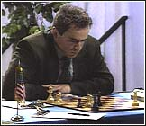
Chess
Name: Garry Kasparov
Title: World Chess
Champion
Crime: Valued greed
over common sense
Humans are still better at making up excuses.
© Jonathan Schaeffer

Slide 7
Perspective on Chess: Pro
“Saying Deep Blue doesn’t really think about chess is like saying an airplane doesn't really fly because it doesn't flap its wings”
Drew McDermott
© Jonathan Schaeffer

Slide 8
Perspective on Chess: Con
“Chess is the Drosophila of artificial intelligence. However, computer chess has developed much as genetics might have if the geneticists had concentrated their efforts starting in 1910 on breeding racing Drosophila. We would have some science, but mainly we would have very fast fruit flies.”
John McCarthy
© Jonathan Schaeffer

Slide 9
Think Like Humans
How the computer performs functions does matter
Comparison of the traces of the reasoning steps
Cognitive science → testable theories of the workings of the human mind
But, do we want to duplicate human imperfections?

Slide 10
Think/Act Rationally
Always make the best decision given what is available (knowledge, time, resources)
Perfect knowledge, unlimited resources → logical reasoning
Imperfect knowledge, limited resources → (limited) rationality
Connection to economics, operational research,
and control theory
But ignores role of consciousness, emotions,
fear of dying on intelligence

Slide 11
Bits of History
1956: The name “Artificial Intelligence” was coined by John McCarthy. (Would “computational rationality” have been better?)
Early period (50’s to late 60’s):
Basic principles and generality
  General problem solving
  Theorem proving
  Games
  Formal calculus

Slide 12
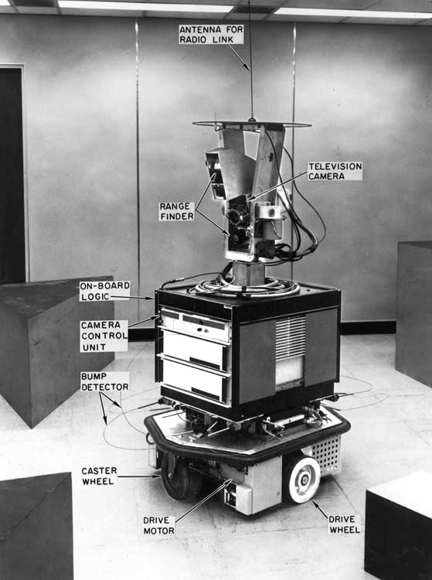
Bits of History
1969-1971: Shakey the robot (Fikes, Hart, Nilsson)
Logic-based planning (STRIPS)
Motion planning (visibility graph)
Inductive learning (PLANEX)
Computer vision

Slide 13
Bits of History
Knowledge-is-Power period (late 60’s to mid 80’s):
  Focus on narrow tasks require expertise
  Encoding of expertise in rule form:
  If: the car has off-highway tires and
  4-wheel drive and
  high ground clearance
  Then: the car can traverse difficult terrain (0.8)
  Knowledge engineering
  5th generation computer project
  CYC system (Lenat)

Slide 14
Bits of History
AI becomes an industry (80’s – present):
  Expert systems: Digital Equipment, Teknowledge, Intellicorp, Du Pont, oil industry, …
  Lisp machines: LMI, Symbolics, …
  Constraint programming: ILOG
  Robotics: Machine Intelligence Corporation, Adept, GMF (Fanuc), ABB, …
  Speech understanding

Slide 15
Bits of History
The return of neural networks, genetic algorithms, and artificial life (80’s – 90’s)
Increased connection with economics, operational research, and control theory (90’s – present)
AI becomes less philosophical, more technical and mathematically oriented
DATA MINING and MACHINE LEARNING

Slide 16
Predictions and Reality … (1/3)
In the 60’s, a famous AI professor from MIT said: “At the end of the summer, we will have developed an electronic eye”
As of today, there is still no general computer vision system capable of understanding complex dynamic scenes
  But deep learning is doing pretty damn well
But computer systems routinely perform road traffic monitoring, facial recognition, some medical image analysis, part inspection, etc…

Slide 17

Predictions and Reality … (2/3)
In 1958, Herbert Simon (CMU) predicted that within 10 years a computer would be Chess champion
This prediction became true in 1998
Today, computers have won over world champions in several games, including Checkers, Othello, and Chess
  And thanks to Deep Learning, Go

Slide 18
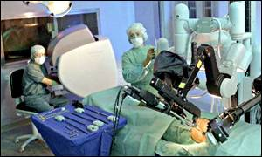
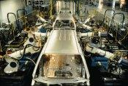
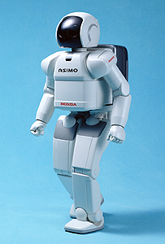
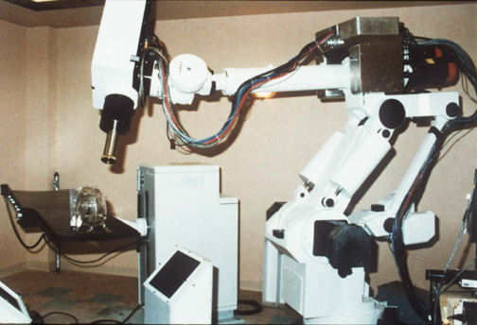
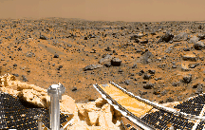
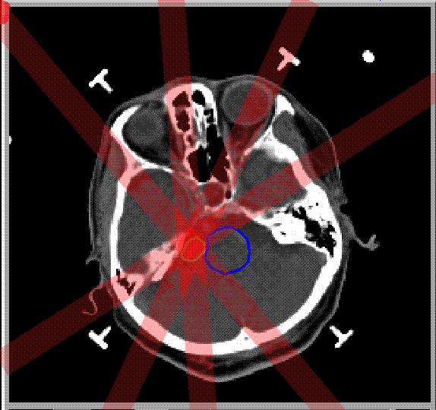
Predictions and Reality … (3/3)
In the 70’s, many believed that computer-controlled robots would soon be everywhere from manufacturing plants to home
Today, some industries (automobile, electronics) are highly robotized, but home robots are still a thing of the future
But robots have rolled on Mars, others are performing brain and heart surgery, and humanoid robots are operational and available for rent (see: http://world.honda.com/news/2001/c011112.html)

Slide 19
Mistakes …
Often, the potential of a new field is over-estimated in its early age, but under-estimated over the longer term. (Same deal for the Internet)
AI proponents have over-estimated the need for smart software, and under-estimated the feasibility and potential of large software systems based on massive coding effort

Slide 20
CPSC 390
Course centered around the notion of an agent

Slide 21
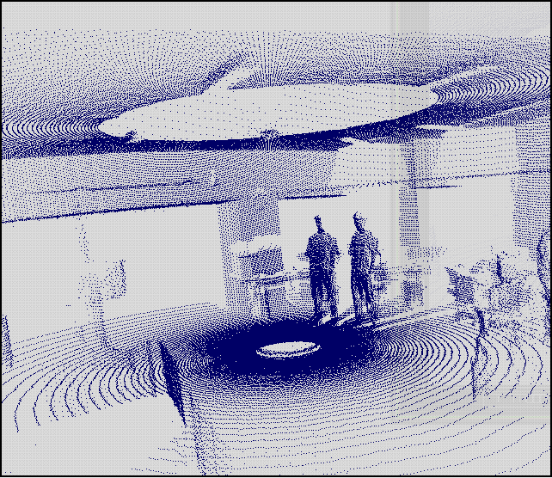
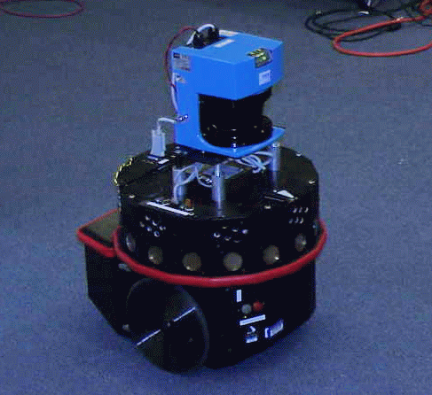
Notion of an Agent
sensors
?
environment
agent
actuators
laser range
finder
sonars
touch sensors

Slide 22
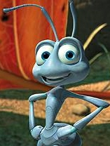
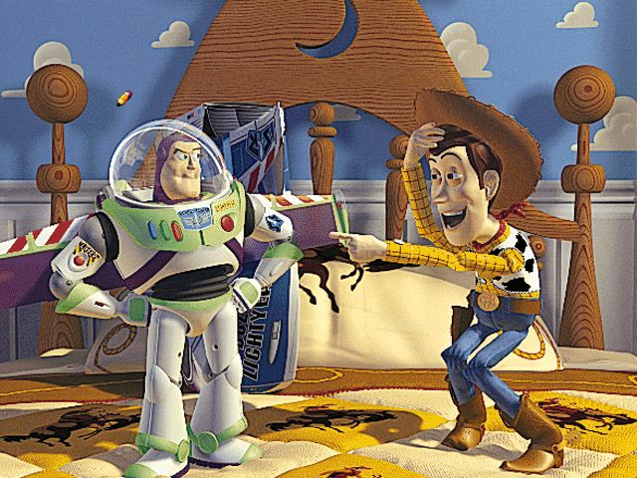
Notion of an Agent
sensors
?
environment
agent
actuators

Slide 23
Notion of an Agent
sensors
?
environment
agent
actuators
Locality of sensors/actuators
Imperfect modeling
Time/resource constraints
Sequential interaction
Multi-agent worlds

Slide 24
Example: Tracking a Target
The robot must keep
the target in view
The target’s trajectory
is not known in advance
The robot may not know
all the obstacles in
advance
Fast decision is required
robot
target

Slide 25
Important Topics
Representing knowledge
Using knowledge
Acquiring knowledge
Problem solving:
  Search
  Constraint satisfaction
Logic and Inference
Planning
Dealing with Uncertainty
  Adversarial search
  Deciding under probabilistic uncertainty
  Belief networks
Inductive learning

Slide 26
Schedule
See the course website for the most up to date version including reading and homework assignments.
Next few lectures:
Searching (blind and heuristic)
Constraint satisfaction and propagation

