Slide 1
Heuristic Search
CPSC 390 – Spring 2020

Slide 2
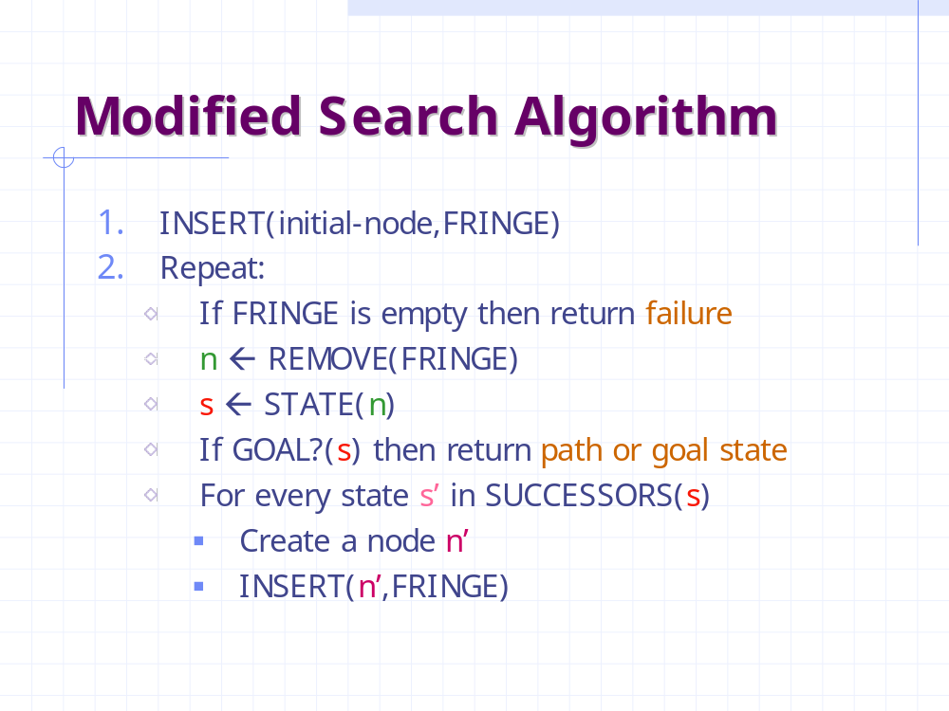
Current Bag of Tricks
Search algorithm
Modified search algorithm

Slide 3
Current Bag of Tricks
Modified search algorithm
Avoiding repeated states

Slide 4
Best-First Search
Define a function:
f : node N → real number f(N)
called the evaluation function, whose
value depends on the contents of the
state associated with N
Order the nodes in the fringe in increasing
values of f(N)
f(N) can be any function you want, but will it work?

Slide 5
Example of Evaluation Function
f(N) = (sum of distances of each tile to its goal)
+ 3 x (sum of score functions for each tile)
where score function for a non-central tile is 2 if it is
not followed by the correct tile in clockwise order
and 0 otherwise
5
8
1
2
3
f(N) = 2 + 3 + 0 + 1 + 3 + 0 + 3 + 1
3x(2 + 2 + 2 + 2 + 2 + 0 + 2)
= 49
4
2
1
4
5
6
7
3
6
7
8
N
goal

Slide 6
Heuristic Function
Function h(N) that estimate the cost of the cheapest path from node N to goal node.
Example: 8-puzzle
5
8
1
2
3
h(N) = number of misplaced tiles
= 6
4
2
1
4
5
6
7
3
6
7
8
N
goal

Slide 7
Heuristic Function
Function h(N) that estimate the cost of the cheapest path from node N to goal node.
Example: 8-puzzle
5
8
1
2
3
h(N) = sum of the distances of
every tile to its goal position
= 2 + 3 + 0 + 1 + 3 + 0 + 3 + 1
= 13
4
2
1
4
5
6
7
3
6
7
8
N
goal

Slide 8
Robot Navigation
Y_{N}
N
X_{N}
h(N) = Straight-line distance to the goal
= [(X_{g} – X_{N})² + (Y_{g} – Y_{N})²]^{1/2}

Slide 9
Examples of Evaluation function
Let g(N) be the cost of the best
path found so far between the initial
node and N
f(N) = h(N) → greedy best-first
f(N) = g(N) + h(N)

Slide 10
8-Puzzle
f(N) = h(N) = number of misplaced tiles
3
3
4
5
3
4
2
4
2
1
3
3
0
4
5
4

Slide 11
8-Puzzle
f(N) = g(N) + h(N)
with h(N) = number of misplaced tiles
3+3
1+5
2+3
3+4
5+2
0+4
3+2
4+1
1+3
2+3
5+0
3+4
1+5
2+4

Slide 12
8-Puzzle
f(N) = h(N) = Σ distances of tiles to goal
6
5
2
5
2
1
4
3
0
4
6
5

Slide 13
Can we Prove Anything?
If the state space is finite and we avoid repeated states, the search is complete, but in general is not optimal
If the state space is finite and we do not avoid repeated states, the search is in general not complete
If the state space is infinite, the search is in general not complete

Slide 14
Admissible heuristic
Let h*(N) be the cost of the optimal path from N to a goal node
Heuristic h(N) is admissible if:
0 ≤ h(N) ≤ h*(N)
An admissible heuristic is always optimistic

Slide 15
8-Puzzle
5
8
1
2
3
4
2
1
4
5
6
7
3
6
7
8
N
goal
h1(N) = number of misplaced tiles = 6 is admissible
h2(N) = sum of distances of each tile to goal = 13
is admissible
h3(N) = (sum of distances of each tile to goal)
+ 3 x (sum of score functions for each tile) = 49
is not admissible

Slide 16
Robot navigation
Cost of one horizontal/vertical step = 1
Cost of one diagonal step = √2
h(N) = straight-line distance to the goal is admissible

Slide 17
A* Search
Evaluation function:
f(N) = g(N) + h(N)
where:
  g(N) is the cost of the best path found so far to N
  h(N) is an admissible heuristic
0 < ε ≤ c(N,N’)
Then, best-first search with “modified search algorithm” is called A* search

Slide 18
Completeness & Optimality of A*
Claim 1: If there is a path from the initial to a goal node, A* (with no removal of repeated states) terminates by finding the best path, hence is:
  complete
  optimal

Slide 19
8-Puzzle
f(N) = g(N) + h(N)
with h(N) = number of misplaced tiles
3+3
1+5
2+3
3+4
5+2
0+4
3+2
4+1
1+3
2+3
5+0
3+4
1+5
2+4

Slide 20
Robot Navigation

Slide 21
Robot Navigation
f(N) = h(N), with h(N) = Manhattan distance to the goal
8
7
6
5
4
3
2
3
4
5
6
7
5
4
3
5
6
3
2
1
0
1
2
4
7
6
5
8
7
6
5
4
3
2
3
4
5
6

Slide 22
Robot Navigation
f(N) = h(N), with h(N) = Manhattan distance to the goal
8
7
6
5
4
3
2
3
4
5
6
7
5
4
3
5
6
3
2
1
0
0
1
2
4
7
7
6
5
8
7
6
5
4
3
2
3
4
5
6

Slide 23
Robot Navigation
f(N) = g(N)+h(N), with h(N) = Manhattan distance to goal
8+3
8+3
7+4
7+4
6+5
6+3
5+6
5+6
4+7
4+7
3+8
3+8
2+9
8
7
6
5
4
3
2+9
3+10
2
3
4
5
6
7+2
7+2
5+6
4+7
3+8
7
5
4
3+8
3
5
6+1
2+9
6+1
2+9
1+10
6
3
2
1+10
0+11
1
0
1
2
4
7+0
7+0
6+1
7
6+1
6
5
8+1
8+1
7+2
7+2
6+3
6+3
5+4
5+4
4+5
4+5
3+6
3+6
2+7
8
7
6
5
4
3
2+7
3+8
2
3
4
5
6

Slide 24
Robot navigation
f(N) = g(N) + h(N), with h(N) = straight-line distance from N to goal
Cost of one horizontal/vertical step = 1
Cost of one diagonal step = √2

Slide 25
About Repeated States
f(N1)=g(N1)+h(N1)
N
N1
S
S1
f(N)=g(N)+h(N)
g(N1) < g(N)
h(N) < h(N1)
f(N) < f(N1)
N2
f(N2)=g(N2)+h(N)
g(N2) < g(N)

Slide 26
Consistent Heuristic
The admissible heuristic h is consistent (or satisfies the monotone restriction) if for every node N and every successor N’ of N:
h(N) ≤ c(N,N’) + h(N’)
(triangular inequality)
N
c(N,N’)
N’
h(N)
h(N’)

Slide 27
8-Puzzle
5
8
1
2
3
4
2
1
4
5
6
7
3
6
7
8
N
goal
h1(N) = number of misplaced tiles
h2(N) = sum of distances of each tile to goal
are both consistent

Slide 28
Robot navigation
Cost of one horizontal/vertical step = 1
Cost of one diagonal step = √2
h(N) = straight-line distance to the goal is consistent

Slide 29
Claims
If h is consistent, then the function f along
any path is non-decreasing:
f(N) = g(N) + h(N)
f(N’) = g(N) +c(N,N’) + h(N’)
N
c(N,N’)
N’
h(N)
h(N’)

Slide 30
Claims
If h is consistent, then the function f along
any path is non-decreasing:
f(N) = g(N) + h(N)
f(N’) = g(N) +c(N,N’) + h(N’)
h(N) ≤ c(N,N’) + h(N’)
f(N) ≤ f(N’)
N
c(N,N’)
N’
h(N)
h(N’)

Slide 31
Claims
If h is consistent, then the function f along
any path is non-decreasing:
f(N) = g(N) + h(N)
f(N’) = g(N) +c(N,N’) + h(N’)
h(N) ≤ c(N,N’) + h(N’)
f(N) ≤ f(N’)
If h is consistent, then whenever A* expands a node it has already found an optimal path to the state associated with this node
N
c(N,N’)
N’
h(N)
h(N’)

Slide 32
Avoiding Repeated States in A*
If the heuristic h is consistent, then:
Let CLOSED be the list of states associated with expanded nodes
When a new node N is generated:
  If its state is in CLOSED, then discard N
  If it has the same state as another node in the fringe, then discard the node with the largest f

Slide 33
Complexity of Consistent A*
Let s be the size of the state space
Let r be the maximal number of states that can be attained in one step from any state
Assume that the time needed to test if a state is in CLOSED is O(1)
The time complexity of A* is O(s r log s)

Slide 34
Heuristic Accuracy
h(N) = 0 for all nodes is admissible and consistent. Hence, breadth-first and uniform-cost are particular A* !!!
Let h1 and h2 be two admissible and consistent heuristics such that for all nodes N:
h1(N) ≤ h2(N).
Then, every node expanded by A* using h2 is also expanded by A* using h1.
h2 is more informed than h1

Slide 35
Iterative Deepening A* (IDA*)
Use f(N) = g(N) + h(N) with admissible and consistent h
Each iteration is depth-first with cutoff on the value of f of expanded nodes

Slide 36
8-Puzzle
f(N) = g(N) + h(N)
with h(N) = number of misplaced tiles
4
Cutoff=4
6

Slide 37
8-Puzzle
f(N) = g(N) + h(N)
with h(N) = number of misplaced tiles
4
Cutoff=4
4
6
6

Slide 38
8-Puzzle
f(N) = g(N) + h(N)
with h(N) = number of misplaced tiles
4
Cutoff=4
4
5
6
6

Slide 39
8-Puzzle
f(N) = g(N) + h(N)
with h(N) = number of misplaced tiles
5
4
Cutoff=4
4
5
6
6

Slide 40
8-Puzzle
f(N) = g(N) + h(N)
with h(N) = number of misplaced tiles
6
5
4
Cutoff=4
4
5
6
6

Slide 41
8-Puzzle
f(N) = g(N) + h(N)
with h(N) = number of misplaced tiles
4
Cutoff=5
6

Slide 42
8-Puzzle
f(N) = g(N) + h(N)
with h(N) = number of misplaced tiles
4
Cutoff=5
4
6
6

Slide 43
8-Puzzle
f(N) = g(N) + h(N)
with h(N) = number of misplaced tiles
4
Cutoff=5
4
5
6
6

Slide 44
8-Puzzle
f(N) = g(N) + h(N)
with h(N) = number of misplaced tiles
4
Cutoff=5
4
5
7
6
6

Slide 45
8-Puzzle
f(N) = g(N) + h(N)
with h(N) = number of misplaced tiles
4
5
Cutoff=5
4
5
7
6
6

Slide 46
8-Puzzle
f(N) = g(N) + h(N)
with h(N) = number of misplaced tiles
4
5
5
Cutoff=5
4
5
7
6
6

Slide 47
8-Puzzle
f(N) = g(N) + h(N)
with h(N) = number of misplaced tiles
4
5
5
Cutoff=5
4
5
7
6
6

Slide 48
About Heuristics
Heuristics are intended to orient the search along promising paths
The time spent computing heuristics must be recovered by a better search
After all, a heuristic function could consist of solving the problem; then it would perfectly guide the search
Deciding which node to expand is sometimes called meta-reasoning
Heuristics may not always look like numbers and may involve large amount of knowledge

Slide 49
Robot Navigation
Local-minimum problem
f(N) = h(N) = straight distance to the goal

Slide 50
What’s the Issue?
Search is an iterative local procedure
Good heuristics should provide some global look-ahead (at low computational cost)

Slide 51
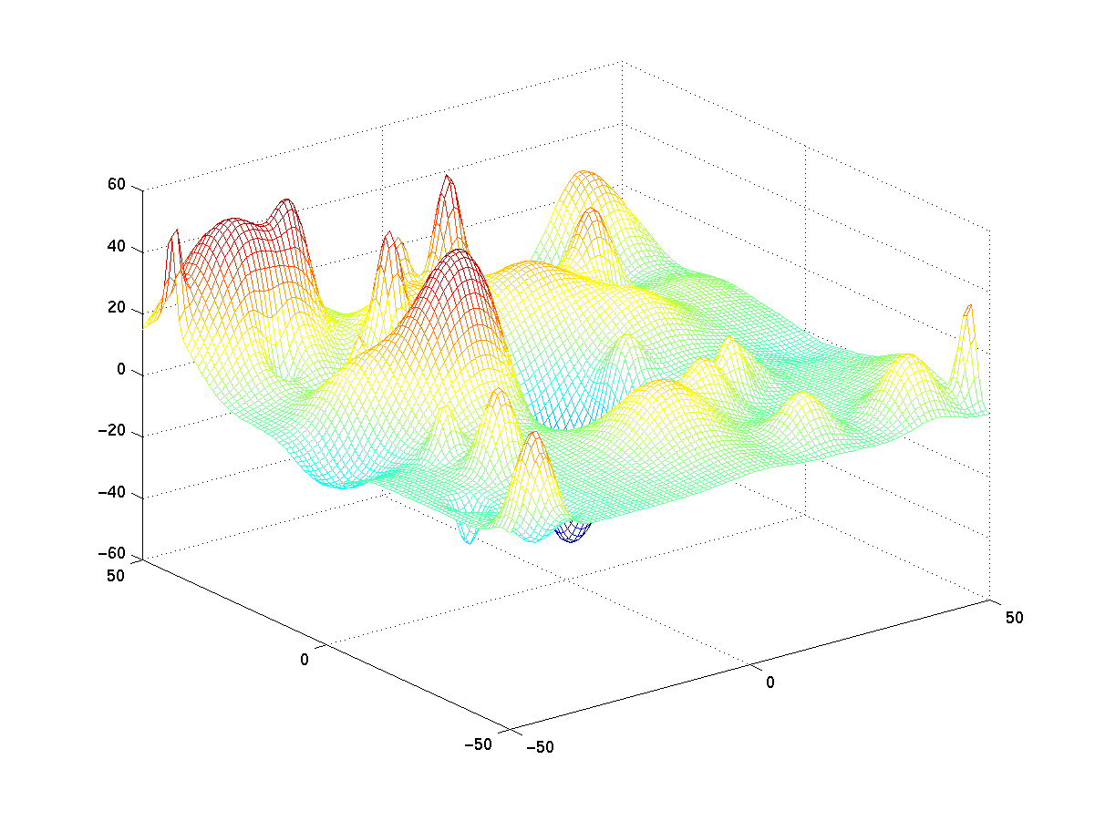
Other Search Techniques
Steepest descent (~ greedy best-first with no search) → may get stuck into local minimum

Slide 52
Other Search Techniques
Steepest descent (~ greedy best-first with no search) → may get stuck into local minimum
Simulated annealing

Slide 53
Other Search Techniques
Steepest descent (~ greedy best-first with no search) → may get stuck into local minimum
Simulated annealing
Genetic algorithms

Slide 54
When to Use Search Techniques?
The search space is small, and
  There is no other available techniques, or
  It is not worth the effort to develop a more efficient technique
The search space is large, and
  There is no other available techniques, and
  There exist “good” heuristics

Slide 55
Summary
Heuristic function
Best-first search
Admissible heuristic and A*
A* is complete and optimal
Consistent heuristic and repeated states
Heuristic accuracy
IDA*

