Slide 1
Constraint Satisfaction Problems
CPSC 390 – Spring 2020

Slide 2
Intro Example: 8-Queens
Purely generate-and-test
The “search” tree is only used to enumerate
all possible 64⁸ combinations

Slide 3
Intro Example: 8-Queens
Another form of generate-and-test, with no
redundancies → “only” 8⁸ combinations

Slide 4
Intro Example: 8-Queens

Slide 5
What is Needed?
Not just a successor function and goal test
But also a means to propagate the constraints imposed by one queen on the others and an early failure test
→ Explicit representation of constraints and constraint manipulation algorithms

Slide 6
Constraint Satisfaction Problem
Set of variables {X1, X2, …, Xn}
Each variable Xi has a domain Di of possible values
Usually Di is discrete and finite
Set of constraints {C1, C2, …, Cp}
Each constraint Ck involves a subset of variables and specifies the allowable combinations of values of these variables

Slide 7
Constraint Satisfaction Problem
Set of variables {X1, X2, …, Xn}
Each variable Xi has a domain Di of possible values
Usually Di is discrete and finite
Set of constraints {C1, C2, …, Cp}
Each constraint Ck involves a subset of variables and specifies the allowable combinations of values of these variables
Assign a value to every variable such that all constraints are satisfied

Slide 8
Example: 8-Queens Problem
64 variables Xij, i = 1 to 8, j = 1 to 8
Domain for each variable {1,0}
Constraints are of the forms:
  Xij = 1 ➔ Xik = 0 for all k = 1 to 8, k≠j
  Xij = 1 ➔ Xkj = 0 for all k = 1 to 8, k≠i
  Similar constraints for diagonals
  ΣXij = 8

Slide 9
Example: 8-Queens Problem
8 variables Xi, i = 1 to 8
Domain for each variable {1,2,…,8}
Constraints are of the forms:
  Xi = k ➔ Xj ≠ k for all j = 1 to 8, j≠i
  Similar constraints for diagonals

Slide 10
Example: Map Coloring
NT
NT
Q
Q
WA
WA
SA
SA
NSW
NSW
V
V
T
T
7 variables {WA,NT,SA,Q,NSW,V,T}
Each variable has the same domain {red, green, blue}
No two adjacent variables have the same value:
WA≠NT, WA≠SA, NT≠SA, NT≠Q, SA≠Q, SA≠NSW, SA≠V,Q≠NSW, NSW≠V

Slide 11
Example: Street Puzzle
1
2
3
4
5
Ni = {English, Spaniard, Japanese, Italian, Norwegian}
Ci = {Red, Green, White, Yellow, Blue}
Di = {Tea, Coffee, Milk, Fruit-juice, Water}
Ji = {Painter, Sculptor, Diplomat, Violonist, Doctor}
Ai = {Dog, Snails, Fox, Horse, Zebra}

Slide 12
Example: Street Puzzle
1
2
3
4
5
Ni = {English, Spaniard, Japanese, Italian, Norwegian}
Ci = {Red, Green, White, Yellow, Blue}
Di = {Tea, Coffee, Milk, Fruit-juice, Water}
Ji = {Painter, Sculptor, Diplomat, Violonist, Doctor}
Ai = {Dog, Snails, Fox, Horse, Zebra}
The Englishman lives in the Red house
The Spaniard has a Dog
The Japanese is a Painter
The Italian drinks Tea
The Norwegian lives in the first house on the left
The owner of the Green house drinks Coffee
The Green house is on the right of the White house
The Sculptor breeds Snails
The Diplomat lives in the Yellow house
The owner of the middle house drinks Milk
The Norwegian lives next door to the Blue house
The Violonist drinks Fruit juice
The Fox is in the house next to the Doctor’s
The Horse is next to the Diplomat’s
Who owns the Zebra?
Who drinks Water?

Slide 13
Example: Task Scheduling
T1
T2
T4
T3
T1 must be done during T3
T2 must be achieved before T1 starts
T2 must overlap with T3
T4 must start after T1 is complete
Are the constraints compatible?
Find the temporal relation between every two tasks

Slide 14
Finite vs. Infinite CSP
Finite domains of values → finite CSP
Infinite domains → infinite CSP
(particular case: linear programming)

Slide 15
Finite vs. Infinite CSP
Finite domains of values → finite CSP
Infinite domains → infinite CSP
We will only consider finite CSP

Slide 16
Constraint Graph
Binary constraints
T1
NT
Q
WA
T2
T4
SA
NSW
T3
V
T
Two variables are adjacent or neighbors if they
are connected by an edge or an arc

Slide 17
CSP as a Search Problem
Initial state: empty assignment
Successor function: a value is assigned to any unassigned variable, which does not conflict with the currently assigned variables
Goal test: the assignment is complete
Path cost: irrelevant

Slide 18
CSP as a Search Problem
Initial state: empty assignment
Successor function: a value is assigned to any unassigned variable, which does not conflict with the currently assigned variables
Goal test: the assignment is complete
Path cost: irrelevant
n variables of domain size d
→ O(d^{n}) distinct complete assignments

Slide 19
Remark
Finite CSP include 3SAT as a special case (see class on logic)
3SAT is known to be NP-complete
So, in the worst-case, we cannot expect to solve a finite CSP in less than exponential time

Slide 20
Commutativity of CSP
The order in which values are assigned
to variables is irrelevant to the final
assignment, hence:
Generate successors of a node by
considering assignments for only one
variable
Do not store the path to node

Slide 21
→ Backtracking Search
empty assignment
1st variable
2nd variable
3rd variable
Assignment = {}

Slide 22
→ Backtracking Search
empty assignment
1st variable
2nd variable
3rd variable
Assignment = {(var1=v11)}

Slide 23
→ Backtracking Search
empty assignment
1st variable
2nd variable
3rd variable
Assignment = {(var1=v11),(var2=v21)}

Slide 24
→ Backtracking Search
empty assignment
1st variable
2nd variable
3rd variable
Assignment = {(var1=v11),(var2=v21),(var3=v31)}

Slide 25
→ Backtracking Search
empty assignment
1st variable
2nd variable
3rd variable
Assignment = {(var1=v11),(var2=v21),(var3=v32)}

Slide 26
→ Backtracking Search
empty assignment
1st variable
2nd variable
3rd variable
Assignment = {(var1=v11),(var2=v22)}

Slide 27
→ Backtracking Search
empty assignment
1st variable
2nd variable
3rd variable
Assignment = {(var1=v11),(var2=v22),(var3=v31)}

Slide 28
Backtracking Algorithm
partial assignment
of variables
CSP-BACKTRACKING({})
CSP-BACKTRACKING(a)
  If a is complete then return a
  X ← select unassigned variable
  D ← select an ordering for the domain of X
  For each value v in D do
    If v is consistent with a then
      Add (X= v) to a
      result ← CSP-BACKTRACKING(a)
      If result ≠ failure then return result
  Return failure

Slide 29
Map Coloring
{}
WA=red
WA=green
WA=blue
WA=red
NT=green
WA=red
NT=blue
NT
Q
WA
WA=red
NT=green
Q=red
WA=red
NT=green
Q=blue
SA
NSW
V
T

Slide 30
Questions
Which variable X should be assigned a value next?
In which order should its domain D be sorted?

Slide 31
Questions
Which variable X should be assigned a value next?
In which order should its domain D be sorted?
What are the implications of a partial assignment for yet unassigned variables? (→ Constraint Propagation
-- see next class)

Slide 32
Choice of Variable
Map coloring
NT
NT
Q
WA
WA
SA
SA
NSW
V
T

Slide 33
Choice of Variable
8-queen

Slide 34
Choice of Variable
Most-constrained-variable heuristic:
Select a variable with the fewest remaining values

Slide 35
Choice of Variable
NT
Q
WA
SA
SA
NSW
Most-constraining-variable heuristic:
Select the variable that is involved in the largest number of constraints on other unassigned variables
V
T

Slide 36
Choice of Value
NT
NT
Q
WA
WA
SA
NSW
V
{}
T

Slide 37
Choice of Value
NT
NT
Q
WA
WA
SA
NSW
V
{blue}
T
Least-constraining-value heuristic:
Prefer the value that leaves the largest subset of legal values for other unassigned variables

Slide 38
Local Search for CSP
1
2
2
0
3
2
3
2
2
2
2
2
3
2
Pick initial complete assignment (at random)
Repeat
  Pick a conflicted variable var (at random)
  Set the new value of var to minimize the number of conflicts
  If the new assignment is not conflicting then return it
(min-conflicts heuristics)

Slide 39
Remark
Local search with min-conflict heuristic works extremely well for million-queen problems
The reason: Solutions are densely distributed in the O(n^{n}) space, which means that on the average a solution is a few steps away from a randomly picked assignment

Slide 40
Applications
CSP techniques allow solving very complex problems
Numerous applications, e.g.:
  Crew assignments to flights
  Management of transportation fleet
  Flight/rail schedules
  Task scheduling in port operations
  Design
  Brain surgery

Slide 41
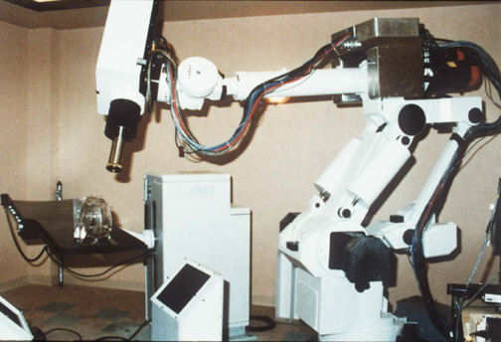
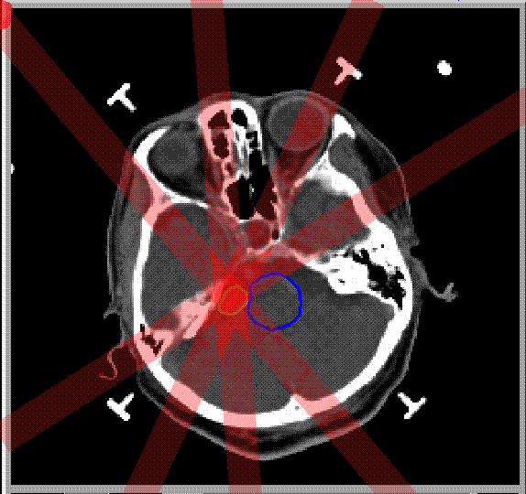
Stereotaxic Brain Surgery

Slide 42
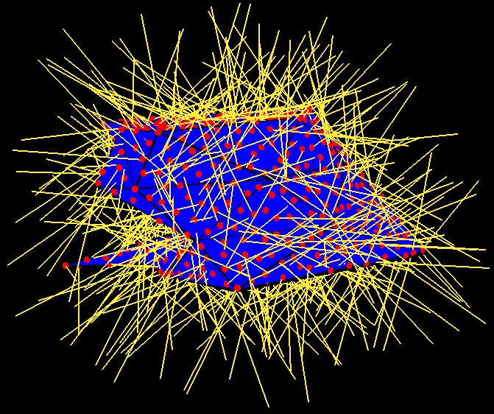
Stereotaxic Brain Surgery
• 2000 < Tumor < 2200
  2000 < B2 + B4 < 2200
  2000 < B4 < 2200
  2000 < B3 + B4 < 2200
  2000 < B3 < 2200
  2000 < B1 + B3 + B4 < 2200
  2000 < B1 + B4 < 2200
  2000 < B1 + B2 + B4 < 2200
  2000 < B1 < 2200
  2000 < B1 + B2 < 2200
T
B1
T
B2
C
B4
B3
• 0 < Critical < 500
  0 < B2 < 500

Slide 43
→ Constraint Programming
“Constraint programming represents one of the closest approaches computer science has yet made to the Holy Grail of programming: the user states the problem, the computer solves it.”
Eugene C. Freuder, Constraints, April 1997

Slide 44
Additional References
Surveys: Kumar, AAAI Mag., 1992; Dechter and Frost, 1999
Text: Marriott and Stuckey, 1998; Russell and Norvig, 2nd ed.
Applications: Freuder and Mackworth, 1994
Conference series: Principles and Practice of
Constraint Programming (CP)
Journal: Constraints (Kluwer Academic Publishers)
Internet
  Constraints Archive
  http://www.cs.unh.edu/ccc/archive

Slide 45
Summary
Constraint Satisfaction Problems (CSP)
CSP as a search problem
Backtracking algorithm
General heuristics
Local search technique
Structure of CSP
Constraint programming

