Slide 1
Spaceship Cockpit Features
Top left: Spaceship integrity (lowers when hit by enemies)
Top right: Warning light turns on when there is immanent danger
Bottom left: Radar system (location of enemies in your area as well as the direction your ship is facing comparatively)
Bottom middle: Targeting system (player should fire when enemy ship lines up with target symbol)
Bottom right: Speedometer (how fast the ship is moving)

Slide 2
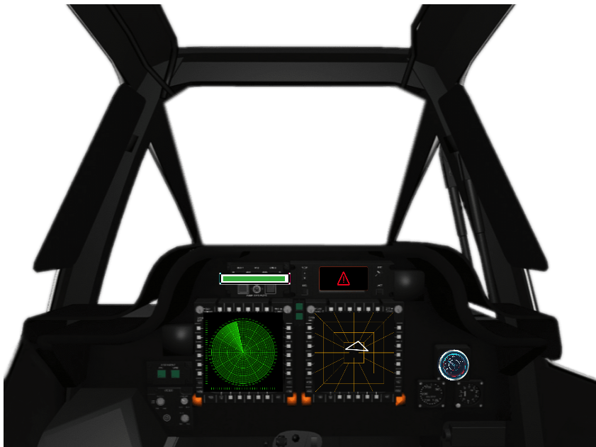

Slide 3
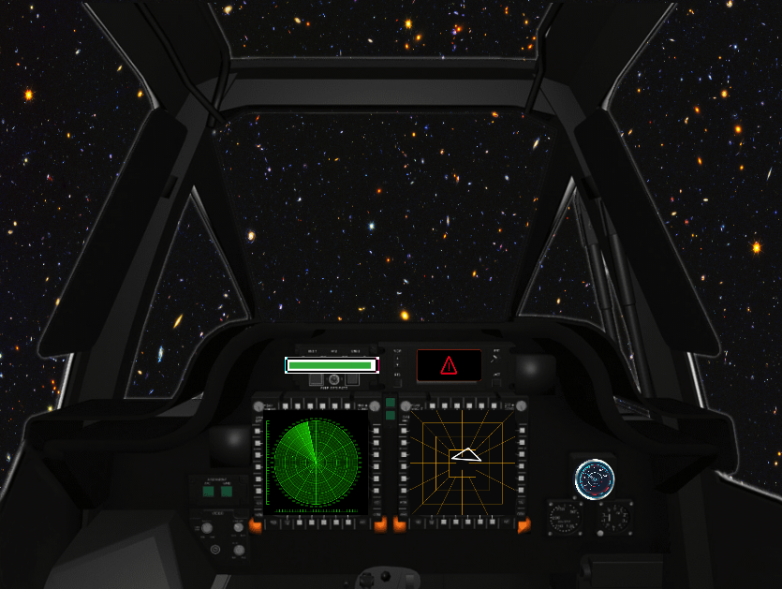
Player can see environment through windows

Slide 4
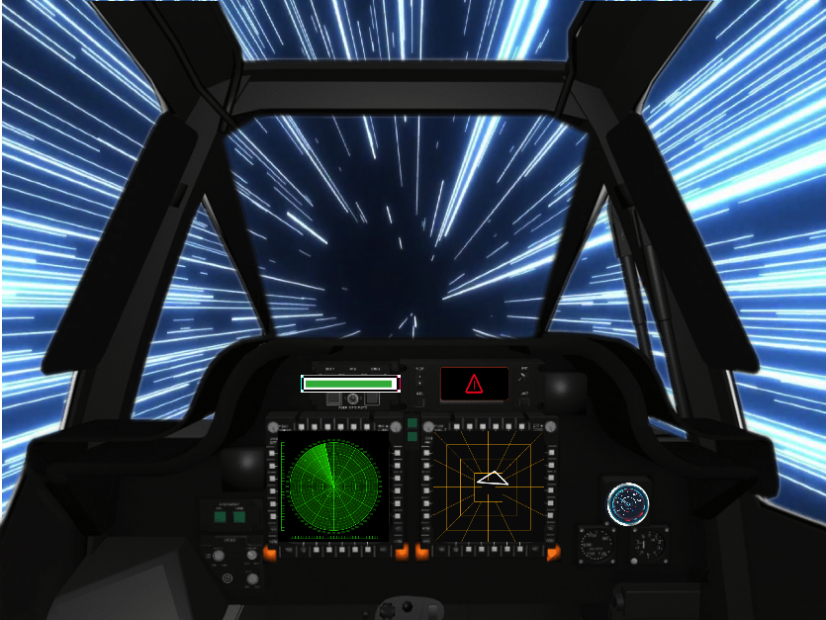
Blur of light changes around the ship depending on the player’s speed

