Slide 1
Insulin Calculator and Diabetic Data Storage Program
Chief Executive Developer: Toby Tuckness
Advisor: Dr. Komal Chhibber

Slide 2
Project Overview
my personal relation to this project
problems that this program solves:
i. calculate insulin for new T1Ds
ii. provide “logs” of patient information
- stores data locally
iii. provide A1C estimate
- currently, only way to test A1C is either manually, or approximate using a CGM
program does not require you to store patient information in order to calculate insulin

Slide 3
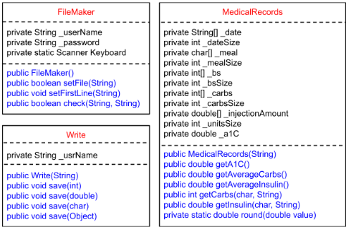

Slide 4
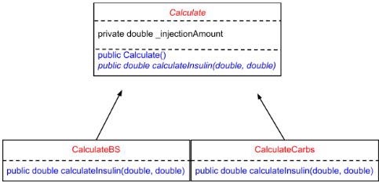

Slide 5
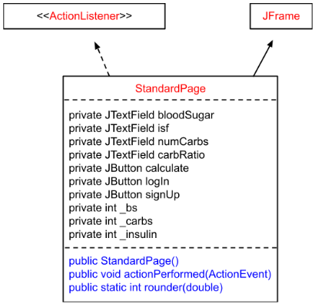

Slide 6
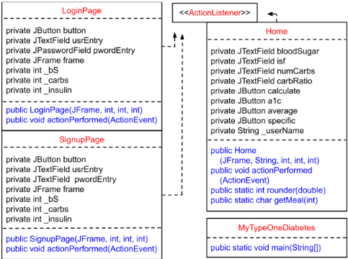

Slide 7
What I have learned through this Project:
how to setup and design a large program
time management over a full 3 month project
efficient large scale data management
using the GUI (Java swing)

Slide 8
Future of this project:
write to and store data on a database
insulin dosage recommendations
receive data from cgm, insulin pump

Slide 9
Acknowledgements:
Dr. Komal Chhibber: advisor
Dr. Niall McCarthy: S.T.E.M. Train Director at SMCC
National Science Foundation: Benefactor
Arizona State University West: Benefactor

