Slide 1





Slide 2
Outline
In this tutorial, I will introduce
Create process from user mode
Create process from kernel mode
fork() in the linux

Slide 3
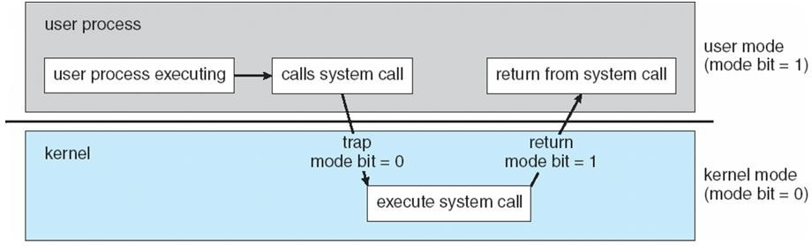
Process
User Mode
Kernel Mode
Complete access to hardware

Slide 4
Process
Each process is named by a process ID number. Generally, process is identified and managed via a process identifier (pid)
A unique process ID is allocated to each process when it is created.
The lifetime of a process ends when its termination is reported to its parent process. At that time, all of the process resources, including its process ID, are freed.

Slide 5
Process
Process: Program in execution
Multiple processes: Concurrent vs Parallel. Processor vs CPU vs Core
In multitasking operating systems, processes (running programs) need a way to create new processes, e.g. to run a program.
Process state:
new: The process is being created
running: Instructions are being executed
waiting: The process is waiting for some event to occur
ready: The process is waiting to be assigned to a processor
terminated: The process has finished execution

Slide 6
Process Creation
Processes are created with the fork system call (so the operation of creating a new process is sometimes called forking a process).
The child process created by fork is an exact clone of the original parent process, except that it has its own process ID.

Slide 7
Process Creation
Functions (Unix-like system):
pid_t fork(void) system call creates new process
Return value
fork() returns -1, the creation of a child process was unsuccessful.
fork() returns a zero to the newly created child process.
fork() returns a positive value, the process ID of the child process, to the parent.
The returned process ID is of type pid_t defined in ”sys/types.h”.

Slide 8
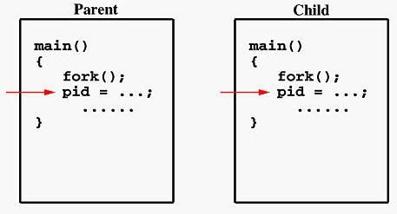
Parent and Child Process
If the call to fork() is executed successfully, Unix will
make two identical copies of address spaces, one for the parent and the other for the child.
Both processes will start their execution at the next statement following the fork() call.

Slide 9
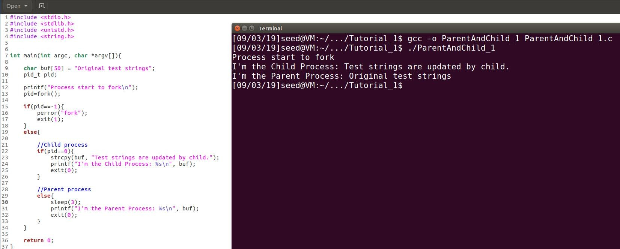
Parent and Child Process 1 - pid
Both parent and child process start execution from next statement after fork call.

Slide 10
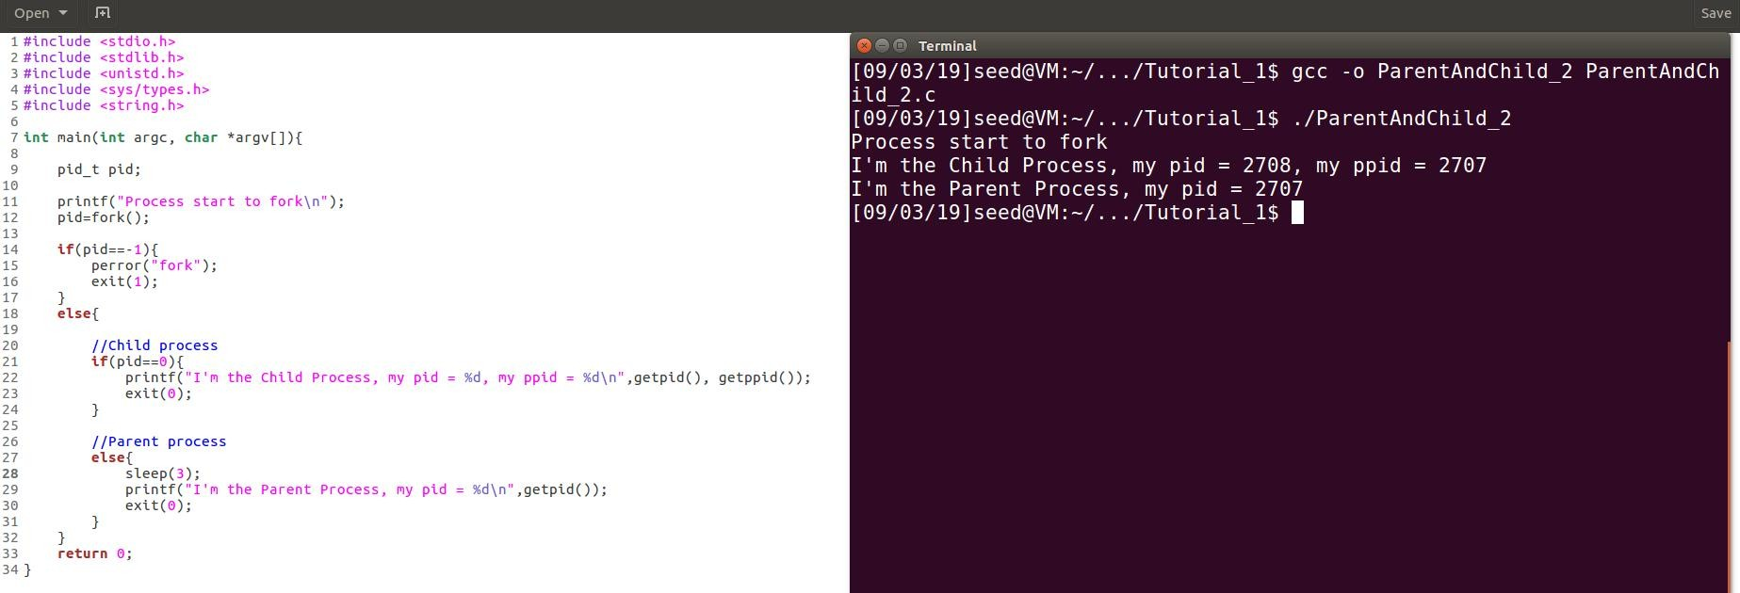
Parent and Child Process 2
getpid() returns PID of calling system.
getppid() returns PID of the parent of calling
system.
Let parent process to sleep for 3s, and then print messages.

Slide 11
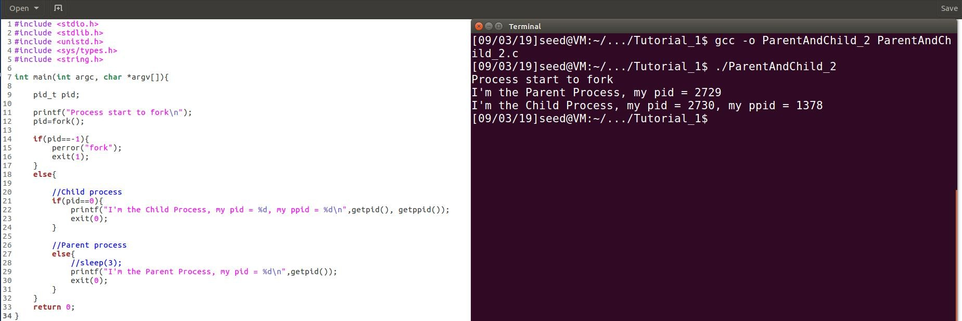

Parent and Child Process 2
Why?
Parent process terminates, and the child process is inherited by init process, whose pid is 1378 in my example. It may change every time rebooting the OS.
When testing in Mac OS, it might be
-1.
Parent and child process runs concurrently after forking.

Slide 12
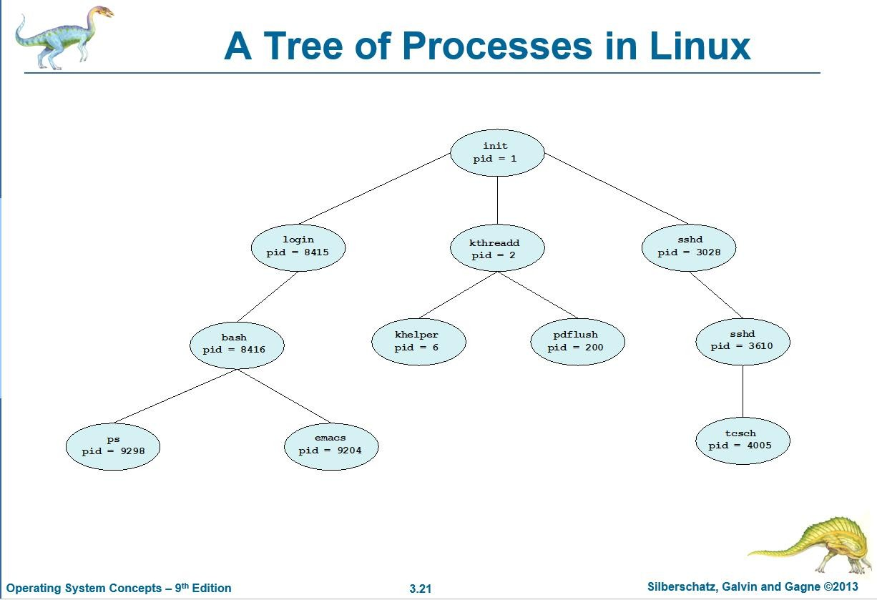
Parent and Child Process

Slide 13
Executing a file
exec is a functionality of an operating system that runs an executable file in the context of an already existing process, replacing the previous executable. This act is also referred to as an overlay.
Exec function family
int execl (const char *filename, const char *arg0, ...)
int execve (const char *filename, char *const argv[], char *const env[])
int execle (const char *filename, const char *arg0, char *const env[], ...)
int execvp (const char *filename, char *const argv[])
int execlp (const char *filename, const char *arg0, ...)

Slide 14
Executing a file
New process will not be created, the original PID does not change, but the machine code, data, heap and stack of the process are replaced by those of the new program.
Return value
A successful exec replaces the current process image, so it cannot return anything to the program that made the call.
If an exec function does return to the calling program, an error occurs, the return value is −1

Slide 15
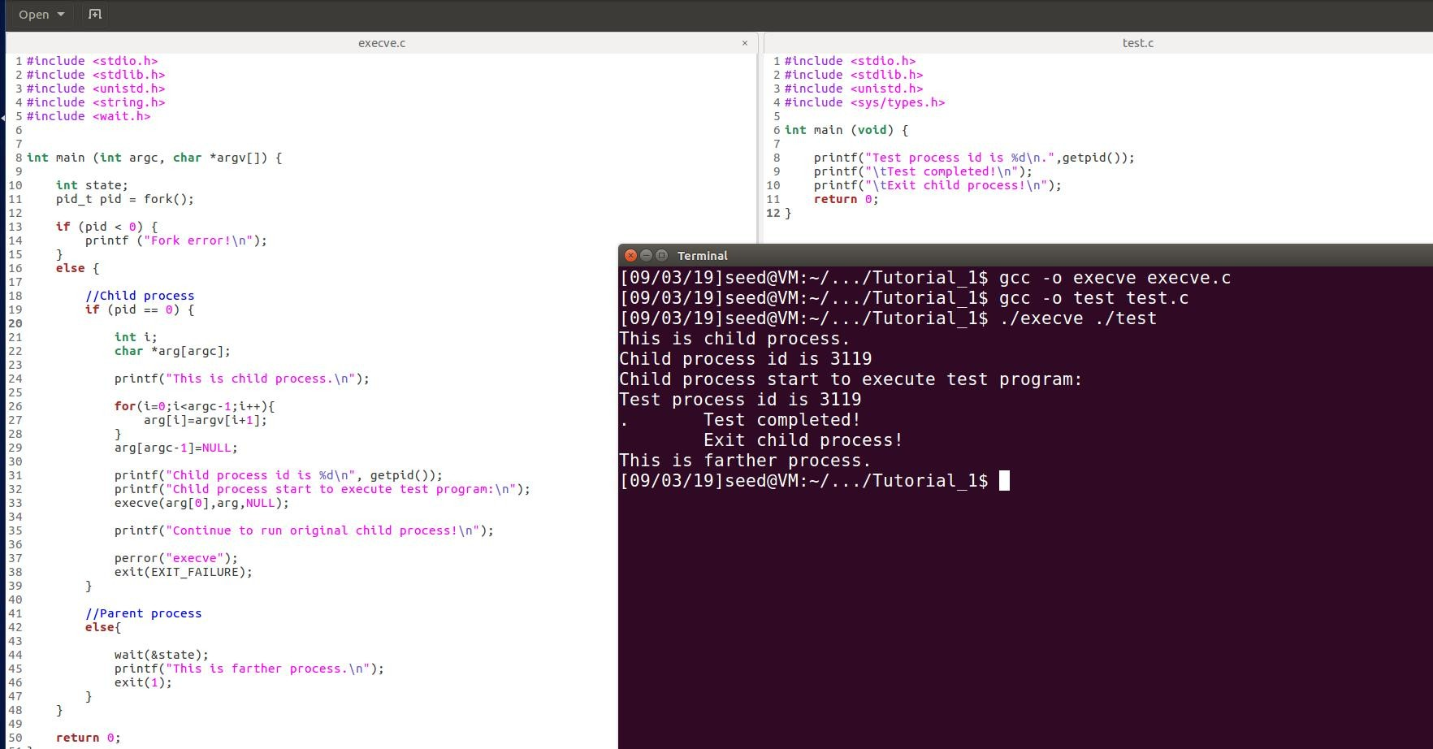
Executing a file – execve()
Check if the test program is replacing child process but will not create new process
path of the executed file
In child process, execute a new file.
Check if the child process is replaced by new program

Slide 16
Process Termination
Process executes last statement and asks the operating system to delete it (exit())
Output data from child to parent (via wait())
Process’ resources are deallocated by operating system
If no parent waiting, then terminated process is a zombie
If parent terminated, processes are orphans

Slide 17
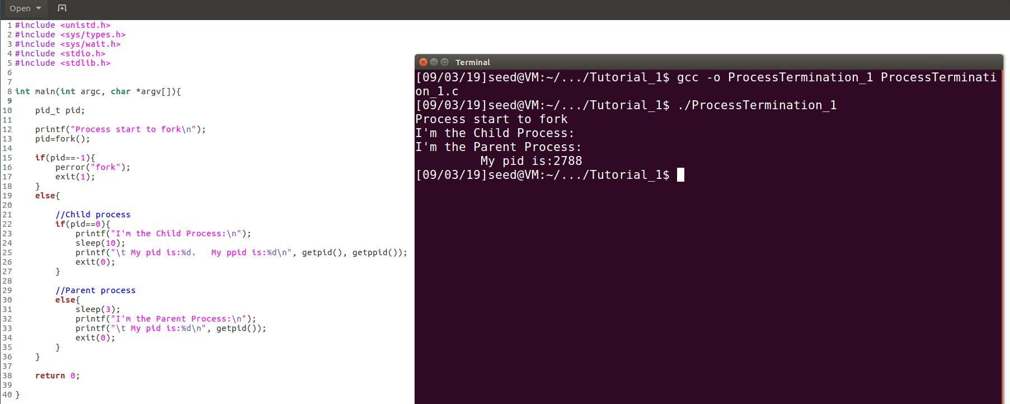
Process Termination 1 - orphan
Let parent process to terminates ahead of child process
Parent process terminates, and the child process becomes orphans, and will be adopted by init process.

Slide 18
Process Termination 2
Functions: (defined in “sys/wait.h”)
0 / WNOHANG / WUNTRACED
0 skips the option, and keeps waiting till the specified child process terminates.
pid_t wait (int *status_ptr)
pid_t waitpid (pid_t pid, int *status_ptr, int option• s) WNOHANG demands status information immediately.
If status information is immediately available on an appropriate child process, waitpid() returns this information. Otherwise, waitpid() returns immediately with an error code indicating that the information was not available. In other words, it checks child processes without causing the caller to be suspended.
Differences
wait() requests status for any child process
WUNTRACED reports on stopped child processes as
waitpid() requests status for specific child process. well as terminated ones.
The waitpid() function behaves the same as wait() if the pid argument is (pid_t) -1 and the options argument is 0.
https://stackoverflow.com/questions/33508997/waitp id-wnohang-wuntraced-how-do-i-use- these/34845669
https://linux.die.net/man/2/waitpid

Slide 19
Process Termination 2
Return value
wait() or waitpid() returns PID of child process when the status of a child process is available.
If unsuccessful, wait() or waitpid() returns -1.
When waitpid() returns with a valid process ID (pid), below macros can analyze the status referenced by the status argument.
int WIFEXITED (int status)
int WIFSIGNALED (int status)
int WIFSTOPPED (int status)
etc.

Slide 20
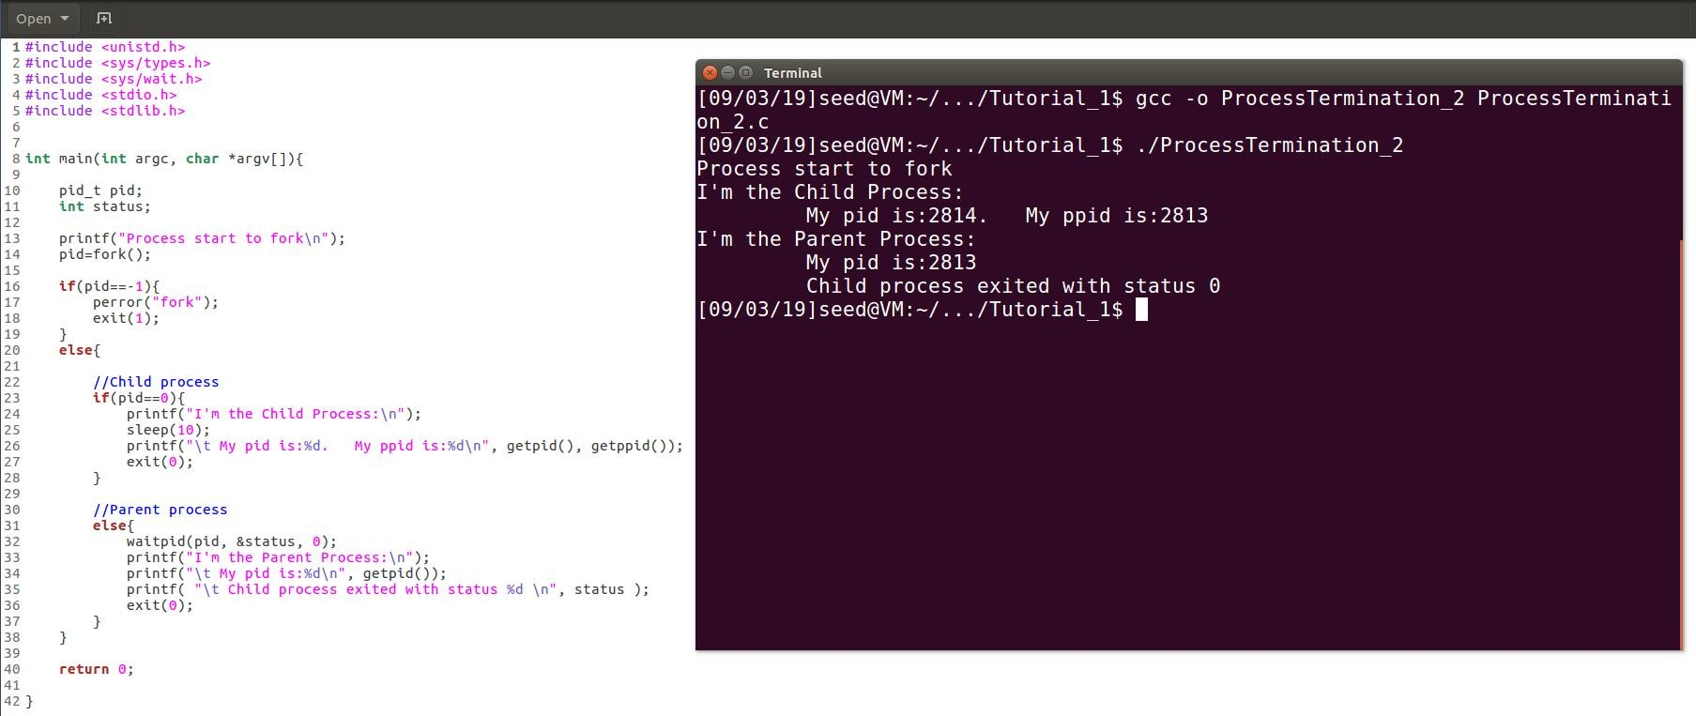
Process Termination 2 – waitpid()
Child process sleeps 10s and parent process will suspend until status information of child process is available.

Slide 21
Process Signals
Linux supports the standard signals listed below.
SIGQUIT 3
SIGKILL 9
SIGTERM 15
SIGSTOP 19
etc.
https://stackoverflow.com/questions/50299429/c-reporting-which-signal-terminated-a- child

Slide 22
Process Signals
Send a signal to caller
int raise (int sig)
Evaluate child process’s status (zero or non-zero)
int WIFEXITED (int status)
int WIFSIGNALED (int status)
int WIFSTOPPED (int status)
Evaluate child process’s returned value of status argument(exact values)
int WEXITSTATUS (int status)
int WTERMSIG (int status)
int WSTOPSIG (int status)

Slide 23
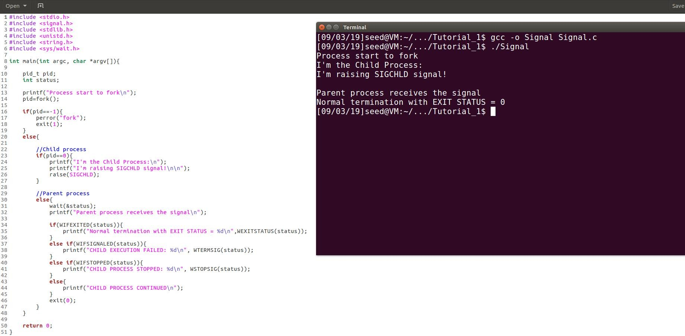
Process Signals 1 – wait()
Raise SIGCHLD in child process
Check if child process exits normally
Get status value of child process

Slide 24
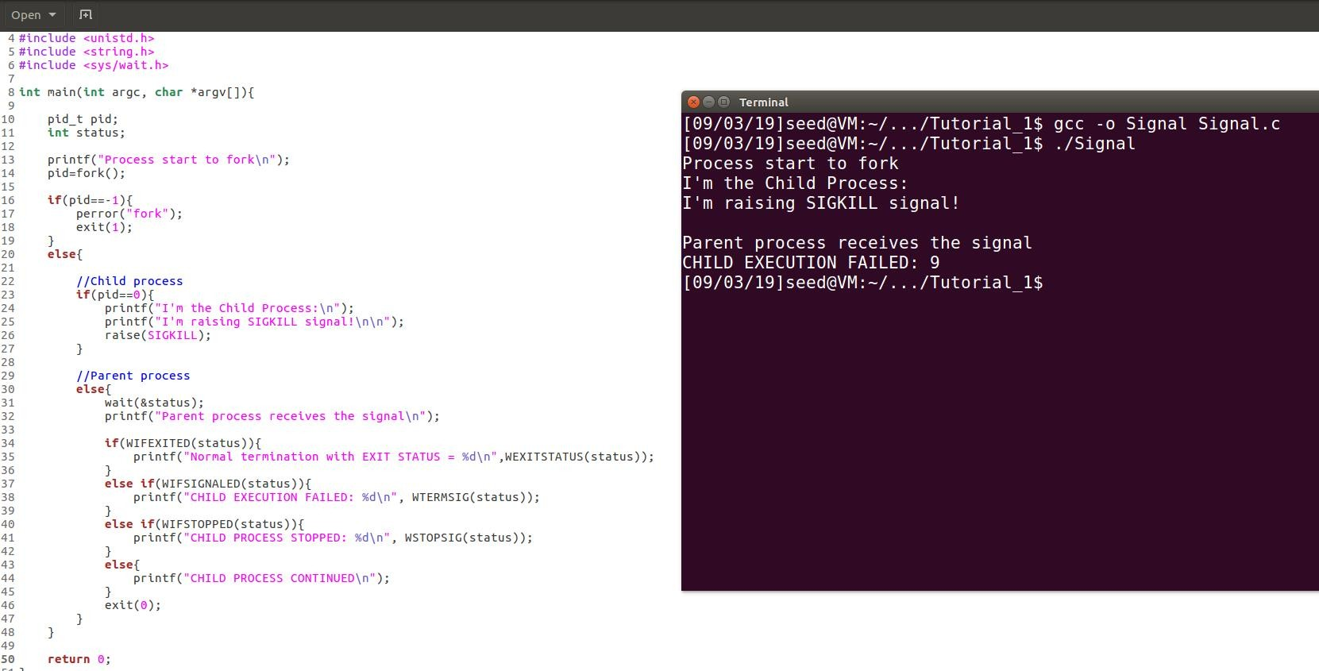
Process Signals 1 – wait()
Raise SIGKILL in child process
Check if child process received a terminating signal
Get status value for child progress’ terminating signal

Slide 25
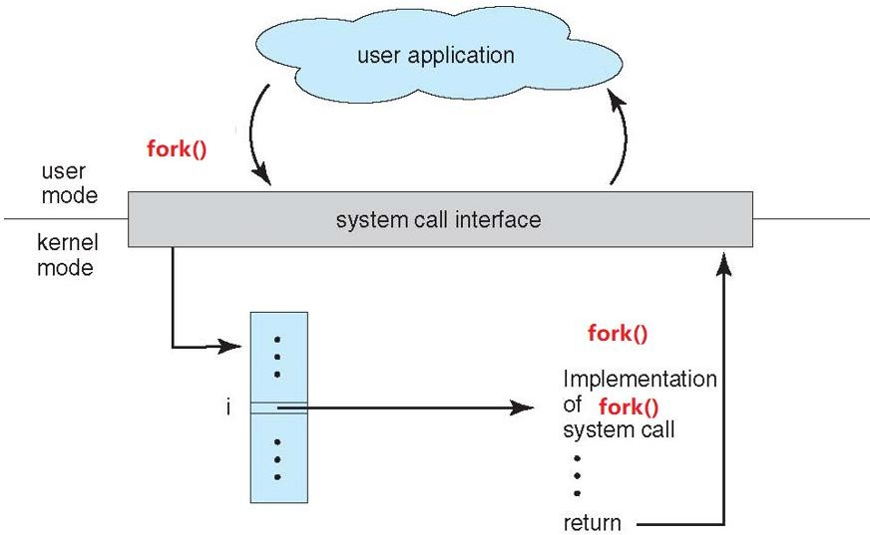
Process creation
Search sys_fork() in sys_call_table[]
Implemented via calling do_fork()

Slide 26
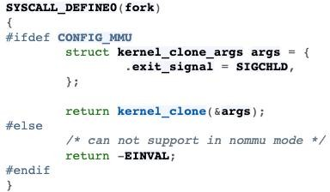
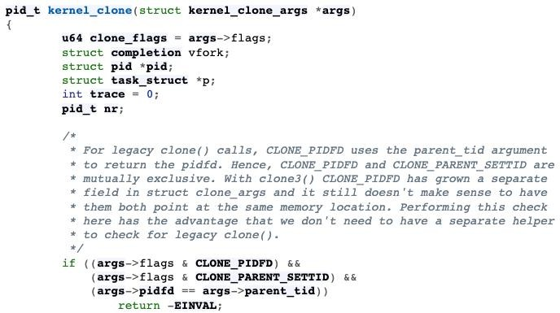
Process creation
https://tinylab.org/riscv-task-implementation/

Slide 27
Process creation (kernel_clone)
Its implementation is defined in ‘/kernel/fork.c’:
Call get_task_pid() to assign an available PID to the new task.
Call copy_process() then either duplicates or shares open files, file system information, signal handlers, process address space, and namespace.
In copy_process, it calls dup_task_struct(), which creates a new kernel stack, thread_info structure, and task_struct for the new process.
wake_up_new_task() to wake up the child process and insert the child process to the running queue.
For more details
https://elixir.bootlin.com/linux/v5.10/source/kernel/fork.c#L2415
You should check basing on your own version

Slide 28
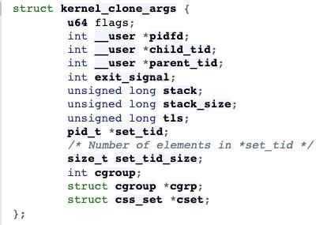
Process creation (kernel_clone)
kernel_clone:
extern pid_t kernel_clone(struct kernel_clone_args *kargs);
Arguments:

Slide 29
Process creation (kernel_clone)
Arguments:
flags: How to clone the child process. When executing fork(), it is set as SIGCHILD.
stack: Specifies the location of the stack used by the child process.
stack_size: Normally set as 0 because it is unused.
parent_tid: Used for clone() to point to user space memory in parent process address space. It is set as NULL when executing fork();
child_tid: Used for clone() to point to user space memory in child process address space. It is set as NULL when executing fork();
tls: Set thread local storage.

Slide 30
Process creation (kernel_clone)
Return value:
Fork successfully: pid of child process
Failed: Err

Slide 31
Program execution (do_execve)
Its implementation is defined in ‘/fs/exec.c’:
struct linux_binprm: This structure is used to hold the arguments that are used when loading binaries. It is defined in ‘include/linux/binfmts.h’
Use prepare_bprm_creds API to initialize the struct
Open your program file and assign corresponding values into struct linux_binprm
Use the bprm_mm_init and prepare_binprm to prepare execute your binary program
Read the file content and copy corresponding information into your struct linux_binprm
Use search_binary_handler to execute your binary program
After execve succeeded, it calls acct_update_integrals and free the binary program by calling free_brpm

Slide 32
Program execution (do_execve)
do_execve:
int do_execve ( struct filename *filename,
const char user *const user * argv, const char user *const user * envp);
Parameters:
filename: Filename of the executable file.
argv: The arguments for executing the file.
envp: System environment variable set.
Return value:
Execute successfully: 0
Failed: Err

Slide 33
Wait for signal (do_wait)
In kernel mode, when system call do_wait() is executed, it is loading exit.ko module.
Its implementation is defined in ‘/kernel/exit.c’:
Create wait_opts structure and add it into wait queue by calling add_wait_queue.
Use set_current_state to update state as TASK_INTERRUPTIBLE or TASK_RUNNING.
When child process terminates, it calls wake_up_parent. Then parent process will go to repeat scanning, so that it can get return of child process’ termination.
For more details:
https://elixir.bootlin.com/linux/v5.10/source/kernel/exit.c(do_wait)

Slide 34
Wait for signal (do_wait)
do_wait:
long do_wait (struct wait_opts *wo);
struct wait_opts:
struct wait_opts { enum pid_type wo_type; //It is defined in ‘/include/linux/pid.h’.
int wo_flags; //Wait options. (0, WNOHANG, WEXITED, etc.)
struct pid *wo_pid; //Kernel's internal notion of a process identifier.
“Find_get_pid()”
struct siginfo user *wo_info; //Singal information.
int user *wo_stat; // Child process’s termination status struct rusage user *wo_rusage; //Resource usage wait_queue_entry_t child_wait; //Task wait queue
int notask_error ;};

Slide 35
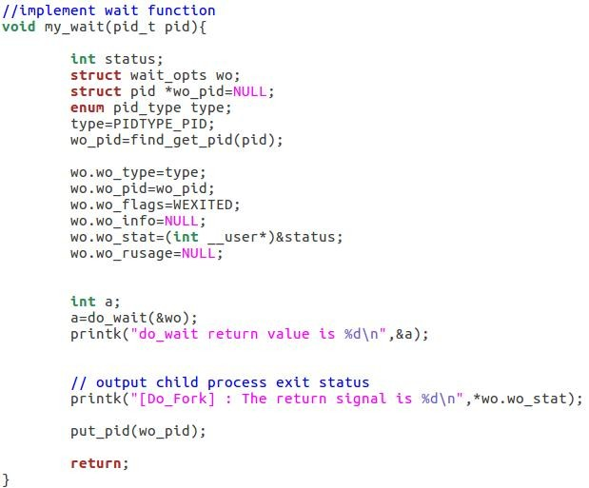
Wait for signal (do_wait)
Look up a PID from hash table and return with it’s count evaluated.
Decrease the count and free memory

Slide 36
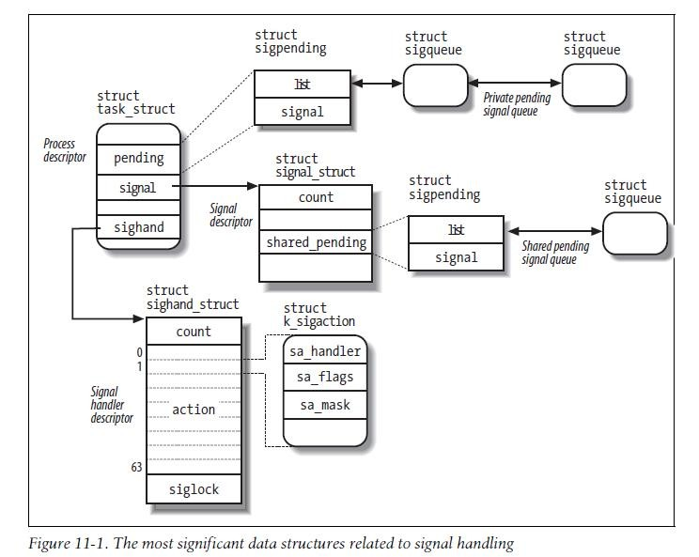
Handle signal (k_sigaction)
For each process in the system, the kernel must keep track of what signals are currently pending or masked. The kernel must keep track of how every thread group is supposed to handle every signal.
To do this, the kernel uses several data structures accessible from the process descriptor. The most significant data structures related to signal handling：

Slide 37
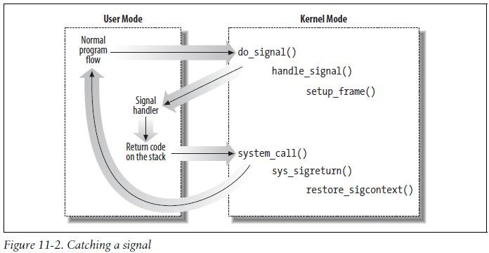
Handle signal (k_sigaction)
The signal field of the process descriptor points to a signal descriptor, a signal_struct structure that keeps track of the shared pending signals.
The of properties of a signal are stored in a k_sigaction structure, which contains the signal properties.
The kernel noticed the arrival of a signal and invoked function to prepare the process descriptor of the process that is supposed to receive the signal. (do_signal())
If a handler has been extablished for the signal, the do_signal() function must enforce its execution. (handle_signal()
)

Slide 38
Kernel Thread
Kthread creation:
struct task_struct *kthread_create( int (*threadfn)(void *data),
void *data,
const char *namefmt, ...);
The data argument will simply be passed to the thread function.
The thread will not start running immediately. It will start to execute when returned task_struct is passed to wake_up_process().
Kthread execution function:
int thread_function(void *data);
It can either call do_exit directly if it is a standalone thread for which no one will call kthread_stop()
Or return when 'kthread_should_stop' is true (which means kthread_stop has been called).

Slide 39
Kernel Thread
Return value:
It returns task_struct when executes successfully.
When fails, it returns ERR_PTR
Kthred start execution with:
int wake_up_process (struct task_struct * p);
ERR_PTR
A convenient function which creates and starts the thread:
struct task_struct *kthread_run( int (*threadfn)(void *data),
void *data,
const char *namefmt, ...);
Same as kthread_create() + wake_up_process()

Slide 40
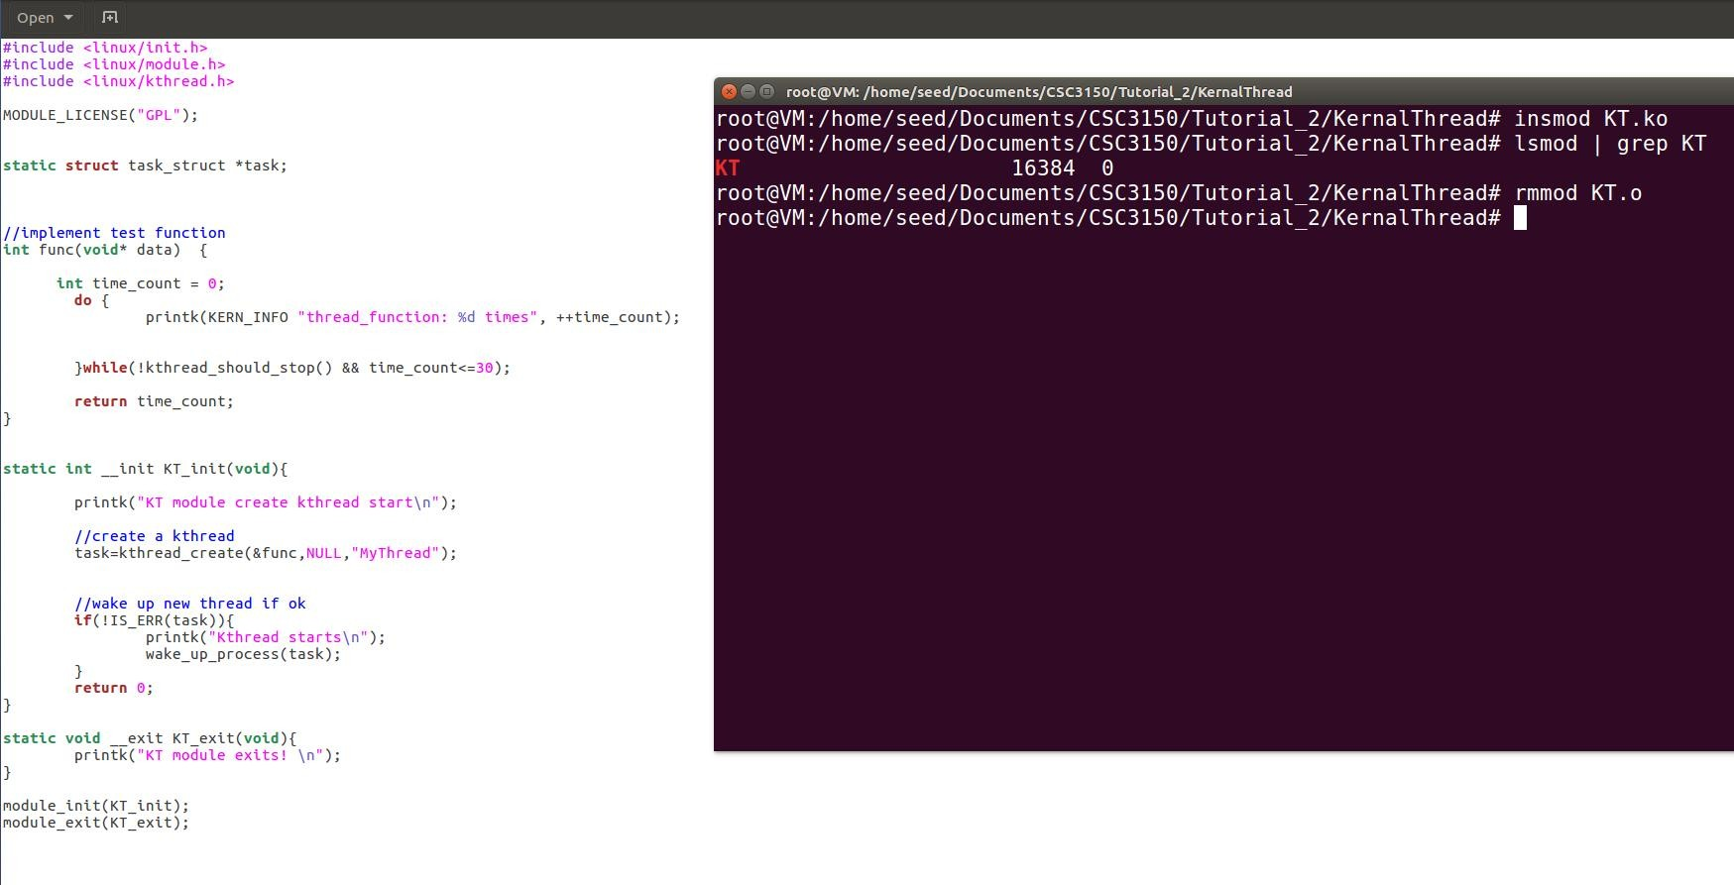

Kernel Thread
GPL: General Public License.
Loading a proprietary or non-GPL-compatible LKM will set a 'taint' flag in the running kernel
Create a kernel thread to execute func

Slide 41
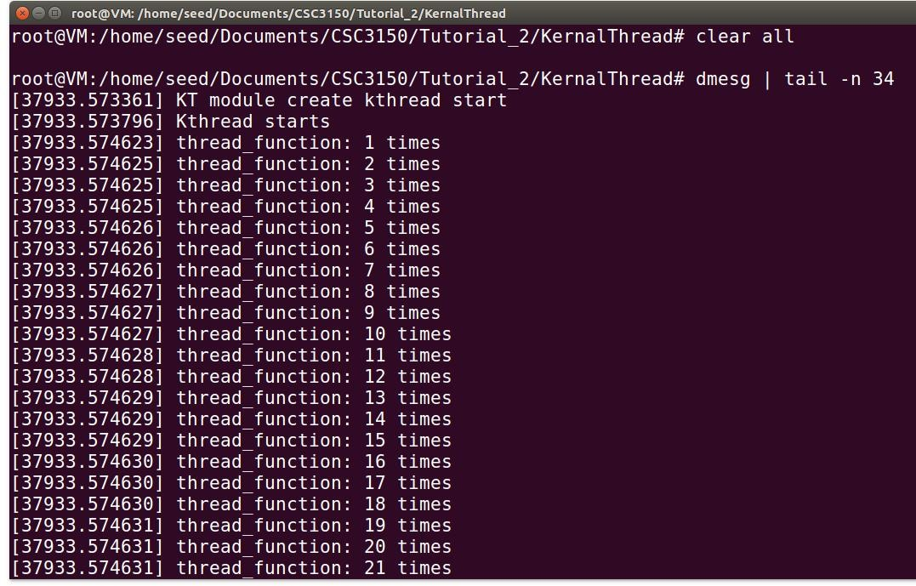
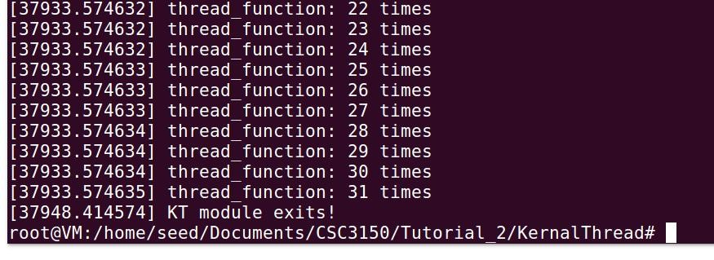
Kernel Thread

Slide 42
Kernel Object
A loadable kernel module (or LKM) is an object file that contains code to extend the running kernel, or so-called base kernel
LKMs are typically used to add support for new hardware and/or file systems, or for adding system calls.
Most current Unix-like systems support loadable kernel modules, although they might use a different name for them,
for example: kernel extension (kext) in MacOS

Slide 43
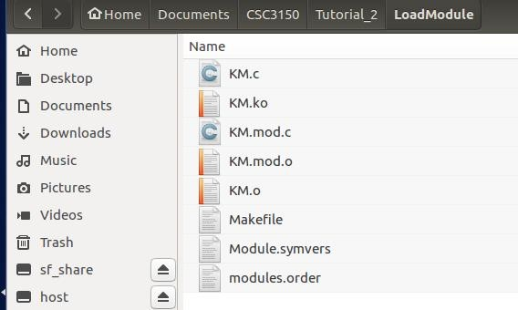
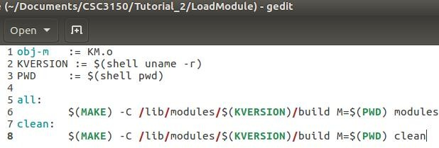
Kernel Object Compiling (Makefile)
Makefile
http://www.cyberciti.biz/tips/compiling-linux-kernel-module.html
Build kernel object
‘KM’ is name of the Kernel Object
Type command “Make”
If you type command “Make clean”, it will clear all built files and leave original c file and makefile .

Slide 44
Insert and Remove Kernel Module
Before insert the kernel object, you have to sign in the root account.
$ sudo su
Insert module
$insmod MODULE_NAME.ko
List the module you insert
$lsmod
$lsmod | grep MODULE_NAME
Remember to remove your module
$rmmod MODULE_NAME.ko

Slide 45
Compile Kernel
Download source code from
http://www.kernel.org
mirro: https://mirror.tuna.tsinghua.edu.cn/kernel/v5.x/
Install Dependency and development tools
sudo apt-get install libncurses-dev gawk flex bison openssl libssl-dev dkms libelf-dev libudev- dev libpci-dev libiberty-dev autoconf llvm dwarves
Extract the source file to /home/seed/work
cp KERNEL_FILE.tar.xz /home/seed/work
cd /home/seed/work
$sudo tar xvf KERNEL_FILE.tar.xz

Slide 46
Compile Kernel
Copy config from /boot to /home/seed/work/KERNEL_FILE
Login root account and go to kernel source directory
$sudo su
$cd /home/seed/work /KERNEL_FILE

Slide 47



Compile Kernel
Clean previous setting and start configuration
$make mrproper
$make clean
$make menuconfig
save the config and exit
Build kernel Image and modules
$make bzImage -j$(nproc)
$make modules -j$(nproc)
~ 30 mins to finish
$make –j$(nproc)
(you could use this command to replace above two commands)

Slide 48


Compile Kernel
Install kernel modules
$make modules_install
Install kernel
$make install
Reboot to load new kernel
$reboot
(When rebooting, you should select the updated kernel)

Slide 49

Compile Kernel
Check exiting kernel version
$uname -r

Slide 50
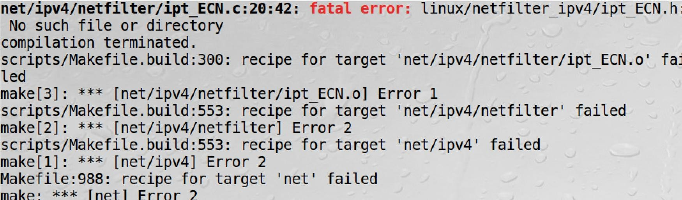
Problem discussion for compiling kernel
Fatal error (No such file or directory)
Ensure your source package is extracted within Linux, not in Windows or Mac.
Filename is Linux is case sensitive, but it is case non-sensitive in Windows or Mac. It may rename some files when extracting them, so that these files cannot be found when compiling.

Slide 51
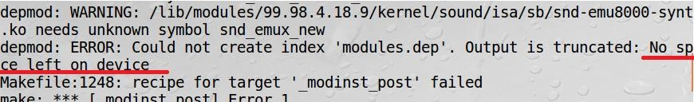
Problem discussion for compiling kernel
Space is not enough
Copy the source file from original space(e.g., /usr/src) to extended space(e.g.,
/home/seed/work)
Remove the source file from original space(e.g., /usr/src)
In source file (stored in extended space), continue to installation.
(Do not start from ‘make clean’, which will remove all the previous built, start from previous interrupted step)

Slide 52
Problem discussion for compiling kernel
Do not compile kernel source code under shared folder.
Copy the source code to extended space.
Then start to compile.
If you compiling it under shared folder, some files might be created failed, and it would lead to error when executing install step.

Slide 53
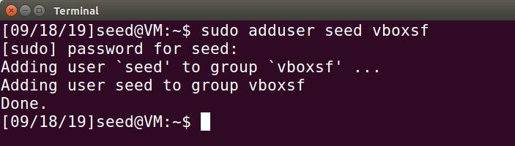
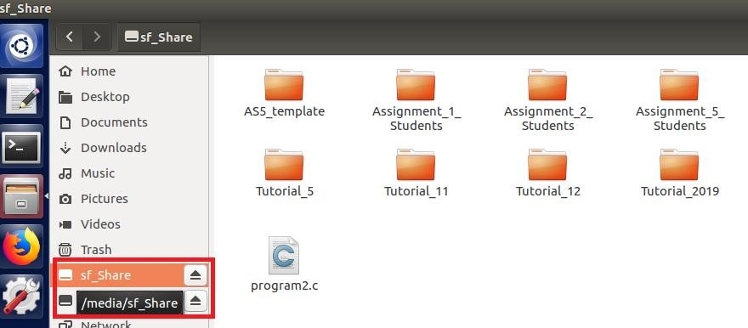
Problem discussion for compiling kernel
Share folder mounting does not work
After creating a Share folder in Shared folder setting, open terminal and type command ‘sudo adduser seed vboxsf’
Reboot the machine
You will see /media/sf_Share will auto mount to your share folder
You could access this share folder via ‘cd /media/sf_Share’.

Slide 54
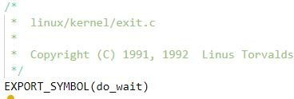

Export Symbol
EXPORT_SYMBOL() provides API to be used in other module.
Before using this symbol in another kernel module, should use ‘extern’ to clarify it.

Slide 55
Export Symbol
If you modify the kernel source code, you should rebuilt the kernel module and install the updated kernel. Then it takes effect.
To save your time, when you rebuilt the kernel, start from ‘make bzImage’. It will only
rebuild the updated modules.
(Do not start from ‘make clean’, which will clean all previous built, and it takes hours to rebuild the kernel modules)
Once the symbol is exported and re-built the kernel module, you will find it’s defined in “Module.symdvers” (auto generated under source code after run “make bzImage”)

Slide 56
Recompile your kernel
If you’ve already compiled and installed the new kernel, then modify the source code and need to make the changes effect. Please start compile from command ‘make bzImage’. (Follow compile steps from Tutorial 2)
To save your time, do not start from ‘make clean’ again, which will remove all your previous built.
Starting from ‘make bzImage’, it will only build the changes.

Slide 57


References
Understanding the Linux KERNEL (3rd edition)
do_fork() (Page 117 – 130)
sigaction (Page 420 – 455)
Linux Kernel Development (3rd edition)
Process descriptor and task structure (Page 24 – 27)
Current task_struct (Page 29 – 30)

Slide 58
Thank you

