Slide 1
CSC335 Final Project:
The Powerful Podcast Player
Sara Grimes, Todd Noecker, Sean O’Meara, Garrett Scott
Notes:
For our final project, our team create a Podcast Player application which we call the Powerful Podcast Player.

Slide 2
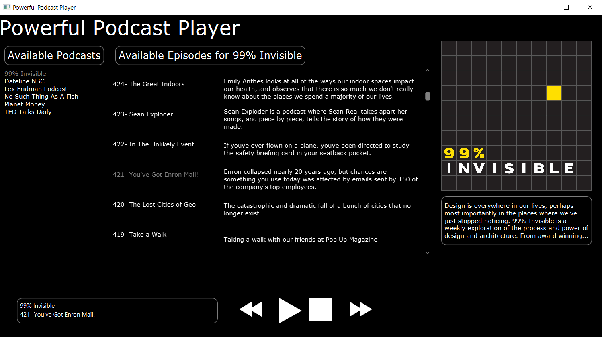
Powerful Podcast Player
Notes:
Here is a screenshot of our Podcast Player app. On the left we have a list of available podcasts, and we can see that the “99% Invisible” podcast is currently selected. In the center we have the list of all available episodes of “99% Invisible” along with their descriptions, and we can see that episode “421 - You’ve Got Eron Mail!” is selected. This information is also displayed in the bottom left corner next to the play, pause, fast forward, and rewind buttons. Lastly, on the right we can see the artwork for the current podcast, along with the description of the current podcast. The artwork, description, and list of episodes will update appropriately when a new podcast is selected.

Slide 3
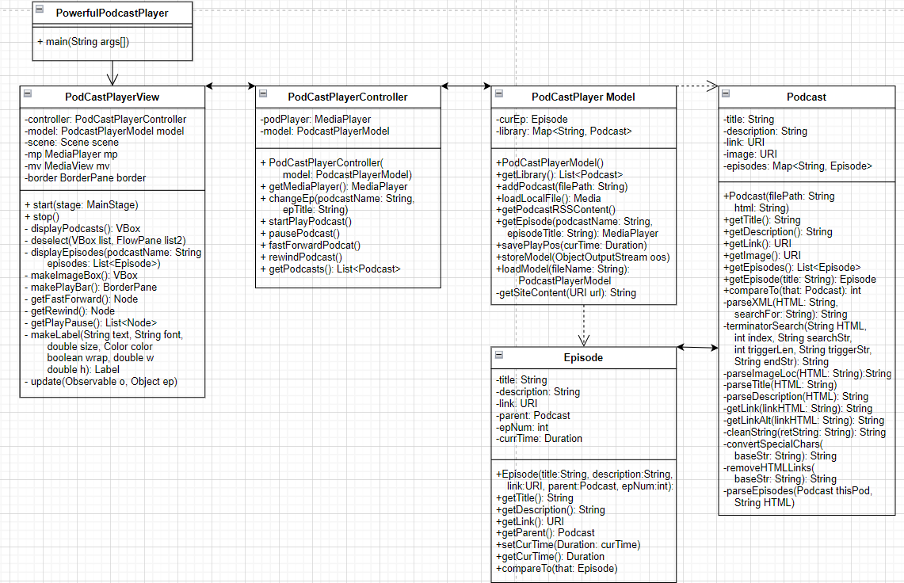
UML
Notes:
This is the final UML diagram for our product. As you can see, we adhered to the MVC architecture with a main, view, controller, and model class. Also, due to the sheer quantity of metadata we needed to organize within the model and pass to different parts of our program, the model contains two inner classes: Podcast and Episode. As you might image, Podcast objects store all the metadata associated with a particular podcast, including a list of Episode objects. Similarly, each Episode object stores all of the metadata associated with a particular episode of a podcast. Note that neither Podcast nor Episode contain any setter methods, or any other methods which actually change the state of model – they act only as wrappers to concisely pass lots of metadata at once.

Slide 4
Wow Factors
Podcast Artwork
Maintains library of Podcasts
Player refreshes podcasts on startup
Saving & Loading
Notes:
Our team implemented several wow factors. First, as we saw in the screenshot previously, our Podcast Player pulls and displays the artwork associated with whichever podcast is playing. Next, we also saw that our Player maintains a library of podcasts for the user, and furthermore this list is automatically updated every time the Player is launched. Finally, the model is serialized and written to a local file upon closing the Player, and this file is loaded upon starting the Player again.

Slide 5
Special Thanks
Special thanks to Sara Grimes for making the View look amazing.
Special thanks to Todd Noecker for doing all of the god-awful file parsing and fixing the test suite.
Special thanks to Sean O’Meara for drafting the Model and resolving all of the merge conflicts in GitHub.
Special thanks to Garrett Scott for figuring out how to actually play the podcasts using the Media object, and figuring out how to serialize the Model.
Special thanks to Denson for being a great stakeholder and supporting us throughout development.
Special thanks to Todd’s girlfriend for her Powerful Podcast Player artwork.
Notes:
Lastly, a special thanks to everyone who worked on this project for being such a hardworking and talented team!

