Slide 1

CST8917 Assignment 2 Approval Workflow Comparison
Todd O’Neil

Slide 2
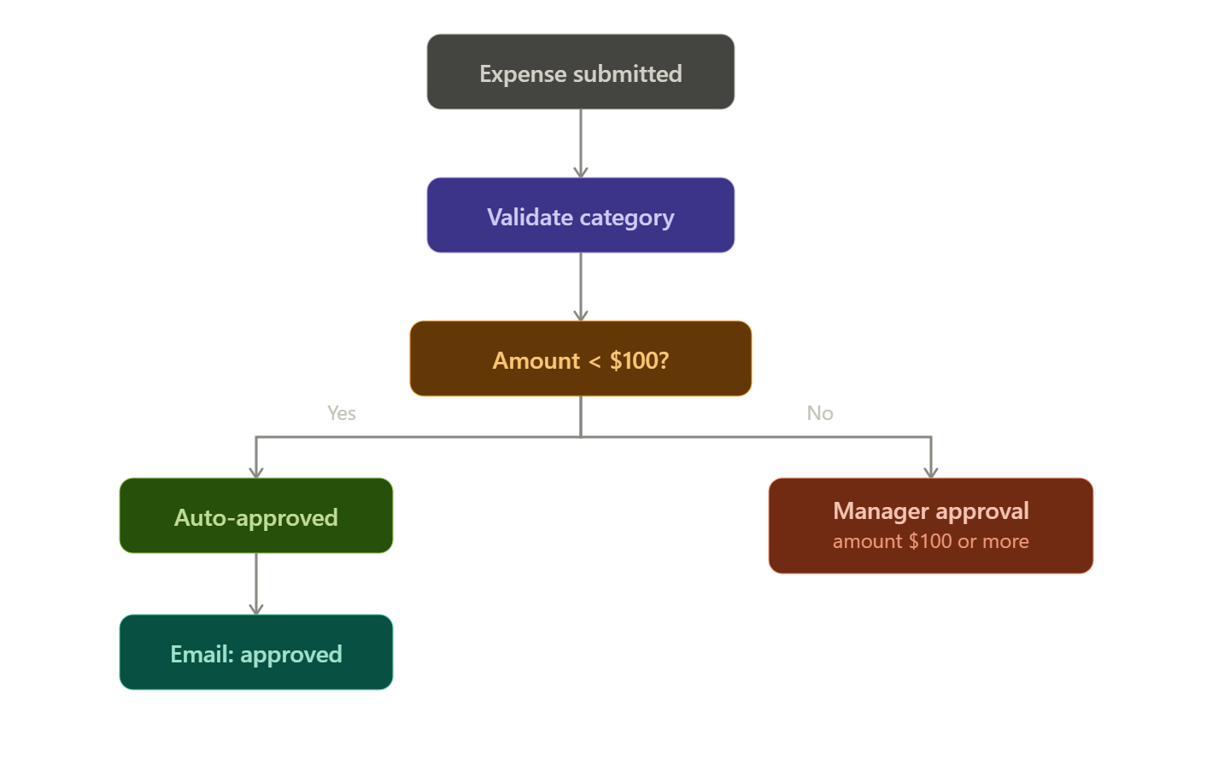
Workflow: submission
Business Rules:
- If expense is less than 100
Auto-approve.
Category field must be valid
Required fields must be present
If expense is Greater than 100 a manager must approve/deny
If manager doesn’t respond in 1 minute flag expense as “Escalated”
Send notification to user

Slide 3
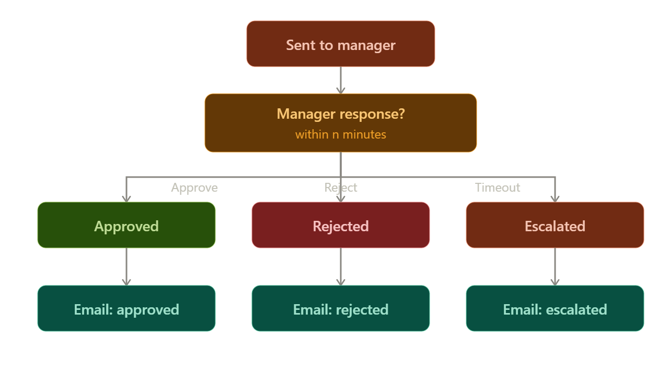
Workflow: decision

Slide 4
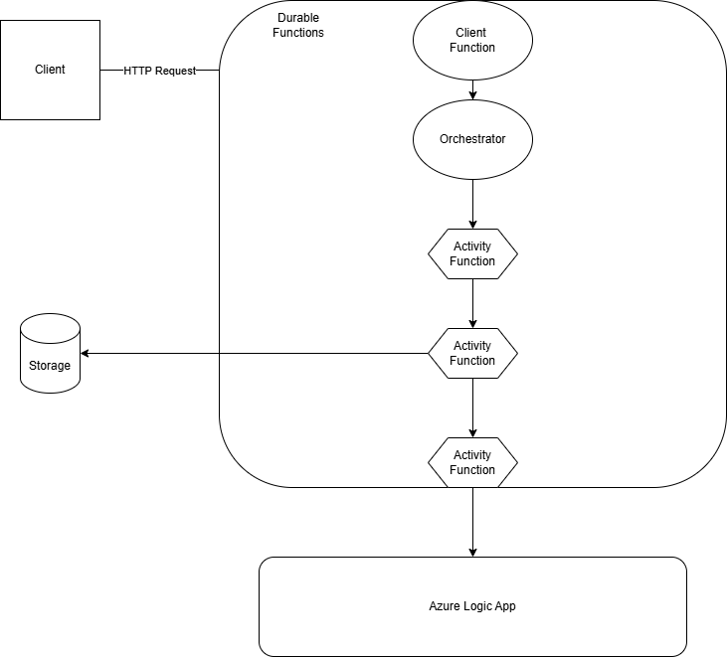
Architecture – Version A: Functions

Slide 5
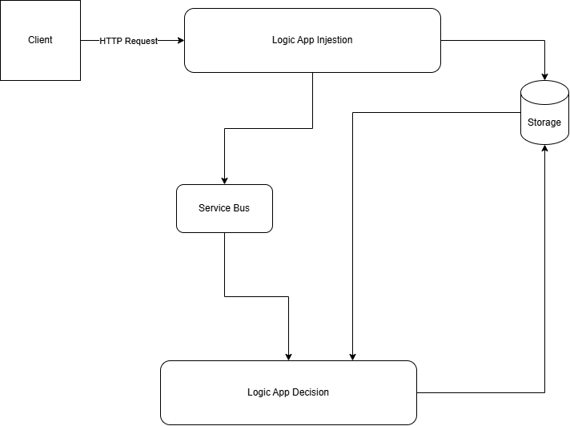
Architecture – Version B: Logic App

Slide 6
Comparison
 | Durable Functions | Logic Apps
Complex Logic | Easier to implement | Gets out of control fast
Testability | Local testing available | Can simulate workflow
Cost (100/10000 day) | $0/$0 per year | $0/$1.95 per year
Error Handling | Finer Control | Limited Control
Human Interaction | Manual configuration | Built-in connectors
Observability | Has Local Development | Visual Tracability

Slide 7
Recommendation – Durable Functions
For something like this in the real-world I would recommend using Durable Functions. Being able
to implement complex decision-based logic is far easier in a coding environment that a no/low-code
solution. The other benefit is being able to test and run locally during development. Logic Apps doesn’t
allow for that, so as you are developing and testing your workflow, you’re incurring charges.

Slide 8
Lessons Learned
Give yourself time for message bus queues. I ran into a dead-lettering issue during escalation workflow in Version B because my messages were too short-lived to be caught in the Manager timeout window
Logic App parallel branching is your friend. Parallel branch is useful when trying to have different paths based on the run/completion status of the action before it.

