Slide 1
Presentation of My Terminal Application

Slide 2
HELLO!
I am Xinzhe Yu

Slide 3
Github repo: https://github.com/Todd0554/CA_T1A3_Terminal_Application

Slide 4
CodeMusic is a music instrument shop.
Customers can choose to buy guitars, amplifiers or pedals
The price of products can be added together
Calculate money
Give discount if customer is CA student
Cash or card
Calculate and do cashback

Slide 5
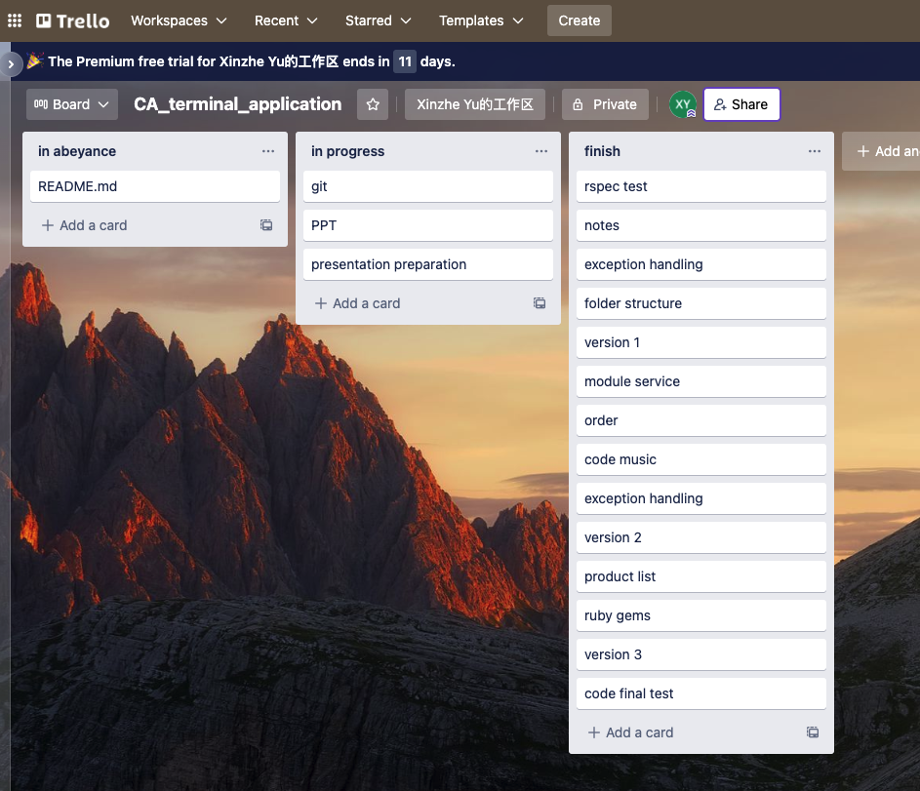
Project Management
Trello
Git
Code
PPT
README.md

Slide 6
Main .rb files
code_music.rb
module_service.rb
order.rb
product_list.rb
ruby_code_music_spec.rb

Slide 7
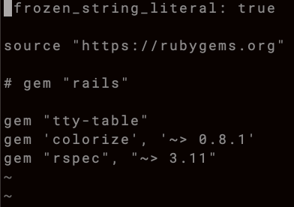
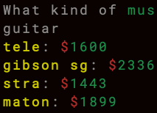
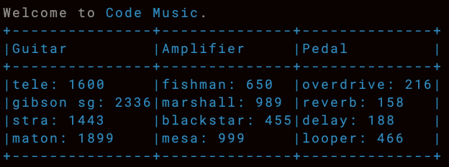
Ruby Gem used
tty-table
colorize
rspec

Slide 8
What’s difficult?
To establish the logic flow of the shopping process
Exception handling
Rspec test

Slide 9
Let’s go shopping in CodeMusic!

Slide 10
The end

