Slide 1

Nvidia GeForce RTX 3070

Slide 2
Agenda
Introduction
Features
Specific characteristics
Price range
Comparison
Conclusion

Slide 3
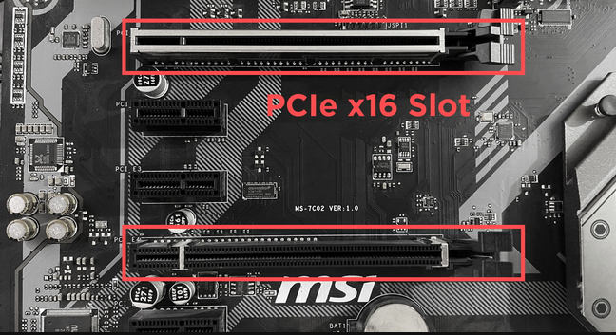
Motherboard with PCIe slots

Slide 4
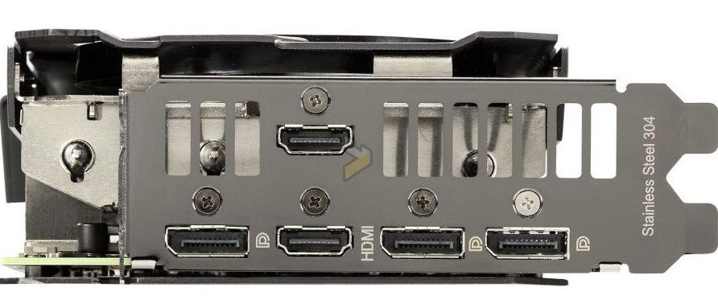
Display outputs on an RTX 3070
HDMI port
DisplayPort
HDMI port
DisplayPort
DisplayPort

Slide 5
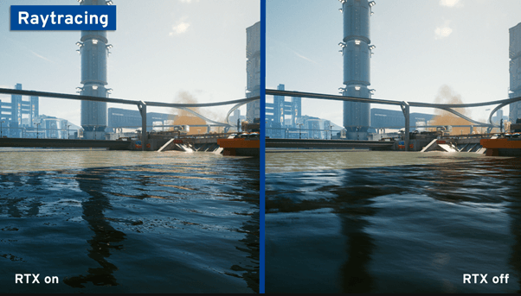
Example of ray-tracing

Slide 6
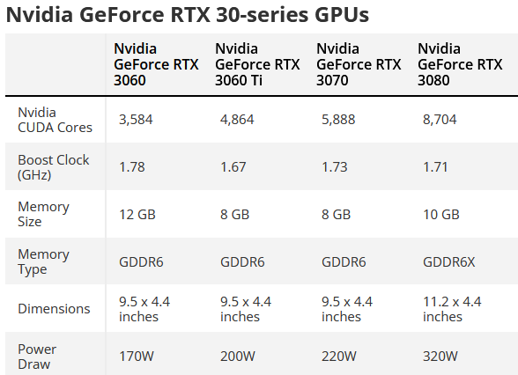

Slide 7





Slide 8
Thank you
Todd Carter – V01187982
cart7982@vandals.uidaho.edu

Slide 9
Bibliography
Image of PCIe slots: “All Types Of PCIe Slots Explained & Compared” by Christopher Harper, https://www.cgdirector.com/types-of-pcie-slots/
Image of HDMI/DisplayPorts:”ASUS reveals its new GeForce RTX 3070 TUF GAMING series” by Anthony Garrefa, https://www.tweaktown.com/news/75535/asus-reveals-its-new-geforce-rtx-3070-tuf-gaming-series/index.html502-555-0152
Image of raytracing example:”What is ray tracing? The graphics technique explained!” by IONOS, https://www.ionos.ca/digitalguide/server/know-how/ray-tracing/
RTX 30-series chart: “Nvidia GeForce RTX 3090 vs 3080 vs 3070 vs 3060” by Marshall Honorof, https://www.tomsguide.com/news/nvidia-geforce-rtx-comparison
Logos:
https://www.newegg.com/
https://www.amazon.com/
https://www.bestbuy.com/
https://www.gamestop.com/

