Slide 1

Nvidia GeForce RTX 3070

Slide 2
Agenda
Introduction
Features
Specific characteristics
Price range
Comparison
Conclusion

Slide 3
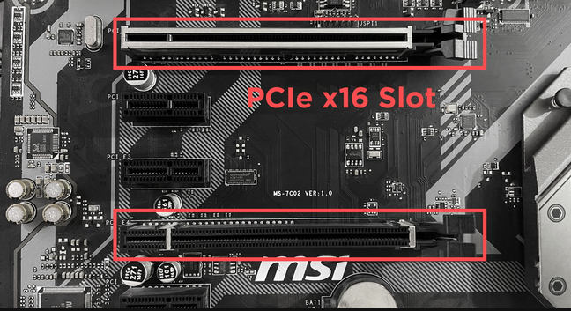
Motherboard with PCIe slots

Slide 4
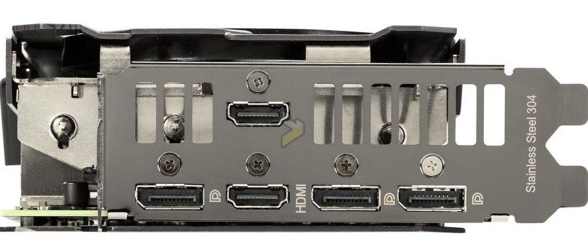
HDMI port
DisplayPort
HDMI port
DisplayPort
DisplayPort

Slide 5
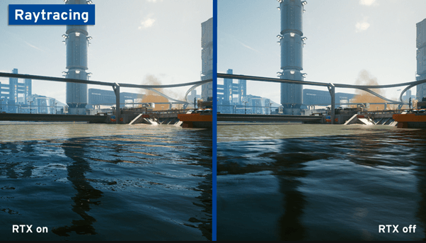

Slide 6


Slide 7
Bibliography
Image of PCIe slots: https://www.cgdirector.com/types-of-pcie-slots/
Image of HDMI/DisplayPorts: https://www.tweaktown.com/news/75535/asus-reveals-its-new-geforce-rtx-3070-tuf-gaming-series/index.html502-555-0152
Image of raytracing example: https://www.ionos.ca/digitalguide/server/know-how/ray-tracing/www.firstupconsultants.com
Logo: https://www.newegg.com/

