Slide 1
Occurrence of Diseases in Pennsylvania 2022
Todd Frazer

Slide 2
Objective
Since the pandemic in 2020 humans are taking more proactive steps in their health and wellness for optimization and prevention of future disease.
Today we will be analyzing raw data from University of Pittsburgh: "Project Tycho"(2022), which collects and provides billions of health data points across the country.
Our objective is to take a look at some lesser known diseases that may be impacting residents in Pennsylvania, and how we may be able to recommend action based off this analysis to improve proactive health steps in PA.

Slide 3
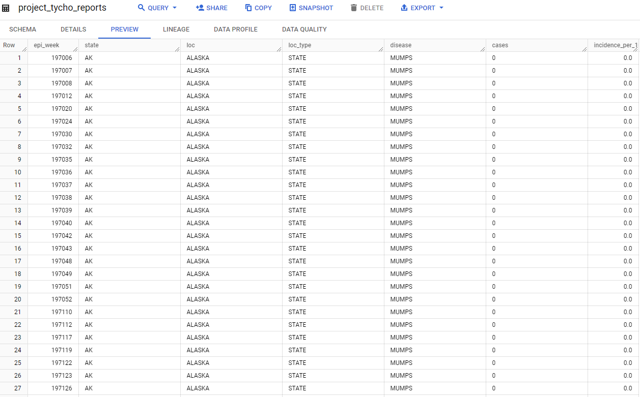
Raw Data from SQL
This data consisted of 7 columns of information from across the entire United States.
Disease, incidence per 100,000 people, and case amounts in 2022 are important key information.
Next we will filter the data to search for exactly what we are looking for: state of Pennsylvania.

Slide 4
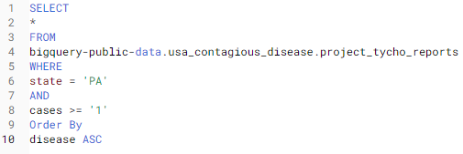
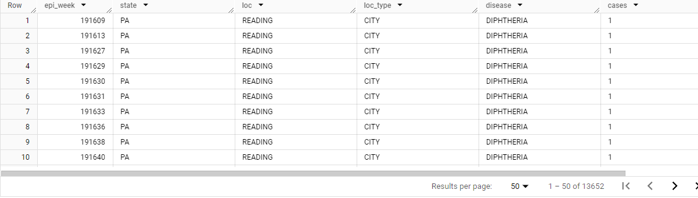
SQL for Clean Data
Using an SQL filter, we are able to filter the 760,000 data points down to 13,652 data points of meaningful information to our objective.
State = PA
Cases >= '1'
Order By ASC

Slide 5
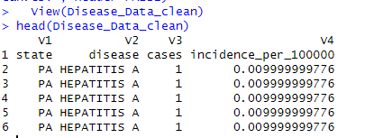
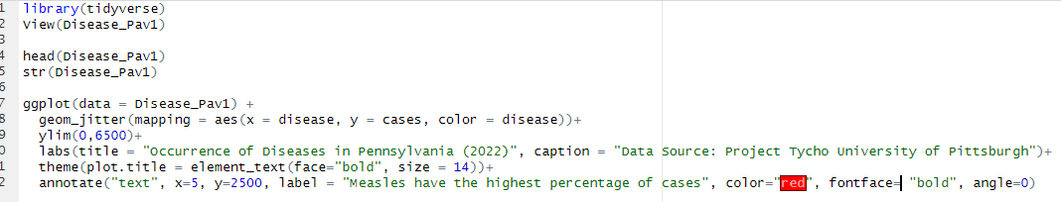
Analysis of Clean Data using R
We are able to view the data in R using the view/head functions to view our data table(to the right). From there we can compare disease type vs amount of cases for PA with the graph code below:

Slide 6
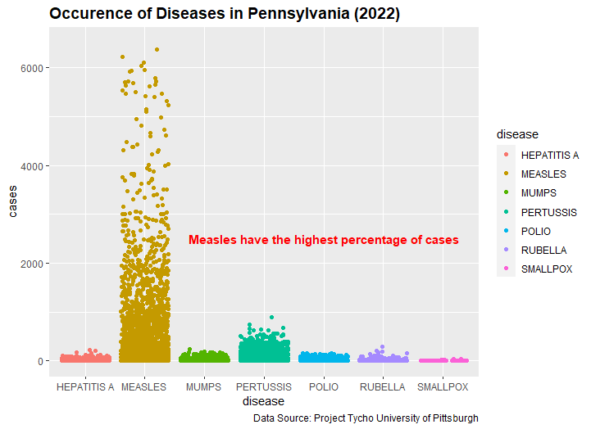
R Graph
We are able to see by the graph (to the right), that of the criteria researched in the data, Measles have the highest percentage in 2022.
Pertussis, a highly contagious respiratory tract infection also causes 'Whooping Cough', has a surprising 2nd place in total cases.

Slide 7
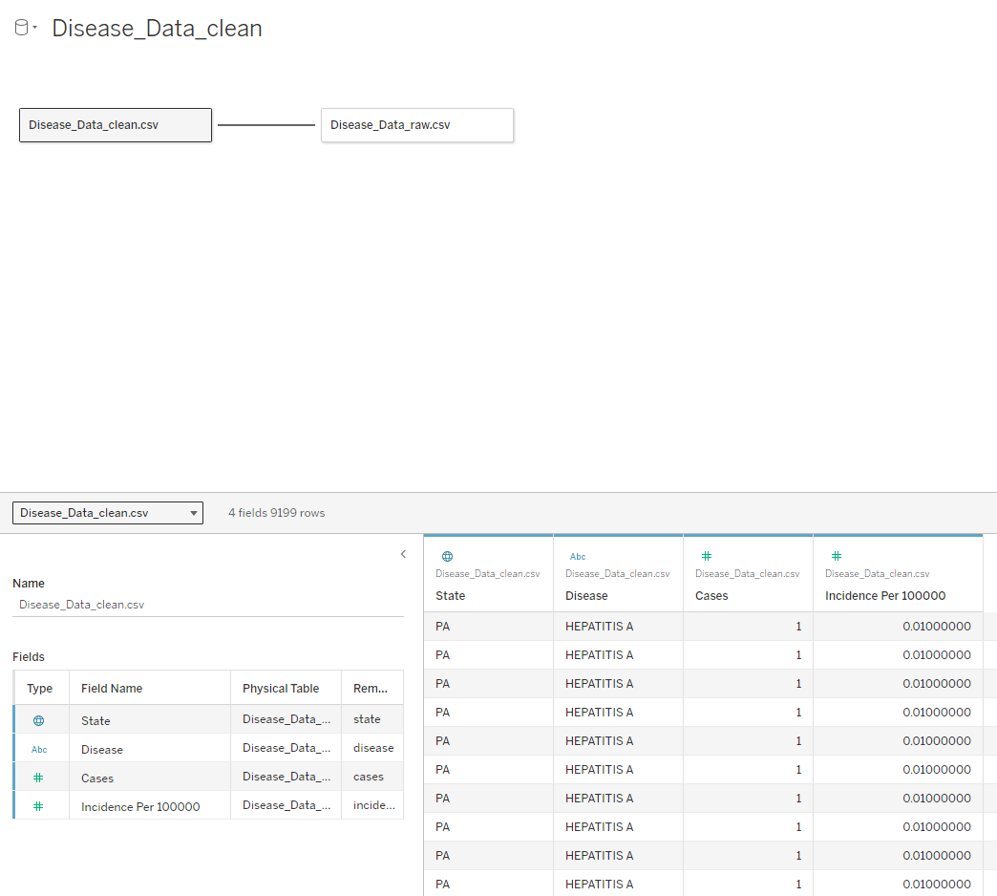
Creating an interactive Dashboard in Tableau
Data is imported into Tableau visualization software.
We then connect the data sets.
Let's compare Cases in PA to incidents per 100,000 people. Let's also take a look at 2 PA cities: Pittsburgh vs Wilkes-Barre.

Slide 8
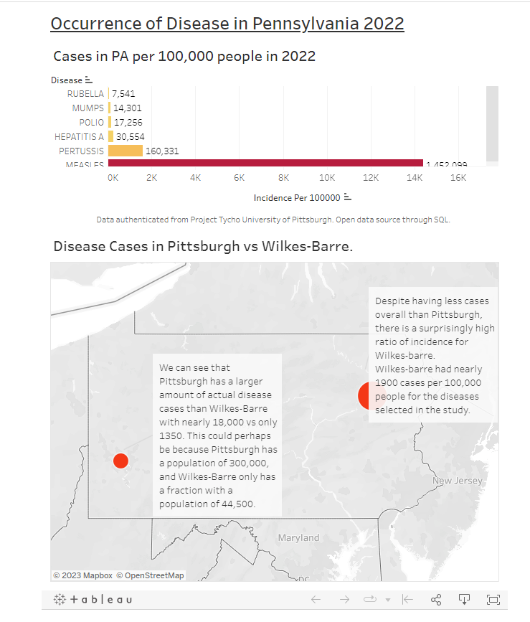
Tableau Visuals
We have found that Pertussis makes up 160,331 of all disease cases in the state of Pennsylvania in 2022. This is surprising data.
We also compare Pittsburgh vs Wilkes-Barre. It is no secret Pittsburgh has nearly 14x the total disease case rate compared to a smaller city with 1/8th the population.
Interestingly, Wilkes-Barre has a high ratio of incidence per 100,000 of actual diseases. Nearly 1900 cases compared to Pittsburgh's 2400. This is interesting data because despite having such a smaller population, per 100,000, they're getting much more sick in Wilkes-barre in ratio compared to total amount in Pittsburgh.
(to view interactive geodashboard click link below)
https://public.tableau.com/views/OccurrenceofDiseaseinPennsylvania2022/Dashboard1?:language=en-US&:display_count=n&:origin=viz_share_link

Slide 9
Conclusion and Findings
Based on the analysis and visuals shown, we can easily see that Pertussis, 'Whooping Cough', is a real issue with over 160,000 children per year in the State of Pennsylvania.
It is the recommendation of this analysis that per the Center for Disease and Control guidelines that children be vaccinated for Pertussis at a young age.
There are 2 vaccines available in PA: Dtap, and Tdap.
Vaccine Data from cdc.gov
Data used from 'Project Tycho' University of Pittsburgh.

