Slide 1
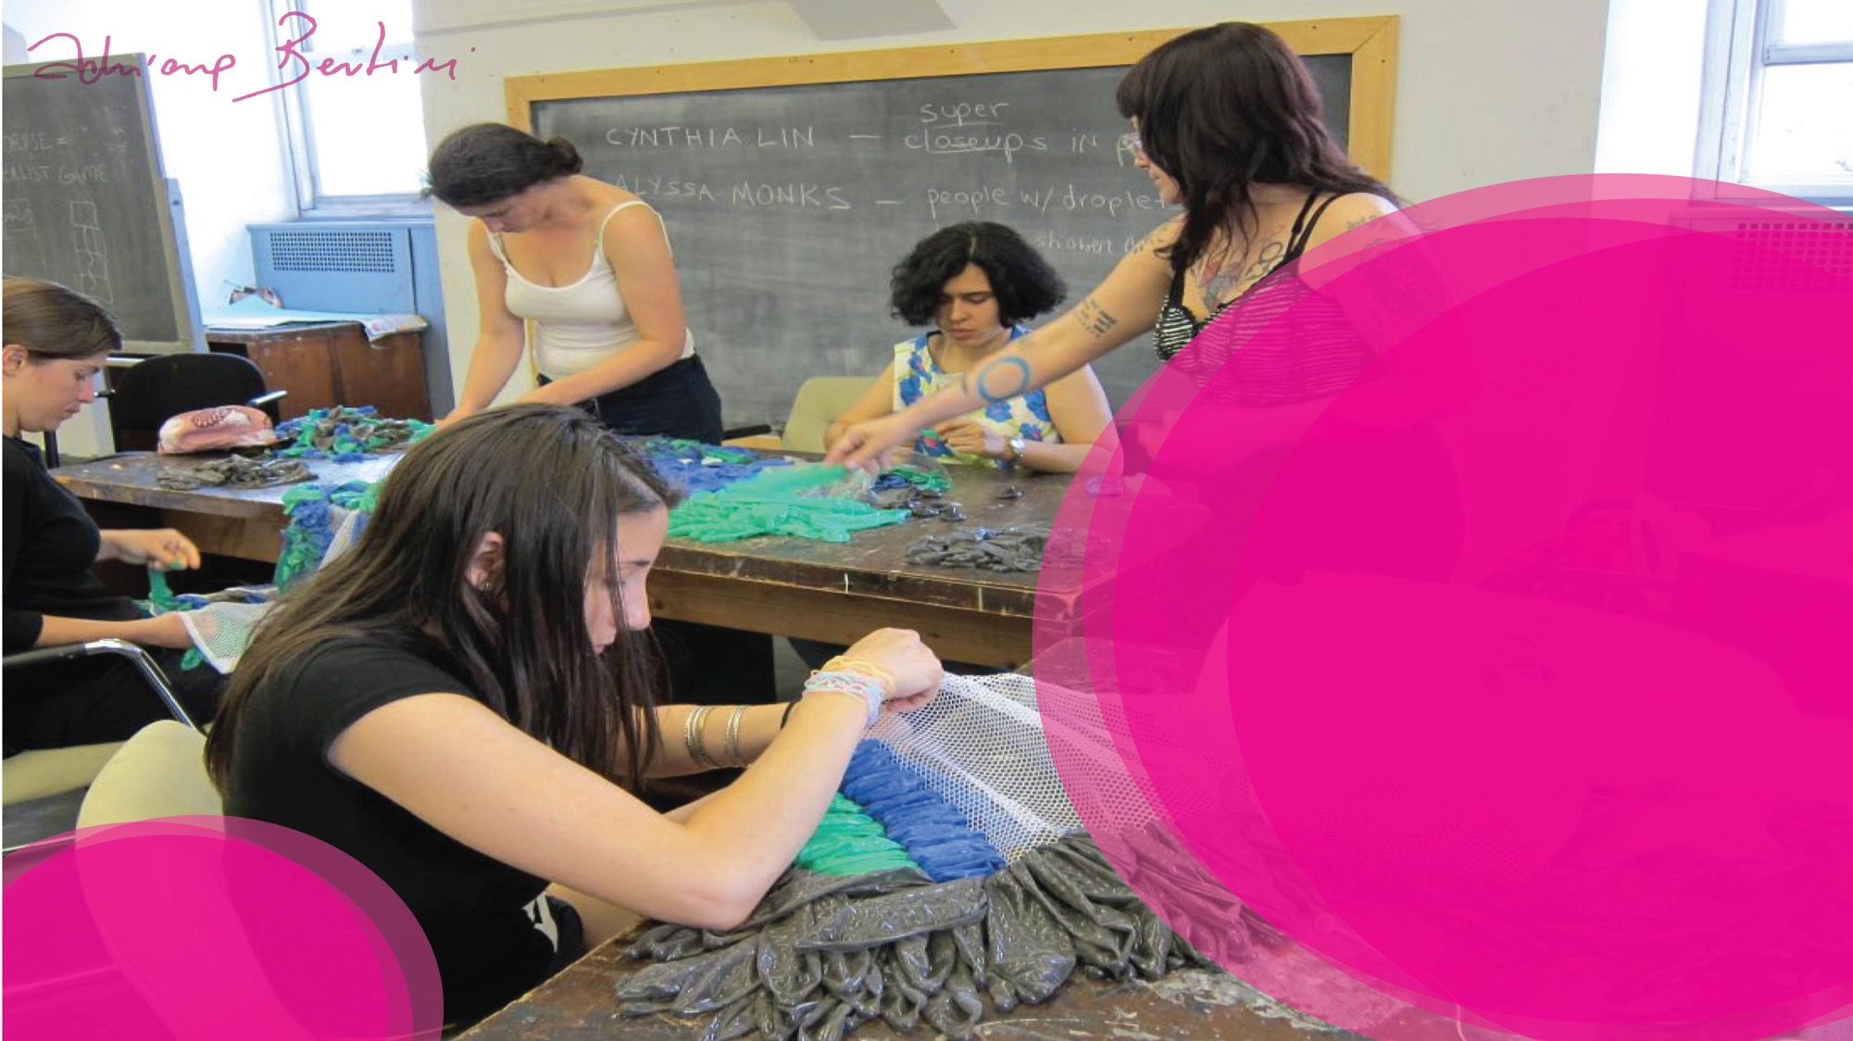
Condom Art
Workshop
Brooklyn College
New York

Slide 2

Who are you?
Name
Age
What you study
Facility & Virtue
Difficulty & Defect
Positive word
Negative word
Favorite Color
Challenge

Slide 3

Why are you here?
What is the feeling that moves you?
What are your expectations at the art workshop?

Slide 4

Let's talk about sex ed?

Slide 5

Some Questions
What color is the hiv?
What was your first reference when you heard the word AIDS? Where, how, when?
Tell me one contemporary word

Slide 6

Contemporary Words
I = I
PEP
PrEP
Vulnerability
Stigma
Criminization
Serophobia
Homophobia
Diversity
Gender
Lgbtqi +
Adherence
ART (antiretroviral therapy)

Slide 7
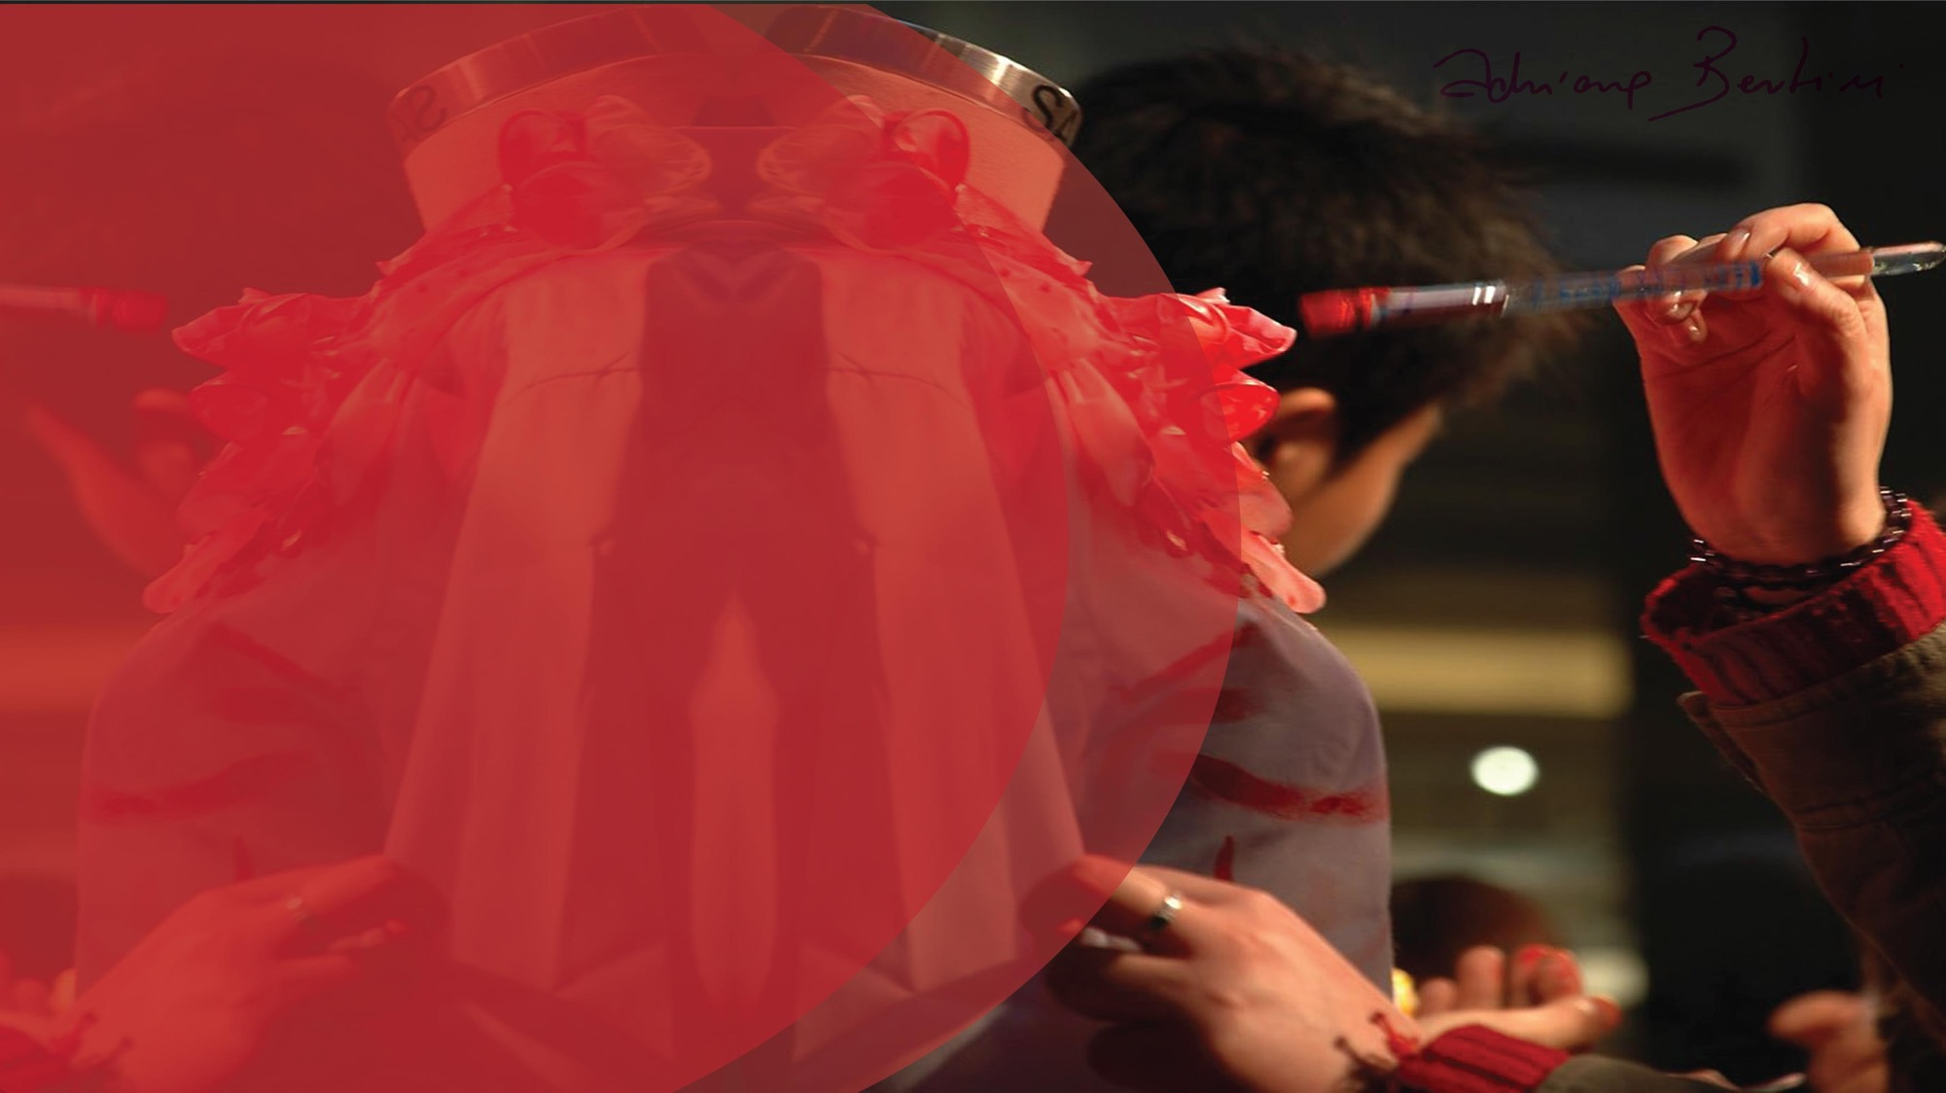
artHvism
Concept
critical thinking in action

Slide 8
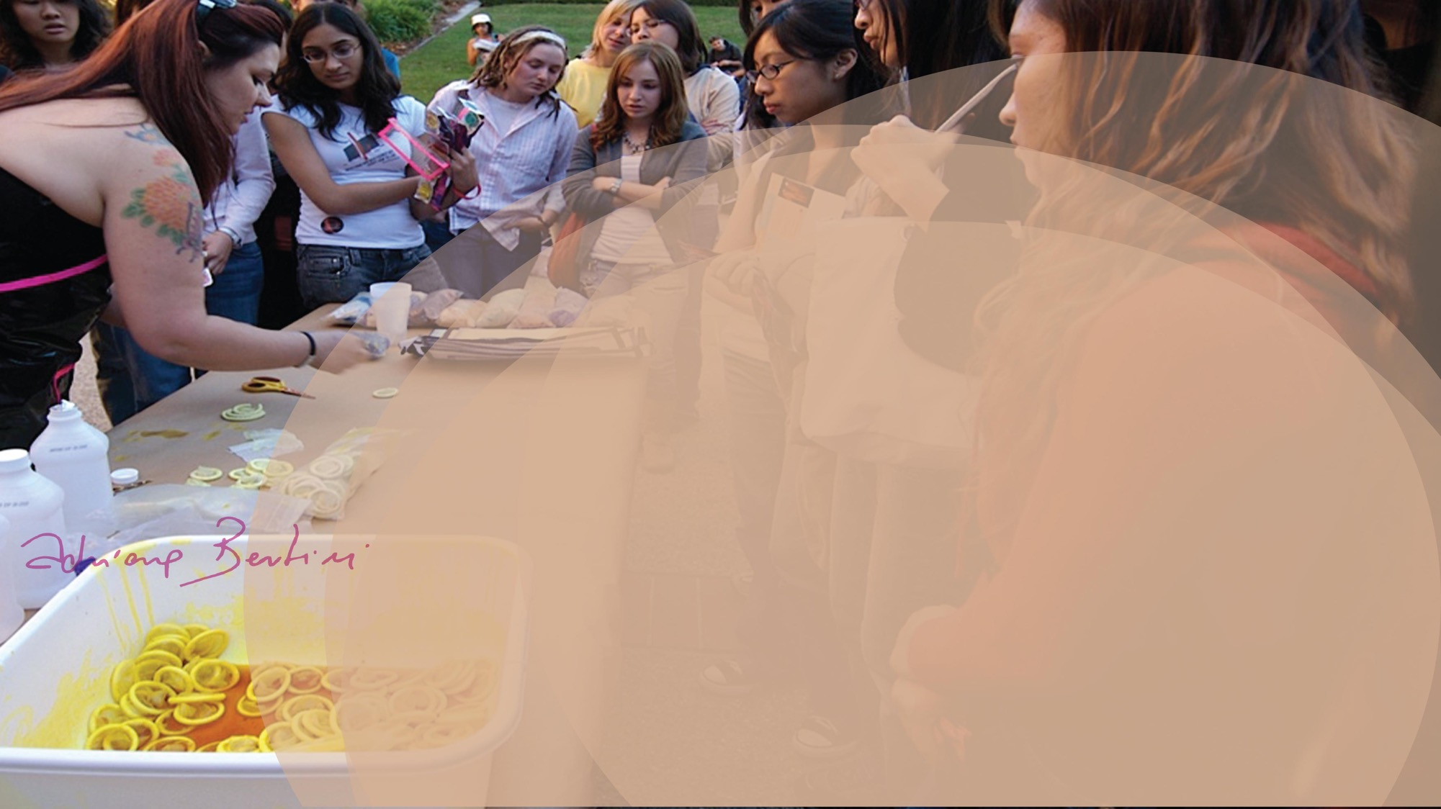
I believe that handling the condoms in the art workshop such as: opening, cutting, stretching, painting, pasting, dyeing is a relaxed moment
where intimacy with condoms is created.
It promotes security and autonomy, breaking taboos and prejudices in contemporary society, facilitating the
reduction of stigma and discrimination.
The workshop is a tool for everyone!

Slide 9
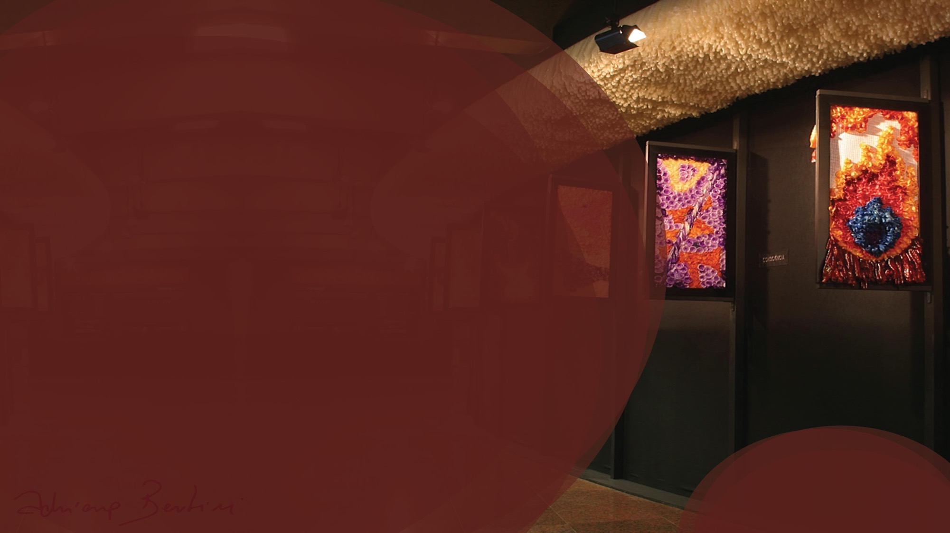
Why fashion?
Concept development
Laboratory of ideas and concepts for
choosing a theme, style, color chart.
Season trends
Theme definition
Color chart
Product mix
Creation process
Development of technical sheets

Slide 10
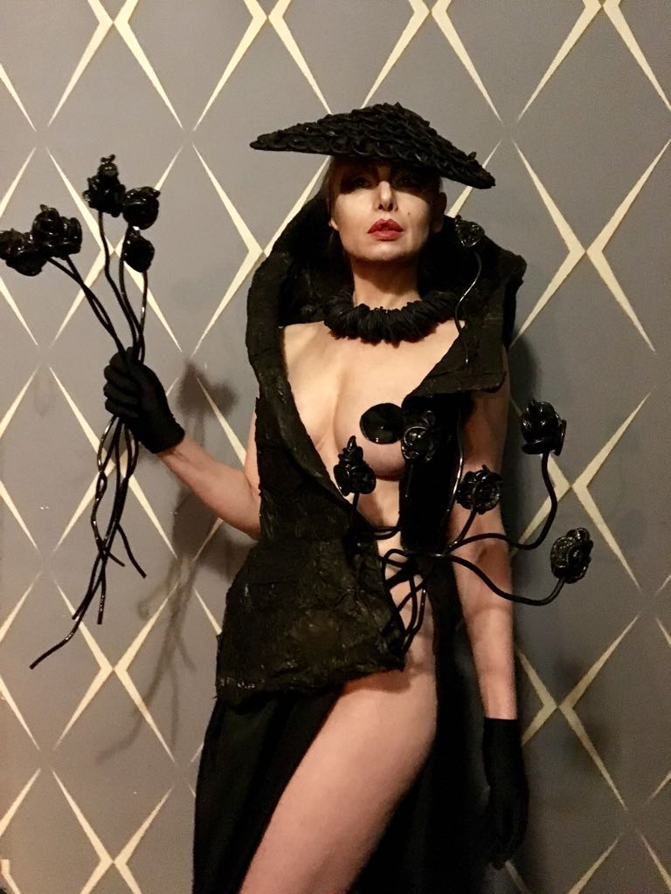
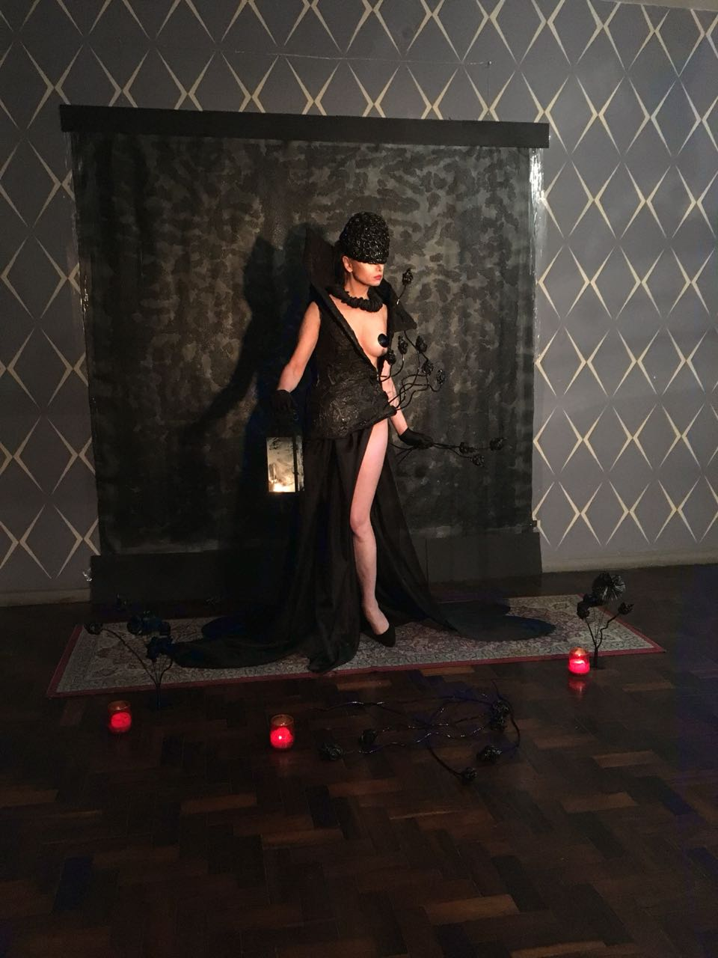

Slide 11
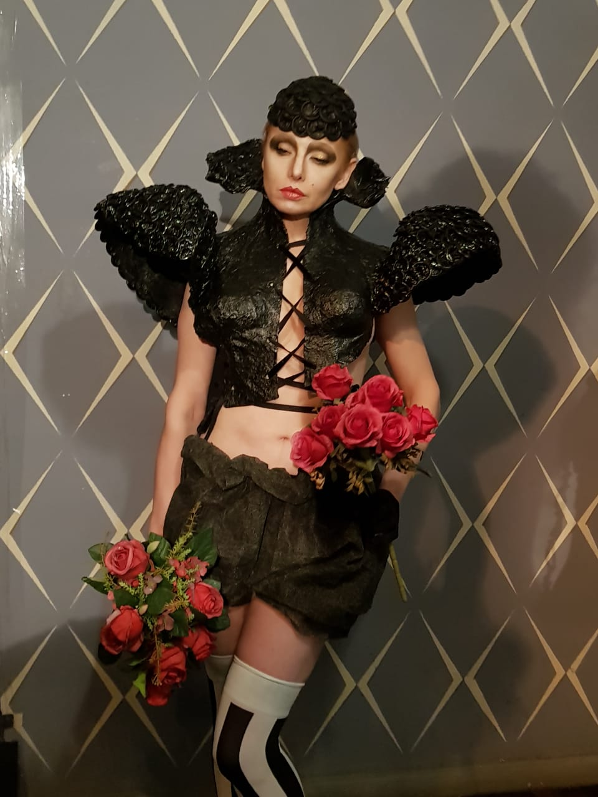
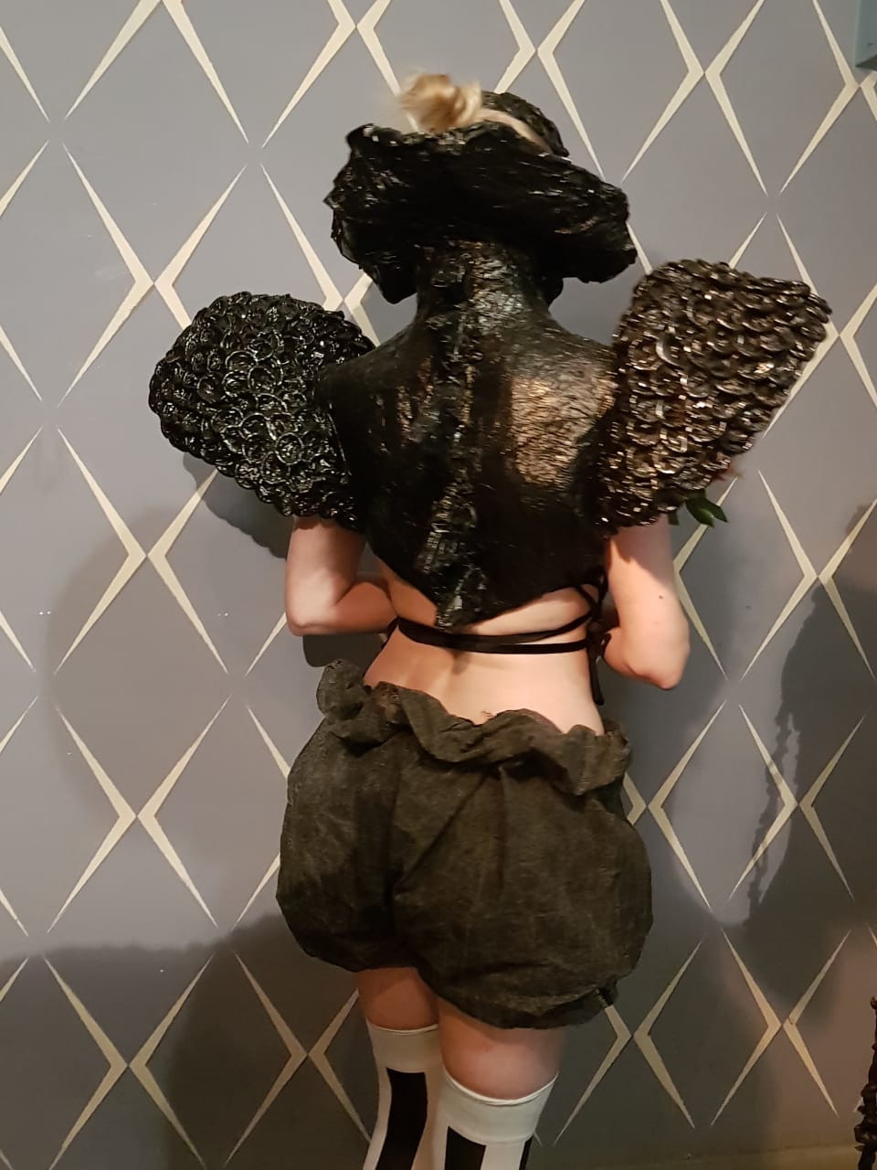

Slide 12
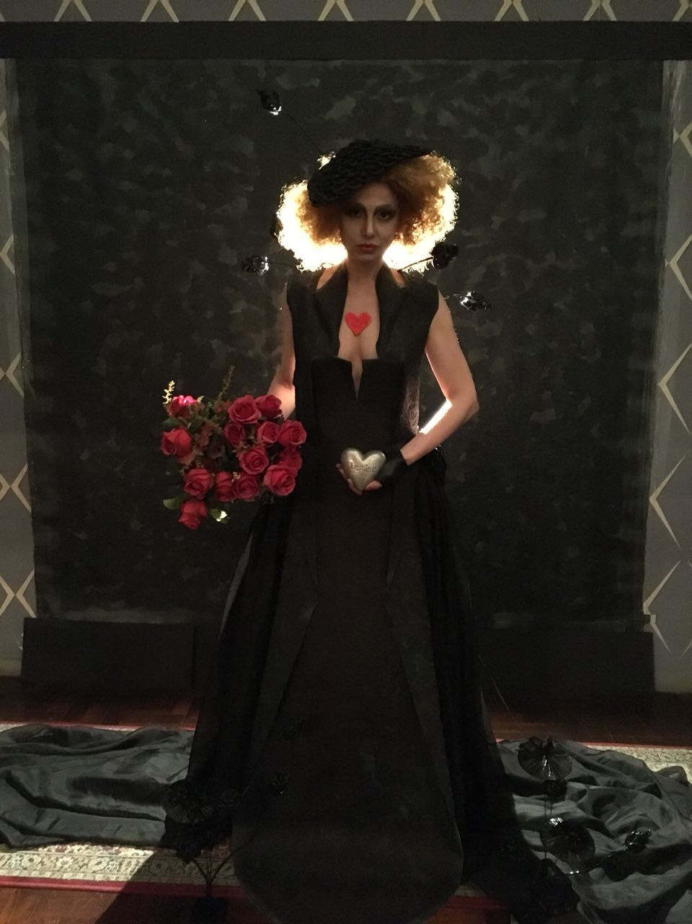
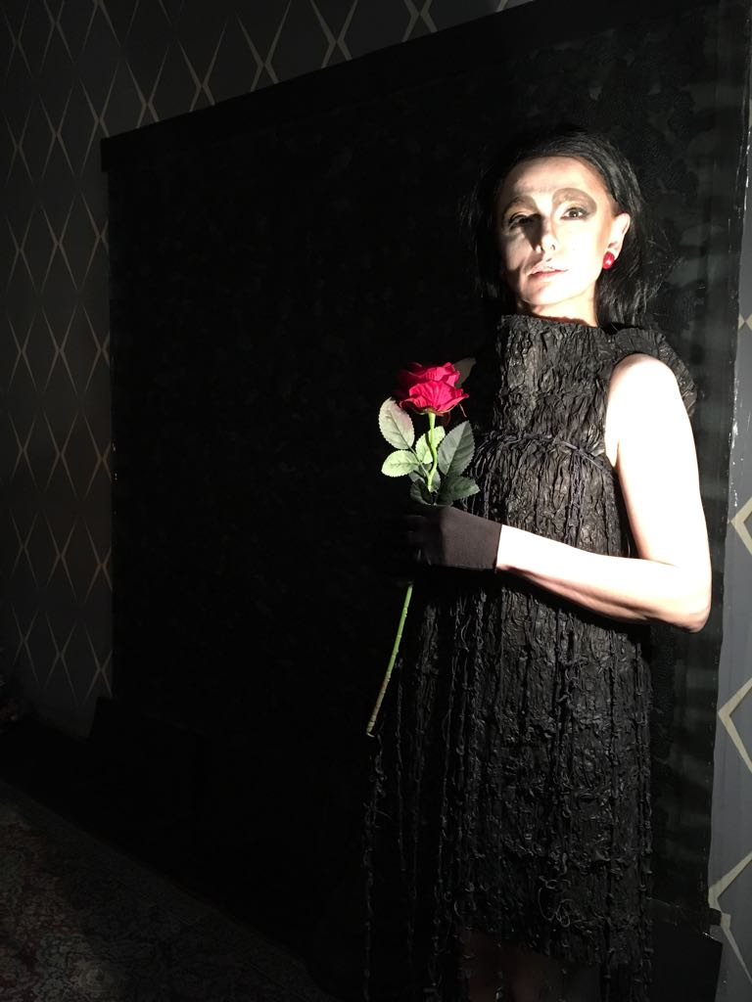

Slide 13

Production Plan:
1st step / discuss the concept
2nd step / prepare condoms
3rd step / work production

Slide 14
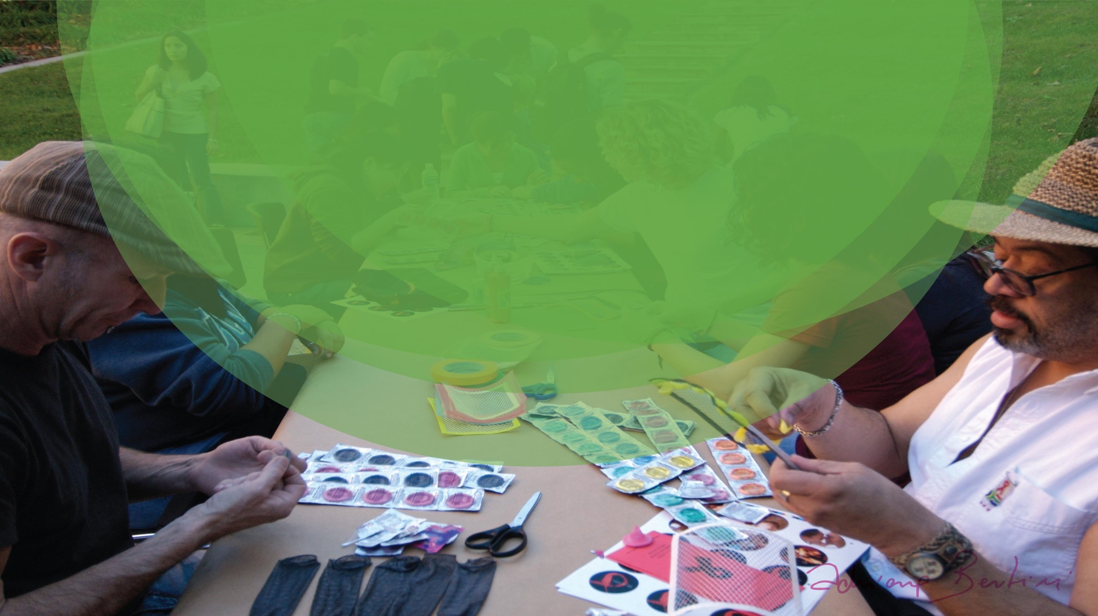
Condoms Practice: 2nd step
Open
Cut
Stretch
Paint
Dye
Sew
Paste
Tie
Embroider
Weave

Slide 15
Why are you here?
What is the feeling that moves you?
What are your expectations at the art workshop?

Slide 16
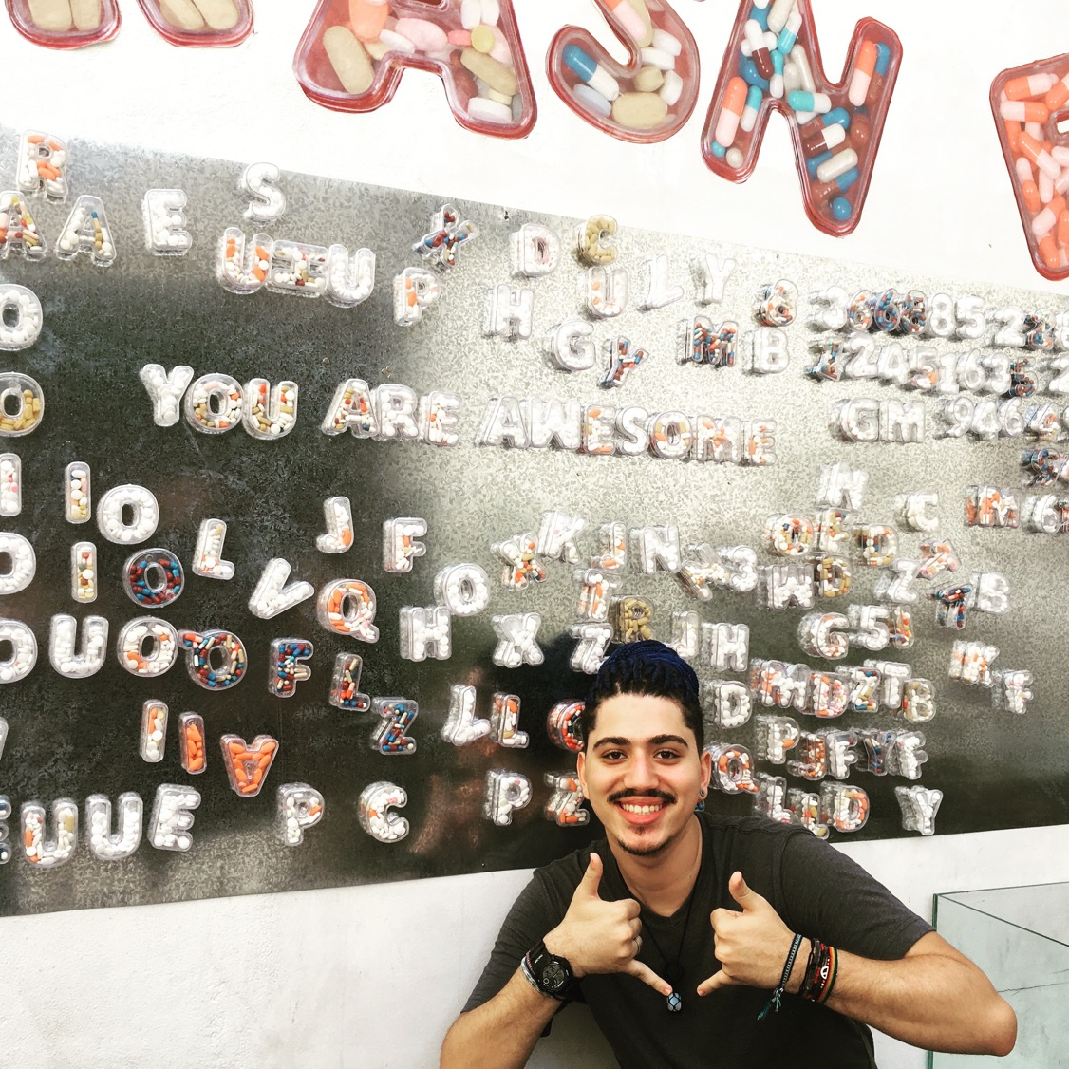
How can we
reframe
Stigma?

