Slide 1


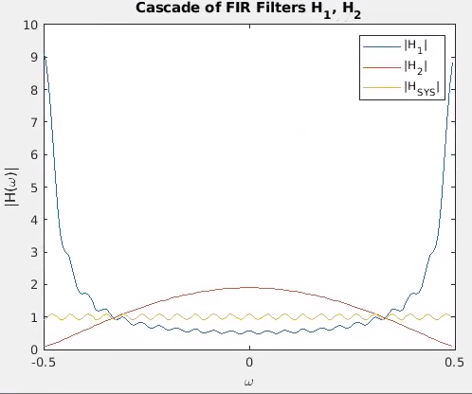
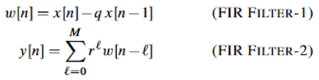
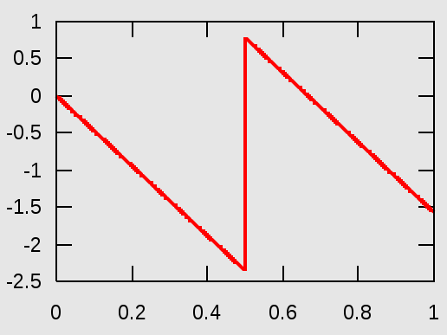


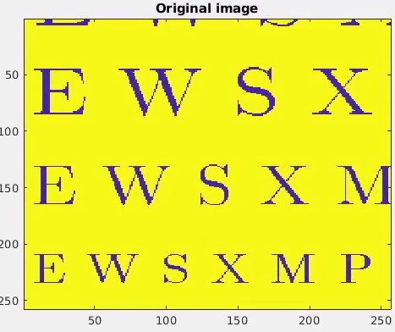
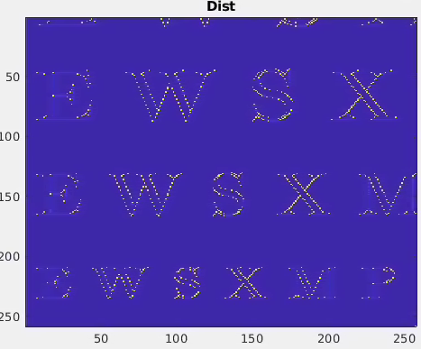
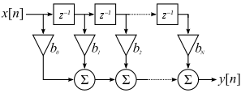
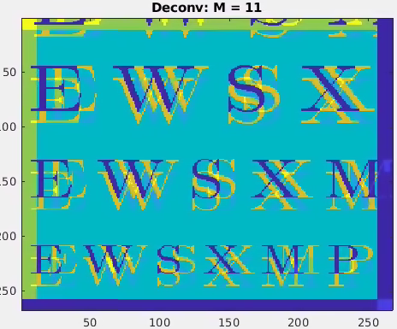
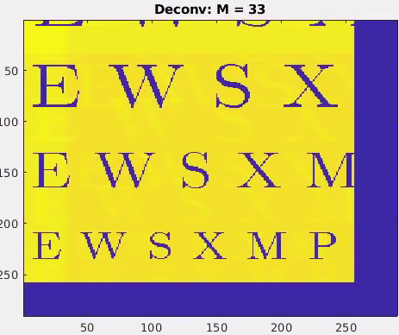
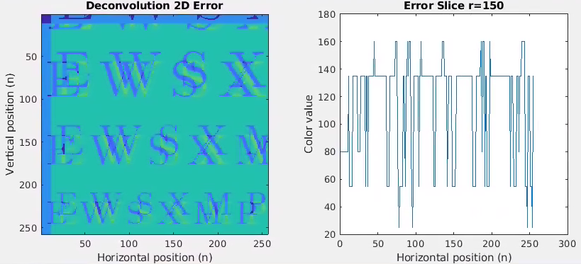
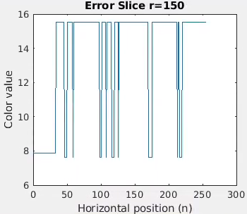
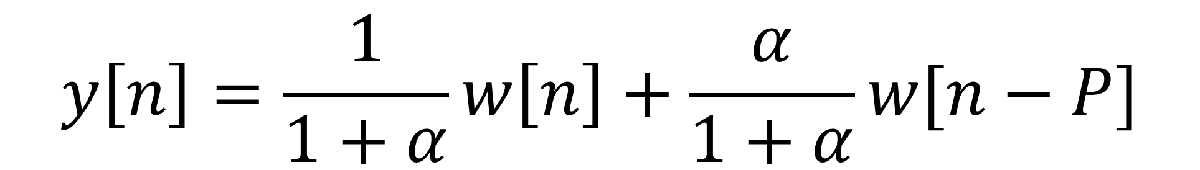
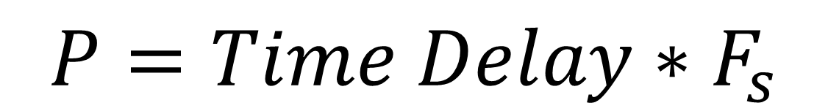
Keaton Davis¹, Luke Hartung¹, Todd Renner¹, Tara Zamani¹
¹ Department of Electrical and Computer Engineering; University of Utah, Salt Lake City, UT
Background
A large component of DSP is audio and image processing. Within this area, computationally efficient FIR filters play a key role in applications such as edge detection, noise reduction, and smoothing.
In this project, we demonstrate edge detection with bar code readers, adding echoes to sound files, and recovering a noisy 2D signal.
Method: Deconvolution (Cascaded Filters)
Method: Edge detection
[Luke/Keaton]
The cascade of Filter-1 (HP) and Filter-2 (LP) results in an approximate restoration (unity gain) of an input signal.
Introduction
Results
Linear Phase
FIR DT-domain Description
FIR Filtering
[ Annotated Audio Delays]
Transversal (“tapped”) filter
Summary
Explain why outcome is interesting. Don’t assume it’s obvious. Three sentences max.
Method: Echo/Reverb
To achieve echoes (“ghosts”) and reverb (cascaded echoes), the output is a weighted sum of the present input with a past input sample.
A time delay is represented as an integer number of samples determined by the sampling frequency.
References
J. Proakis and D. Manolakis, Digital signal processing, 4th ed. Upper Saddle River, NJ: Pearson Education, 2007, pp. 577-766.
^{Acknowledgement:}
This work is supported by the fundamental concepts covered in Dr. Neda Nategh’s ECE6530/5530 DSP course.

