Slide 1
Curve Fitting Motivated Differential Evolution Mutation
Georgi Kostadinov, Petar Tomov, Iliyan Zankinski
Bulgarian Academy of Sciences
Institute of Information and Communication Technologies
acad. Georgi Bonchev Str., block 2, 1113 Sofia, Bulgaria
http://www.iict.bas.bg/

Slide 2
Agenda
Differential Evolution
Curve Fitting
Mutation Proposition
Experiments

Slide 3
Differential Evolution
Metaheuristic for global optimization
In the class of Genetic Algorithms
It is used for multidimensional real-valued functions
It does not use the gradient
  The optimization problem to be differentiable

Slide 4
It is used in problems
Which are real-valued
Which not need to be differentiable
Which may not even continuous
Which can be noisy
Which men even change over time

Slide 5
It is organized as
Population of candidate solutions
Creating new candidate solutions by combining existing ones
Keeping whichever candidate solution has the best score
The optimization problem is treated as a black box
  Provides a measure of quality given a candidate solution

Slide 6
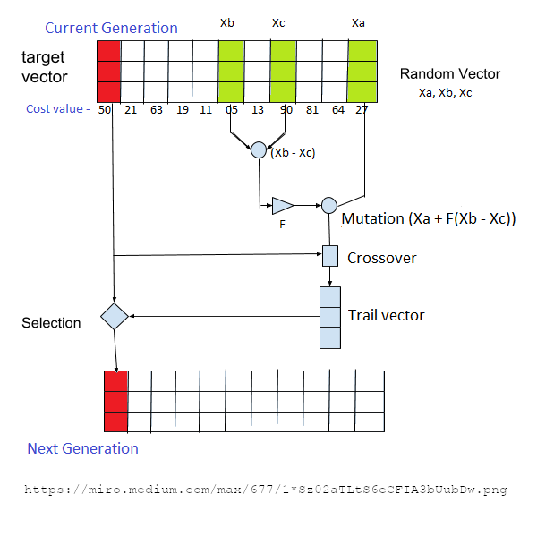
Calculation flow

Slide 7
Mutation operator
It uses a weighted difference vector
  Random individuals form the difference vector
  The resulting difference vector is scaled with weighting coefficient
It helps to exploit surrounding area after the crossover operator

Slide 8
Curve Fitting
Process of constructing a curve
Should has the best fit to a series of data points
Curve fitting can involve one of the two
  Interpolation (exact fit to the data is required)
  Smoothing (function is constructed that approximately fits the data)

Slide 9
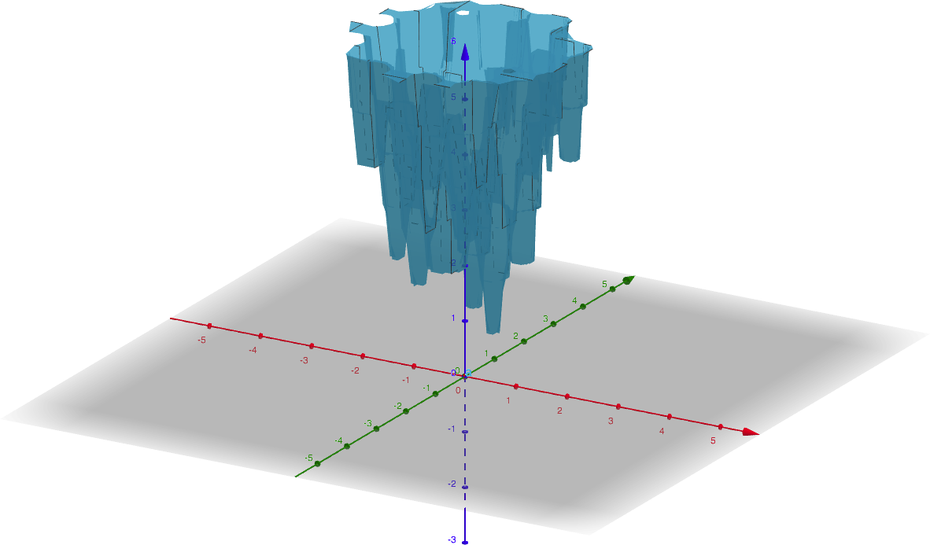
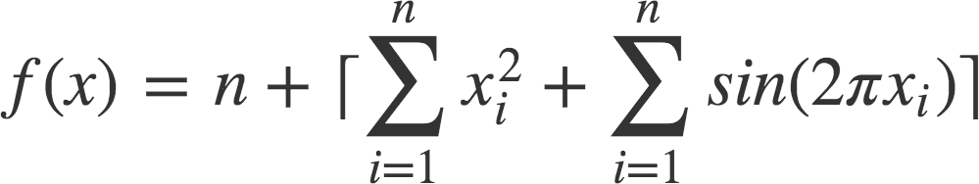
Benchmark Function
Proposed by Todor Balabanov

Slide 10
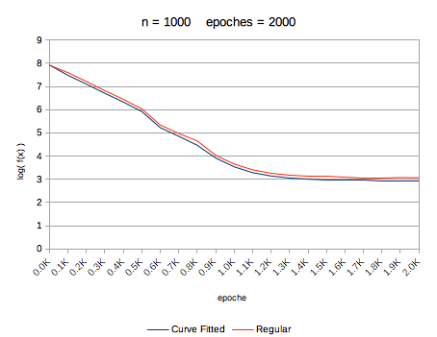
Experimental Results

Slide 11
Questions
Thank you!
Acknowledgments
This work was inspired and
supported by private funding of
Velbazhd Software LLC

