Slide 1
Searching Optimal Solutions for Multidimensional Nonlinear Functions in LibreOffice
Gergana Mateeva, Dimitar Parvanov, Todor Balabanov
Bulgarian Academy of Sciences
Institute of Information and Communication Technologies
acad. Georgi Bonchev Str., block 2, 1113 Sofia, Bulgaria
http://www.iict.bas.bg/

Slide 2
Agenda
Problem identification
Test functions
LibreOffice Calc
Research

Slide 3
NonLinearity
Efficient methods for linear optimization
Difficulties arise with any form of nonlinearity

Slide 4
functions
Rastrigin
Sphere
Rosenbrock
Styblinski-Tang

Slide 5
Dimensions
Test functions can be calculated at a significant value for the dimensions

Slide 6
Libre Calc
Nonlinear Solver
  Currently in Java
  Will be rewritten in C++

Slide 7
The Solver
Hybrid algorithm
  Differential Evolution
  Particle Swarm Optimization

Slide 8
ReSearch
Determine the performance of the currently used nonlinear solver in LibreOffice Calc

Slide 9
Usefulness
It will be useful when the C++ version of the solver is completed

Slide 10
CompUter
Intel Core i5 2.3GHz, 1 CPU 2 cores, 8GB RAM
macOS High Sierra 10.13.6, LibreOffice 7.2.7.2

Slide 11
Experiments
Functions dimensions
  1, 5, 10, 50, 100, 500, and 1000
  Above 1000 it is too slow

Slide 12
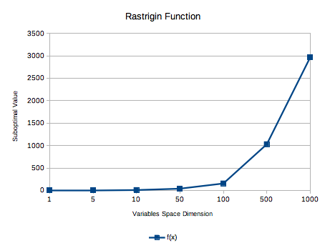
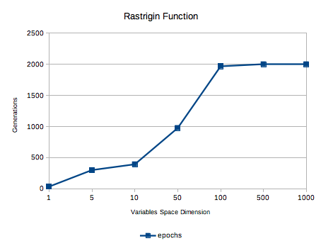
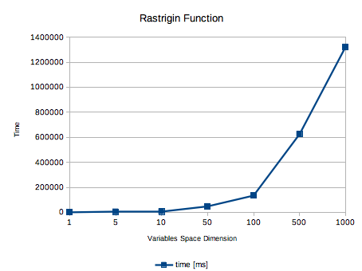
Rastrigin

Slide 13
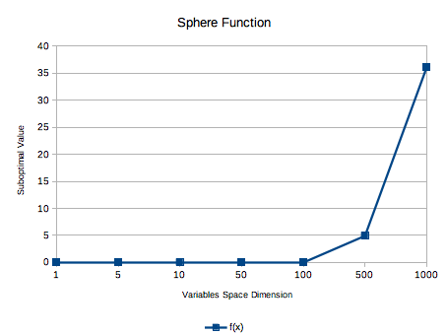
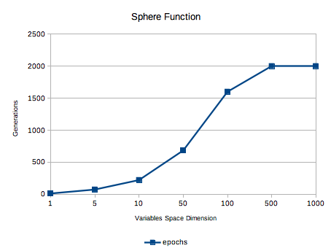
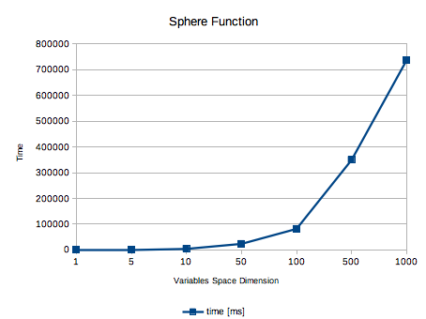
Sphere

Slide 14
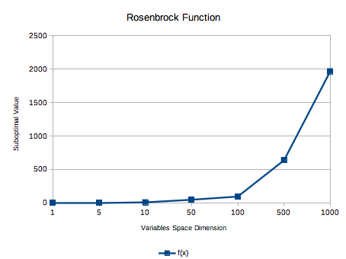
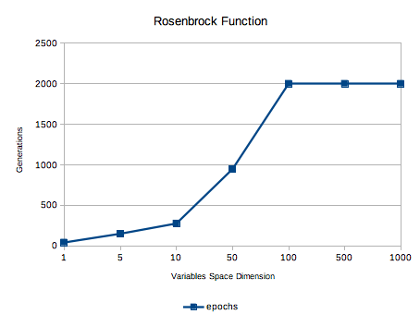
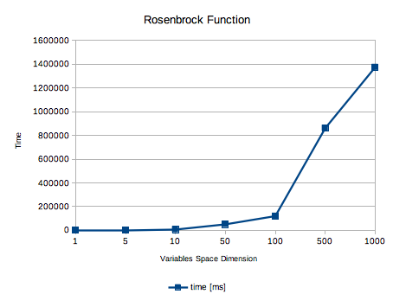
Rosenbrock

Slide 15
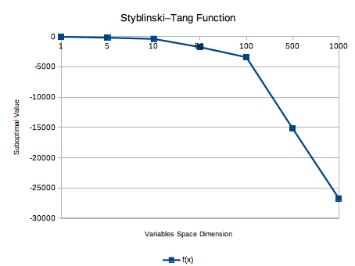
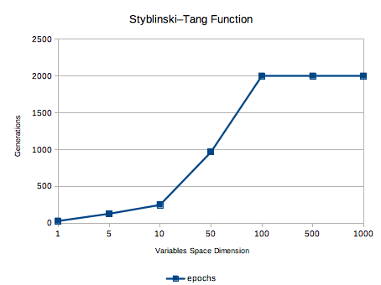
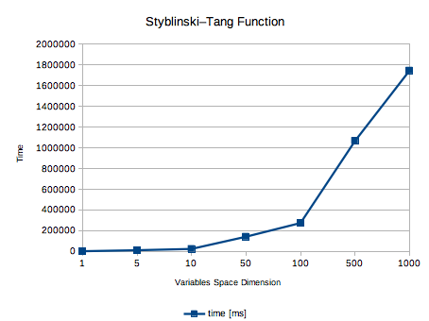
Styblinski-Tang

Slide 16
Conclusions
Efficiency achieved in LibreOffice Calc Nonlinear Solver
Four well-known test functions were used

Slide 17
Conclusions
As the variable space dimensionality increases, the optimization module's ability to determine the global optimum decreases

Slide 18
Conclusions
The efficiency of the optimization module is highly dependent on the initial point that serves as a starting point when starting the optimization process

Slide 19
Questions
Thank you!
Acknowledgments
This work was inspired and
supported by private funding of
Velbazhd Software LLC

