Slide 1
Linear Congruent Generator Imitation in Slot Machine Gambling Games
Vladislav Saykov, Ioan Dimitrov, Radoslav Batalski, Denis Tsvetanov, Georgi Doldurov, Lora Doldurova, Todor Balabanov

Slide 2
Agenda
Slot Machines
Probabilistic Model
Legal Aspects
Difficulties
Solutions
Research

Slide 3
Slot Machines
The most popular gambling games
  They are often referred to as fruit machines
Virtual strips of winning symbols
  They were mechanical devices that offered fruit bars as prizes
Modern slot machines are computerized devices
  They utilize virtual reels

Slide 4
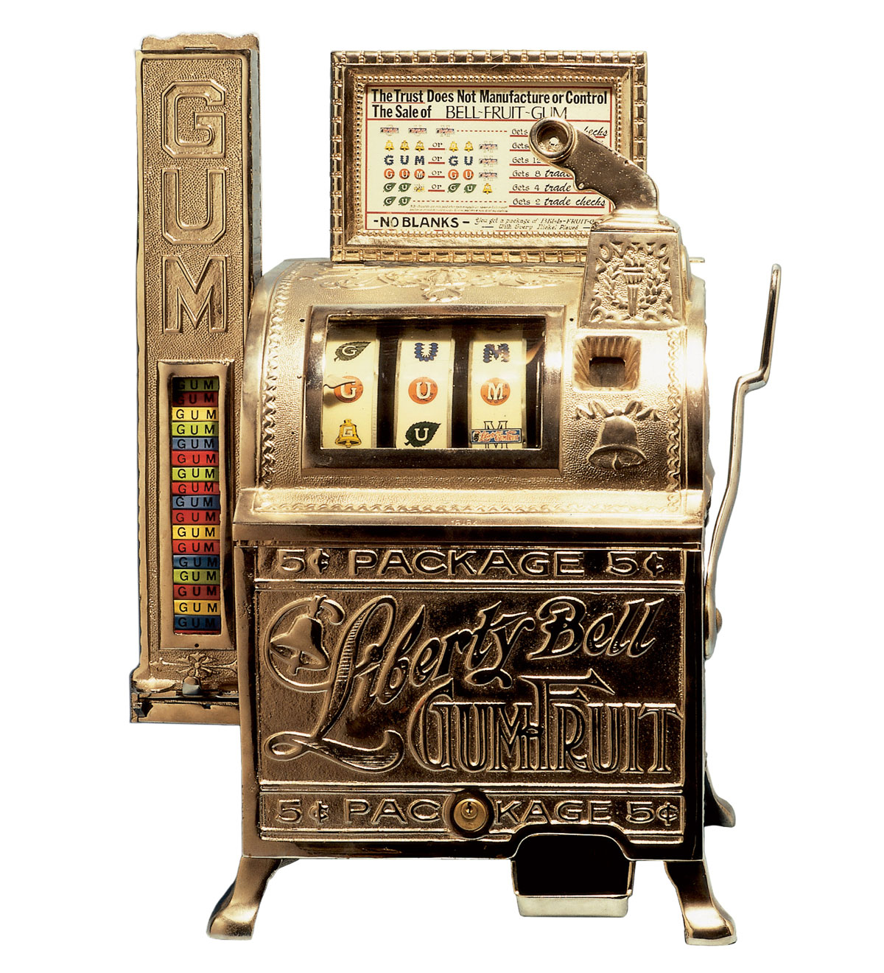
Mechanical Slot Game

Slide 5
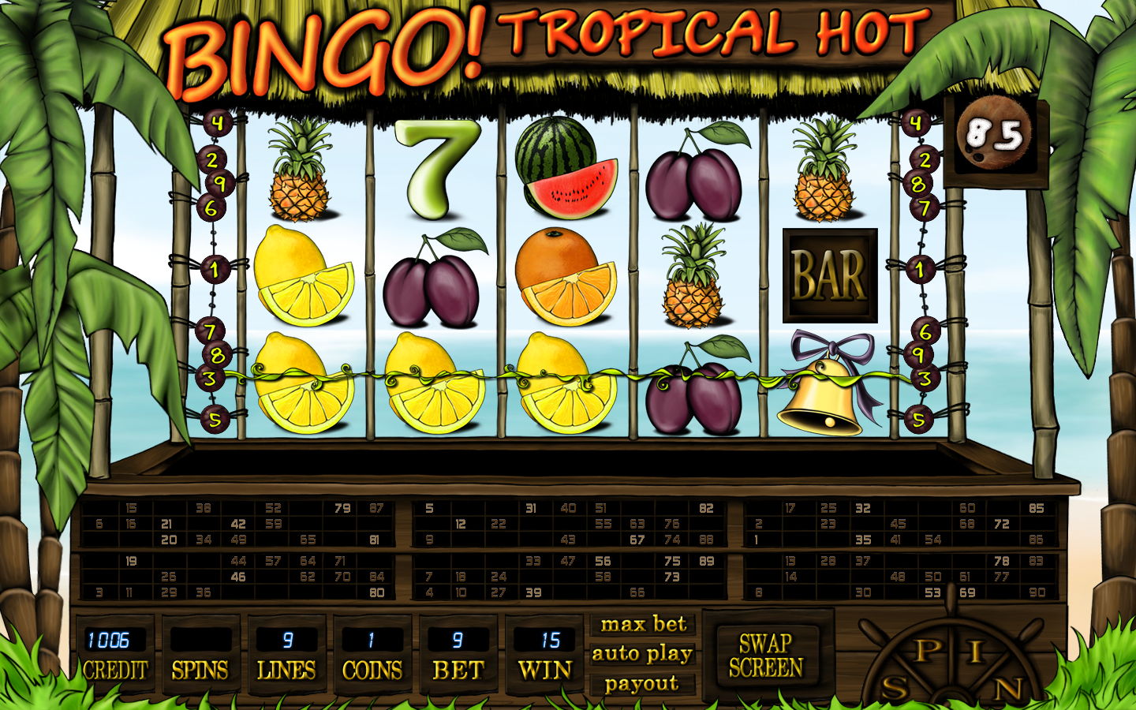
Computerized Slot Game

Slide 6
Statistical Model
Slot machines utilize virtual reels
  Often represented as two-dimensional arrays of numbers
    A discrete probability distribution
The traditional spinning has been replaced by randomly selecting the reels' stopping positions
  This random selection relies on random number generators
    Pseudo generators – mathematical formulas
    True generators – hardware-based

Slide 7
Legal Fame
Forbidden markets
  Gambling is illegal
Shady markets
  Missing or not working laws
Developed markets
  Legal gambling
  Strict legal framework
  In most of these markets, the law mandates the use of cryptographically secure random number generators

Slide 8
Cryptographically Secure RNGs
They produce high-quality random numbers
The generation speed may be slower
Most jurisdictions require the raw random numbers to be modified only linearly and to be taken from a single RNG instance only
Legal requirements state that each randomly generated number must be stored in an event log for potential legal inspection
How to be in the legal frame?

Slide 9
Linear Congruential Generator
X[n+1] = (a * X[n] + c) % m
  The formula uses only three operations
  It is very efficient as CPU instructions
X[0] is taken from a real-world random event
It is one of the most popular pseudo-random number generators
Its greatest advantage is its simplicity
Its greatest disadvantage is its simplicity
  It is not cryptographically secure

Slide 10
Imitation of LCG
For a single bet session (single bet, single base game spin, and single free spins / bonus game(s))
  Only a single random number is taken from the CSRNG
  All other numbers are generated with an LCG-like mathematical formula (not a real PRNG)
Low volume of logged numbers
Usage of a single RNG instance
PRNG-like programming API
  Only linear transformations

Slide 11
Questions to Answer
Is the gamble’s subjective experience the same?
Are the cumulative statistics similar?
Is the combinatorial analysis of a discrete model more complicated?

Slide 12
Thank you!

