Slide 1
BdKCSE’2017
Dual MLP for Time Series Forecasting
with Hidden Layer Sharing
I. Blagoev, T. Atanasova, I. Zankinski
Institute of Information and Communication Technologies
Bulgarian Academy of Sciences

Slide 2
Agenda
Time Series
  Financial Forecasting
Artificial Neural Networks
  Topologies
Model Proposition
  Dual Multilayer Perceptron

Slide 3
Time Series Forecasting
Definition:
y(t) =S(t) + T(t) +E(t)
y(t) - data in the period t
S(t) - seasonal component at period t
T(t) - trend cycle component at period t
E(t) - irregular component at period t

Slide 4
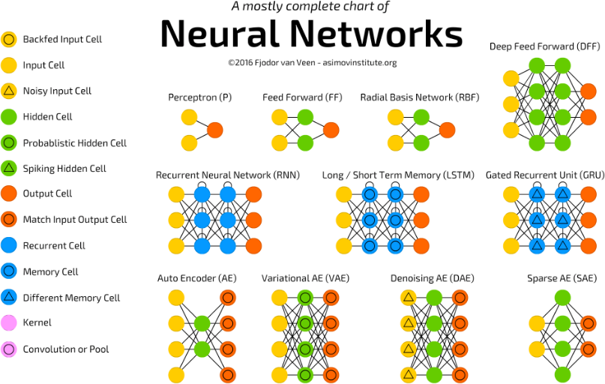
ANN Topologies (1/2)

Slide 5
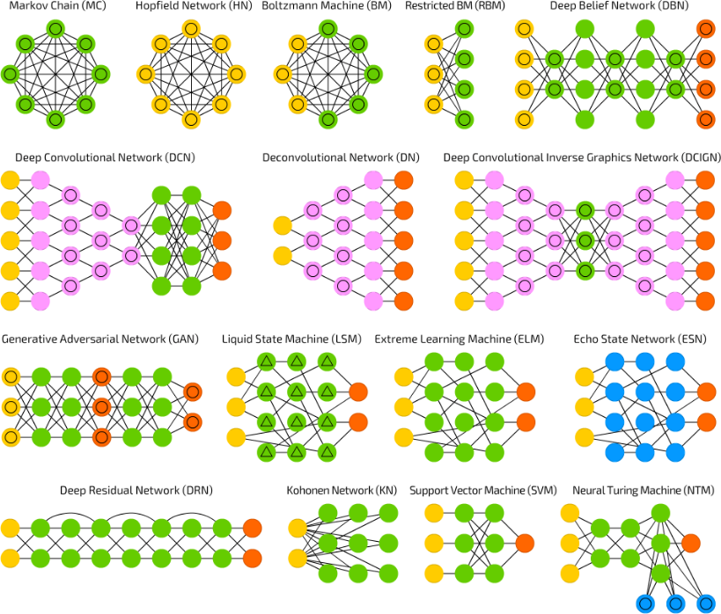
ANN Topologies (2/2)

Slide 6
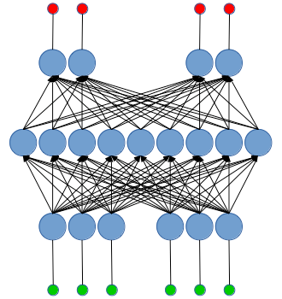
Dual MLP

Slide 7
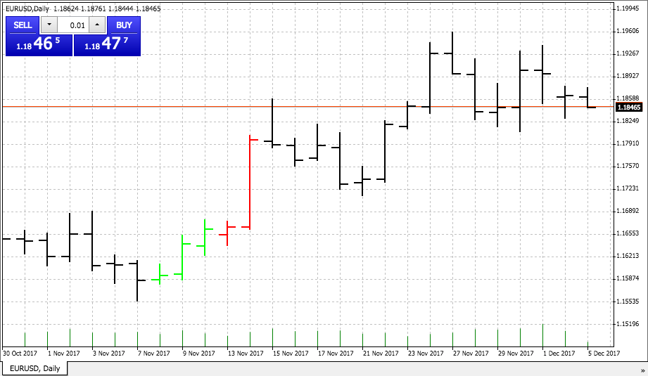
Daily EUR/USD

Slide 8
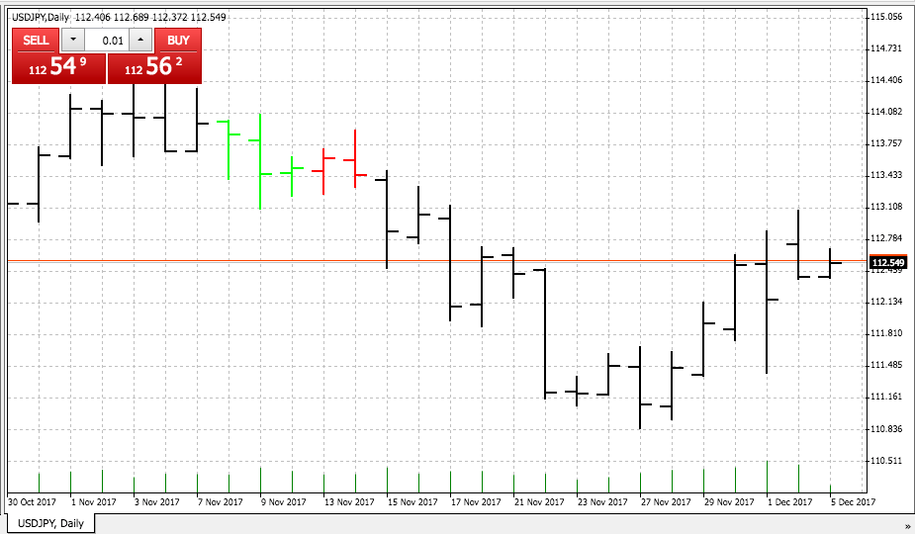
Daily USD/JPY

Slide 9
Thank you!

