Slide 1
Activation Function Permutation for Multilayer Perceptron Training
International Conference on
Big Data, Knowledge and Control Systems Engineering
21-22 November 2018, Sofia, Bulgaria
Todor Balabanov, Tatiana Atanasova, Ivan Blagoev
Institute of Information and Communication Technologies Bulgarian Academy of Sciences

Slide 2
Agenda
Artificial neural networks
Transfer and activation functions
Permutation of activation functions
Experiments and results

Slide 3
Artificial Neural Networks
Developed since 1943
Inspired by biological neural systems
Used for estimation or approximation of a function
Self adapting tool

Slide 4
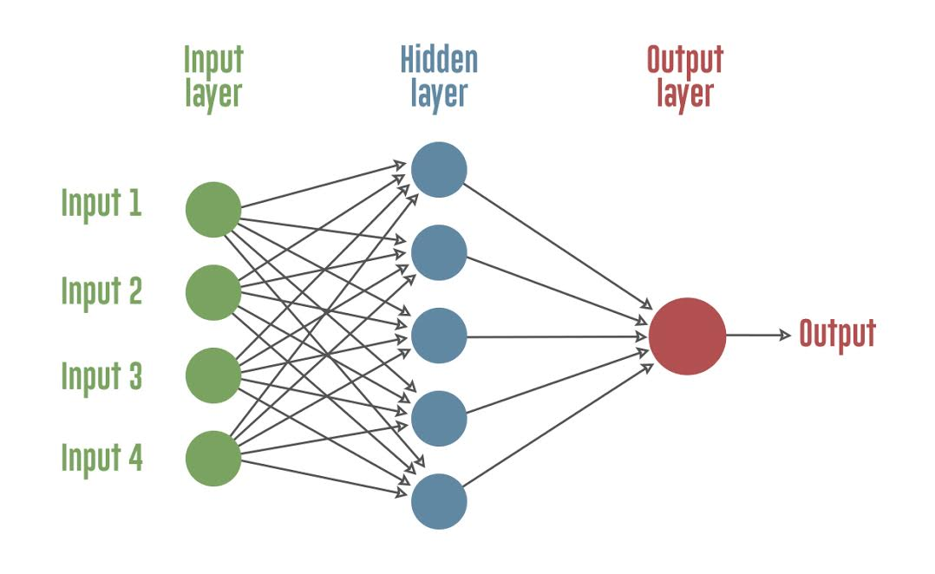
ANN Components
Weighted directed graph
Neurons - nodes in the graph
Weights - real numbers for the graph links
Topology - links organization

Slide 5
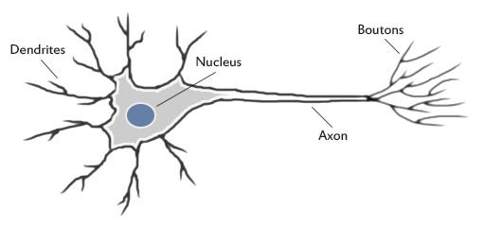
Biological Neuron
http://www.theprojectspot.com/images/post-assets/nnl.jpg

Slide 6
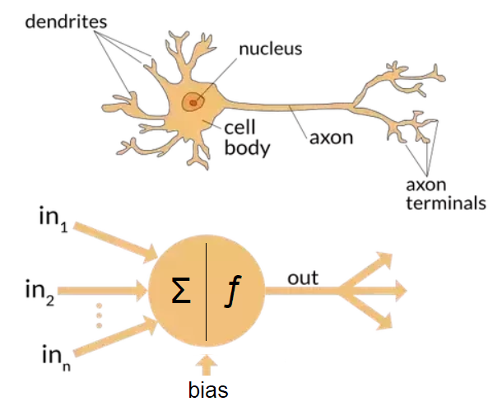
Biological vs Artificial Neuron
https://cdn-images-1.medium.com/max/1200/1*SJPacPhP4KDEB1AdhOFy_Q.png

Slide 7
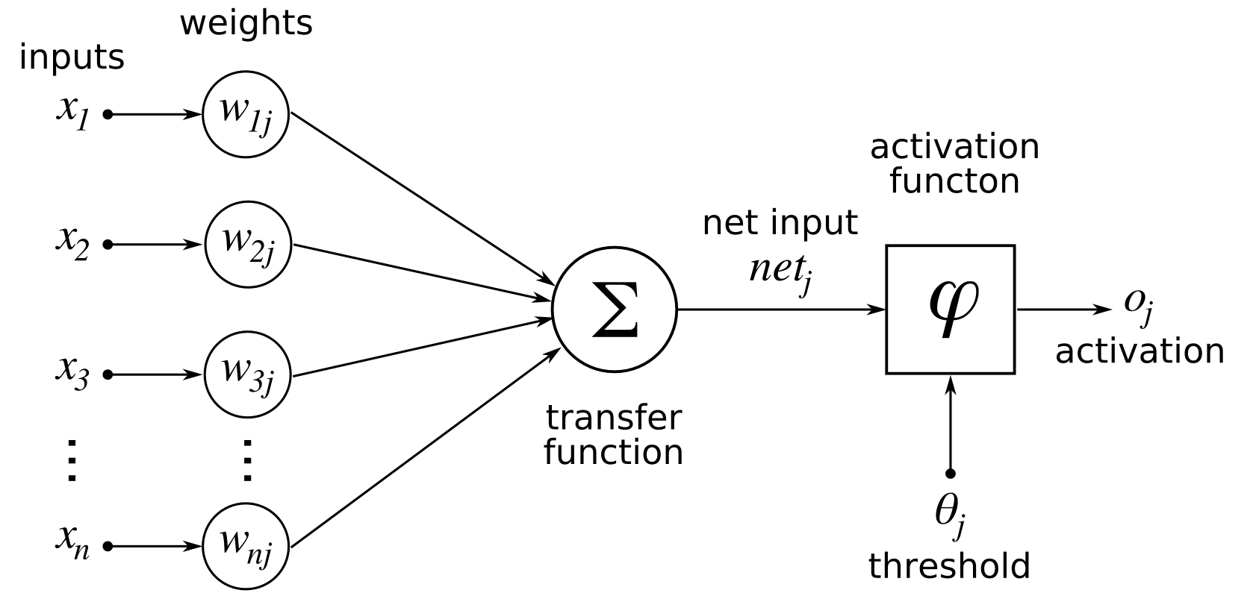
Artificial Neuron Components

Slide 8
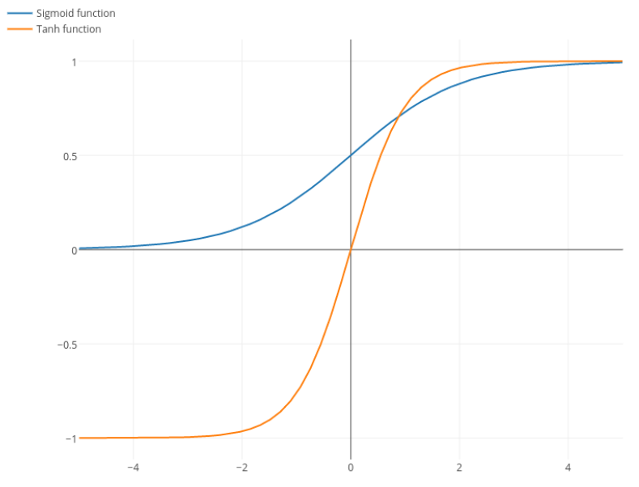
Hyperbolic Tangent and Sigmoid
https://i.stack.imgur.com/o0JA0.png

Slide 9
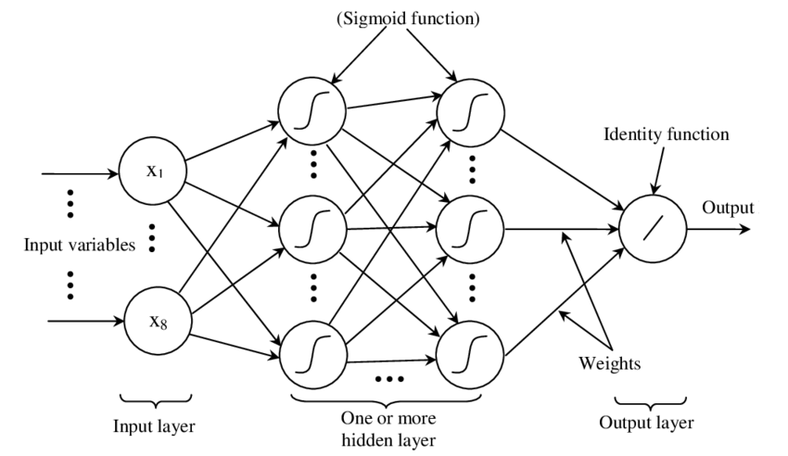
Different Activations by Layers

Slide 10
Research Proposition
Artificial neural networks training speed-up
  Multilayer perceptron (three layers)
  Back-propagation training
  Hyperbolic tangent as basic activation function
  Sigmoid as permutation alternative
  By activation functions permutation
http://github.com/TodorBalabanov/EncogDigitsResilient

Slide 11
Experiments
Encog Machine Learning Framework
Java programming language
Digits recognition data set
MLP with 256-266-10 topology
  Hyperbolic tangent and permutation with sigmoid
  Only with hyperbolic tangent

Slide 12
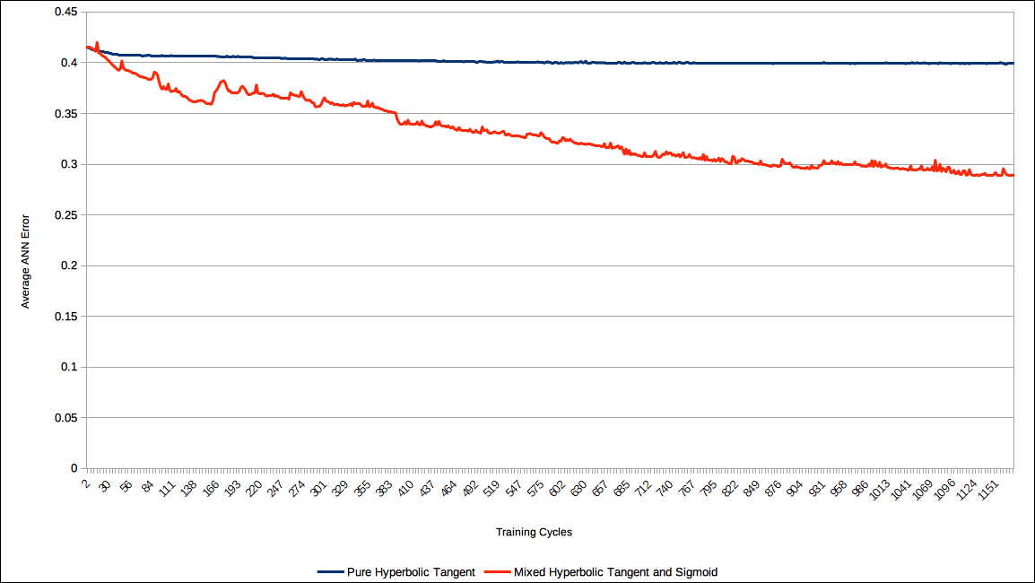
Results in 30 Runs

Slide 13
Conclusions
Training speed-up is achieved by activation functions permutation in multilayered perceptron
As further research
  More activation function can be combined
  Training as distributed computing
  Other classification areas

Slide 14
Questions & Answers
Thank you!

