Slide 1
Weights Permutation in Multilayer Perceptron

Slide 2

Agenda
Artificial neural networks
Neural networks weights
Permutation of the weights
Experiments and results

Slide 3
Artificial Neural Networks
Developed since 1943
Inspired by biological neural systems
Used for estimation or approximation of a function
Self adapting tool

Slide 4
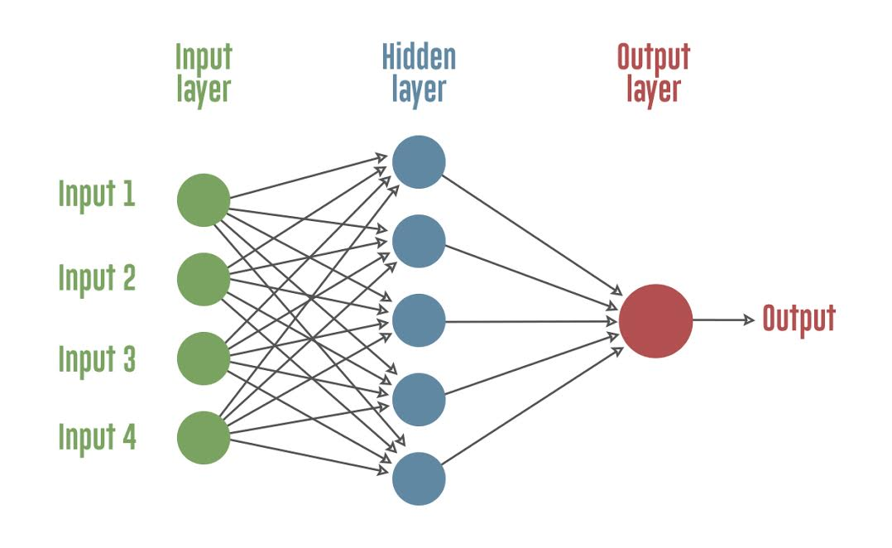
ANN Components
Weighted directed graph
Neurons - nodes in the graph
Weights - real numbers for the graph links
Topology - links organization

Slide 5
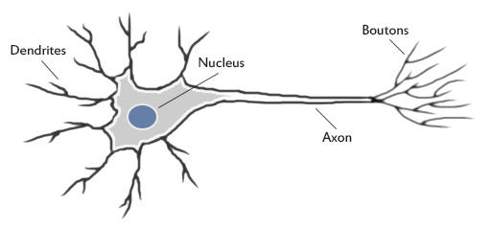
Biological Neuron
http://www.theprojectspot.com/images/post-assets/nnl.jpg

Slide 6
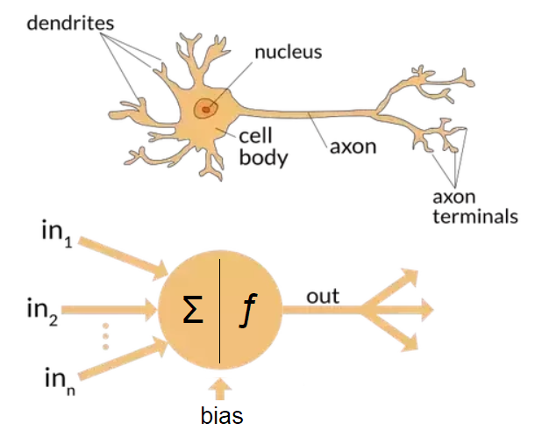
Biological vs Artificial Neuron
https://cdn-images-1.medium.com/max/1200/1*SJPacPhP4KDEB1AdhOFy_Q.png

Slide 7
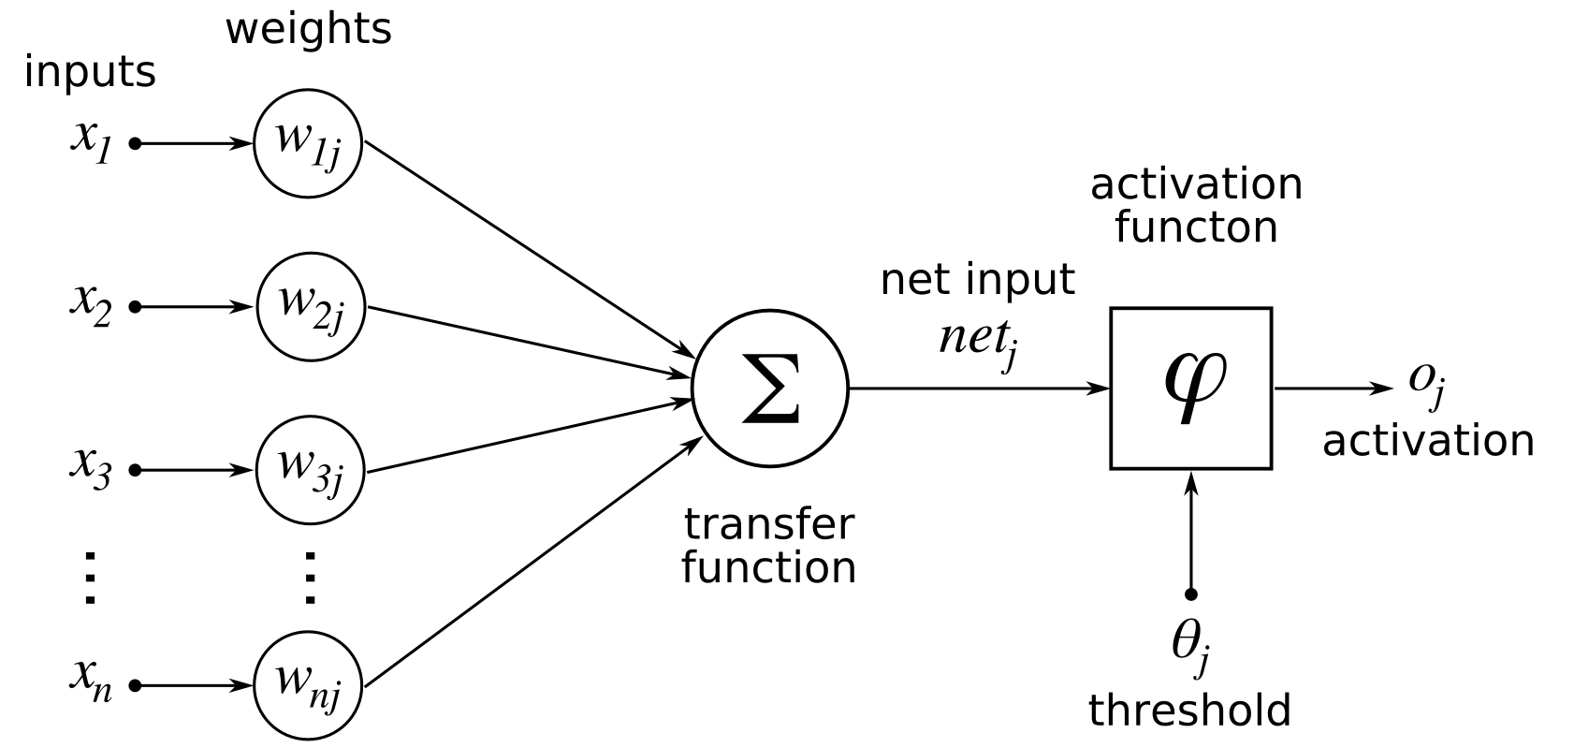
Artificial Neuron Components

Slide 8
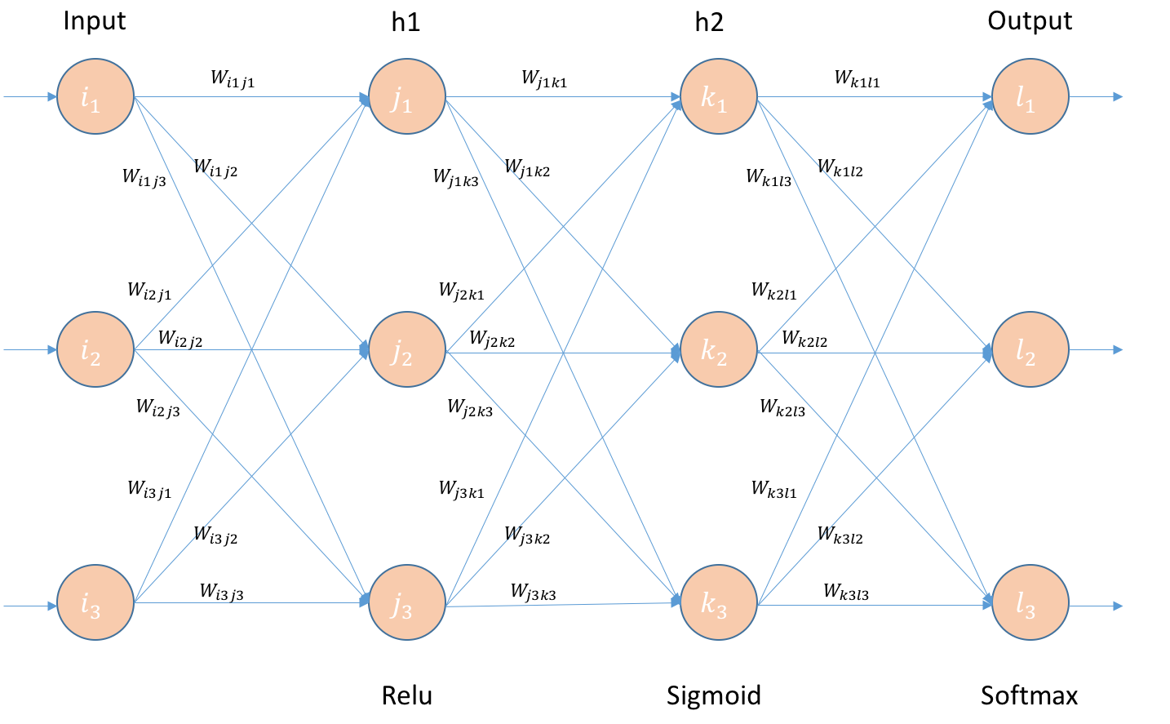
Artificial Neural Network Weights
https://cdn-images-1.medium.com/max/2000/1*fnU_3MGmFp0LBIzRPx42-w.png

Slide 9


Research Proposition
Artificial neural network training speed-up
  Multilayer perceptron (three layers)
  Back-propagation training
  Sigmoid as an activation function
  Permutation of the weights in the hidden layer
    Swap random weights for a single training cycle
http://github.com/Coding-Sunday-Sofia/multi-layer-perceptron

Slide 10
Experiments
Self made open source solution
Java programming language
XOR function learn
MLP with 2-30-1 topology
  Training without weights permutation
  Training with weights permutation

Slide 11
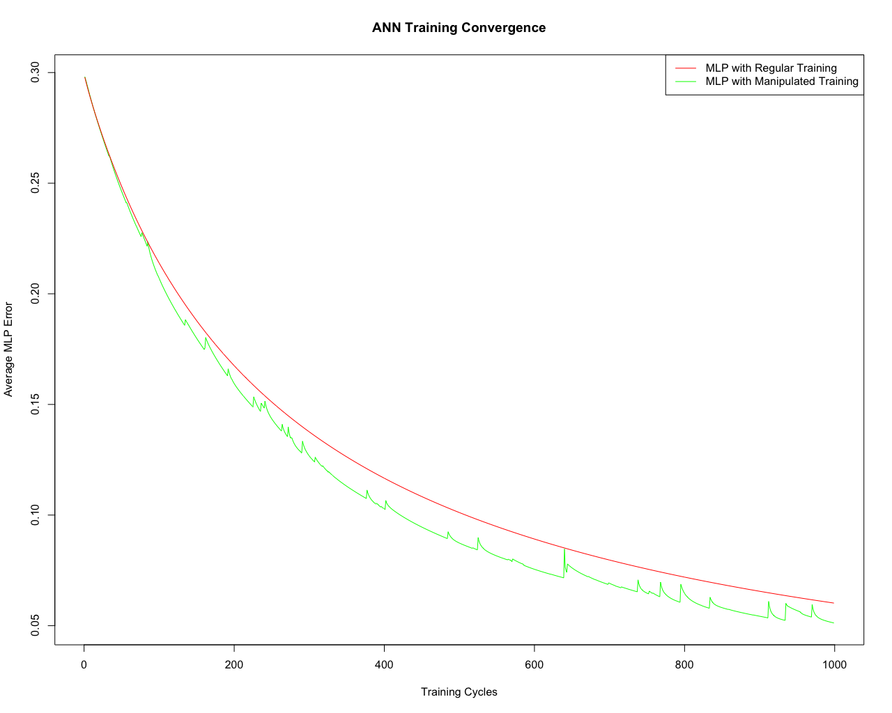
Results from 30 runs

Slide 12
Conclusions
There is training speed-up
The process is not so smooth as regular back-propagation training
As further research
  Weights permutation can be combined with activation function permutation
  Permutation of the weights can be experimented between set of artificial neural networks

Slide 13
Questions & Answers
Thank you!

