Slide 1
Double-Stranded Differential Evolution and Particle Swarm Optimization with LibreOffice Nonlinear Programming Solver
Gergana Mateeva, Delyan Keremedchiev,
Kalin Kopanov, Velizar Varbanov, Todor Balabanov
EAI CSECS 2024 28-30 June, New Bulgarian University, Sofia, Bulgaria

Slide 2
AGENDA
Evolutionary algorithms
Analogy from biological genetics
Experiments and results

Slide 3
DIFFERENTIAL EVOLUTION
Population-based metaheuristics
It used for global optimization
Works in real numbers domain

Slide 4
SOLUTION VECTOR ENCODING
Encoding of the problem in real numbers
High-dimensional spaces
Population
  Set of possible solution

Slide 5
SELECTION OPERATOR
Two or more parents are selected to produce offspring
The expectation is for better parents to produce even better offspring

Slide 6
CROSSOVER OPERATION
Swap parts of the parent vectors
The idea is taken from the biological crossover

Slide 7
MUTATION OPERATOR
Small change in the elements of the offspring vector
A weighted difference vector is used

Slide 8
BIOLOGICAL GENETICS
RNA
  Single-stranded chain of information
DNA
  Double-stranded chain of information

Slide 9
DOUBLE-STRANDED POPULATION
Each individual has two vectors for its representation
In this study - positive and negative vector

Slide 10
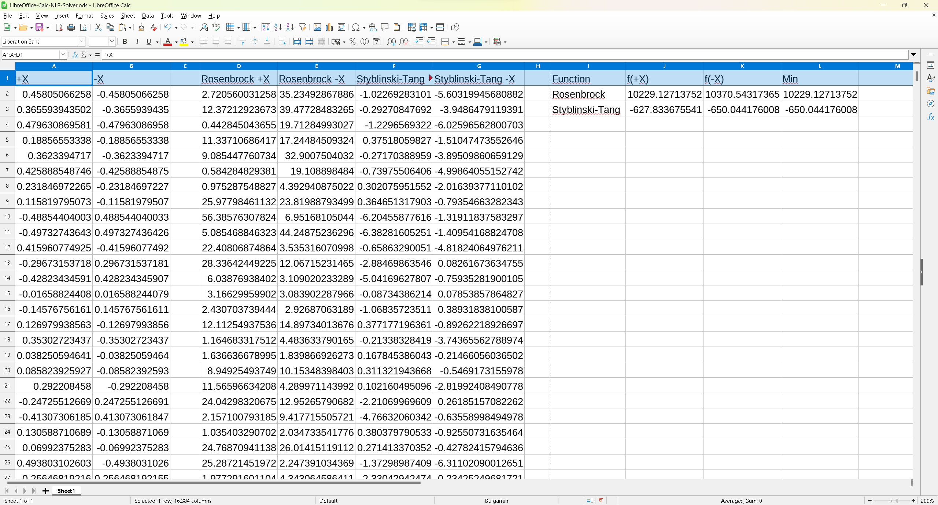
LIBRE CALC MODEL

Slide 11
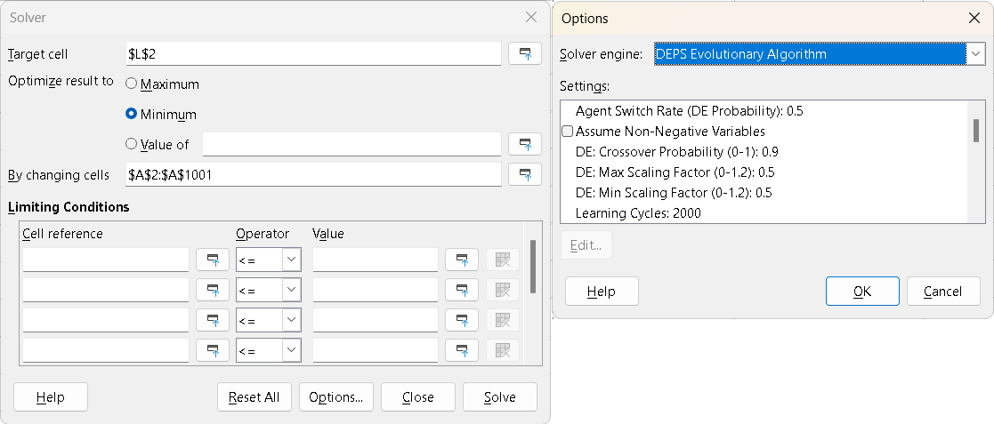
NLP SOLVER CONFIGURATION

Slide 12
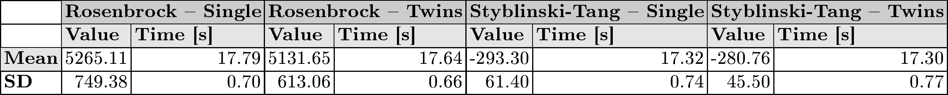
RESULTS

Slide 13
Conclusion
Double-stranded model approaches the global optimum faster
Double amount of calculations make double-stranded not so efficient

Slide 14
QUESTIONS AND ANSWERS
Thank you for your attention!
Acknowledgement
  This research is financed by the Central Strategic Development Fund of New Bulgarian University

