Slide 1

Todor Balabanov
Multi-Objective Optimization in Image Approximation
01-03 October 2020
ICAI2020
Varna

Slide 2
Multi-Objective Optimization in
Image Approximation
Todor Balabanov
ICAI2020
01-03 October
Varna, 2020

Slide 3
Contents
Bitmap images
  Simplification
  Vectorization
  Colors reduction
Genetic Algorithms
  Our implementation
Experiments and results

Slide 4
Bitmap Images
Simplification
  Represent an image in a simpler way
Vectorization
  Conversion of pixels in to instructions of simple drawing primitives
Colors reduction
  Transformation of full-colors image into limited set of colors
  In our case 24-bit colors to 16 indexed colors

Slide 5
Genetic Algorithm
Search heuristic
Mimics natural selection
In the class of evolutionary algorithms
Uses inheritance, mutation, selection and crossover

Slide 6
Our Implementation of GA
Individuals are ordered set (variable size) of simple ellipses
Single cut point crossover
Mutation is a small correction of x-y position and orientation angle of a single ellipse
Selection is based on Euclidean distance between the source image and the generated image
http://github.com/TodorBalabanov/EllipsesImageApproximator

Slide 7
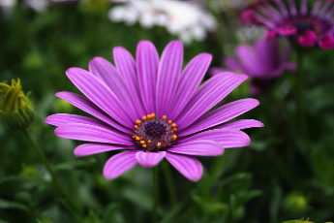

Slide 8
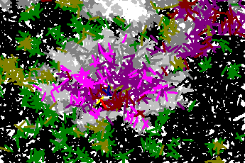

Slide 9
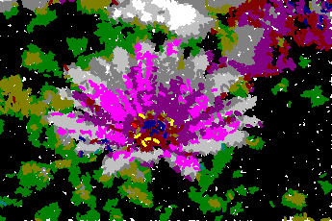

Slide 10
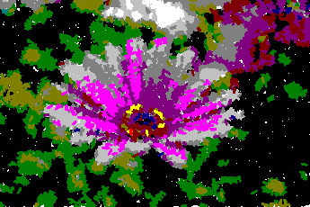

Slide 11
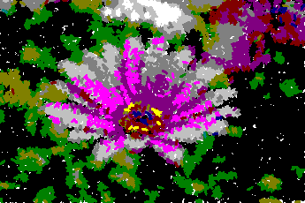

Slide 12
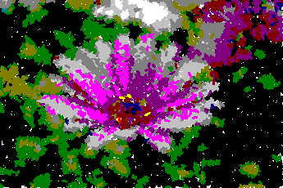

Slide 13
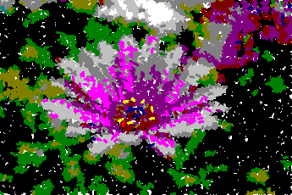

Slide 14
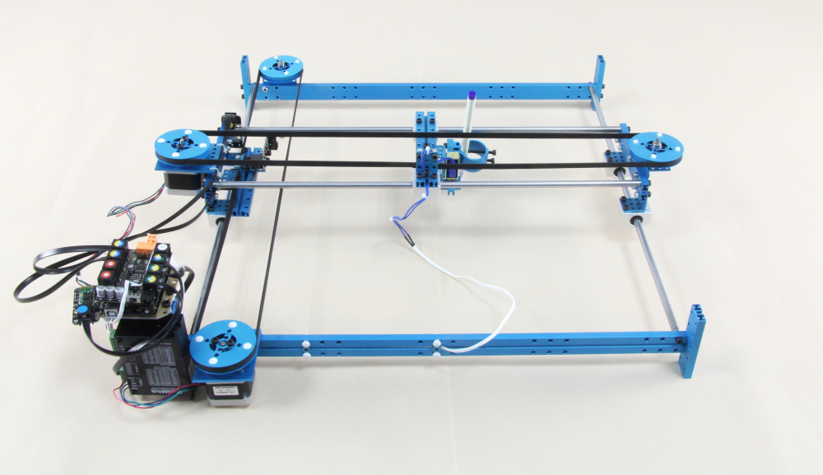
Usage

Slide 15
Conclusions
Genetic algorithms based bitmap images simplification by vectorization and colors reduction is very effective
The optimization process is very time consuming

Slide 16
Questions
&
Answers

