Slide 1
Iliyan Zankinski
Hybrid Approach Based on Combination of Backpropagation and Evolutionary Algorithms for Artificial Neural Networks Training by Using Mobile Devices in Distributed Computing Environment

Slide 2
Agenda
Financial forecasting
Artificial Neural Networks
Genetic Algorithms
Activation Function Proposal
Mobile Devices Distributed Computing

Slide 3
Financial Time Series Forecasting
Collection of measurements made in a sequence through time
Foreign Exchange Markets (FOREX)
  The main trading is done by exchanging currencies
  The most volatile in price changing object of trading

Slide 4
FOREX Decision Makers Objectives
Will the price go up or down
What volume to trade
How long to keep the positions opened

Slide 5
Artificial Neural Networks
Inspired by research into the nature of the human brain
Consists of five components:
  Topology which is directed graph
  Node state real number variable
  Real number value as weight of each edge
  Real number value for node input bias
  Node transfer function

Slide 6
Neuron’s Transfer Function
Consist of two functions:
  Sum function which in most cases is linear
  Activation function which in most cases is sigmoid or hyperbolic tangent
Sum of the weighted input is sent to the activation function before to be signaled as an output

Slide 7
Feed-Forward Networks
Do not have input arcs
  Input nodes should be supplied with value
  Input information is spread across the network
  Other nodes are changing their state variable according to the propagation rules
In multilayer perceptron
  Any path from an input node to an output node traverses the same number of arcs
  Hidden layer is a group of nodes which are neither input nor output and are on the same number of arcs distance from the input layer and the output layer

Slide 8
Multilayer Perceptron
It is fully connected if each node in a particular layer is connected to each node in the previous layer
It generalizes well in practical problems
Gradient based training algorithms can be successfully applied

Slide 9
Backpropagation Drawbacks
The performance slow comes from the fact that complex spaces have nearly global optimum around the local optimum
It requires the activation function differentiability

Slide 10
Genetic Algorithms
Meta heuristics for global optimization inspired from the ideas of biological evolution
Consists of five components:
  Encoding of the problem as chromosomes
  Evaluation function for survival capabilities
  Initial population initialization strategy
  Set of recombination operators
  Population and operators parameters

Slide 11
GA Advantages
Does not have scaling problems
Very suitable for parallel/distributed computing
Have capabilities to escape local optima

Slide 12
Activation Function Proposal
The most often used activation functions in MLPs are the sigmoid function and the hyperbolic tangent function
We propose two new functions
  Exponent regulated sin activation function
  Fading sin activation function

Slide 13

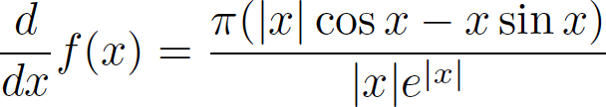
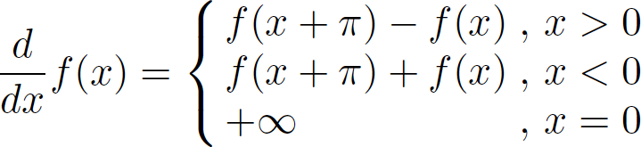
Exponent Regulated Sin Definition
(1)
(2)
(3)

Slide 14
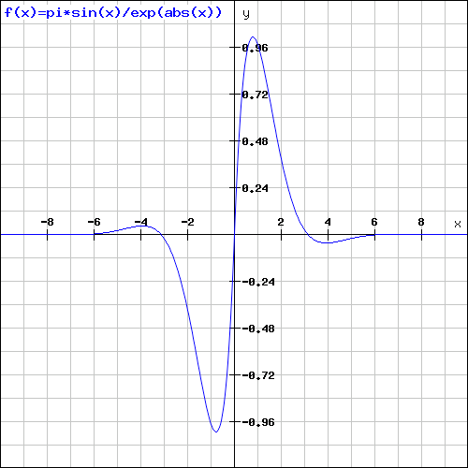
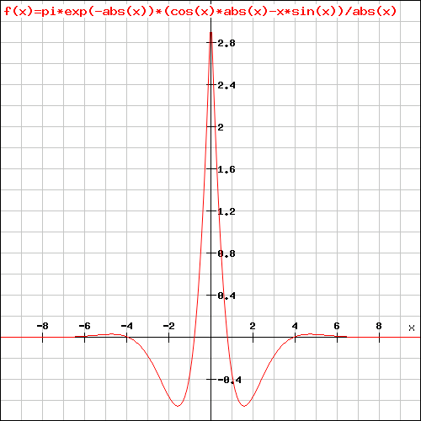
Exponent Regulated Sin Plot

Slide 15
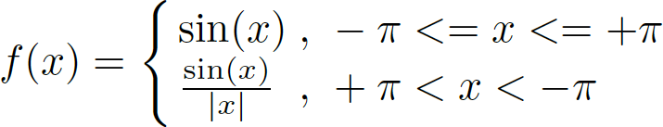
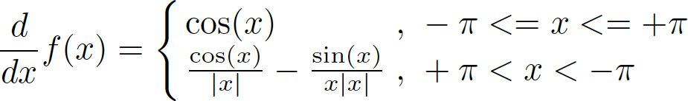
Fading Sin Definition
(4)
(5)

Slide 16
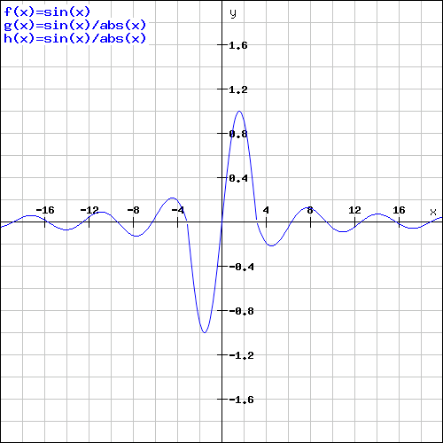
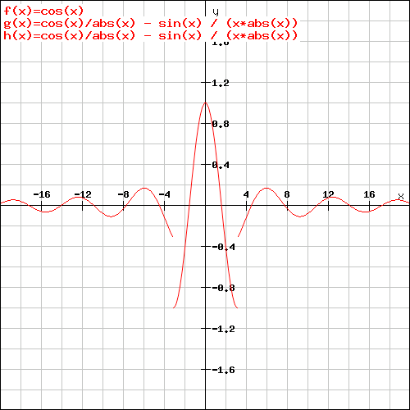
Fading Sin Plot

Slide 17
Mobile Devices Distributed Computing

Slide 18
Activation Functions Experimental Setup
Intel Core i7-4790 - 3.6GHz - 4 cores – 8 threads
8GB RAM
Microsoft Windows 10
Java 8 Update 112 (64bit)
Encog Core v3.3.0 - Java Version

Slide 19
Activation Functions Experimental Data
MLP Neural Network (256-64-10 topology)
Data set of 1593 handwritten digits
  Around 80 persons
  Scanned and stretched in a rectangular box 16 x 16
  Gray scale of 256 values
http://github.com/VelbazhdSoftwareLLC/EncogDigitsResilient

Slide 20
Activation Functions Experimental List
Fading Sin
Exponent Regulated Sin
Sigmoid
Bipolar Sigmoid
Logarithm
Hyperbolic Tangent
Elliott Symmetric

Slide 21
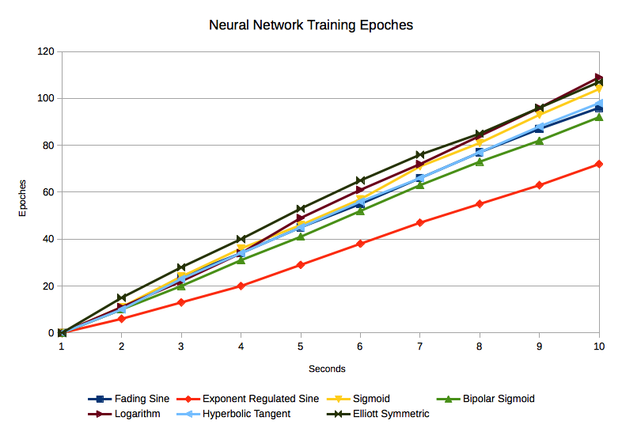
Neural Network Training Cycles

Slide 22
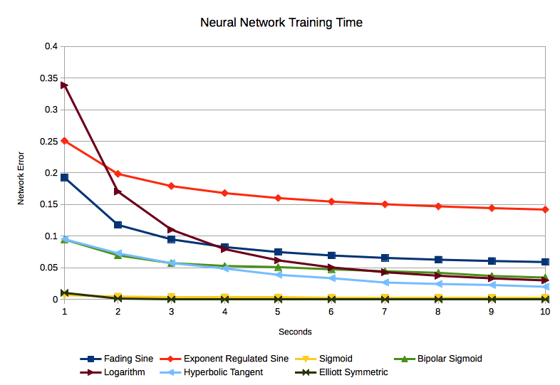
Neural Network Error

Slide 23
Conclusions & Further Work

Slide 24
Questions & Answers
Thank you!

