Slide 1

Petаr Tomov
2D Optimal Packing with
Population Based Algorithms
Institute of Information and Communication Technologies
Bulgarian Academy of Sciences
acad. Georgi Bonchev Str., block 2
1113 Sofia, Bulgaria
p.tomov@iit.bas.bg

Slide 2
Agenda
Problem description
Genetic algorithms
Experiments and results

Slide 3
Optimal Packing Problem
Optimization problem in mathematics
Attempting to pack objects together
  Into one or many containers
A typical goal is to fill a single container as densely as possible

Slide 4
ESGI113 & ESGI120 Goals
Cut optimally into pieces a sheet of steel without overlapping them
ESGI113 less complicated
  Both the peaces and the sheet are with rectangular shape
ESGI120 more complicated
  Rectangular sheet but convex polygons of pieces

Slide 5
Optimization Goal
Maximize the percentage of stock sheet utilization
Maximizing the number of shapes placed inside the plate
This study does not considerer orientation constraints
  Any rotation of the given shape is allowed

Slide 6
Packing Problems
Known since 10th century
The rectangular packing problem is known to be NP-complete
  It is often not possible to provide exact solutions within a reasonable time limit
There is an increased complexity of non-rectangular problems

Slide 7
Genetic Algorithms
Search heuristic inspired by the process of natural selection
Population based algorithms
Used to generate points (candidate solutions) into solutions space
  By inheritance (crossover), mutation and selection

Slide 8
GA Based Optimization 1/2
Traditional solution representation is a binary sequence of 0s and 1s
Optimization usually starts from random generated population
The optimization process is iterative
Fitness value of each individual usually represents the objective function which is a subject of optimization

Slide 9
GA Based Optimization 2/2
The most fit individuals into the population are selected
  They are recombined (crossover and/or mutation) to form a new generation
New generation is used in the next iteration of the algorithm
Termination is usually at reaching maximum number of generations or reaching the desired level of the fitness value

Slide 10
Geometric Considerations
All shapes are represented as polygons
Arcs are approximated with small lines
Holes inside the shapes are not considered
Each polygon is represented as set of vertices
It is not allowed the polygons to overlap
All polygons must be entirely placed inside the stock sheet

Slide 11
Pieces Placement
To guarantee that two polygons do not overlap and are positioned as close as possible a concept similar to no-fit-polygon is used
  The first polygon is positioned on the plane - it is considered as the fixed piece
  The second polygon is tracing sheet the edge of the fixed polygon
To ensure that any shape is entirely placed inside the stock sheet, a concept similar to inner-fit-polygon is used

Slide 12
Objective of the PIS Problem
Place the largest number of irregular shapes inside a limited rectangular stock sheet
All the shapes have different orientation
Parameters of each shape
  Orientation - rotation angle relative to the original orientation
  Placement point - (x,y) coordinates
  Order in which shapes are placed on the sheet

Slide 13
GA for Optimal Packing Order
Input data are taken from a text file in order initial population to be initialized
  Sheet size, pieces order, polygons, orientation
Packing algorithm is applied
  The individual fitness value is the length of the steel sheet used after packing is applied
GA operators are applied
  Permutational crossover and mutation (with rotation of the piece)
Elitism rule is used

Slide 14
Algorithm
1. Load plates information and store them as polygon objects;
2. Initialize random GA population;
3. Optimization:
3.1 Select parents;
3.2 Crossover;
3.3 Mutation;
3.4 Pack polygons;
3.5 Measure used sheet length as tness value;
3.6 Keep newly generated chromosome;
3.7 Stop if predened number of generations is reached;
3.8 Repeat from 3.1;

Slide 15
Parameters
Generation gap 0.98
Crossover rate 0.90
Mutation rate 0.01
Maximum generations 100
Number of individuals 137
Number of variables 318
Inserted rate 100%
http://github.com/VelbazhdSoftwareLLC/ESGI120Problem2GeneticAlgorithmSolver

Slide 16
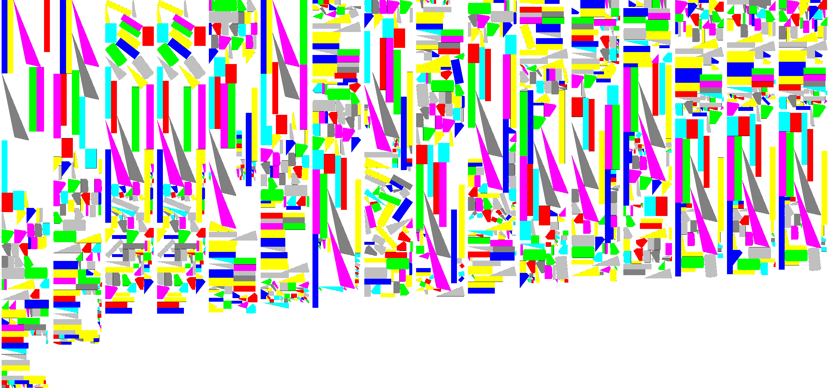
Solution 1/3

Slide 17
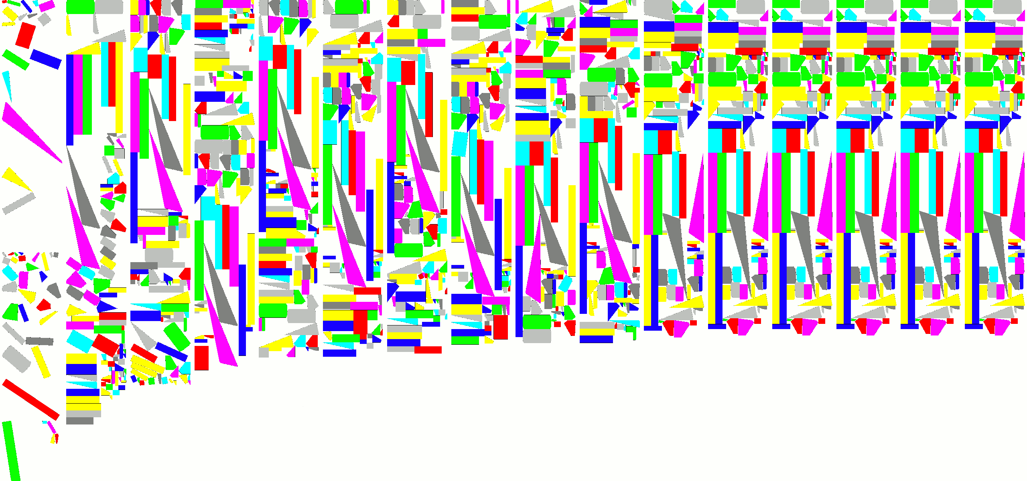
Solution 2/3

Slide 18
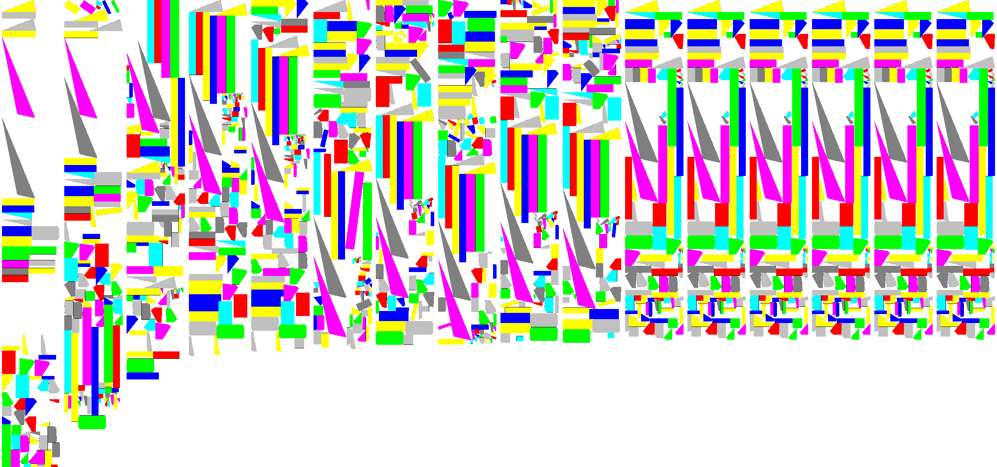
Solution 3/3

Slide 19
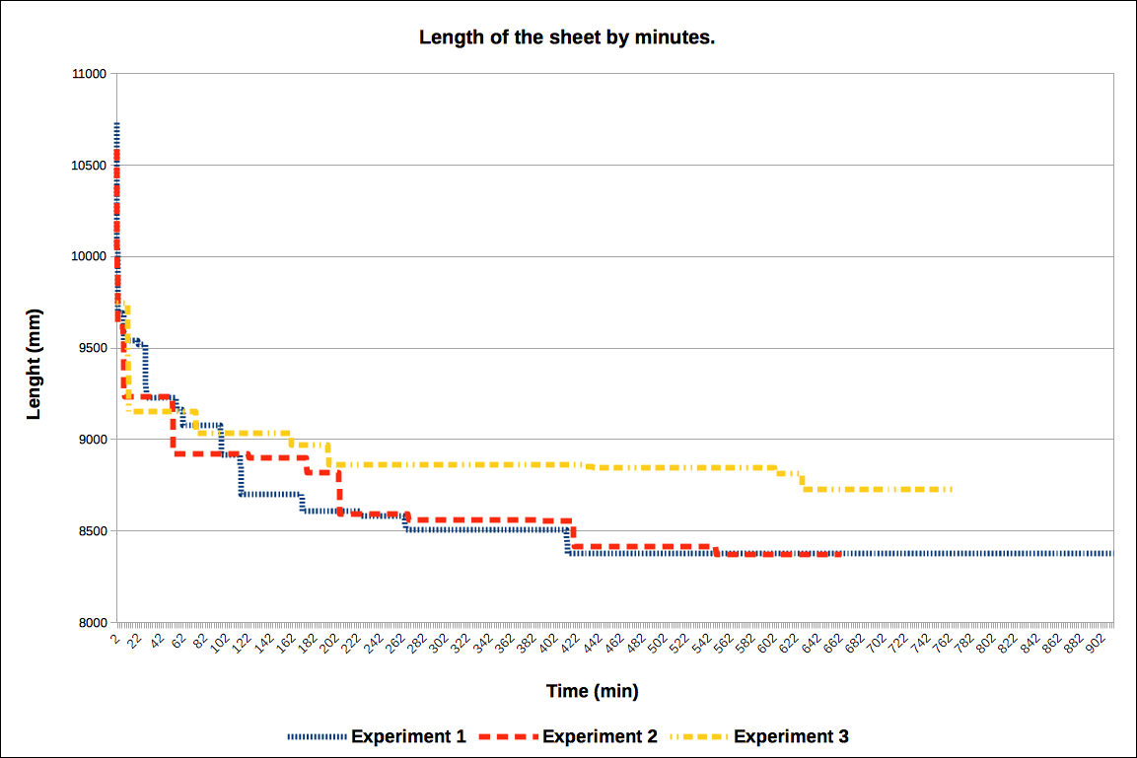
Convergence

Slide 20
Conclusions
GAs for PIS is a promising approach
Solutions are suboptimal
In real industrial application GA may be combined with interactive human assistance in order to achieve faster and better solutions
As further work distributed computing solution can be interesting

Slide 21
Qustions & Answers
Thank you!

