Slide 1
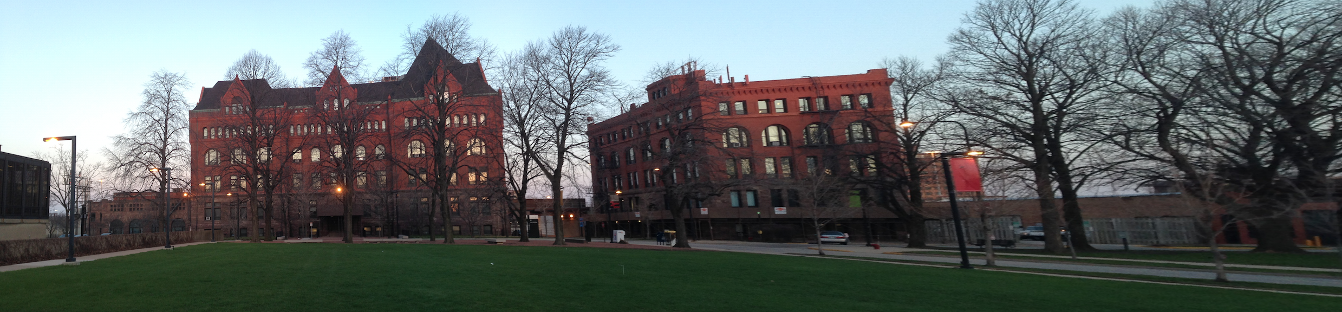
Panoramic image stitching

Slide 2
steps
Feature Matching
-Extract and match SIFT features between all images
Image matching
-Use the same algorithm in the class that calculate matrix H in coplanar camera calibration (RANSAC) to calculate Homography matrix between images
-accept an matched image pair only if : Ni>8.0+0.3*Nj
Bundle Adjustment
Multi-Band Blending

Slide 3
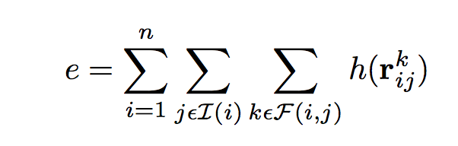
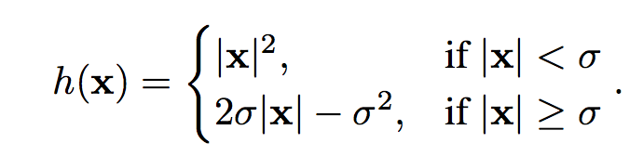
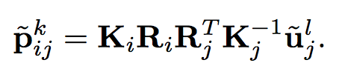
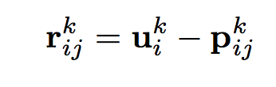
Bundle Adjustment
Use Levenberg-Marquard to minimize:

Slide 4
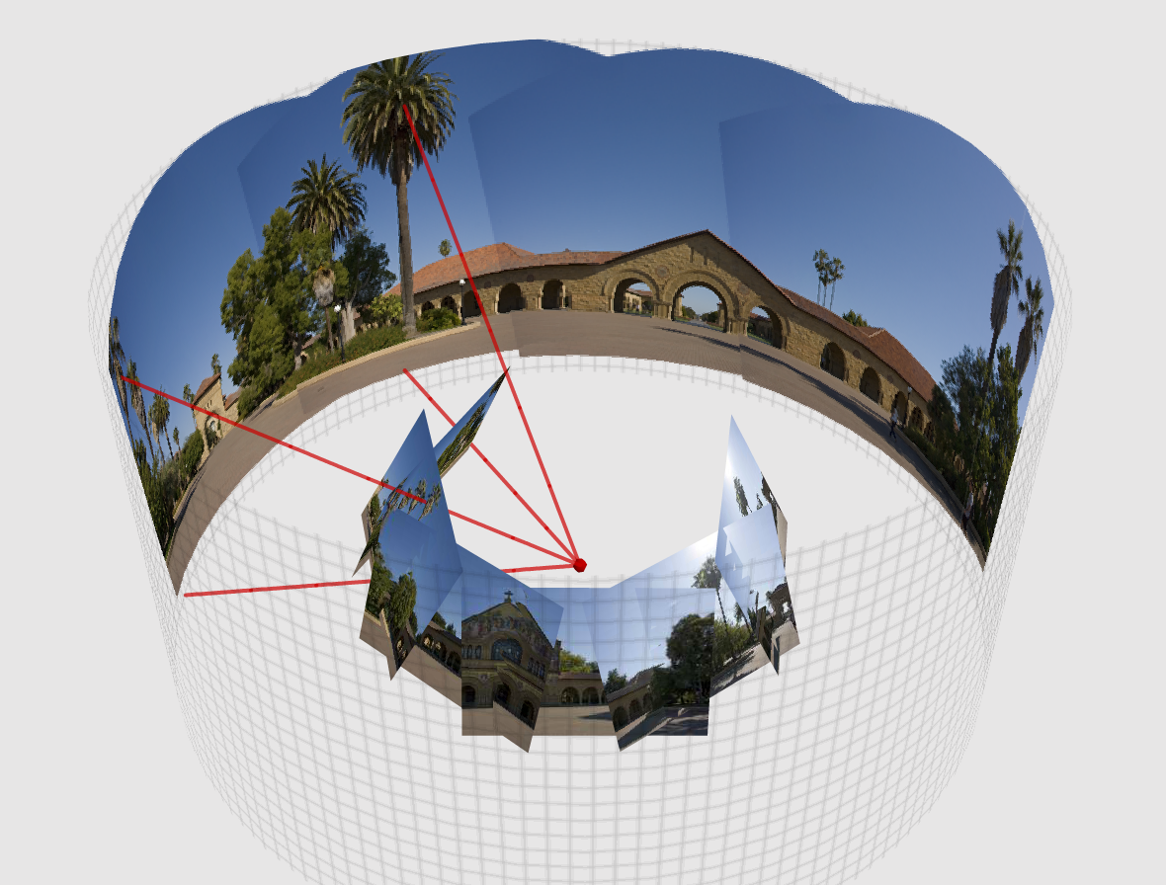
Project to Cylindrical/spherical Coordinate

Slide 5
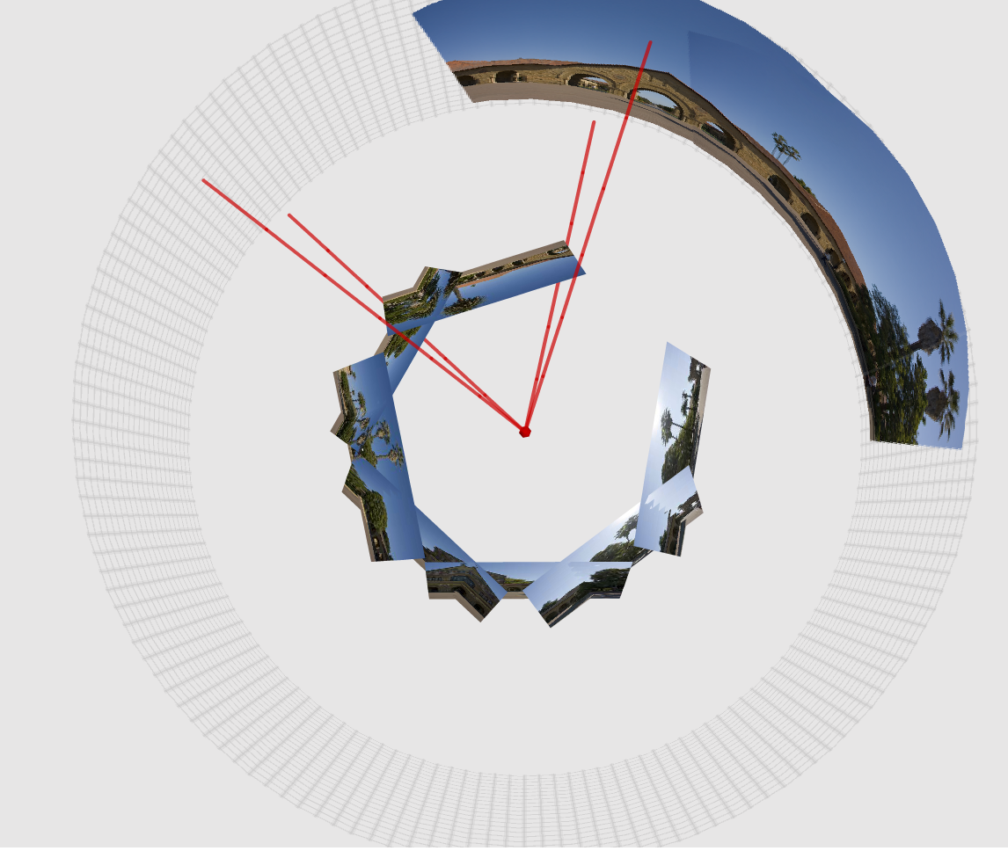
Project to Cylindrical/spherical Coordinate

Slide 6
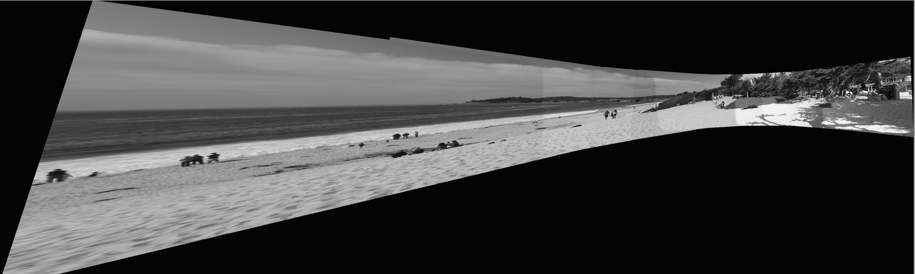
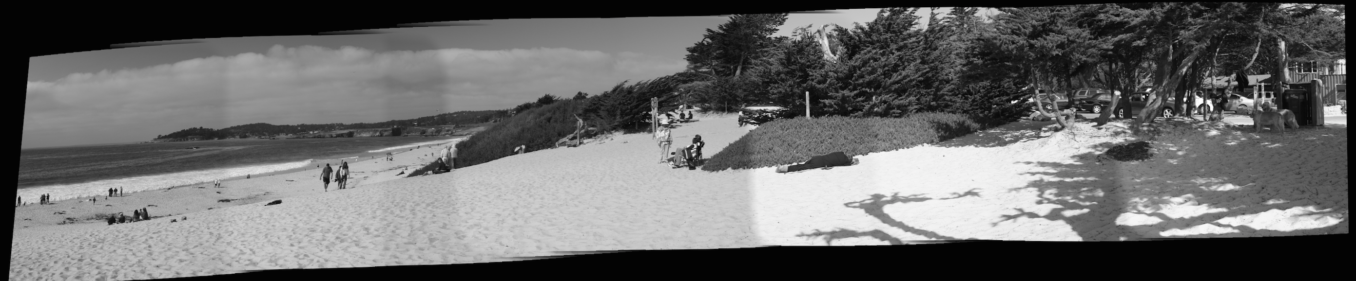

Slide 7
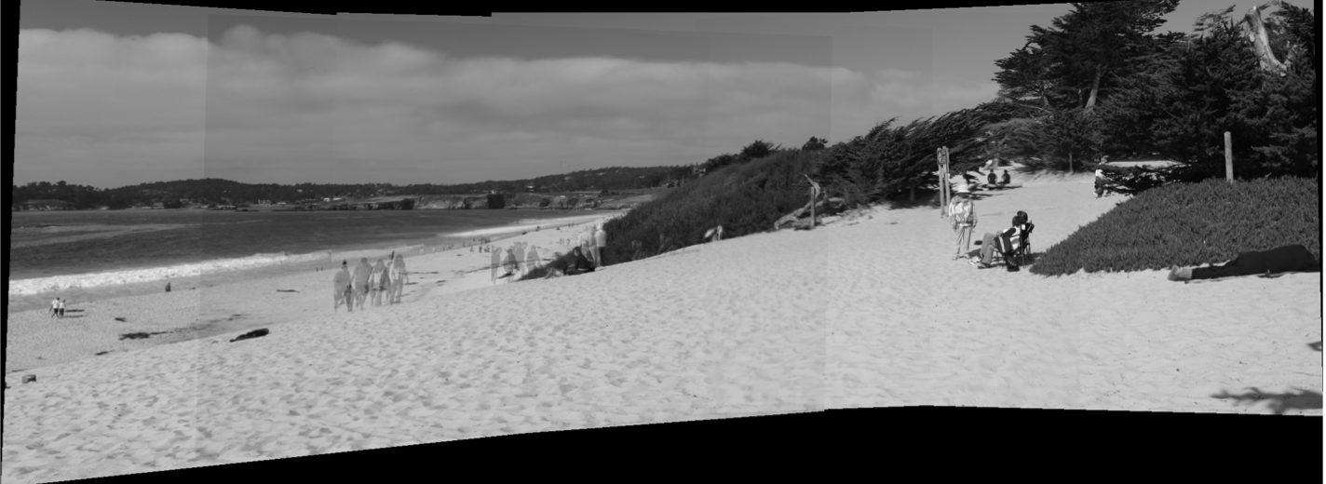
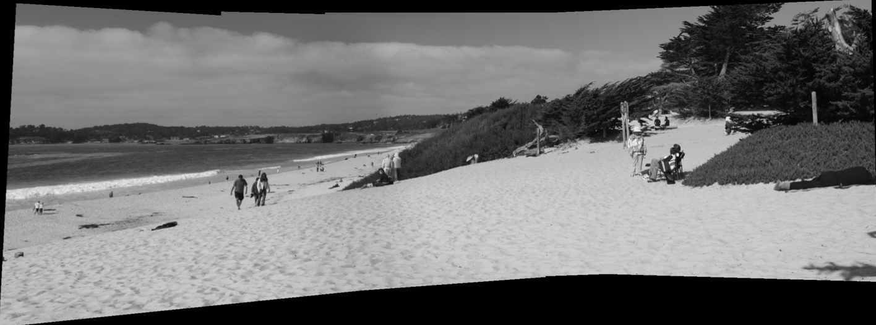
Multi-Band Blending

Slide 8
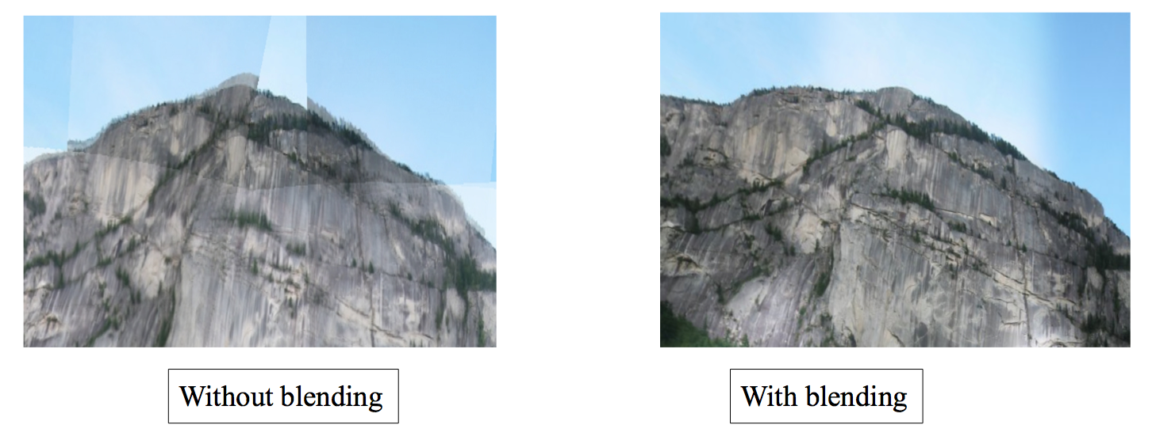
Multi-Band Blending

Slide 9
Multi-Band Blending
Decompose the image into several frequency ranges
Blend low frequencies over a large spatial range
Blend high frequencies over a small spatial range
Difference of Gaussian

Slide 10
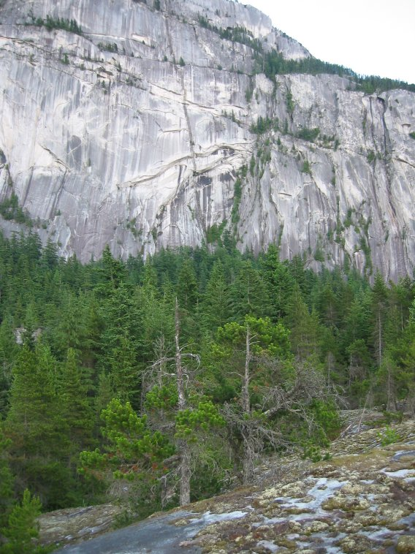
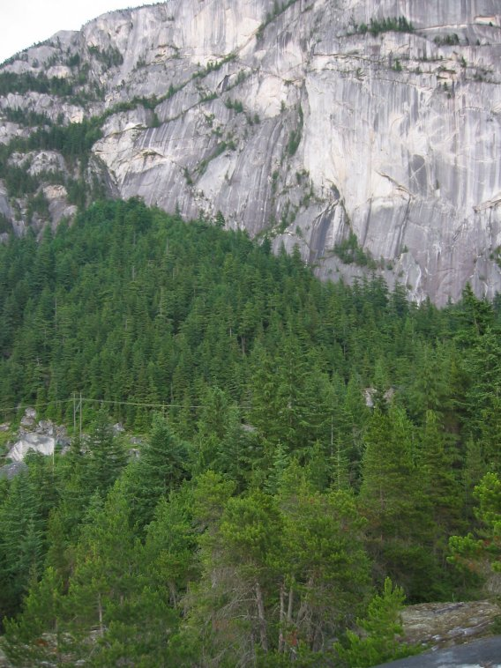
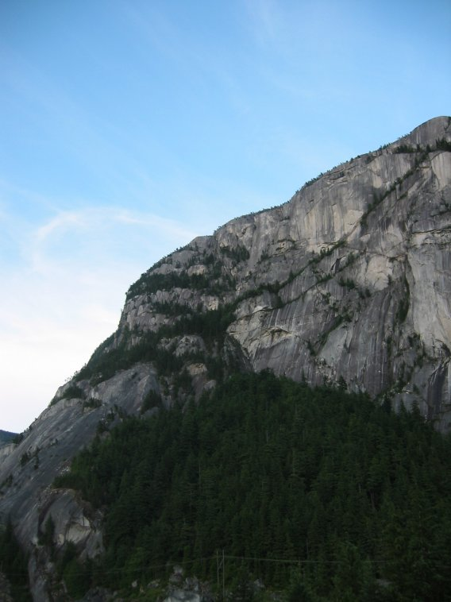
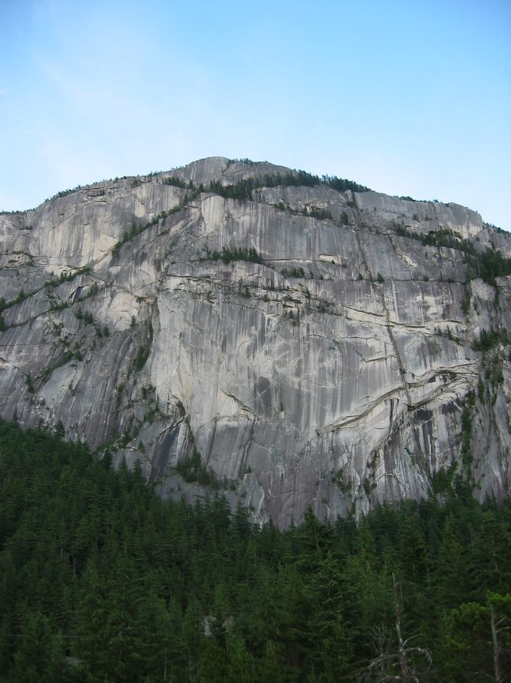
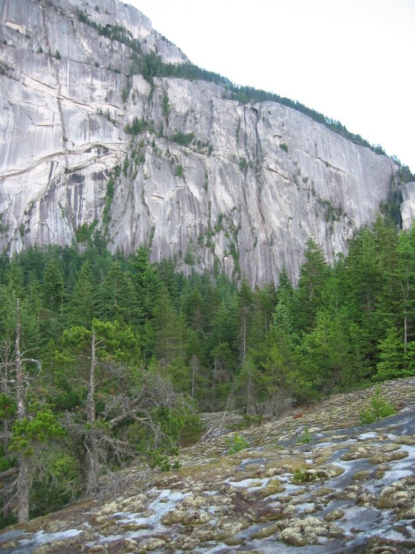
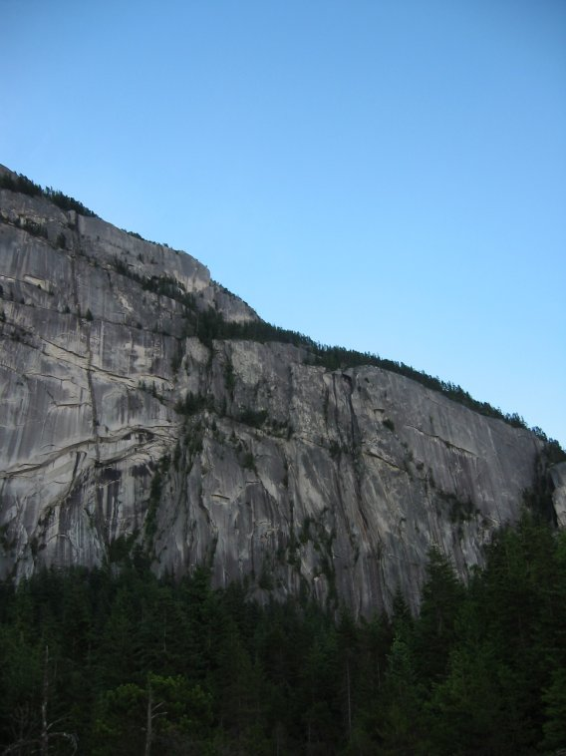
Multi-Band Blending

Slide 11
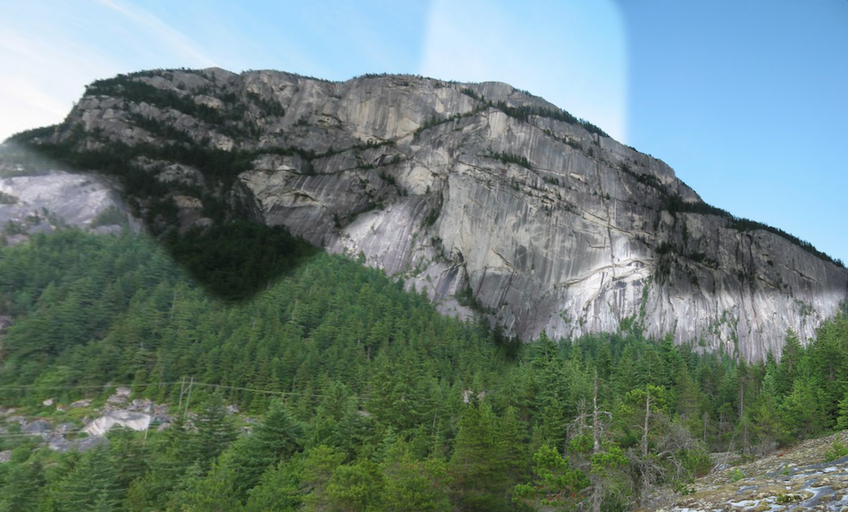
Multi-Band Blending

Slide 12
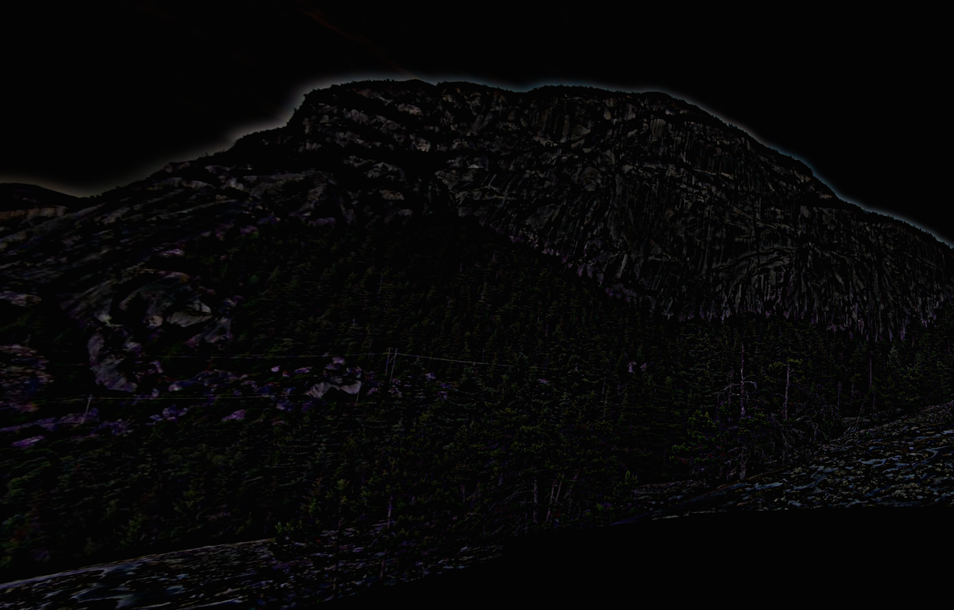
Multi-Band Blending

Slide 13
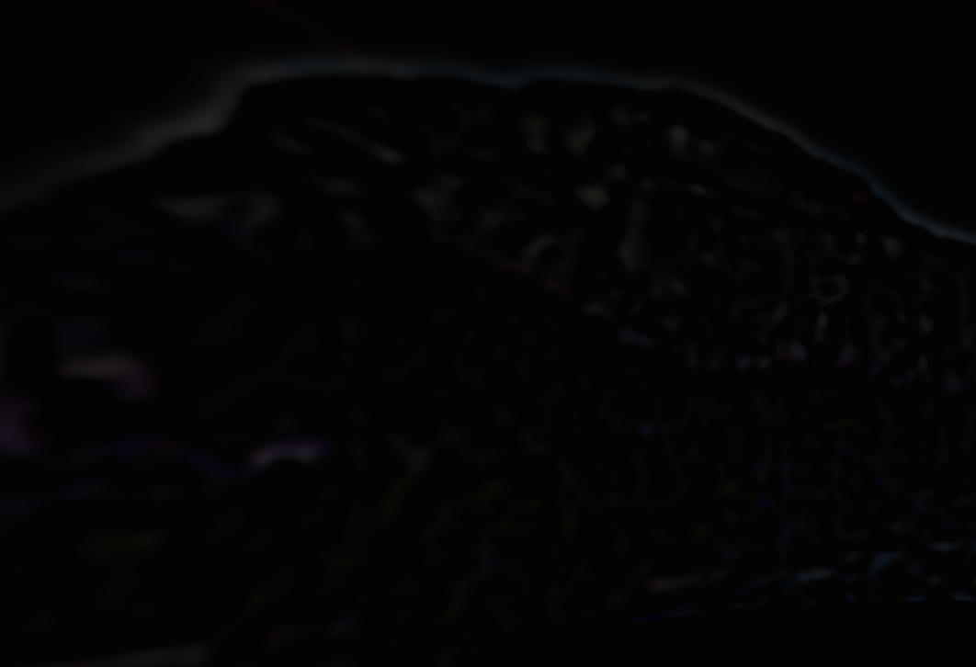
Multi-Band Blending

Slide 14

Multi-Band Blending

Slide 15
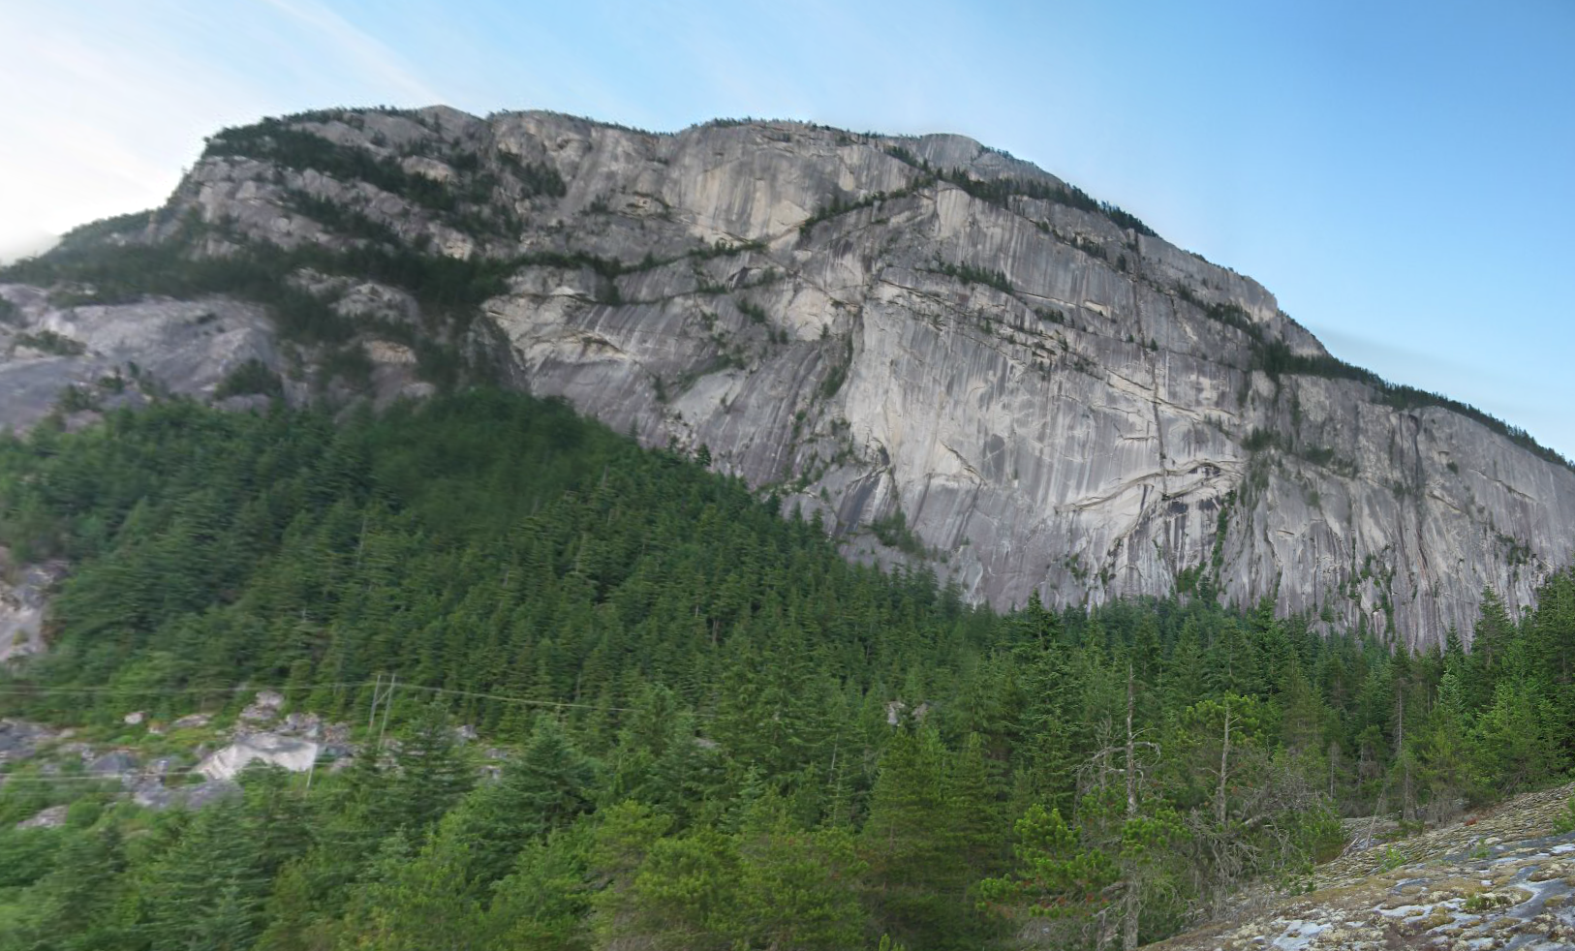
Multi-Band Blending

Slide 16
Thank you
END

