Slide 1

project update
CSE445.3
PRESENTED BY - GROUP 5
S M Samiul Haq - 2011103042
Tanzeem Haque - 2131122642
Tofayel Ahmed - 2112096042
Entiser Hossain - 2021789642

Slide 2


S M Samiul Haq - 2011103042
Project Overview
Tanzeem Haque - 2131122642
Tofayel Ahmed - 2112096042
Entiser Hossain - 2021789642
E
A basic facial recognition system
Detects a person’s face and their expression
Classification model - using 4 classes:
Angry
Happy
Surprised
Neutral

Slide 3

S M Samiul Haq - 2011103042
dataset collection
Tanzeem Haque - 2131122642
Tofayel Ahmed - 2112096042
Entiser Hossain - 2021789642
Python script to take pictures of multiple subjects
Subjects captured images doing expressions corresponding to each class
Captured 100+ images per class, per person
80% of the created dataset will randomly selected for training, while the rest will be used for testing
->
->
->
->

Slide 4
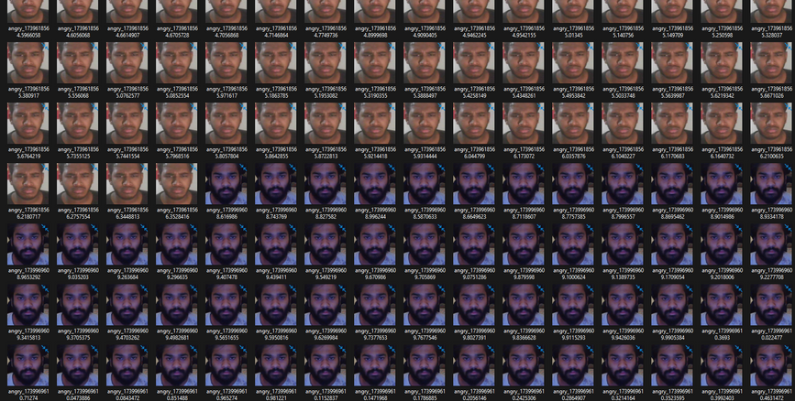
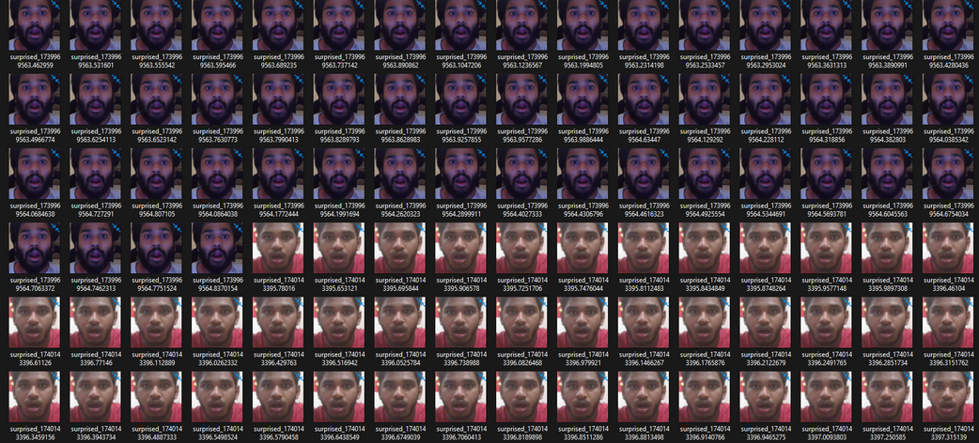
angry expression
surprised expression
S M Samiul Haq - 2011103042
dataset images
Tanzeem Haque - 2131122642
Tofayel Ahmed - 2112096042
Entiser Hossain - 2021789642

Slide 5
S M Samiul Haq - 2011103042
model selection
Tanzeem Haque - 2131122642
Tofayel Ahmed - 2112096042
Entiser Hossain - 2021789642
Considered Models:
VGG-Face
ResNet-50
Selection Criteria:
Hardware resource requirements
Model capabilities in expression detection
Decision:
Chosen Model: ResNet-50
Reason: Efficient performance with available hardware and effective in handling facial expression detection.

Slide 6
challenges and future improvements
S M Samiul Haq - 2011103042
Tanzeem Haque - 2131122642
Tofayel Ahmed - 2112096042
Entiser Hossain - 2021789642
challenges
future steps
01
Dataset Imbalance & Limitations
01
Enhanced Accuracy
02
Facial Expression Similarity
02
User-Friendly Design
03
Hardware Constraints
03
Diverse Training Data

Slide 7
!
Thank You
E

