Slide 1
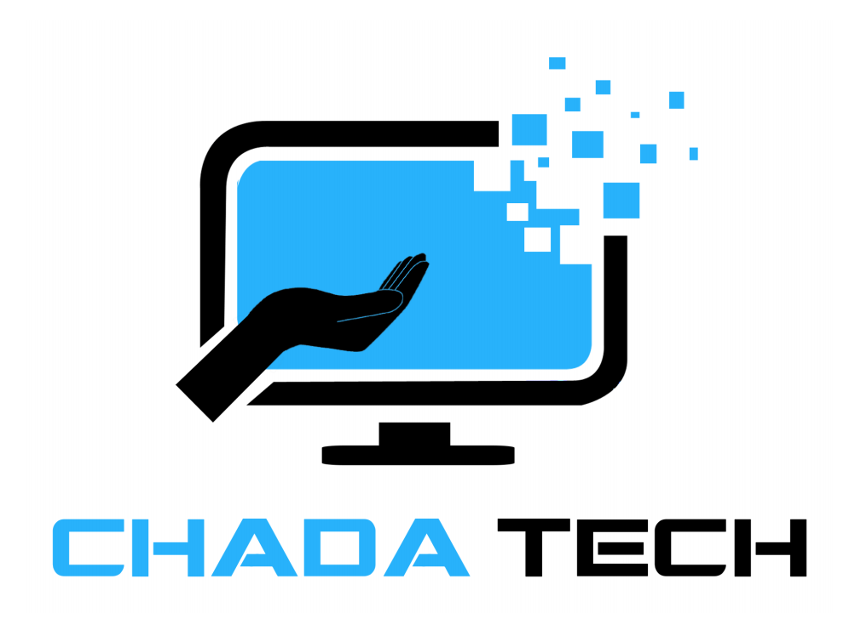
Is Scrum-Agile right for ChadaTech?
Lessons from the SNHU Travel pilot
Mutia Aminu Jimbah, Scrum Master
CS 250 Final Project | Instructor: Maryann Kupa
October 19, 2026
Notes:
Welcome. ChadaTech asked our team to pilot Scrum-Agile on the SNHU Travel app so leadership can decide whether to move every development team. In the next few minutes I cover the roles, the phases, how waterfall would have handled our biggest problem, and the factors for choosing between the two. I close with a recommendation. AI use is disclosed on the references slide.

Slide 2
Recommendation: adopt Scrum-Agile
71%
~60%
57%
of surveyed teams use Agile in their software development life cycle
report improved collaboration
report better alignment with business needs
Our pilot supports this. Make Scrum-Agile the default for projects with evolving requirements, keep waterfall for fixed-scope or regulated work, and tailor the approach to each project.
Source: Digital.ai (2024), 17th State of Agile report.
Notes:
The headline is simple (these figures are industry-wide, not pilot measurements): adopt Scrum-Agile as the default, but tailor it. Digital.ai’s 2024 State of Agile report found 71 percent of respondents use Agile in their software development life cycle, with about 60 percent reporting better collaboration and 57 percent better alignment with business needs. Our SNHU Travel pilot supports this, as the next slides show.

Slide 3



Three accountabilities, four teammates
Product Owner
Scrum Master
Developers
Owns the value and the backlog
Coaches Scrum and clears blockers
Build and test the increment (Developer and Tester)
WHY IT MATTERS
Keeps the team building what the client needs most.
WHY IT MATTERS
Protects focus and keeps the Scrum events working.
WHY IT MATTERS
Turn ordered stories into working, Done software.
SNHU TRAVEL
Christy ran the focus group and reordered the backlog for the pivot.
SNHU TRAVEL
I set the 15-minute Daily Scrum, a blocker rule, and the Definition of Done.
SNHU TRAVEL
Nicole built the Top Five list and Slide Show; Brian tested them and found story gaps.
Together they form a cross-functional, self-managing team that splits traditional project-manager duties across roles (Schwaber & Sutherland, 2020; Sassa et al., 2023).
Notes:
Scrum defines three accountabilities. The Product Owner maximizes the value of the product and orders the backlog; in our pilot that meant reordering it when the client chose detox and wellness travel. The Scrum Master is accountable for establishing Scrum and helping the team improve; As Scrum Master, I set a 15-minute Daily Scrum, a rule that blockers come straight to me, and a Definition of Done. Christy ran the focus group and ranked personalization first. Developers, which includes Nicole and our tester Brian, create the increment and uphold the Definition of Done. Sassa and colleagues note that the traditional project manager’s duties are spread across these roles.

Slide 4
Each sprint runs the full SDLC
1
Requirements
2
Design
3
Build
Backlog refinement and Sprint Planning turn top stories into a Sprint Goal before work starts.
Just-enough design per story, refined with the team, so designs never go stale.
Small increments, synced by the Daily Scrum, surface blockers within a day.
4
Test
5
Deploy
6
Maintain
Testing runs inside the sprint, so Done means working, not just code complete.
Each Increment meets the Definition of Done and can be released, so value ships early.
The Sprint Review and Retrospective feed feedback and fixes into the next sprint.
SDLC phases mapped to the Scrum events (Schwaber & Sutherland, 2020); iterative, test-driven versus plan-driven methods (Thesing et al., 2021).
Notes:
In waterfall each SDLC phase happens once, in order. In Scrum-Agile the same phases happen inside every sprint of one month or less. Requirements are refined and planned into a Sprint Goal, design happens story by story, building is synchronized by the Daily Scrum, testing is inside the sprint against acceptance criteria and the Definition of Done, each Increment is releasable, and the Sprint Review and Retrospective drive maintenance and improvement. Thesing and colleagues describe the contrast as plan-driven versus iterative, test-driven methods.

Slide 5
Waterfall vs. Agile: the wellness pivot
WATERFALL (what would have happened)
Requirements
Design
Build
Test
Deploy
Pivot arrives during Build. A change request reopens approved requirements and design, and a bug like our missing JAR picture would surface only in Test.
SCRUM-AGILE (what we did)
Focus group and stories
Top Five list and Slide Show
Wellness pivot
Pivot handled by reordering the backlog. Christy kept the dates, and Nicole changed only the title, five pictures, and five captions.
From our SNHU Travel work (Modules 3 to 6); waterfall as a plan-driven method (Thesing et al., 2021).
Notes:
Here is our biggest problem: management found an industry report and redirected SNHU Travel toward detox and wellness travel. In a waterfall model the requirements and design were already approved, so the pivot would arrive as a change request during Build and reopen earlier phases. A defect like the missing picture Nicole found in the exported JAR, caused by a file-name capitalization mismatch, would also surface only in the Test phase. In Scrum-Agile Christy kept the dates and reordered the backlog, and Nicole changed only the title, five picture references, and five captions. Thesing and colleagues characterize classical waterfall as plan-driven.

Slide 6
Choosing a method: five factors
Factor | Waterfall fits when… | Agile fits when… | SNHU Travel
Scope | Requirements are fixed and well specified | Requirements will evolve with feedback | Three customers’ stories, then a wellness pivot
Time | Deadline and phase gates are set in advance | Value ships in increments and scope can flex | Dates held by reordering the backlog
Cost | Fixed price needs a full up-front estimate | Budget funds sprints and absorbs change | Pivot changed a title, 5 pictures, 5 captions
Organization | Hierarchical or regulated; heavy documentation | Client is available; collaborative culture | Product Owner reachable by email and Daily Scrum
Team | Large, specialized teams working in phases | Small, cross-functional, self-managing team | Four people: Product Owner, Scrum Master, Developer, Tester
Factors follow Thesing et al. (2021); the “fits when” columns are my adaptation. PMBOK 7 also advises tailoring the approach (PMI, 2021).
Notes:
Thesing, Feldmann, and Burchardt built a 15-criterion decision model in five areas: scope, time, costs, organizational context, and project-team characteristics, from a literature analysis and 15 practitioner interviews. I use those five areas as the factors. The first three columns are how each factor tends to point; the last column is our evidence. SNHU Travel had stories from only three customers, a Product Owner reachable for questions, a four-person cross-functional team, and a pivot, all of which favor Agile. For fixed-scope, heavily regulated work, the left column would win. PMBOK 7 also emphasizes tailoring the approach to the project.

Slide 7
Next steps for ChadaTech
1
Make Scrum-Agile the default for projects with evolving requirements.
2
Keep waterfall, or a hybrid, for fixed-scope or regulated work (Conforto, 2024; PMI, 2021).
3
Train Product Owners and Scrum Masters first; leadership understanding is a top barrier (Digital.ai, 2024).
4
Give every team one shared board; ours was split across a spreadsheet, a workbook, and email.
Chart data: PMI Pulse of the Profession as reported by Conforto (2024).
Notes:
Hybrid approaches grew from 20 percent in 2020 to 31.5 percent in 2023 in PMI’s Pulse research, as reported by Conforto, which supports a fit-for-purpose posture rather than one framework everywhere. My four recommendations: default to Scrum-Agile where requirements evolve, keep waterfall or hybrids for fixed-scope or regulated work, train Product Owners and Scrum Masters first because Digital.ai found leadership understanding and resistance to change are top barriers, and give every team one shared board, because our backlog, test cases, and questions were split across a spreadsheet, a workbook, and email.

Slide 8
References
Anthropic. (2026). Claude Sonnet 5.5 [Large language model]. https://www.anthropic.com/claude
Conforto, E. (2024, February 23). The hybrid era: Project management embraces the fit-for-purpose approach. PMI Blog. https://www.pmi.org/blog/project-management-embraces-the-fit-for-purpose-approach
Digital.ai. (2024, January 16). 17th State of Agile report: 71% use Agile in their SDLC [Press release]. Business Wire. https://www.businesswire.com/news/home/20240116199385/en/17th-State-of-Agile-Report-71-Use-Agile-in-their-SDLC
Project Management Institute. (2021). A guide to the project management body of knowledge (PMBOK guide) (7th ed.).
Sassa, A. C., de Almeida, I. A., Pereira, T. N. F., & de Oliveira, M. S. (2023). Scrum: A systematic literature review. International Journal of Advanced Computer Science and Applications, 14(4). https://thesai.org/Downloads/Volume14No4/Paper_20-Scrum_A_Systematic_Literature_Review.pdf
Schwaber, K., & Sutherland, J. (2020). The Scrum guide. https://scrumguides.org/scrum-guide.html
Thesing, T., Feldmann, C., & Burchardt, M. (2021). Agile versus waterfall project management: Decision model for selecting the appropriate approach to a project. Procedia Computer Science, 181, 746–756. https://doi.org/10.1016/j.procs.2021.01.227
AI use: This presentation was drafted with Claude (Anthropic, 2026) from my Module Three to Six work; I reviewed the content and sources.
Notes:
All sources are cited in APA style. Five are from the last five years: Thesing et al. 2021, PMI 2021, Sassa et al. 2023, Digital.ai 2024, and Conforto 2024. The Scrum Guide 2020 is the authoritative definition of the roles and events. AI assistance is disclosed per the course guidelines.

