Slide 1

Team : Go Paloks
Livestock Management System
CSE 4408: System Analysis and Design Lab
Presentation 3
May 13, 2026

Slide 2
Team Members
Sadnan - 230041119
Tawfiq - 230041129
Irtisham - 230041131
Abtahi - 230041135
Arkam - 230041157
02/18

Slide 3
Organizational Overview
Integrated Smart Farm System
Covers: Poultry, Fisheries, Cattle
Goal: Efficiency + Sustainability
Interconnected subsystems (resource sharing)
03/18

Slide 4

Key Issues
1
2
3
4
5
Manual Record
Disconnected Subsystem
No real-time monitoring
Delayed Decision
Poor Tracking
Data Loss
Human Error
Inconsistency
Duplicate work
Manual Handoff
Higher error rate
False/Missed Alert
Data Inconsistency
Failed Predictive Analysis
Irregular vaccination
Missed feed-tracking
Neglection can cause huge loss
Inconsistent production
Overstocking or shortage of resources
Lack of accountability
04/18

Slide 5
Objectives vs Requirements
Auto Data & Report generation
Real-time tracking
Subsystem Integration
Resource management and system usability
All subsystem supported centralised database
Monitoring & Alert system for analytics
Unified Interface & Synchronized Subsystem
Modular yet Concise & Interconnected Architecture
05/18

Slide 6
Data Source
We have a direct line to a conventional livestock farm stakeholder.
Co-founder of Parallax Infotech gave approximate costs of the software development
Estimated farm resource & operation costs (based on current manual record-keeping process.)
Estimated development & Training cost
Livestock feed prices have been collected from ARMAN Feeds and Fisheries Ltd.
06/18

Slide 7


Technical Feasibility l
TEO
1. Enhance the previous project?
Previous system: Entirely paper-based
No existing software infrastructure
Therefore, a freshly built system from scratch is required .
Solution: Replace the whole project
Web-based application
Relational databases
07/18

Slide 8
Technical Feasibility ll
TEO
2. Existence of technology
Web/mobile interface
Dashboards
Reporting tools.
3. Lack of in-house expertise but they can be hired
UI development
Backend development
Testing
Mobile app dev
4. Packaged Solution & Customization
Available but requires customization
Each subsystem needs to be synchronised as needed.
Conclusion: Technically Feasible
08/18

Slide 9
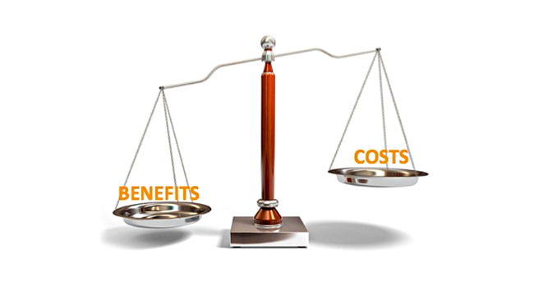
Economical Feasibility I
TEO
1. Benefit vs Cost
Benefits:
Reduced manual record keeping
No data loss
No delayed decisions
Improved tracking
Cost:
Development
Training
Setup
Observation:
Long term benefits
Better efficiency
One time cost.
09/18

Slide 10
Economical Feasibility II
TEO
2. Major Cost Considerations
System analysis
Design work
Employee training
Outsource hiring cost
Database setup
3. Clear value for System
Improved resource plan
Ensures accountability
Reduction of waste
Automated data
Flawless transaction record
Conclusion: Economically Feasible
10/18

Slide 11
Operational Feasibility I
TEO
1. System operates correctly?
Made by the experts in the field
Thorough system analysis
User feedback taken into consideration
2. Will system be used once deployed ?
Intuitive system
Training will be provided
Simple & helpful
11/18

Slide 12
Operational Feasibility II
TEO
3. How will it impact workflows and processes?
Improved workflow:
Digital record keeping
Centralised reporting
Easy Tracking:
Daily logs & Working Schedules
Inventory updates
Health monitoring
Conclusion: Operationally Feasible
12/18

Slide 13
Cost Forecast
Cost Item Estimated Cost —--------------------------------------------------------
System analyst [primary] -> ৳60,000*(4 month/yr) Software developer -> ৳80,000*2 Database/server setup -> ৳35,000*2 Training and transition -> ৳55,000 —------------------------------------------------------ Total One-Year Cost -> ৳510,000
13/18

Slide 14
Benefit Forecast
i) Reduced manual record-keeping effort -> ৳180,000 ((30k[manager] - 15k[data insertion]) * 12) ii) Reduced feed mismanagement -> ৳140,000 (10*25 kg packet of cattle feed *12) [20 cow approx] -> ৳60,000 (2*50kg sacks chicken feed*12) [1k chicken approx] -> ৳100,000 (5*25kg sacks of fish feed *12) [5 acre pond of Mixed carp fish] iii) Faster reporting and decision-making -> ৳12,000 [5% upscaling] iv) Better Inventory Control -> ৳10,000 —----------------------------------------------------------------------- Total Yearly Benefit -> ৳492,000
14/18

Slide 15
Cost vs Benefit Analysis
Item | Amount
Total Initial Cost | ৳510,000
Yearly Benefit | ৳492,000
First-Year Net Position | ৳18,000 loss
Second-Year Net Position | ৳474,000 gain
Initially, we might incur an amount of loss but after that we will gain benefits in multitudes.
15/18

Slide 16
Payback Analysis
Payback period means how long it takes to recover the investment.
Payback Period = Initial Investment ÷ Annual Net Benefit
Payback Period = ৳510,000 ÷ ৳492,000 = 1.036 years
The estimated payback period is around 1.078 years. The system can recover its cost within nearly one year and one months.
16/18

Slide 17
Break-Even Analysis
Break-even means the point where total benefits become equal to total costs.
Total Initial Cost = ৳510,000 Yearly benefit = ৳492,000 Monthly benefit = ৳492,000 ÷ 12 = ৳41,000
Break-even Point = ৳510,000 ÷ ৳41,000 = 12.43 months The system is expected to break even in approximately 13 months (approx.)
17/18

Slide 18
Thank You
We are ready for your valuable feedback!

