Slide 1
Mutation Conservation in Mendelian Genes
Maria Chavez
July 10, 2015

Slide 2
Setup
Got the protein sequences from Entrez Protein
Got Amino Acid mutations from ClinVar
Performed a protein MSA using CLUSTALW2

Slide 3
Analysis
For every amino acid in which there is a mutation I found the Jensen Shannon Divergence, Shannon Entropy and Sum of Pairs score
Calculated standard deviation, standard error, t, and p values for relationships. Confirmed using a t-test with R

Slide 4
Results Summary
Replaceable vs non replaceable genes (yeast paper)

Slide 5
Replaceable Genes (sample = 8)
Ave mutations per gene: 5.25, only one benign mutation analyzed
On average 1.624 mutations are fully conserved (23%)
Fully conserved mutations make up on average 2% of fully conserved amino acids
Difference between average AA and pathogenic AA is not statistically significant (Jensen Shannon Divergence p: 0.2763591, Shannon Entropy p: 0.1860548, Sum of Pairs p: 0.1375894)

Slide 6
Non-Replaceable Genes (sample = 6)
Ave mutations per gene: 4, 24% benign
On average 0.4 mutations are fully conserved (7%)
Fully conserved mutations make up on average 1% of fully conserved amino acids
Difference between average AA and pathogenic AA (p > a) is not statistically significant (Jensen Shannon Divergence p: 0.113819, Shannon Entropy p: 0.145702, Sum of Pairs p: 0.3490833)
Difference between pathogenic and benign (p > b) not significant (Jensen Shannon Divergence p: 0.1159944, Shannon Entropy p: 0.05275803, Sum of Pairs p: 0.1341106)

Slide 7
Replaceable vs non replaceable
On average AA in replaceable genes are more conserved than AA in non replaceable genes (Jensen Shannon Divergence p: 0.0289762, Shannon Entropy p: 0.03484218, and Sum of Pairs p: 0.04859736)
On average pathogenic mutations are more conserved in replaceable than non replaceable genes (using shannon entropy and sum of pairs) though the difference is not statistically significant (p: 0.3611836 and 0.1574445 respectively)

Slide 8
Results
First 9.6% of full dataset (260 mendelian genes)

Slide 9

First 9.6% of full dataset (sample = 25)
Ave mutations per gene: 7.68, 14% benign
On average 2.66 mutations are fully conserved (25%)
Fully conserved mutations make up on average 2% of fully conserved amino acids
Difference between average AA and pathogenic AA (p > a) is statistically significant in 2/3 methods
Difference between pathogenic and benign (p > b) is significant

Slide 10
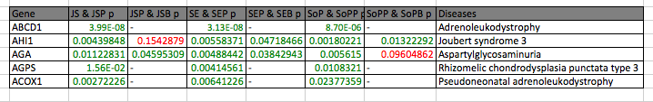
Top 5 genes where difference between average AA and pathogenic is most significant

Slide 11
Where does NPC1 stand in relation to the currently analyzed dataset?
Percentage of fully conserved mutations is lower than the average in the dataset (NPC1: 20%, average: 25%)
Fully conserved mutations make up 7% of the fully conserved amino acids, vs an average of 2%
51 mutations, 19% benign vs average of 7.68 and 14%

Slide 12
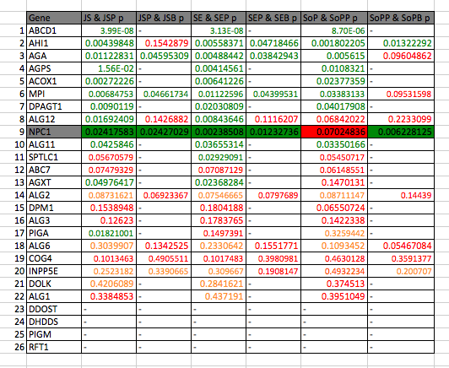
Where does NPC1 stand in relation to the currently analyzed dataset?

