Slide 1
Mutation Conservation in Mendelian Genes
July 17, 2015

Slide 2
Setup
Got the protein sequences from Entrez Protein
Got Amino Acid mutations from ClinVar
Performed a protein MSA using CLUSTALW2

Slide 3
Analysis
For every amino acid in which there is a mutation I found the Jensen Shannon Divergence, Shannon Entropy and Sum of Pairs score
Calculated standard deviation, standard error, t, and p values for relationships. Confirmed using a t-test with R

Slide 4
Results
First 21.9% of full dataset (260 mendelian genes)

Slide 5

First 21.9% of full dataset (sample = 57)
Ave mutations per gene: 9.57, 22% benign
On average 3.4 mutations are fully conserved (27%)
Fully conserved mutations make up on average 2% of fully conserved amino acids
Difference between average AA and pathogenic AA (p > a) is statistically significant
Difference between pathogenic and benign (p > b) is statistically significant

Slide 6
Now some graphs!

Slide 7
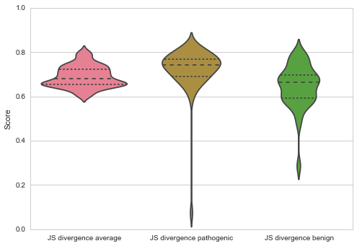
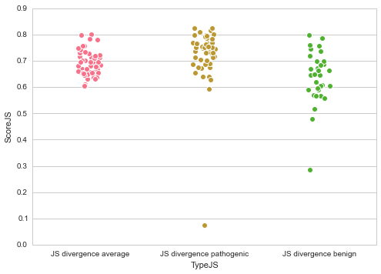
Jensen Shannon Divergence Scores

Slide 8
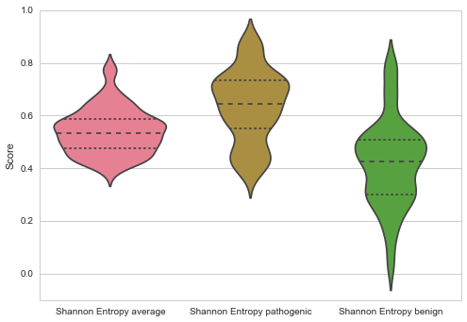
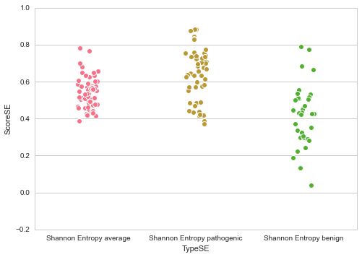
Shannon Entropy Scores

Slide 9
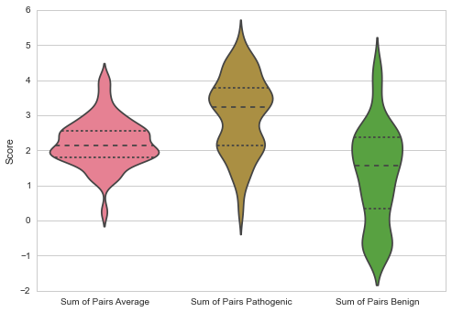
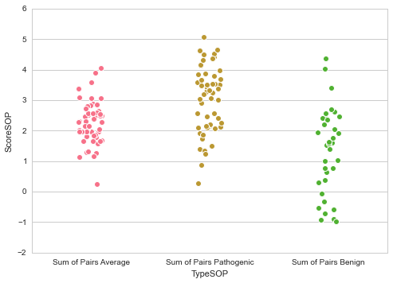
Sum of Pairs Scores

Slide 10
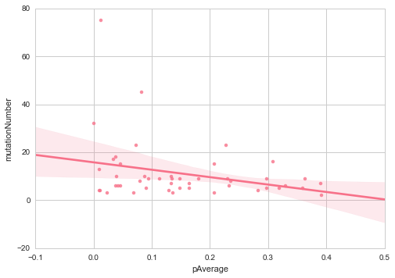
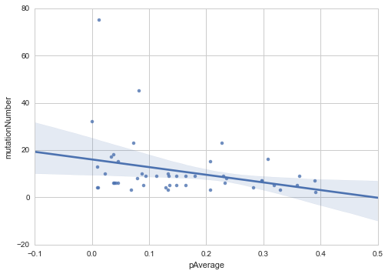
Correlation between # of mutations and p value

