Slide 1
Mutation Conservation Across Organisms in NPC1
Maria Chavez
June 19, 2015

Slide 2
Setup
Got the protein sequences from Entrez Protein
Got Amino Acid mutations from ClinVar (total: 51)
Performed a protein MSA using CLUSTALW2

Slide 3
Analysis
For every amino acid in which there is a mutation I found the Jensen Shannon Divergence, Shannon Entropy and Sum of Pairs score
Calculated standard deviation, standard error, t, and p values for relationships. Confirmed using a t-test with R

Slide 4
Results

Slide 5
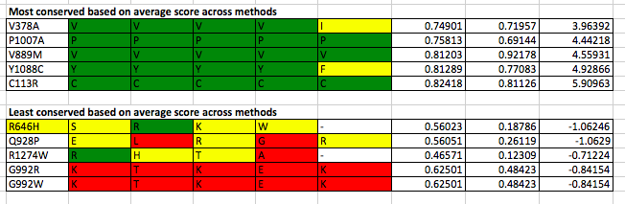

Slide 6
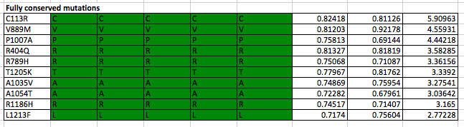

Slide 7
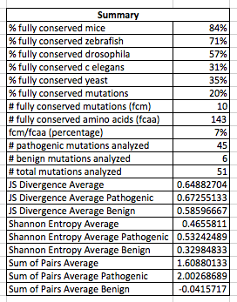

Slide 8
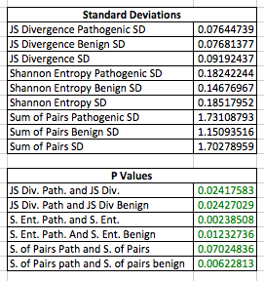

Slide 9
Any suggestions on what else I can do with the data?

