Slide 1
CEN 352: Software Engineering
Asst. Prof. Dr. Serkan KARTAL
Department of Computer Engineering
2017-2018
http://193.140.54.203/skartal/dokumanlar
© Lethbridge/Laganière 2005
Chapter 1: Software and Software Engineering

Slide 2
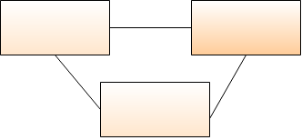
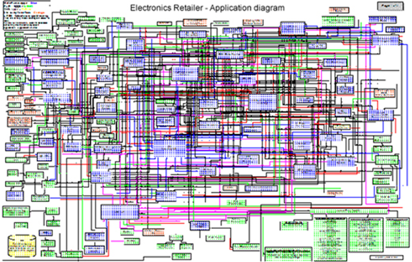
Why learn Software Engineering
Simple software systems are easy to develop
Any programmers can code them - easy enough
But, large and complex ones - not that easy !
You need a disciplined approach —> Software Engineering
© Lethbridge/Laganière 2005
Chapter 1: Software and Software Engineering

Slide 3
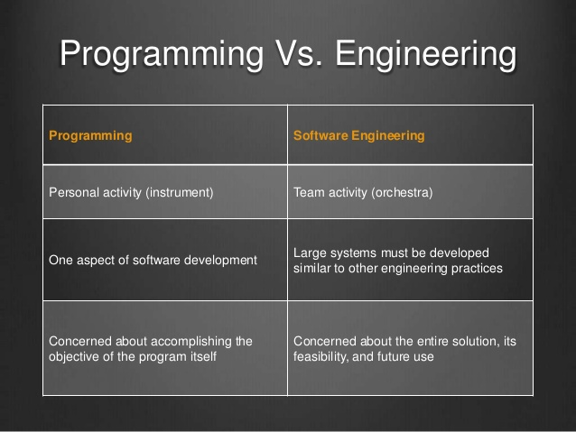
Software Engineering is NOT Programming!

Slide 4
Why take this course
To learn how large software developed
To learn software development stages
To learn Object-Oriented software engineering
To learn Unified Modeling Language (UML)
To learn Design Patterns
To learn Architecting Designing Software
Testing
© Lethbridge/Laganière 2005
Chapter 1: Software and Software Engineering

Slide 5
Course Information
Office Hours: Wednesdays and Fridays between 2:00pm and 3:00pm
Lecture notes: Available via the webpage
Textbooks:
(Required) Timothy C. Lethbridge and Robert Laganière, Object-Oriented Software Engineering: Practical Software Development using UML and Java, McGraw Hill
© Lethbridge/Laganière 2005
Chapter 1: Software and Software Engineering

Slide 6
Object-Oriented Software Engineering
Practical Software Development using UML and Java
Chapter 1:
Software and Software Engineering

Slide 7
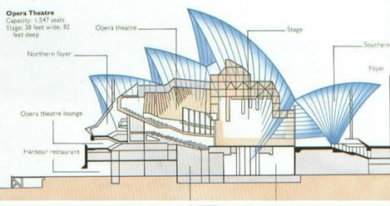
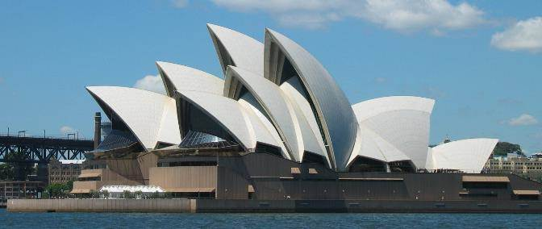
1.1 The Nature of Software...
Software is intangible
  Hard to understand development effort
Software is easy to reproduce
  Cost is in its development
    in other engineering products, manufacturing is the costly stage
The industry is labor-intensive
  Hard to automate
© Lethbridge/Laganière 2005
Chapter 1: Software and Software Engineering

Slide 8
The Nature of Software ...
Untrained people can hack something together
  Quality problems are hard to notice
Software is easy to modify
  People make changes without fully understanding it
Software does not ‘wear out’
  It deteriorates by having its design changed:
    erroneously, or
    in ways that were not anticipated, thus making it complex
© Lethbridge/Laganière 2005
Chapter 1: Software and Software Engineering

Slide 9
The Nature of Software
Conclusions
  Much software has poor design and is getting worse
  Demand for software is high and rising
  We are in a perpetual ‘software crisis’
  We have to learn to ‘engineer’ software
© Lethbridge/Laganière 2005
Chapter 1: Software and Software Engineering

Slide 10
Types of Software...
Custom
  For a specific customer
    Developing Airline Ticket Reservation System
Generic
  Sold on open market
    Developing Windows 10 (a new operating system)
  Often called
    COTS (Commercial Off The Shelf)
    Shrink-wrapped
Embedded
  Built into hardware
  Hard to change
© Lethbridge/Laganière 2005
Chapter 1: Software and Software Engineering

Slide 11
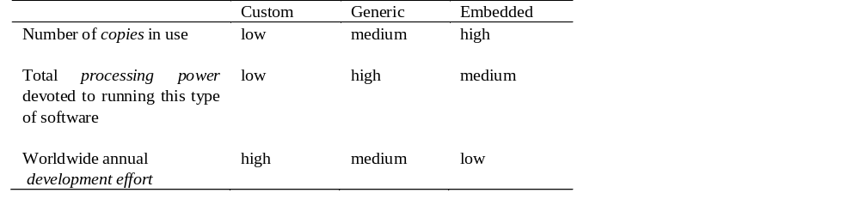
Types of Software
Differences among custom, generic and embedded software
© Lethbridge/Laganière 2005
Chapter 1: Software and Software Engineering

Slide 12
Types of Software
Real time software
  E.g. control and monitoring systems
  Must react immediately
  Safety often a concern
Data processing software
  Used to run businesses
  Accuracy and security of data are key
Some software has both aspects
© Lethbridge/Laganière 2005
Chapter 1: Software and Software Engineering

Slide 13
1.2 What is Software Engineering?...
The process of solving customers’ problems by the systematic development and evolution of large, high-quality software systems within cost, time and other constraints
Other definitions:
  IEEE: (1) the application of a systematic, disciplined, quantifiable approach to the development, operation, maintenance of software; that is, the application of engineering to software. (2) The study of approaches as in (1).
  The Canadian Standards Association: The systematic activities involved in the design, implementation and testing of software to optimize its production and support.
© Lethbridge/Laganière 2005
Chapter 1: Software and Software Engineering

Slide 14
What is Software Engineering?…
Solving customers’ problems
  This is the goal of software engineering
  Sometimes the solution is to buy, not build
  Adding unnecessary features does not help solve the problem
  Software engineers must communicate effectively to identify and understand the problem
© Lethbridge/Laganière 2005
Chapter 1: Software and Software Engineering

Slide 15
What is Software Engineering?…
Systematic development and evolution
  An engineering process involves applying well understood techniques in a organized and disciplined way
  Many well-accepted practices have been formally standardized
    e.g. by the IEEE or ISO
  Most development work is evolution
© Lethbridge/Laganière 2005
Chapter 1: Software and Software Engineering

Slide 16
What is Software Engineering?…
Large, high quality software systems
  Software engineering techniques are needed because large systems cannot be completely understood by one person
  Teamwork and co-ordination are required
  Key challenge: Dividing up the work and ensuring that the parts of the system work properly together
  The end-product must be of sufficient quality
© Lethbridge/Laganière 2005
Chapter 1: Software and Software Engineering

Slide 17
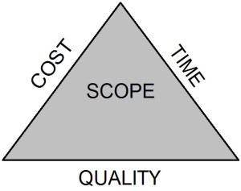
What is Software Engineering?
Cost, time and other constraints
  Finite resources
  The benefit must outweigh the cost
  Others are competing to do the job cheaper and faster
  Inaccurate estimates of cost and time have caused many project failures
© Lethbridge/Laganière 2005
Chapter 1: Software and Software Engineering

Slide 18
1.4 Stakeholders in Software Engineering
1. Users
  Those who use the software
2. Customers
  Those who pay for the software
3. Software developers
4. Development Managers
All four roles can be fulfilled by the same person
© Lethbridge/Laganière 2005
Chapter 1: Software and Software Engineering

Slide 19
1.5 Software Quality...
Usability
  Users can learn it and fast and get their job done easily
Efficiency
  It doesn’t waste resources such as CPU time and memory
Reliability
  It does what it is required to do without failing
Maintainability
  It can be easily changed
Reusability
  Its parts can be used in other projects, so reprogramming is not needed
© Lethbridge/Laganière 2005
Chapter 1: Software and Software Engineering

Slide 20
Software Quality and the Stakeholders
Customer:
User:
solves problems at
easy to learn;
an acceptable cost in
efficient to use;
terms of money paid and
helps get work done
resources used
QUALITY
SOFTWARE
Developer:
Development manager:
easy to design;
sells more and
easy to maintain;
pleases customers
easy to reuse its parts
while costing less
to develop and maintain
© Lethbridge/Laganière 2005
Chapter 1: Software and Software Engineering

Slide 21

Software Quality: Conflicts and Objectives
The different qualities can conflict
  Increasing efficiency can reduce maintainability or reusability
  Increasing usability can reduce efficiency
Setting objectives for quality is a key engineering activity
  You then design to meet the objectives
  Avoids ‘over-engineering’ which wastes money
Optimizing is also sometimes necessary
  E.g. obtain the highest possible
  reliability using a fixed budget
© Lethbridge/Laganière 2005
Chapter 1: Software and Software Engineering

Slide 22
Internal Quality Criteria
These:
  Characterize aspects of the design of the software
  Have an effect on the external quality attributes
  E.g.
    The amount of commenting of the code
    The complexity of the code
© Lethbridge/Laganière 2005
Chapter 1: Software and Software Engineering

Slide 23
Short Term Vs. Long Term Quality
Short term:
  Does the software meet the customer’s immediate needs?
  Is it sufficiently efficient for the volume of data we have today?
Long term:
  Maintainability
  Customer’s future needs
  Scalability: Can the software handle larger volumes of data?
© Lethbridge/Laganière 2005
Chapter 1: Software and Software Engineering

Slide 24
1.6 Software Engineering Projects
Most projects are evolutionary or maintenance projects, involving work on legacy systems
  Corrective projects: fixing defects
  Adaptive projects: changing the system in response to changes in
    Operating system
    Database
    Rules and regulations
  Enhancement projects: adding new features for users
  Reengineering or perfective projects: changing the system internally so it is more maintainable
© Lethbridge/Laganière 2005
Chapter 1: Software and Software Engineering

Slide 25
Software Engineering Projects
‘Green field’ projects
  New development
  The minority of projects
© Lethbridge/Laganière 2005
Chapter 1: Software and Software Engineering

Slide 26
Software Engineering Projects
Projects that involve building on a framework or a set of existing components.
  A framework is an application that is missing some important details.
    E.g. Specific rules of this organization.
  Such projects:
    Involve plugging together components that are:
      Already developed.
      Provide significant functionality.
    Benefit from reusing reliable software.
    Provide much of the same freedom to innovate found in green field development.
© Lethbridge/Laganière 2005
Chapter 1: Software and Software Engineering

Slide 27
1.7 Activities Common to Software Projects...
Requirements and specification
  Includes
    Domain analysis
    Defining the problem
    Requirements gathering
      Obtaining input from as many sources as possible
    Requirements analysis
      Organizing the information
    Requirements specification
      Writing detailed instructions about how the software should behave
© Lethbridge/Laganière 2005
Chapter 1: Software and Software Engineering

Slide 28
Activities Common to Software Projects...
Design
  Deciding how the requirements should be implemented, using the available technology
  Includes:
    Systems engineering: Deciding what should be in hardware and what in software
    Software architecture: Dividing the system into subsystems and deciding how the subsystems will interact
    Detailed design of the internals of a subsystem
    User interface design
    Design of databases
© Lethbridge/Laganière 2005
Chapter 1: Software and Software Engineering

Slide 29
Activities Common to Software Projects
Modeling
  Creating representations of the domain or the software
    Use case modeling
    Structural modeling
    Dynamic and behavioural modeling
Programming
Quality assurance
  Reviews and inspections
  Testing
Deployment
Managing the process
© Lethbridge/Laganière 2005
Chapter 1: Software and Software Engineering

Slide 30
1.8 The Nine Themes of the Book
1. Understanding the customer and the user
2. Basing development on solid principles and reusable technology
3. Object orientation
4. Visual modeling using UML
5. Evaluation of alternatives
6. Incorporating quantitative and logical thinking
7. Iterative and agile development
8. Communicating effectively using documentation
9. Risk management in all SE activities
© Lethbridge/Laganière 2005
Chapter 1: Software and Software Engineering

