Slide 1
Object-Oriented Software Engineering Practical Software Development using UML and Java
Chapter 10:
Testing and Inspecting to Ensure High Quality

Slide 2

Definitions
SW Testing: Techniques to execute programs with the intent of finding as many defects as possible and/or gaining sufficient confidence in the software system under test.
“Program testing can show the presence of bugs, but never their absence” (Edsger Dijkstra, 1930-2002)

Slide 3
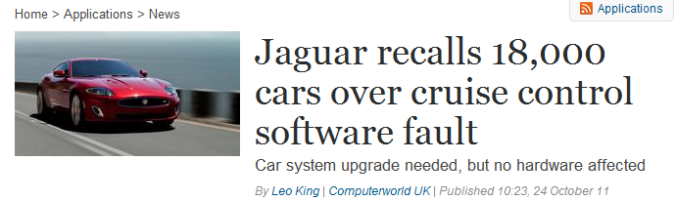
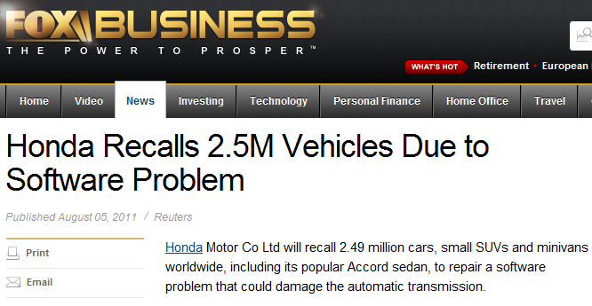
Need for SW testing-Examples of SW Failures

Slide 4
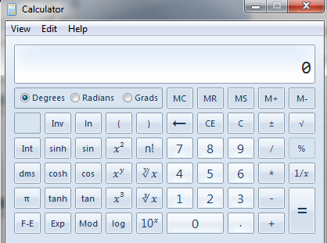
Brain storming: How will you test the Win Calculator?
Test plan
How many inputs (test cases)?
So MANY possibilities
How do we know if we have tested the system “enough”?
How do we know if the outputs are correct!?
If the system changes, shall we test everything AGAIN?

Slide 5
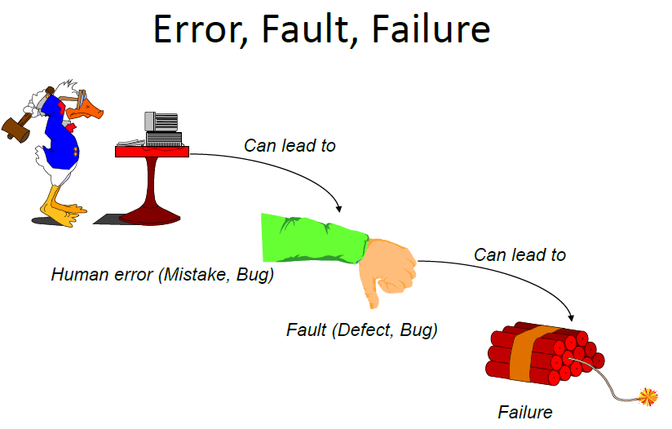
10.1 Basic definitions
An error is a slip-up or inappropriate decision by a software developer that leads to the introduction of a defect
A defect is a flaw in any aspect of the system that contributes, or may potentially contribute, to the occurrence of one or more failures
A failure is an unacceptable behaviour exhibited by a system

Slide 6


Slide 7


Slide 8
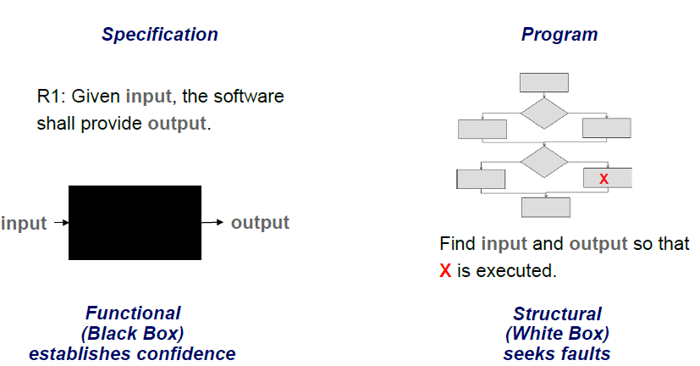
Basic Approaches

Slide 9
Glass-box (white-box) testing
Also called ‘white-box’ or ‘structural’ testing
Testers have access to the system design
They can
Examine the design documents
View the code
Observe at run time the steps taken by algorithms and their internal data
Individual programmers often informally employ glass-box testing to verify their own code

Slide 10
Black-box/ closed box testing
Testing based only on specification:
Exhaustive testing
2. Equivalence class testing (Equivalence Partitioning)
3. Boundary value analysis

Slide 11
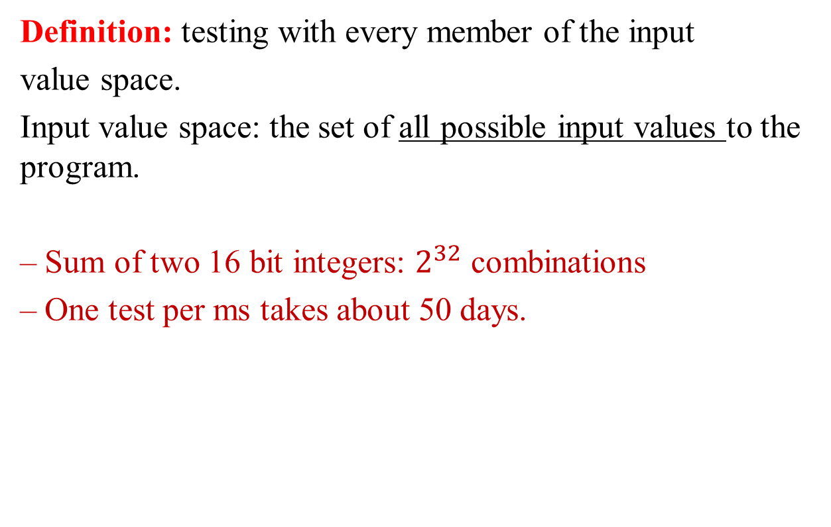
1. Exhaustive testing
Definition: testing with every member of the input
value space.
Input value space: the set of all possible input values to the program.
– Sum of two 16 bit integers: $2^{32}$ combinations
– One test per ms takes about 50 days.

Slide 12
Equivalence Class Testing
Equivalence Class (EC) testing is a technique used to reduce the number of test cases to a manageable level while still maintaining reasonable test coverage.
Each EC consists of a set of data that is treated the same by the module or that should produce the same result. Any data value within a class is equivalent, in terms of testing, to any other value.

Slide 13
Examples of equivalence classes
Valid input is a month number (1-12)
Equivalence classes are: [-∞..0], [1..12], [13.. ∞]
Valid input is one of ten strings representing a type of fuel
Equivalence classes are
10 classes, one for each string
A class representing all other strings

Slide 14
Combinations of equivalence classes
Combinatorial explosion means that you cannot realistically test every possible system-wide equivalence class.
If there are 4 inputs with 5 possible values there are 5⁴ (i.e. 625) possible system-wide equivalence classes.
You should first make sure that at least one test is run with every equivalence class of every individual input.
You should also test all combinations where an input is likely to affect the interpretation of another.
You should test a few other random combinations of equivalence classes.

Slide 15
Example equivalence class combinations
One valid input is either ‘Metric’ or ‘US/Imperial’
Equivalence classes are:
Metric, US/Imperial, Other
Another valid input is maximum speed: 1 to 750 km/h or 1 to 500 mph
Validity depends on whether metric or US/imperial
Equivalence classes are:
[-∞..0], [1..500], [501..750], [751.. ∞]
Some test combinations
Metric, [1..500] valid
US/Imperial, [1..500] valid
Metric, [501..750] valid
US/Imperial, [501..750] invalid

Slide 16

Testing at boundaries of equivalence classes
More errors in software occur at the boundaries of equivalence classes
The idea of equivalence class testing should be expanded to specifically test values at the extremes
of each equivalence class
E.g. The number 0 often causes problems
E.g.: If the valid input is a month number (1-12)
Test equivalence classes as before
Test 0, 1, 12 and 13 as well as very large positive and negative values

Slide 17
Detecting specific categories of defects
A tester must try to uncover any defects the other software engineers might have introduced.
This means designing tests that explicitly try to catch a range of specific types of defects that commonly occur

Slide 18
10.3 Defects in Ordinary Algorithms
Incorrect logical conditions
Defect:
The logical conditions that govern looping and if-then-else statements are wrongly formulated.
Testing strategy:
Use equivalence class and boundary testing.
Consider as an input each variable used in a rule or logical condition.

Slide 19
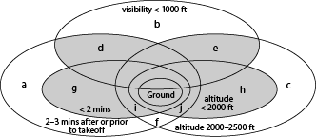
Example of incorrect logical conditions defect
What is the hard-to-find defect in the following code?
The landing gear must be deployed whenever the plane is within 2 minutes from landing or takeoff, or within 2000 feet from the ground. If visibility is less than 1000 feet, then the landing gear must be deployed whenever the plane is within 3 minutes from landing or lower than 2500 feet
Total number of system equivalence classes: 108
if(!landingGearDeployed &&
(min(now-takeoffTime,estLandTime-now))<
(visibility < 1000 ? 180 :120) ||
relativeAltitude <
(visibility < 1000 ? 2500 :2000)
)
{
throw
new LandingGearException();
}

Slide 20
Defects in Ordinary Algorithms
Performing a calculation in the wrong part of a control construct
Defect:
The program performs an action when it should not, or does not perform an action when it should.
Typically caused by inappropriately excluding or including the action from a loop or a if construct.
Testing strategies:
Design tests that execute each loop zero times, exactly once, and more than once.
Anything that could happen while looping is made to occur on the first, an intermediate, and the last iteration.

Slide 21
Example of performing a calculation in the wrong part of a control construct
while(j<maximum)
{
k=someOperation(j);
j++;
}
if(k==-1) signalAnError();
if (j<maximum)
doSomething();
if (debug) printDebugMessage();
else doSomethingElse();

Slide 22
Defects in Ordinary Algorithms
Not terminating a loop or recursion
Defect:
A loop or a recursion does not always terminate, i.e. it is ‘infinite’.
Testing strategies:
Analyse what causes a repetitive action to be stopped.
Run test cases that you anticipate might not be handled correctly.

Slide 23
Defects in Ordinary Algorithms
Not setting up the correct preconditions for an algorithm
Defect:
Preconditions state what must be true before the algorithm should be executed.
A defect would exist if a program proceeds to do its work, even when the preconditions are not satisfied.
Testing strategy:
Run test cases in which each precondition is not satisfied.

Slide 24
Defects in Ordinary Algorithms
Not handling null conditions
Defect:
A null condition is a situation where there normally are one or more data items to process, but sometimes there are none.
It is a defect when a program behaves abnormally when a null condition is encountered.
Testing strategy:
Brainstorm to determine unusual conditions and run appropriate tests.

Slide 25
Defects in Ordinary Algorithms
Not handling singleton or non-singleton conditions
Defect:
A singleton condition occurs when there is normally more than one of something, but sometimes there is only one.
A non-singleton condition is the inverse.
Defects occur when the unusual case is not properly handled.
Testing strategy:
Brainstorm to determine unusual conditions and run appropriate tests.

Slide 26
Defects in Ordinary Algorithms
Off-by-one errors
Defect:
A program inappropriately adds or subtracts one.
Or loops one too many times or one too few times.
This is a particularly common type of defect.
Testing strategy:
Develop tests in which you verify that the program:
computes the correct numerical answer.
performs the correct number of iterations.

Slide 27
Example of off-by-one defect
for (i=1; i<arrayname.length; i++)
{
/* do something */
}
Use Iterators to help eliminate these defects
while (iterator.hasNext())
{
anOperation(++val);
}

Slide 28
Defects in Ordinary Algorithms
Operator precedence errors
Defect:
An operator precedence error occurs when a programmer omits needed parentheses, or puts parentheses in the wrong place.
Operator precedence errors are often extremely obvious...
but can occasionally lie hidden until special conditions arise.
E.g. If x*y+z should be x*(y+z) this would be hidden if z was normally zero.
Testing:
In software that computes formulae, run tests that anticipate such defects.

Slide 29
Defects in Ordinary Algorithms
Use of inappropriate standard algorithms
Defect:
An inappropriate standard algorithm is one that is unnecessarily inefficient or has some other property that is widely recognized as being bad.
Testing strategies:
The tester has to know the properties of algorithms and design tests that will determine whether any undesirable algorithms have been implemented.

Slide 30
Example of inappropriate standard algorithms
An inefficient sort algorithm
The most classical ‘bad’ choice of algorithm is sorting using a so-called ‘bubble sort’
An inefficient search algorithm
Ensure that the search time does not increase unacceptably as the list gets longer
Check that the position of the searched item does not have a noticeable impact on search time.
A non-stable sort
A search or sort that is case sensitive when it should not be, or vice versa

Slide 31
10.4 Defects in Numerical Algorithms
Not using enough bits or digits
Defect:
A system does not use variables capable of representing the largest values that could be stored.
When the capacity is exceeded, an unexpected exception is thrown, or the data stored is incorrect.
Testing strategies:
Test using very large numbers to ensure the system has a wide enough margin of error.

Slide 32
Defects in Numerical Algorithms
Not using enough places after the decimal point or significant figures
Defects:
A floating point value might not have the capacity to store enough significant figures.
A fixed point value might not store enough places after the decimal point.
A typical manifestation is excessive rounding.
Testing strategies:
Perform calculations that involve many significant figures, and large differences in magnitude.
Verify that the calculated results are correct.

Slide 33
Defects in Numerical Algorithms
Ordering operations poorly so errors build up
Defect:
A large number does not store enough significant figures to be able to accurately represent the result.
Testing strategies:
Make sure the program works with inputs that have large positive and negative exponents.
Have the program work with numbers that vary a lot in magnitude.
Make sure computations are still accurately performed.

Slide 34
Defects in Numerical Algorithms
Assuming a floating point value will be exactly equal to some other value
Defect:
If you perform an arithmetic calculation on a floating point value, then the result will very rarely be computed exactly.
To test equality, you should always test if it is within a small range around that value.
Testing strategies:
Standard boundary testing should detect this type of defect.

Slide 35
Example of defect in testing floating value equality
Bad:
for (double d = 0.0; d != 10.0; d+=2.0) {...}
Better:
for (double d = 0.0; d < 10.0; d+=2.0) {...}

Slide 36
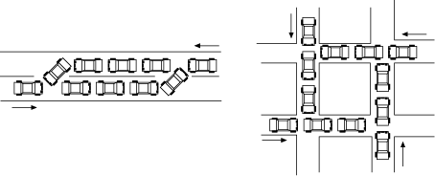
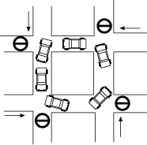
10.5 Defects in Timing and Co-ordination
Deadlock and livelock
Defects:
A deadlock is a situation where two or more threads are stopped, waiting for each other to do something.
The system is hung
Livelock is similar, but now the system can do some computations, but can never get out of some states.

Slide 37
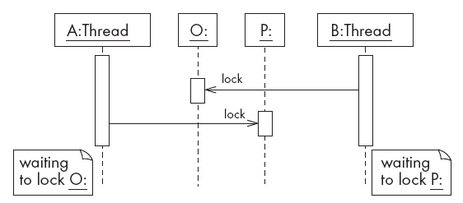
Example of deadlock

Slide 38
Defects in Timing and Co-ordination
Critical races
Defects:
One thread experiences a failure because another thread interferes with the ‘normal’ sequence of events.
Testing strategies:
It is particularly hard to test for critical races using black box testing alone.
One possible, although invasive, strategy is to deliberately slow down one of the threads.
Use inspection.

Slide 39
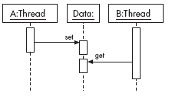
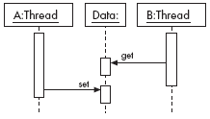
Example of critical race
a) Normal
b) Abnormal due to delay in thread A

Slide 40
Semaphore and synchronization
Critical races can be prevented by locking data so that they cannot be accessed by other threads when they are not ready
One widely used locking mechanism is called a semaphore.
In Java, the synchronized keyword can be used.
It ensures that no other thread can access an object until the synchronized method terminates.

Slide 41
10.6 Defects in Handling Stress and Unusual Situations
Insufficient throughput or response time on minimal configurations
Defect:
On a minimal configuration, the system’s throughput or response time fail to meet requirements.
Testing strategy:
Perform testing using minimally configured platforms.

Slide 42
Defects in Handling Stress and Unusual Situations
Incompatibility with specific configurations of hardware or software
Defect:
The system fails if it is run using particular configurations of hardware, operating systems and external libraries.
Testing strategy:
Extensively execute the system with all possible configurations that might be encountered by users.

Slide 43
Defects in Handling Stress and Unusual Situations
Defects in handling peak loads or missing resources
Defects:
The system does not gracefully handle resource shortage.
Resources that might be in short supply include:
memory, disk space or network bandwidth, permission.
The program being tested should report the problem in a way the user will understand.
Testing strategies:
Devise a method of denying the resources.
Run a very large number of copies of the program being tested, all at the same time.

Slide 44
Defects in Handling Stress and Unusual Situations
Inappropriate management of resources
Defect:
A program uses certain resources but does not make them available when it no longer needs them.
Testing strategy:
Run the program intensively in such a way that it uses many resources, relinquishes them and then uses them again repeatedly.

Slide 45
Defects in Handling Stress and Unusual Situations
Defects in the process of recovering from a crash
Defects:
Any system will undergo a sudden failure if its hardware fails, or if its power is turned off.
It is a defect if the system is left in an unstable state and hence is unable to fully recover.
It is also a defect if a system does not correctly deal with the crashes of related systems.
Testing strategies:
Kill a program at various times during execution.
Try turning the power off, however operating systems themselves are often intolerant of doing that.

Slide 46
10.7 Documentation defects
Defect:
The software has a defect if the user manual, reference manual or on-line help:
gives incorrect information
fails to give information relevant to a problem.
Testing strategy:
Examine all the end-user documentation, making sure it is correct.
Work through the use cases, making sure that each of them is adequately explained to the user.

Slide 47
10.8 Writing Formal Test Cases and Test Plans
A test case is an explicit set of instructions designed to detect a particular class of defect in a software system.
A test case can give rise to many tests.
Each test is a particular running of the test case on a particular version of the system.

Slide 48
Information to include in a formal test case
A. Identification and classification:
Each test case should have a number, and may also be given a descriptive title.
The system, subsystem or module being tested should also be clearly indicated.
The importance of the test case should be indicated.
B. Instructions:
Tell the tester exactly what to do.
The tester should not normally have to refer to any documentation in order to execute the instructions.
C. Expected result:
Tells the tester what the system should do in response to the instructions.
The tester reports a failure if the expected result is not encountered.
D. Cleanup (when needed):
Tells the tester how to make the system go ‘back to normal’ or shut down after the test.

Slide 49
Test plans
A test plan is a document that contains a complete set of test cases for a system
Along with other information about the testing process.
The test plan is one of the standard forms of documentation.
If a project does not have a test plan:
Testing will inevitably be done in an ad-hoc manner.
Leading to poor quality software.
The test plan should be written long before the testing starts.
You can start to develop the test plan once you have developed the requirements.

Slide 50
Levels of importance of test cases
Level 1:
First pass critical test cases.
Designed to verify the system runs and is safe.
No further testing is possible.
Level 2:
General test cases.
Verify that day-to-day functions correctly.
Still permit testing of other aspects of the system.
Level 3:
Detailed test cases.
Test requirements that are of lesser importance.
The system functions most of the time but has not yet met quality objectives.

Slide 51
Determining test cases by enumerating attributes
It is important that the test cases test every aspect of the requirements.
Each detail in the requirements is called an attribute.
An attribute can be thought of as something that is testable.
A good first step when creating a set of test cases is to enumerate the attributes.
A way to enumerate attributes is to circle all the important points in the requirements document.
However there are often many attributes that are implicit.

Slide 52
10.9 Strategies for Testing Large Systems
Big bang testing versus integration testing
In big bang testing, you take the entire system and test it as a unit
A better strategy in most cases is incremental testing:
You test each individual subsystem in isolation
Continue testing as you add more and more subsystems to the final product
Incremental testing can be performed horizontally or vertically, depending on the architecture
Horizontal testing can be used when the system is divided into separate sub-applications

Slide 53
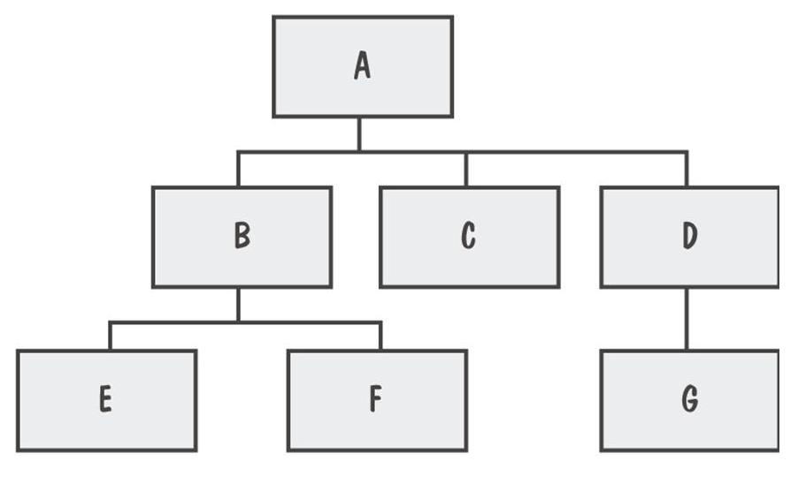
View of a System
System viewed as a hierarchy of components

Slide 54
10.9 Strategies for Testing Large Systems
Big bang testing versus integration testing
In big bang testing, you take the entire system and test it as a unit
System
A
C
B
G
F
E
D

Slide 55
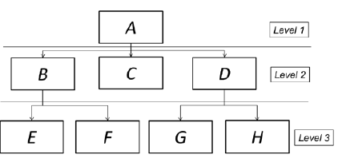
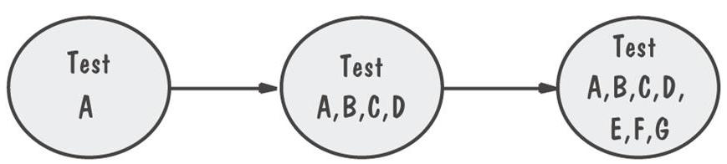
Top down testing
Start by testing just the user interface.
The big drawback to top down testing is the cost of writing the stubs.

Slide 56
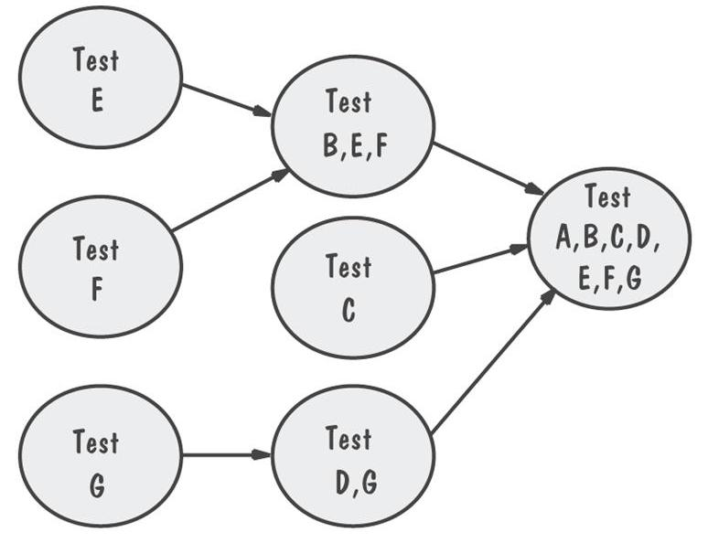
Bottom-up testing
Start by testing the very lowest levels of the software.
You needs drivers to test the lower layers of software.
Drivers are simple programs designed specifically for testing that make calls to the lower layers.

Slide 57
Sandwich testing
Sandwich testing is a hybrid between bottom-up and top down testing.
Test the user interface in isolation, using stubs.
Test the very lowest level functions, using drivers.
When the complete system is integrated, only the middle layer remains on which to perform the final set of tests.

Slide 58
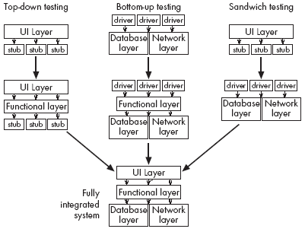
Vertical strategies for incremental integration testing

Slide 59
The test-fix-test cycle
When a failure occurs during testing:
Each failure report is entered into a failure tracking system.
It is then screened and assigned a priority.
Low-priority failures might be put on a known bugs list that is included with the software’s release notes.
Some failure reports might be merged if they appear to result from the same defects.
Somebody is assigned to investigate a failure.
That person tracks down the defect and fixes it.
Finally a new version of the system is created, ready to be tested again.

Slide 60
The ripple effect
There is a high probability that the efforts to remove the defects may have actually added new defects
The maintainer tries to fix problems without fully understanding the ramifications of the changes
The maintainer makes ordinary human errors
The system regresses into a more and more failure-prone state

Slide 61
Regression testing
It tends to be far too expensive to re-run every single test case every time a change is made to software.
Hence only a subset of the previously-successful test cases is actually re-run.
This process is called regression testing.
The tests that are re-run are called regression tests.
Regression test cases are carefully selected to cover as much of the system as possible.
The “law of conservation of bugs”:
The number of bugs remaining in a large system is proportional to the number of bugs already fixed

Slide 62
Deciding when to stop testing
All of the level 1 test cases must have been successfully executed.
Certain pre-defined percentages of level 2 and level 3 test cases must have been executed successfully.
The targets must have been achieved and are maintained for at least two cycles of ‘builds’.
A build involves compiling and integrating all the components.
Failure rates can fluctuate from build to build as:
Different sets of regression tests are run.
New defects are introduced.

Slide 63
The roles of people involved in testing
The first pass of unit and integration testing is called developer testing.
Preliminary testing performed by the software developers who do the design.
Independent testing is performed by a separate group.
They do not have a vested interest in seeing as many test cases pass as possible.
They develop specific expertise in how to do good testing, and how to use testing tools.

Slide 64
Testing performed by users and clients
Alpha testing
Performed by the user or client, but under the supervision of the software development team.
Beta testing
Performed by the user or client in a normal work environment.
Recruited from the potential user population.
An open beta release is the release of low-quality software to the general population.
Acceptance testing
Performed by users and customers.
However, the customers do it on their own initiative.

