Slide 1
Object-Oriented Software Engineering
Practical Software Development using UML and Java
Chapter 11:
Managing the Software Process

Slide 2
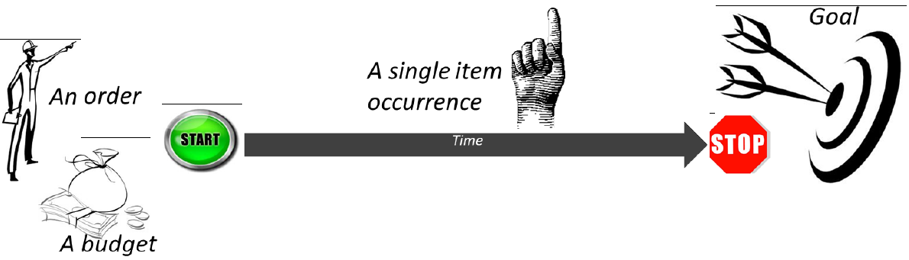
11.1 What is Project Management?
Project management encompasses all the activities needed to plan and execute a project:
  Deciding what needs to be done
  Estimating costs
  Ensuring there are suitable people to undertake the project
  Defining responsibilities
  Scheduling
  Making arrangements for the work
  continued ...
© Lethbridge/Laganière 2005
Chapter 11: Managing the Software Process

Slide 3
What is Project Management?
  Directing
  Being a technical leader
  Reviewing and approving decisions made by others
  Building morale and supporting staff
  Monitoring and controlling
  Co-ordinating the work with managers of other projects
  Reporting
  Continually striving to improve the process
© Lethbridge/Laganière 2005
Chapter 11: Managing the Software Process

Slide 4



11.2 Software Process Models
Software process models are general approaches for organizing a project into activities.
  Help the project manager and his or her team to decide:
    What work should be done;
    In what sequence to perform the work.
  The models should be seen as aids to thinking, not rigid prescriptions of the way to do things.
  Each project ends up with its own unique plan.
© Lethbridge/Laganière 2005
Chapter 11: Managing the Software Process

Slide 5
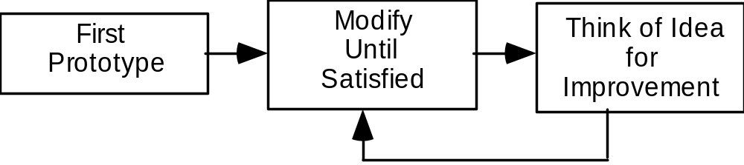
The opportunistic approach
© Lethbridge/Laganière 2005
Chapter 11: Managing the Software Process

Slide 6
The opportunistic approach
… is what occurs when an organization does not follow good engineering practices.
  It does not acknowledge the importance of working out the requirements and the design before implementing a system.
  The design of software deteriorates faster if it is not well designed.
  Since there are no plans, there is nothing to aim towards.
  There is no explicit recognition of the need for systematic testing and other forms of quality assurance.
  The above problems make the cost of developing and maintaining software very high.
© Lethbridge/Laganière 2005
Chapter 11: Managing the Software Process

Slide 7
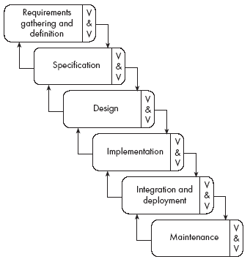
The waterfall model
© Lethbridge/Laganière 2005
Chapter 11: Managing the Software Process

Slide 8
The waterfall model
The classic way of looking at S.E. that accounts for the importance of requirements, design and quality assurance.
  The model suggests that software engineers should work in a series of stages.
  Before completing each stage, they should perform quality assurance (verification and validation).
  The waterfall model also recognizes, to a limited extent, that you sometimes have to step back to earlier stages.
© Lethbridge/Laganière 2005
Chapter 11: Managing the Software Process

Slide 9
Limitations of the waterfall model
  The model implies that you should attempt to complete a given stage before moving on to the next stage
    Does not account for the fact that requirements constantly change.
    It also means that customers can not use anything until the entire system is complete.
  The model makes no allowances for prototyping.
  It implies that you can get the requirements right by simply writing them down and reviewing them.
  The model implies that once the product is finished, everything else is maintenance.
© Lethbridge/Laganière 2005
Chapter 11: Managing the Software Process

Slide 10
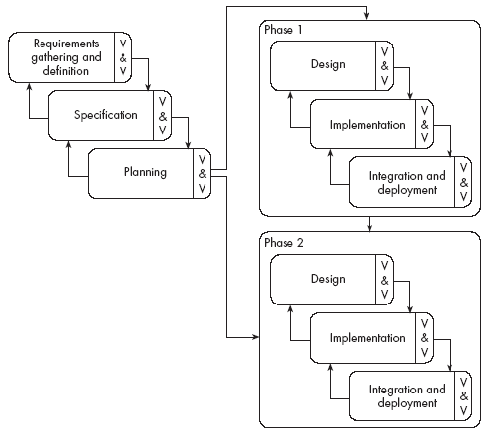
The phased-release model
© Lethbridge/Laganière 2005
Chapter 11: Managing the Software Process

Slide 11
The phased-release model
It introduces the notion of incremental development.
  After requirements gathering and planning, the project should be broken into separate subprojects, or phases.
  Each phase can be released to customers when ready.
  Parts of the system will be available earlier than when using a strict waterfall approach.
  However, it continues to suggest that all requirements be finalized at the start of development.
© Lethbridge/Laganière 2005
Chapter 11: Managing the Software Process

Slide 12
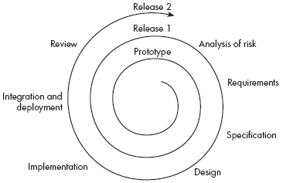

The spiral model
© Lethbridge/Laganière 2005
Chapter 11: Managing the Software Process

Slide 13
The spiral model
It explicitly embraces prototyping and an iterative approach to software development.
  Start by developing a small prototype.
  Followed by a mini-waterfall process, primarily to gather requirements.
  Then, the first prototype is reviewed.
  In subsequent loops, the project team performs further requirements, design, implementation and review.
  The first thing to do before embarking on each new loop is risk analysis.
  Maintenance is simply a type of on-going development.
© Lethbridge/Laganière 2005
Chapter 11: Managing the Software Process

Slide 14

The evolutionary model
© Lethbridge/Laganière 2005
Chapter 11: Managing the Software Process

Slide 15
The evolutionary model
It shows software development as a series of hills, each representing a separate loop of the spiral.
  Shows that loops, or releases, tend to overlap each other.
  Makes it clear that development work tends to reach a peak, at around the time of the deadline for completion.
  Shows that each prototype or release can take
    different amounts of time to deliver;
    differing amounts of effort.
© Lethbridge/Laganière 2005
Chapter 11: Managing the Software Process

Slide 16
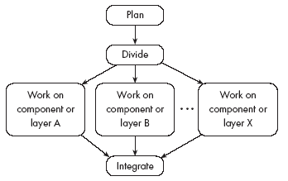
The concurrent engineering model
© Lethbridge/Laganière 2005
Chapter 11: Managing the Software Process

Slide 17
The concurrent engineering model
It explicitly accounts for the divide and conquer principle.
  Each team works on its own component, typically following a spiral or evolutionary approach.
  There has to be some initial planning, and periodic integration.
© Lethbridge/Laganière 2005
Chapter 11: Managing the Software Process

Slide 18
Agile approaches
Lightweight approaches to satisfy the customers with
"early and continuous delivery of valuable software“
Manifesto for Agile Software Development
Individuals and interactions over processes and tools
Working software over comprehensive documentation
Customer collaboration over contract negotiation
Responding to change over following a plan
© Lethbridge/Laganière 2005
Chapter 11: Managing the Software Process

Slide 19
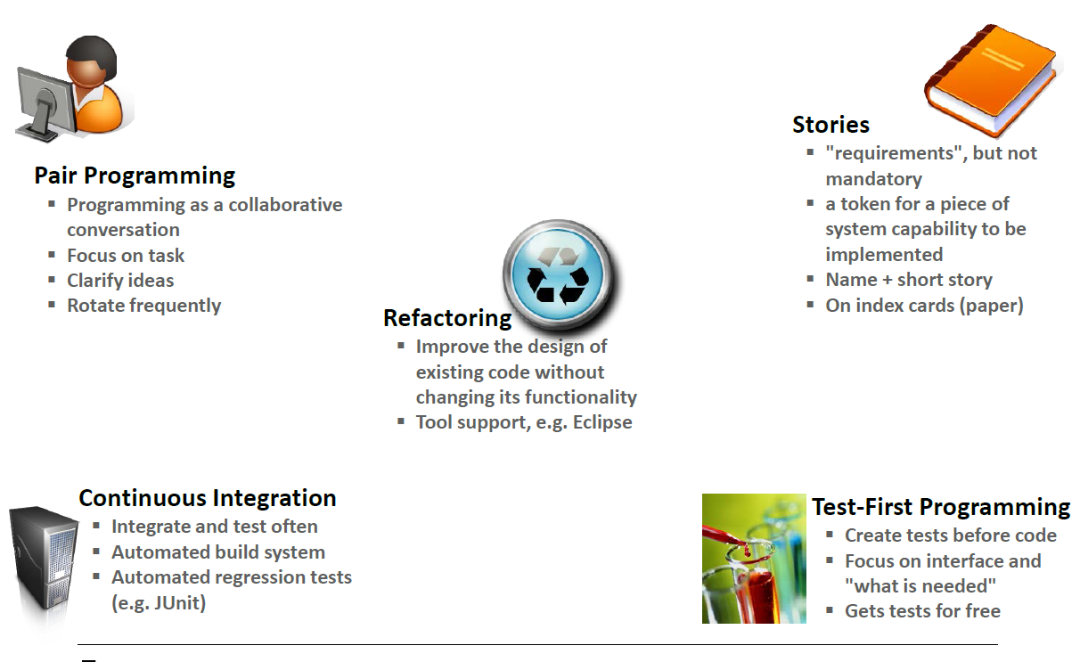
eXtreme Programming (XP)
  The most famous agile technique is eXtreme Programming (XP)
© Lethbridge/Laganière 2005
Chapter 11: Managing the Software Process

Slide 20
eXtreme Programming (XP)
    All stakeholders work closely together
    User stories are written instead of requirement document
    There must be a series of small and frequent releases (1 to 3 weeks)
    The project variable are: scope, resources and time (and quality)
    Test cases are written before the software is developed
    A large amount of refactoring is encouraged
    Pair programming is recommended
© Lethbridge/Laganière 2005
Chapter 11: Managing the Software Process

Slide 21
Choosing a process model
  From the waterfall model:
    Incorporate the notion of stages.
  From the phased-release model:
    Incorporate the notion of doing some initial high-level analysis, and then dividing the project into releases.
  From the spiral model:
    Incorporate prototyping and risk analysis.
  From the evolutionary model:
    Incorporate the notion of varying amounts of time and work, with overlapping releases.
  From concurrent engineering:
    Incorporate the notion of breaking the system down into components and developing them in parallel.
© Lethbridge/Laganière 2005
Chapter 11: Managing the Software Process

Slide 22
Reengineering
Periodically project managers should set aside some time to re-engineer part or all of the system
  The extent of this work can vary considerably:
    Cleaning up the code to make it more readable.
    Completely replacing a layer.
    Re-factoring part of the design.
  In general, the objective of a re-engineering activity is to increase maintainability.
© Lethbridge/Laganière 2005
Chapter 11: Managing the Software Process

Slide 23
11.3 Cost estimation
To estimate how much software-engineering time will be required to do some work.
  Elapsed time
    The difference in time from the start date to the end date of a task or project.
  Development effort
    The amount of labour used in person-months or person-days.
    To convert an estimate of development effort to an amount of money:
      You multiply it by the weighted average cost (burdened cost) of employing a software engineer for a month (or a day).
© Lethbridge/Laganière 2005
Chapter 11: Managing the Software Process

Slide 24
Principles of effective cost estimation
Principle 1: Divide and conquer.
  To make a better estimate, you should divide the project up into individual subsystems.
  Then divide each subsystem further into the activities that will be required to develop it.
  Next, you make a series of detailed estimates for each individual activity.
  And sum the results to arrive at the grand total estimate for the project.
© Lethbridge/Laganière 2005
Chapter 11: Managing the Software Process

Slide 25
Principles of effective cost estimation
Principle 2: Include all activities when making estimates.
  The time required for all development activities must be taken into account.
  Including:
      Prototyping
      Design
      Inspecting
      Testing
      Debugging
      Writing user documentation
      Deployment.
© Lethbridge/Laganière 2005
Chapter 11: Managing the Software Process

Slide 26
Principles of effective cost estimation
Principle 3: Base your estimates on past experience combined with knowledge of the current project.
  If you are developing a project that has many similarities with a past project:
    You can expect it to take a similar amount of work.
  Base your estimates on the personal judgement of your experts
    or
  Use algorithmic models developed in the software industry as a whole by analyzing a wide range of projects.
    They take into account various aspects of a project’s size and complexity, and provide formulas to compute anticipated cost.
© Lethbridge/Laganière 2005
Chapter 11: Managing the Software Process

Slide 27
Algorithmic models
Allow you to systematically estimate development effort.
  Based on an estimate of some other factor that you can measure, or that is easier to estimate:
    The number of use cases
    The number of distinct requirements
    The number of classes in the domain model
    The number of widgets in the prototype user interface
    An estimate of the number of lines of code
© Lethbridge/Laganière 2005
Chapter 11: Managing the Software Process

Slide 28
Principles of effective cost estimation
Principle 4: Be sure to account for differences when extrapolating from other projects.
  Different software developers
  Different development processes and maturity levels
  Different types of customers and users
  Different schedule demands
  Different technology
  Different technical complexity of the requirements
  Different domains
  Different levels of requirement stability
© Lethbridge/Laganière 2005
Chapter 11: Managing the Software Process

Slide 29
Principles of effective cost estimation
Principle 5: Anticipate the worst case and plan for contingencies.
  Develop the most critical use cases first
    If the project runs into difficulty, then the critical features are more likely to have been completed
  Make three estimates:
    Optimistic (O)
      Imagining a everything going perfectly
    Likely (L)
      Allowing for typical things going wrong
    Pessimistic (P)
      Accounting for everything that could go wring
© Lethbridge/Laganière 2005
Chapter 11: Managing the Software Process

Slide 30
Principles of effective cost estimation
Principle 6: Combine multiple independent estimates.
  Use several different techniques and compare the results.
  If there are discrepancies, analyze your calculations to discover what factors causing the differences.
  Use the Delphi technique.
    Several individuals initially make cost estimates in private.
    They then share their estimates to discover the discrepancies.
    Each individual repeatedly adjusts his or her estimates until a consensus is reached.
© Lethbridge/Laganière 2005
Chapter 11: Managing the Software Process

Slide 31
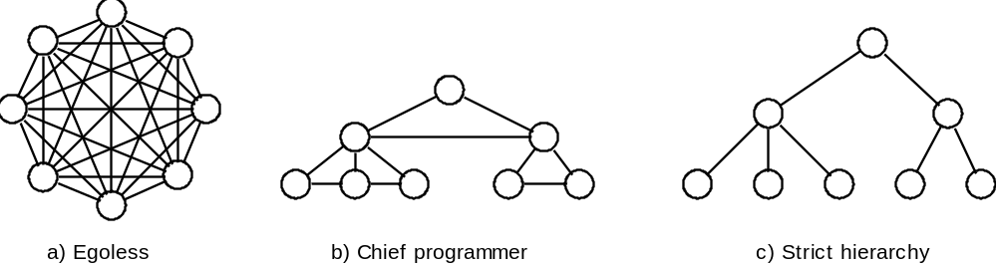
11.4 Building Software Engineering Teams
Software engineering is a human process.
  Choosing appropriate people for a team, and assigning roles and responsibilities to the team members, is therefore an important project management skill
  Software engineering teams can be organized in many different ways
© Lethbridge/Laganière 2005
Chapter 11: Managing the Software Process

Slide 32
Software engineering teams
Egoless team:
  In such a team everybody is equal, and the team works together to achieve a common goal.
  Decisions are made by consensus.
  Most suited to difficult projects with many technical challenges.
© Lethbridge/Laganière 2005
Chapter 11: Managing the Software Process

Slide 33
Software engineering teams
Hierarchical manager-subordinate structure:
  Each individual reports to a manager and is responsible for performing the tasks delegated by that manager.
  Suitable for large projects with a strict schedule where everybody is well-trained and has a well-defined role.
  However, since everybody is only responsible for their own work, problems may go unnoticed.
© Lethbridge/Laganière 2005
Chapter 11: Managing the Software Process

Slide 34
Software engineering teams
Chief programmer team:
  Midway between egoless and hierarchical.
  The chief programmer leads and guides the project.
  He or she consults with, and relies on, individual specialists.
© Lethbridge/Laganière 2005
Chapter 11: Managing the Software Process

