Slide 1
Object-Oriented Software Engineering
Practical Software Development using UML and Java
Chapter 4:
Developing Requirements

Slide 2
4.1 Domain Analysis
The process by which a software engineer learns about the domain to better understand the problem:
  The domain is the general field of business or technology in which the clients will use the software
  A domain expert is a person who has a deep knowledge of the domain
Benefits of performing domain analysis:
  Faster development
  Better system
  Anticipation of extensions

Slide 3
Domain Analysis document
  A. Introduction
  B. Glossary
  C. General knowledge about the domain
  D. Customers and users
  E. The environment
  F. Tasks and procedures currently performed
  G. Competing software
  H. Similarities to other domains

Slide 4
4.2 The Starting Point for Software Projects
green field project

Slide 5
4.3 Defining the Problem and the Scope
A problem can be expressed as:
  A difficulty the users or customers are facing,
  Or as an opportunity that will result in some benefit such as improved productivity or sales.
The solution to the problem normally will entail developing software
A good problem statement is short and succinct

Slide 6
Defining the Scope
Narrow the scope by defining a more precise problem
  List all the things you might imagine the system doing
    Exclude some of these things if too broad
    Determine high-level goals if too narrow
Example: A university registration system

Slide 7
4.4 What is a Requirement ?
It is a statement describing either
  1) an aspect of what the proposed system must do,
  or 2) a constraint on the system’s development.
  In either case it must contribute in some way towards adequately solving the customer’s problem;
  the set of requirements as a whole represents a negotiated agreement among the stakeholders.
A collection of requirements is a requirements document.

Slide 8
4.5 Types of Requirements
Functional requirements
  Describe what the system should do
Quality requirements
  Constraints on the design to meet specified levels of quality
Platform requirements
  Constraints on the environment and technology of the system
Process requirements
  Constraints on the project plan and development methods

Slide 9
Functional Requirements
  What inputs the system should accept
  What outputs the system should produce
  What data the system should store that other systems might use
  What computations the system should perform
  The timing and synchronization of the above

Slide 10
Quality Requirementts
All must be verifiable
Examples: Constraints on
  Response time
  Throughput
  Resource usage
  Reliability
  Availability
  Recovery from failure
  Allowances for maintainability and enhancement
  Allowances for reusability

Slide 11
4.6 Use-Cases: describing how the user will use the system
A use case is a typical sequence of actions that a user performs in order to complete a given task
  The objective of use case analysis is to model the system from the point of view of
    … how users interact with this system
    … when trying to achieve their objectives.
    It is one of the key activities in requirements analysis
  A use case model consists of
    a set of use cases
    an optional description or diagram indicating how they are related

Slide 12
Use cases
A use case should
  Cover the full sequence of steps from the beginning of a task until the end.
  Describe the user’s interaction with the system ...
    Not the computations the system performs.
  Be written so as to be as independent as possible from any particular user interface design.
  Only include actions in which the actor interacts with the computer.
    Not actions a user does manually

Slide 13
Scenarios
A scenario is an instance of a use case
  A specific occurrence of the use case
    a specific actor ...
    at a specific time ...
    with specific data.

Slide 14
How to describe a single use case
A. Name: Give a short, descriptive name to the use case.
B. Actors: List the actors who can perform this use case.
C. Goals: Explain what the actor or actors are trying to achieve.
D. Preconditions: State of the system before the use case.
E. Summary: Give a short informal description.
F. Related use cases.
G. Steps: Describe each step using a 2-column format.
H. Postconditions: State of the system in following completion.
A and G are the most important

Slide 15
Use case diagrams

Slide 16
Extensions
  Used to make optional interactions explicit or to handle exceptional cases.
  Keep the description of the basic use case simple.

Slide 17
Generalizations
  Much like superclasses in a class diagram.
  A generalized use case represents several similar use cases.
  One or more specializations provides details of the similar use cases.

Slide 18
Inclusions
  Allow one to express commonality between several different use cases.
  Are included in other use cases
    Even very different use cases can share sequence of actions.
    Enable you to avoid repeating details in multiple use cases.
  Represent the performing of a lower-level task with a lower-level goal.

Slide 19
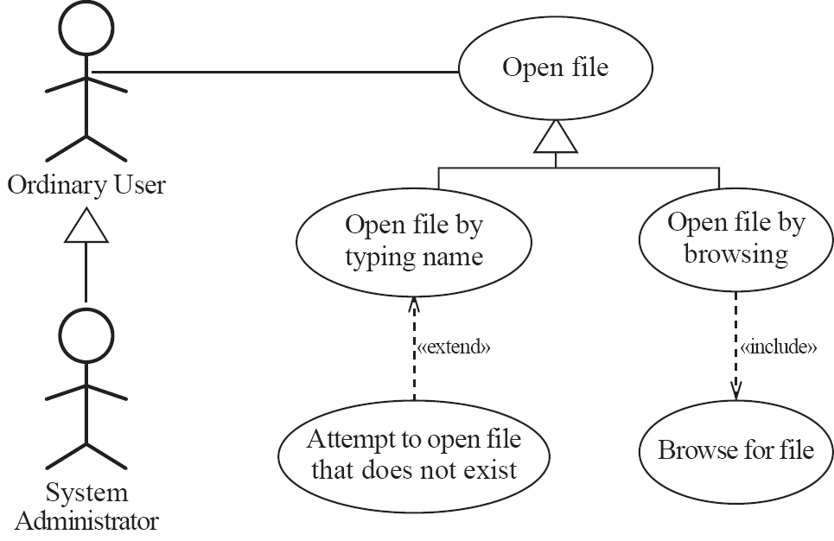
Example of generalization, extension and inclusion

Slide 20
Example description of a use case

Slide 21
Example (continued)

Slide 22
Example (continued)

Slide 23
Example (continued)

Slide 24
Example (continued)

Slide 25
The modeling processes: Choosing use cases on which to focus
  Often one use case (or a very small number) can be identified as central to the system
    The entire system can be built around this particular use case
  There are other reasons for focusing on particular use cases:
    Some use cases will represent a high risk because for some reason their implementation is problematic
    Some use cases will have high political or commercial value

Slide 26
The benefits of basing software development on use cases
They can
  Help to define the scope of the system
  Be used to plan the development process
  Be used to both develop and validate the requirements
  Form the basis for the definition of test cases
  Be used to structure user manuals

Slide 27
Use cases must not be seen as a panacea
  The use cases themselves must be validated
    Using the requirements validation methods.
  Some aspects of software are not covered by use case analysis.
  Innovative solutions may not be considered.

Slide 28
4.7 Some Techniques for Gathering and Analysing Requirements
Observation
  Read documents and discuss requirements with users
  Shadowing important potential users as they do their work
    ask the user to explain everything he or she is doing
  Session videotaping
Interviewing
  Conduct a series of interviews
    Ask about specific details
    Ask about the stakeholder’s vision for the future
    Ask if they have alternative ideas
    Ask for other sources of information
    Ask them to draw diagrams

Slide 29
Gathering and Analysing Requirements...
Brainstorming
  Appoint an experienced moderator
  Arrange the attendees around a table
  Decide on a ‘trigger question’
  Ask each participant to write an answer and pass the paper to its neighbour
Joint Application Development (JAD) is a technique based on intensive brainstorming sessions

Slide 30
Gathering and Analysing Requirements...
Prototyping
  The simplest kind: paper prototype.
    a set of pictures of the system that are shown to users in sequence to explain what would happen
  The most common: a mock-up of the system’s UI
    Written in a rapid prototyping language
    Does not normally perform any computations, access any databases or interact with any other systems
    May prototype a particular aspect of the system

Slide 31
Gathering and Analysing Requirements...
Use case analysis
  Determine the classes of users that will use the facilities of this system (actors)
  Determine the tasks that each actor will need to do with the system

Slide 32
4.8 Types of Requirements Document
  Two extremes:
    An informal outline of the requirements using a few paragraphs or simple diagrams
      requirements definition
    A long list of specifications that contain thousands of pages of intricate detail
      requirements specification
Requirements
xxxx
xxxxxxx
xxx
xxxxxxxxxxx
xxxxx
xxxxxxxxxxxxx
xxxxxxx
xxx
xxxxxxxxxxxxxxx
  Requirements documents for large systems are normally arranged in a hierarchy
subsystem 1
subsystem 2
Requirements
Requirements
xxxx
Definition
xxxxxxx
xxxx
xxx
xxxxxxx
Requirements
xxxxxxxxxxx
xxx
xxxxx
xxxxxxxxxxx
Specification
xxxxxxxxxxxxx
xxxxx
xxxxxxx
xxxx
xxx
xxxxxxxxxxxxx
xxxxxxxxxxxxxxx
xxxxxxx
xxxxxxx
xxx
xxx
xxxxxxxxxxx
xxxxxxxxxxxxxxx
xxxxx
xxxxxxxxxxxxx
sub-subsystems
xxxxxxx
xxx
Requirements
Requirements
Requirements
Requirements
xxxxxxxxxxxxxxx
Definition
Definition
Definition
Definition
xxxx
xxxx
xxxx
sub-subsystems
xxxx
xxxxxxx
xxxxxxx
xxxxxxx
Requirements
xxx
xxx
xxxxxxx
xxx
Requirements
Requirements
xxxxxxxxxxx
xxx
Requirements
xxxxxxxxxxx
xxxxxxxxxxx
xxxxx
Specification
xxxxxxxxxxx
Specification
Specification
Specification
xxxxx
xxxx
xxxxx
xxxxx
xxxxxxxxxxxxx
xxxxxxxxxxxxx
Requirements
xxxx
xxxx
xxxxxxx
Requirements
xxxxxxxxxxxxx
xxxxxxxxxxxxx
xxxxxxx
Requirements
xxxxxxx
xxxx
xxxxxxx
xxxxxxx
xxxxxxx
xxxxxxx
xxx
xxx
Requirements
Definition
Definition
xxxxxxx
xxx
xxx
xxx
xxx
xxxxxxxxxxx
Definition
xxx
xxx
xxxxxxxxxxxxxxx
xxxxxxxxxxxxxxx
Definition
xxxx
xxxxxxxxxxx
xxxxxxxxxxx
xxxxx
xxxx
xxxxxxxxxxxxxxx
xxxxxxxxxxxxxxx
xxxx
xxxxxxx
xxxxxxxxxxx
xxxxx
xxxxx
xxxxxxxxxxxxx
xxxx
xxxxxxx
xxxxxxx
xxx
Requirements
xxxxx
xxxxxxxxxxxxx
xxxxxxxxxxxxx
xxxxxxx
xxxxxxx
xxx
Requirements
xxxxxxxxxxxxx
xxxxxxx
xxx
xxx
Requirements
xxxxxxxxxxx
xxxxxxxxxxx
xxxxxxx
xxx
Requirements
xxxxxxxxxxx
xxxxx
Specification
xxxxxxx
xxx
xxxxxxxxxxx
Specification
Specification
xxx
xxxxxxxxxxxxxxx
xxxxx
xxxxx
xxxx
xxx
xxxxxxxxxxxxxxx
xxxxx
Specification
xxxxxxxxxxxxx
xxxxxxxxxxxxx
xxxxxxxxxxxxxxx
xxxx
xxxx
xxxxxxx
xxxxxxxxxxxxxxx
xxxxxxxxxxxxx
xxxxxxxxxxxxx
xxxxxxx
xxxxxxx
xxxx
xxxxxxx
xxxxxxx
xxxxxxx
xxxxxxx
xxx
xxx
xxxxxxx
xxx
xxx
xxx
xxx
xxxxxxxxxxx
xxx
xxx
xxxxxxxxxxxxxxx
xxxxxxxxxxxxxxx
xxxxxxxxxxx
xxxxxxxxxxx
xxxxx
xxxxxxxxxxxxxxx
xxxxxxxxxxxxxxx
xxxxxxxxxxx
xxxxx
xxxxx
xxxxxxxxxxxxx
xxxxx
xxxxxxxxxxxxx
xxxxxxxxxxxxx
xxxxxxx
xxxxxxxxxxxxx
xxxxxxx
xxxxxxx
xxx
xxxxxxx
xxx
xxx
xxxxxxxxxxxxxxx
xxx
xxxxxxxxxxxxxxx
xxxxxxxxxxxxxxx
xxxxxxxxxxxxxxx

Slide 33
Level of detail required in a requirements document
  How much detail should be provided depends on:
    The size of the system
    The need to interface to other systems
    The readership
    The stage in requirements gathering
    The level of experience with the domain and the technology
    The cost that would be incurred if the requirements were faulty

Slide 34
4.9 Reviewing Requirements
  Each individual requirement should
    Have benefits that outweigh the costs of development
    Be important for the solution of the current problem
    Be expressed using a clear and consistent notation
    Be unambiguous
    Be logically consistent
    Lead to a system of sufficient quality
    Be realistic with available resources
    Be verifiable
    Be uniquely identifiable
    Does not over-constrain the design of the system

Slide 35
Requirements documents...
  The document should be:
    sufficiently complete
    well organized
    clear
    agreed to by all the stakeholders
  Traceability:

Slide 36
Requirements document...
  A. Problem
  B. Background information
  C. Environment and system models
  D. Functional Requirements
  E. Non-functional requirements

Slide 37
4.10 Managing Changing Requirements
Requirements change because:
  Business process changes
  Technology changes
  The problem becomes better understood
Requirements analysis never stops
  Continue to interact with the clients and users
  The benefits of changes must outweigh the costs.
    Certain small changes (e.g. look and feel of the UI) are usually quick and easy to make at relatively little cost.
    Larger-scale changes have to be carefully assessed
      Forcing unexpected changes into a partially built system will probably result in a poor design and late delivery
  Some changes are enhancements in disguise
    Avoid making the system bigger, only make it better

Slide 38
4.13 Difficulties and Risks in Domain and Requirements Analysis
  Lack of understanding of the domain or the real problem
    Do domain analysis and prototyping
  Requirements change rapidly
    Perform incremental development, build flexibility into the design, do regular reviews
  Attempting to do too much
    Document the problem boundaries at an early stage, carefully estimate the time
  It may be hard to reconcile conflicting sets of requirements
    Brainstorming, JAD sessions, competing prototypes
  It is hard to state requirements precisely
    Break requirements down into simple sentences and review them carefully, look for potential ambiguity, make early prototypes

