Slide 1
Object-Oriented Software Engineering
Practical Software Development using UML and Java
Chapter 6:
Using Design Patterns

Slide 2
6.1 Introduction to Patterns
The recurring aspects of designs are called design patterns.
  A pattern is the outline of a reusable solution to a general problem encountered in a particular context
  Many of them have been systematically documented for all software developers to use
  A good pattern should
    Be as general as possible
    Contain a solution that has been proven to effectively solve the problem in the indicated context.
  Studying patterns is an effective way to learn from the experience of others
© Lethbridge/Laganière 2005
Chapter 6: Using design patterns
Notes:
As you gain experience in object-oriented software development, you will begin to notice that many parts of your models or designs reappear, with only slight
changes, in many different systems or subsystems. These recurring aspects are called patterns. Many of them have been systematically documented for all
software developers to use.

Slide 3
Pattern description
  Context:
    The general situation in which the pattern applies
  Problem:
    A short sentence or two raising the main difficulty.
  Forces:
    The issues or concerns to consider when solving the problem
  Solution:
    The recommended way to solve the problem in the given context.
      ‘to balance the forces’
  Antipatterns: (Optional)
    Solutions that are inferior or do not work in this context.
  Related patterns: (Optional)
    Patterns that are similar to this pattern.
  References:
    Who developed or inspired the pattern.
© Lethbridge/Laganière 2005
Chapter 6: Using design patterns

Slide 4
6.2 The Abstraction-Occurrence Pattern
  Context:
    Often in a domain model you find a set of related objects (occurrences).
    The members of such a set share common information
      but also differ from each other in important ways.
  Problem:
    What is the best way to represent such sets of occurrences in a class diagram?
  Forces:
    You want to represent the members of each set of occurrences without duplicating the common information
© Lethbridge/Laganière 2005
Chapter 6: Using design patterns

Slide 5
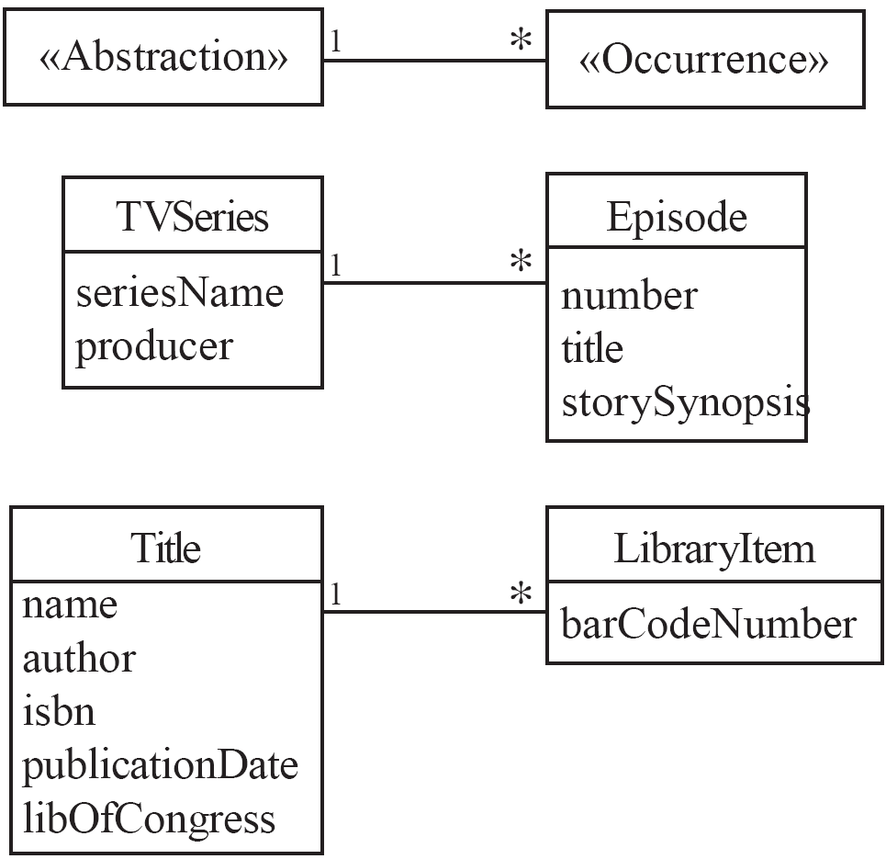
Abstraction-Occurrence
  Solution:
© Lethbridge/Laganière 2005
Chapter 6: Using design patterns
Notes:
Often in a projectyou find a set of related objects that we will call occurrences; the members of such a set share common information but also
differ from each other in important ways.

Slide 6
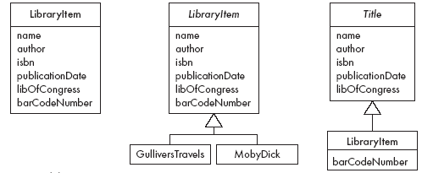
Abstraction-Occurrence
Antipatterns:
© Lethbridge/Laganière 2005
Chapter 6: Using design patterns

Slide 7
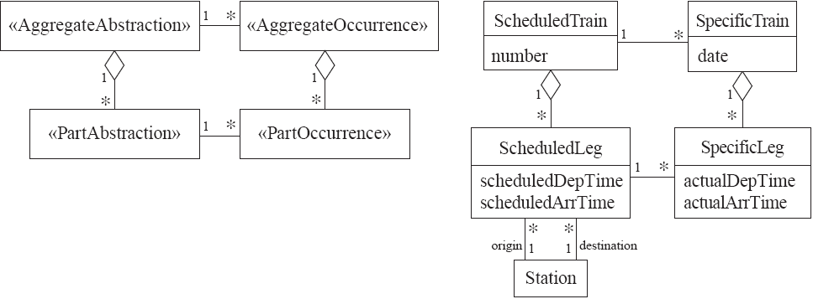
Abstraction-Occurrence
Square variant
© Lethbridge/Laganière 2005
Chapter 6: Using design patterns

Slide 8
6.3 The General Hierarchy Pattern
  Context:
    Objects in a hierarchy can have one or more objects above them (superiors),
      and one or more objects below them (subordinates).
    Some objects cannot have any subordinates
  Problem:
    How do you represent a hierarchy of objects, in which some objects cannot have subordinates?
  Forces:
    You want a flexible way of representing the hierarchy
      that prevents certain objects from having subordinates
    All the objects have many common properties and operations
© Lethbridge/Laganière 2005
Chapter 6: Using design patterns

Slide 9
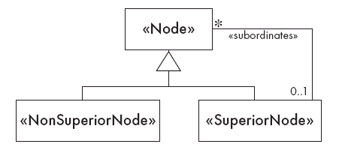
General Hierarchy
  Solution:
© Lethbridge/Laganière 2005
Chapter 6: Using design patterns

Slide 10
© Lethbridge/Laganière 2005
Chapter 6: Using design patterns

Slide 11
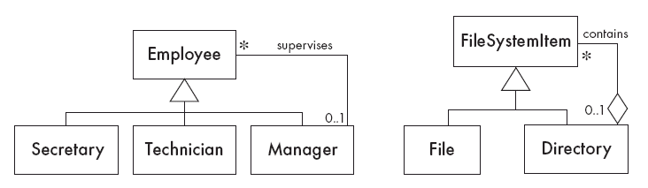
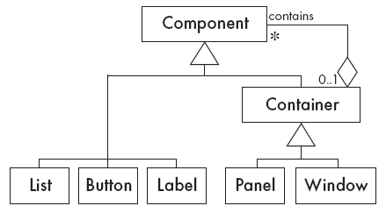
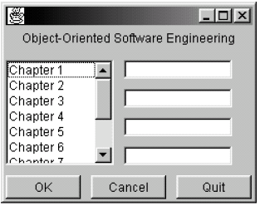
General Hierarchy
  Solution:
© Lethbridge/Laganière 2005
Chapter 6: Using design patterns

Slide 12
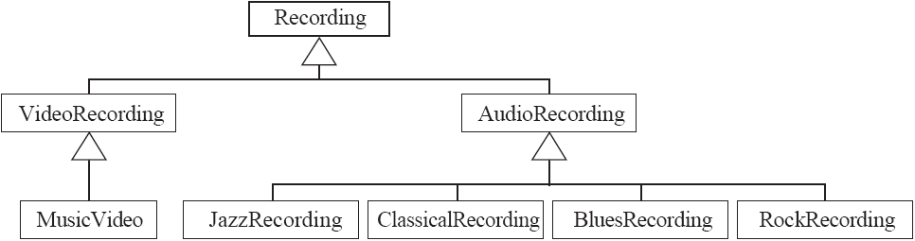
General Hierarchy
Antipattern:
© Lethbridge/Laganière 2005
Chapter 6: Using design patterns

Slide 13
6.4 The Player-Role Pattern
  Context:
    A role is a particular set of properties associated with an object in a particular context.
    An object may play different roles in different contexts.
  Problem:
    How do you best model players and roles so that a player can change roles or possess multiple roles?
© Lethbridge/Laganière 2005
Chapter 6: Using design patterns

Slide 14
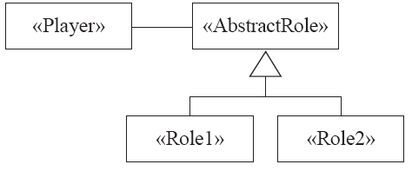
Player-Role
  Forces:
    It is desirable to improve encapsulation by capturing the information associated with each separate role in a class.
    You want to avoid multiple inheritance.
    You cannot allow an instance to change class
  Solution:
© Lethbridge/Laganière 2005
Chapter 6: Using design patterns

Slide 15
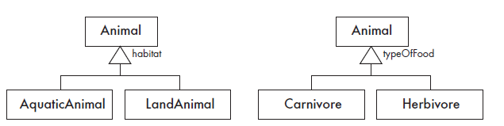
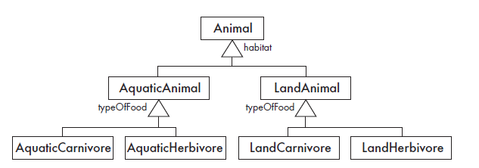
© Lethbridge/Laganière 2005
Chapter 6: Using design patterns

Slide 16
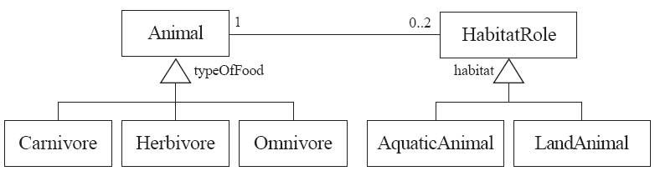
Player-Role
Example 1:
© Lethbridge/Laganière 2005
Chapter 6: Using design patterns

Slide 17
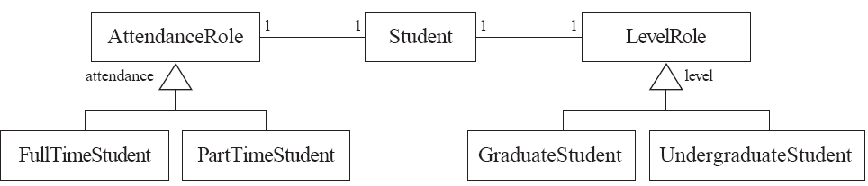
Player-Role
Example 2:
© Lethbridge/Laganière 2005
Chapter 6: Using design patterns

Slide 18
Player-Role
Antipatterns:
  Merge all the properties and behaviours into a single «Player» class and not have «Role» classes at all.
  Create roles as subclasses of the «Player» class.
© Lethbridge/Laganière 2005
Chapter 6: Using design patterns

Slide 19
6.5 The Singleton Pattern
  Context:
    It is very common to find classes for which only one instance should exist (singleton)
  Problem:
    How do you ensure that it is never possible to create more than one instance of a singleton class?
  Forces:
    The use of a public constructor cannot guarantee that no more than one instance will be created.
    The singleton instance must also be accessible to all classes that require it
© Lethbridge/Laganière 2005
Chapter 6: Using design patterns
Notes:
prevent

Slide 20
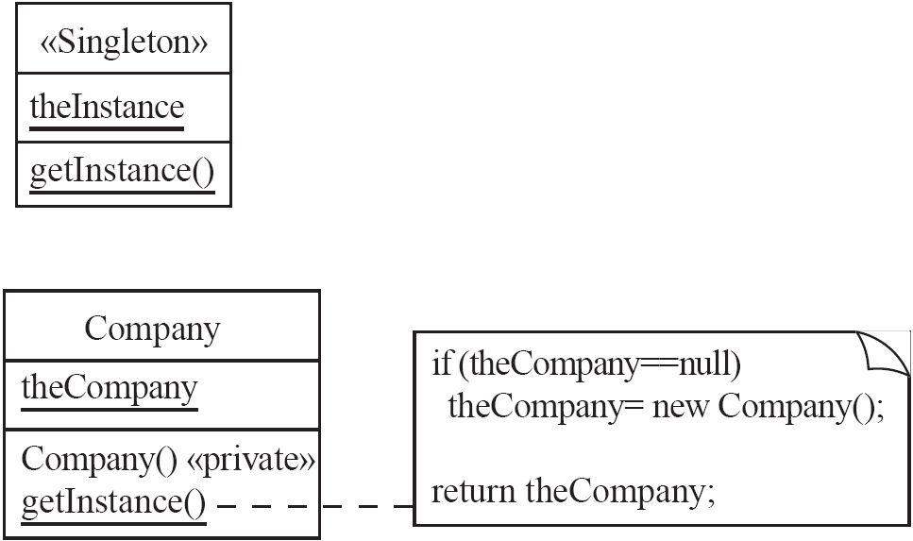
Singleton
  Solution:
© Lethbridge/Laganière 2005
Chapter 6: Using design patterns

Slide 21
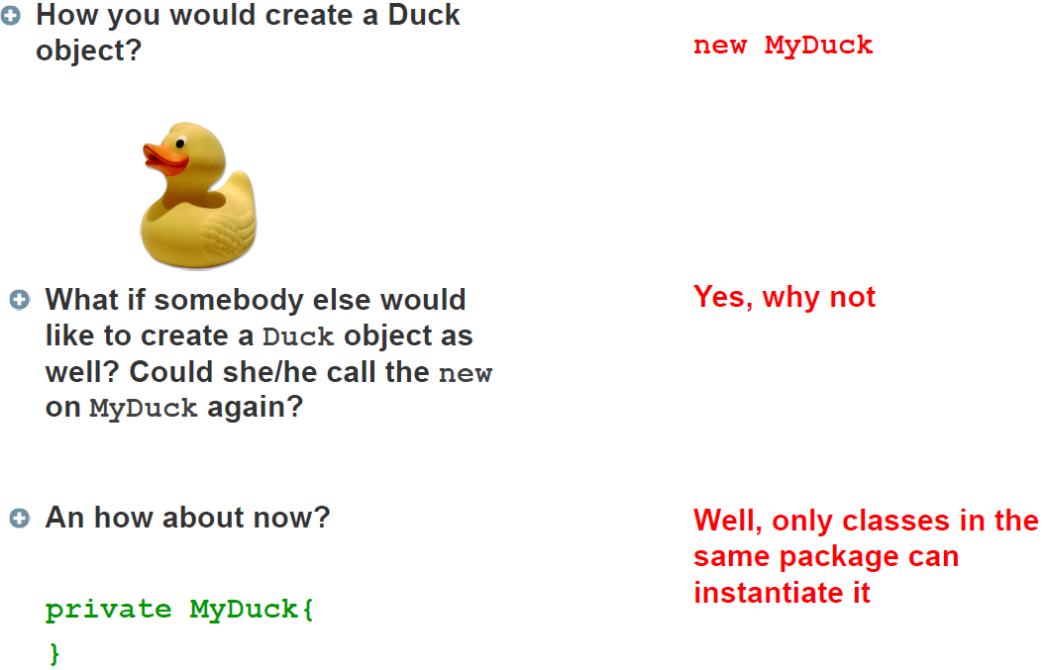
© Lethbridge/Laganière 2005
Chapter 6: Using design patterns

Slide 22
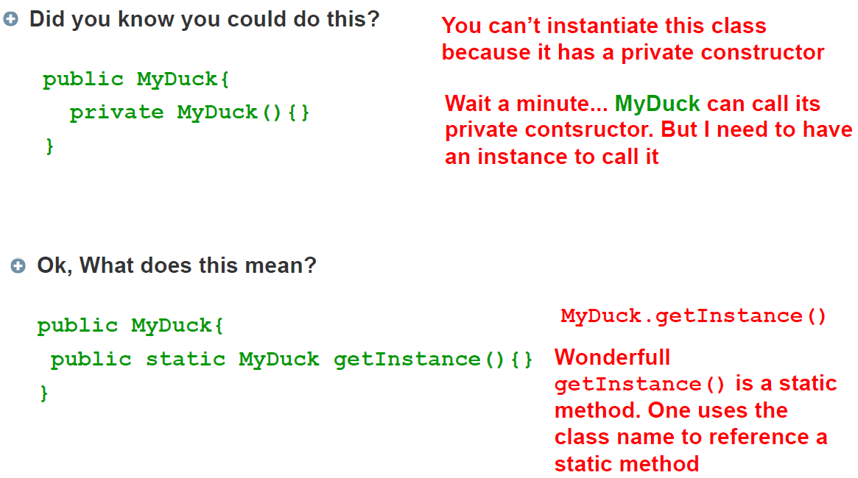
© Lethbridge/Laganière 2005
Chapter 6: Using design patterns

Slide 23
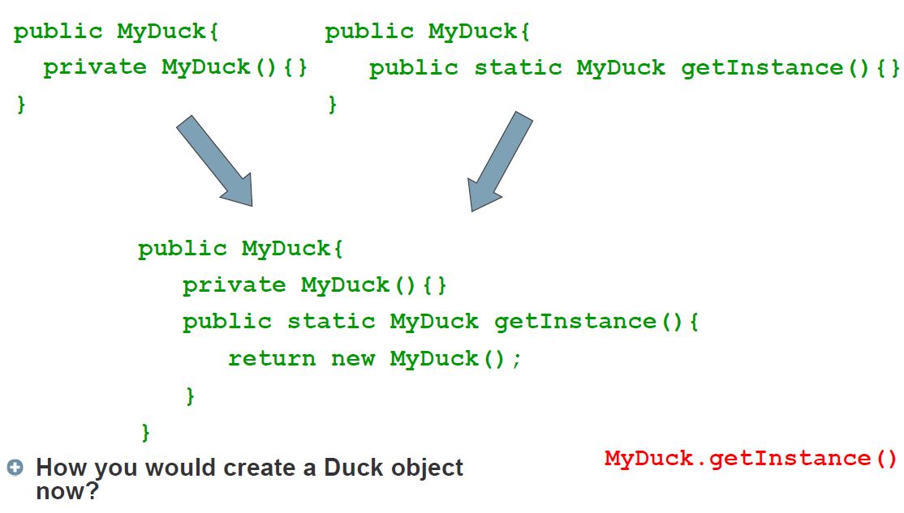
© Lethbridge/Laganière 2005
Chapter 6: Using design patterns

Slide 24
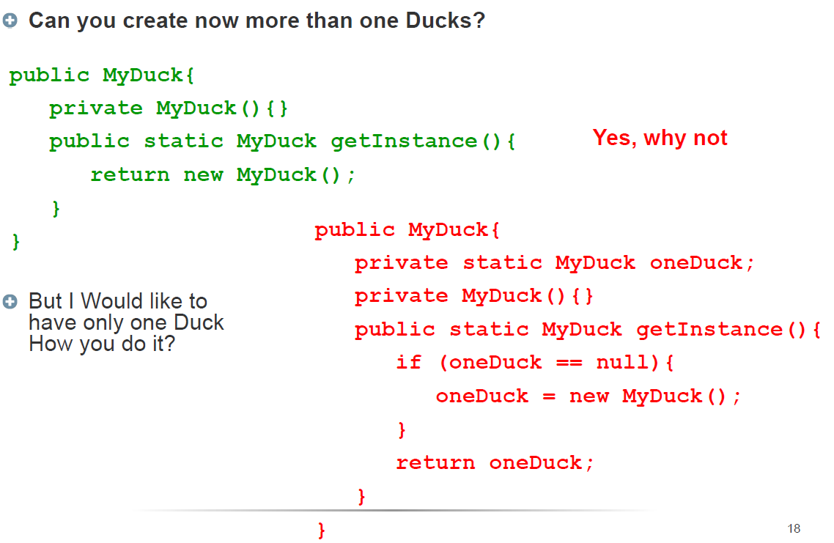
© Lethbridge/Laganière 2005
Chapter 6: Using design patterns

Slide 25
6.6 The Observer Pattern
  Context:
    When an association is created between two classes, the code for the classes becomes inseparable.
    If you want to reuse one class, then you also have to reuse the other.
  Problem:
    How do you reduce the interconnection between classes, especially between classes that belong to different modules or subsystems?
  Forces:
    You want to maximize the flexibility of the system to the greatest extent possible
© Lethbridge/Laganière 2005
Chapter 6: Using design patterns
Notes:
notify

Slide 26
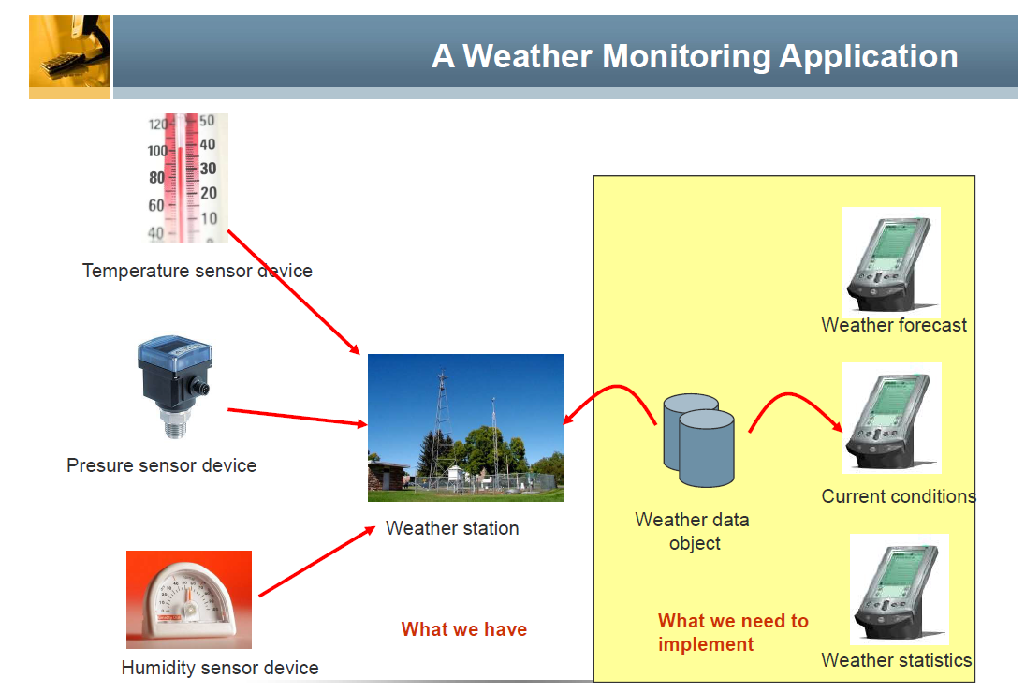
© Lethbridge/Laganière 2005
Chapter 6: Using design patterns

Slide 27
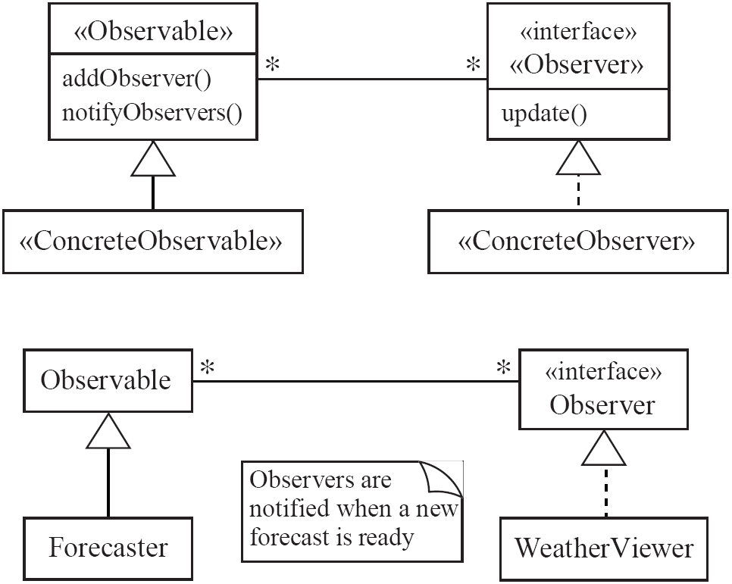
Observer
  Solution:
© Lethbridge/Laganière 2005
Chapter 6: Using design patterns

Slide 28
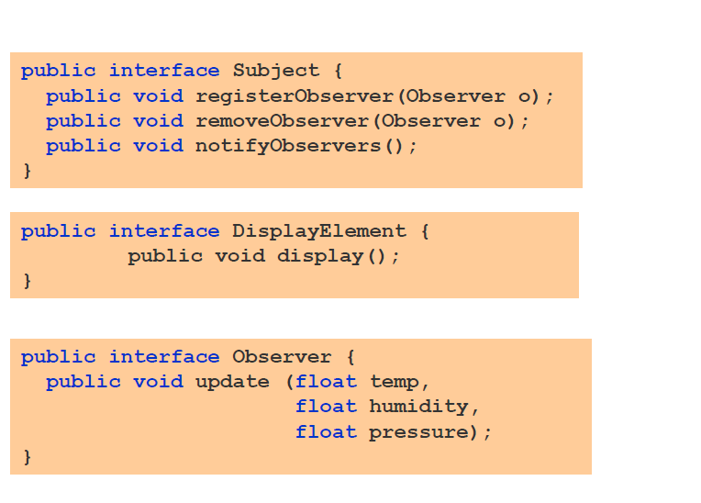
© Lethbridge/Laganière 2005
Chapter 6: Using design patterns

Slide 29
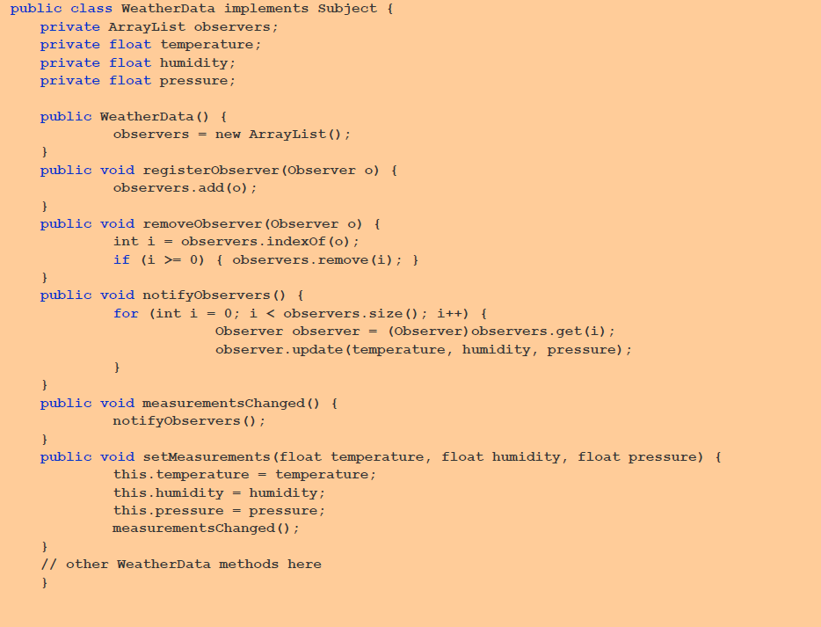
© Lethbridge/Laganière 2005
Chapter 6: Using design patterns

Slide 30
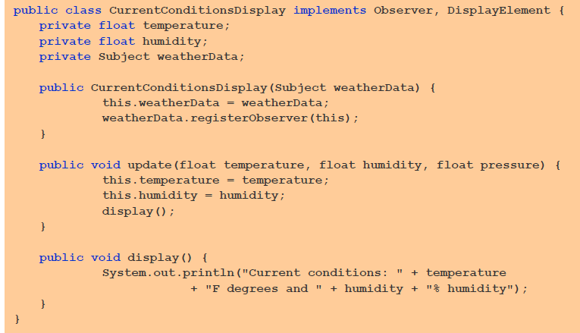
© Lethbridge/Laganière 2005
Chapter 6: Using design patterns

Slide 31
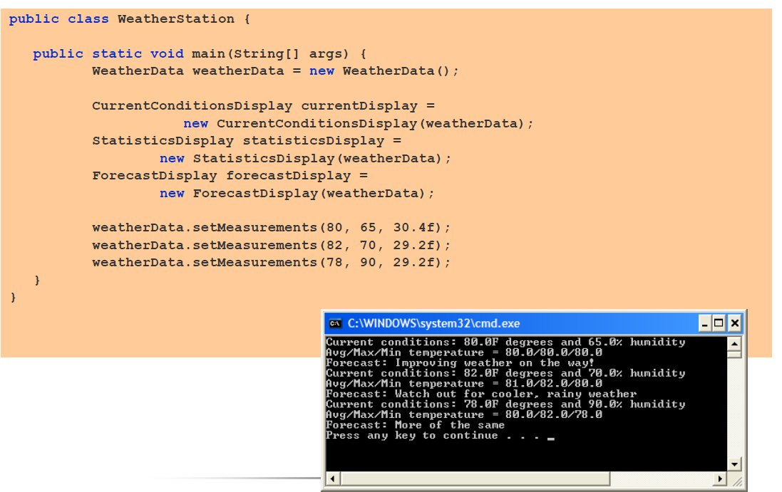
© Lethbridge/Laganière 2005
Chapter 6: Using design patterns

Slide 32
Observer
Antipatterns:
  Connect an observer directly to an observable so that they both have references to each other.
  Make the observers subclasses of the observable.
© Lethbridge/Laganière 2005
Chapter 6: Using design patterns

Slide 33
6.7 The Delegation Pattern
  Context:
    You are designing a method in a class
    You realize that another class has a method which provides the required service
    Inheritance is not appropriate
      E.g. because the isa rule does not apply
  Problem:
    How can you most effectively make use of a method that already exists in the other class?
  Forces:
    You want to minimize development cost by reusing methods
© Lethbridge/Laganière 2005
Chapter 6: Using design patterns

Slide 34
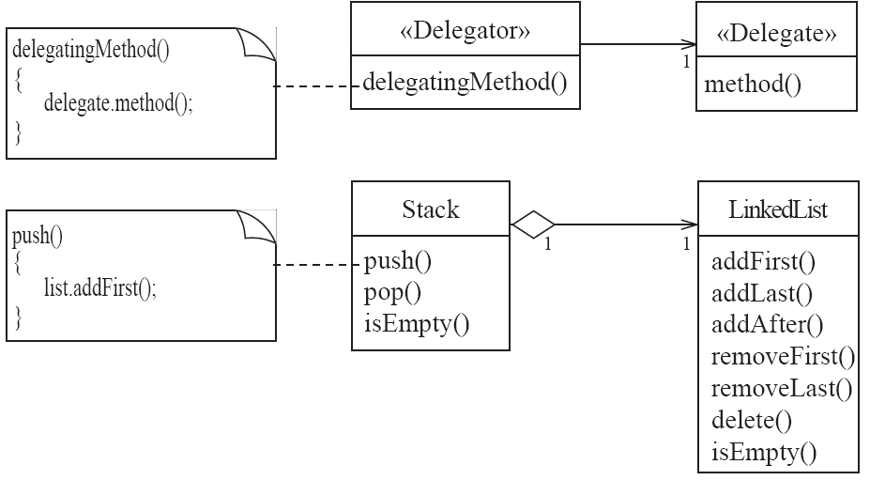
Delegation
  Solution:
© Lethbridge/Laganière 2005
Chapter 6: Using design patterns

Slide 35
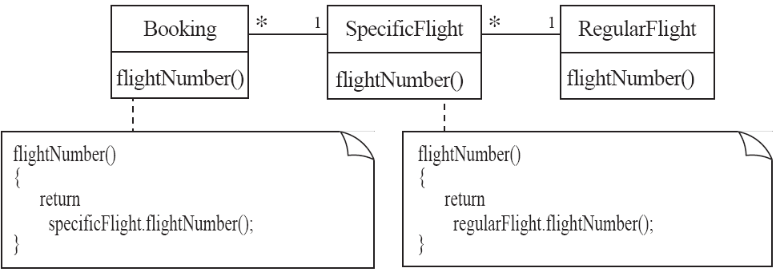
Delegation
Example:
© Lethbridge/Laganière 2005
Chapter 6: Using design patterns

Slide 36
Delegation
Antipatterns
  Overuse generalization and inherit the method that is to be reused
  Instead of creating a single method in the «Delegator» that does nothing other than call a method in the «Delegate
    consider having many different methods in the «Delegator» call the delegate’s method
  Access non-neighboring classes
return specificFlight.regularFlight.flightNumber();
return getRegularFlight().flightNumber();
© Lethbridge/Laganière 2005
Chapter 6: Using design patterns

Slide 37
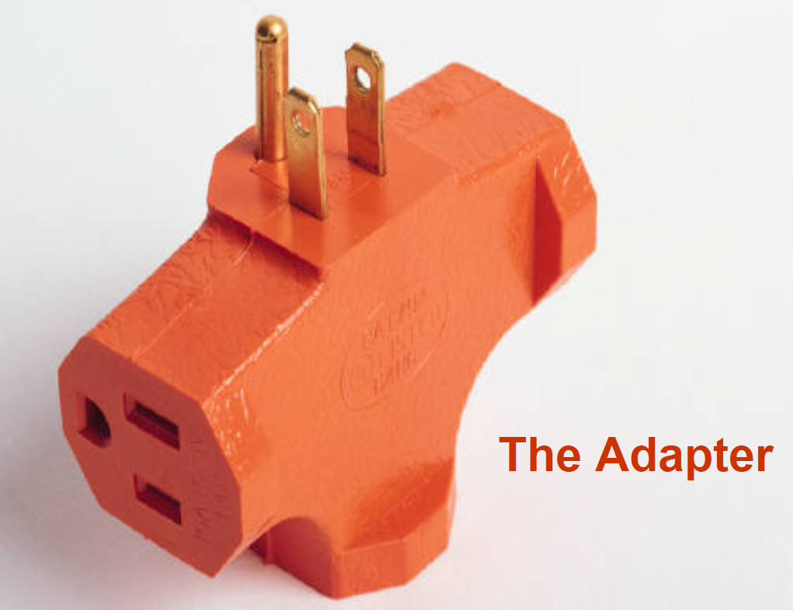

© Lethbridge/Laganière 2005
Chapter 6: Using design patterns

Slide 38
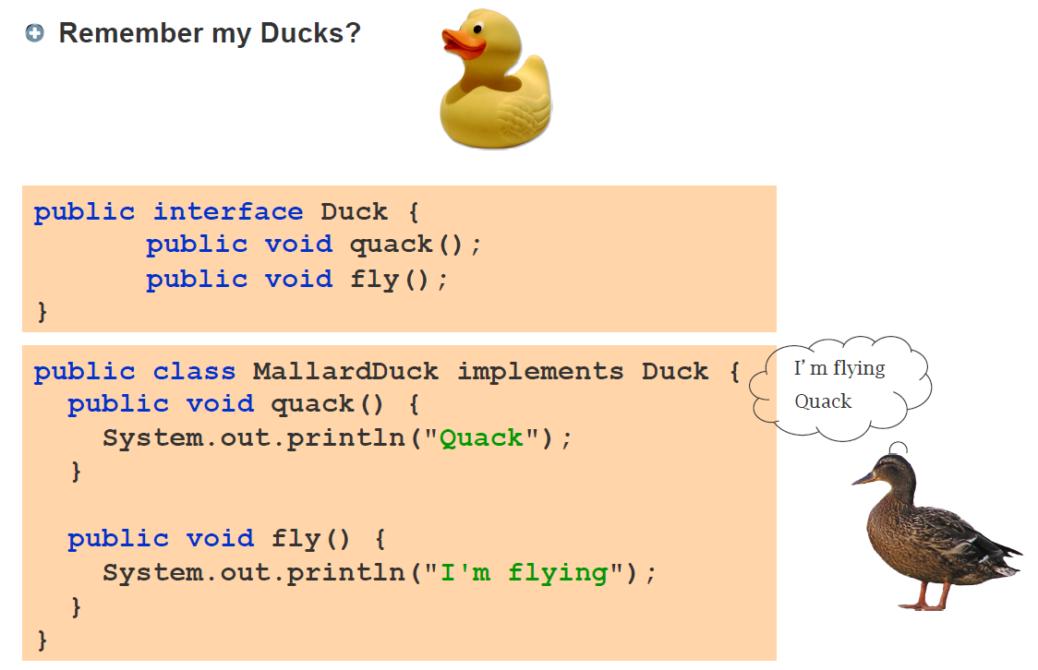
© Lethbridge/Laganière 2005
Chapter 6: Using design patterns

Slide 39
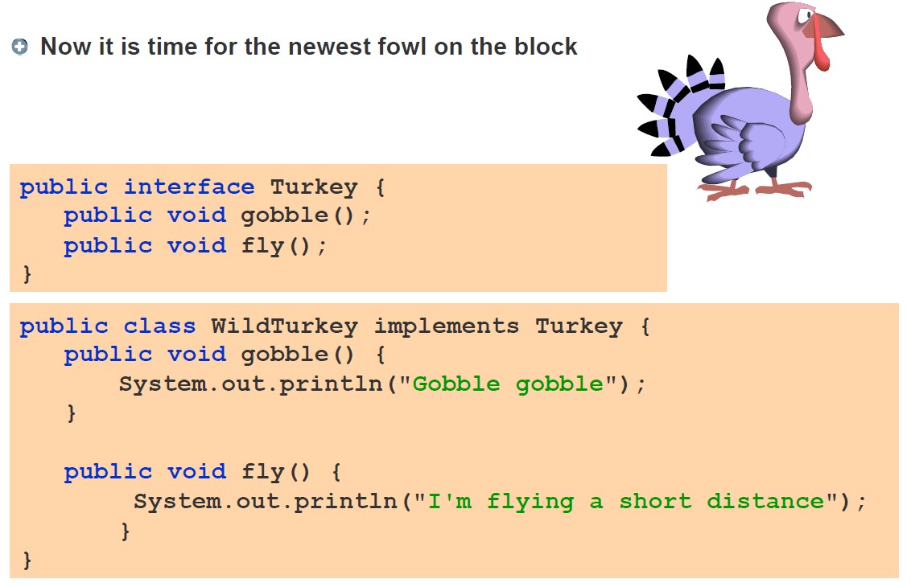
© Lethbridge/Laganière 2005
Chapter 6: Using design patterns

Slide 40
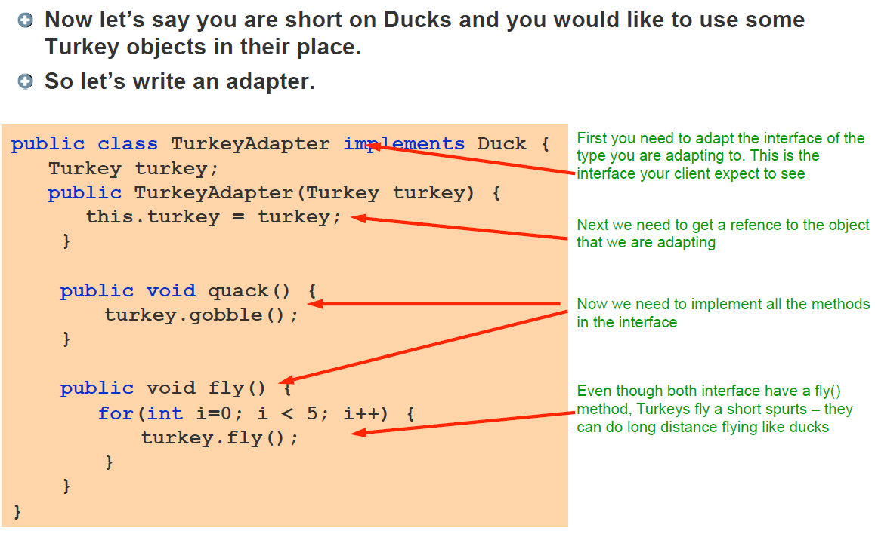
© Lethbridge/Laganière 2005
Chapter 6: Using design patterns

Slide 41
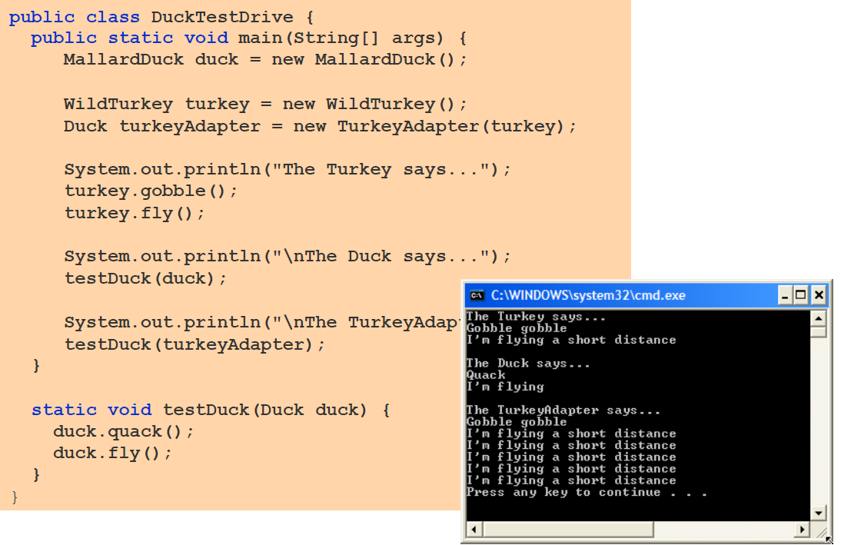
© Lethbridge/Laganière 2005
Chapter 6: Using design patterns

Slide 42
6.8 The Adapter Pattern
  Context:
    You are building an inheritance hierarchy and want to incorporate it into an existing class.
    The reused class is also often already part of its own inheritance hierarchy.
  Problem:
    How to obtain the power of polymorphism when reusing a class whose methods
      have the same function
      but not the same signature
    as the other methods in the hierarchy?
  Forces:
    You do not have access to multiple inheritance or you do not want to use it.
© Lethbridge/Laganière 2005
Chapter 6: Using design patterns

Slide 43
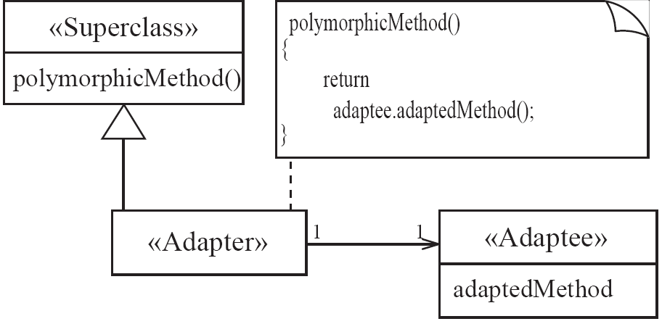
Adapter
  Solution:
© Lethbridge/Laganière 2005
Chapter 6: Using design patterns

Slide 44
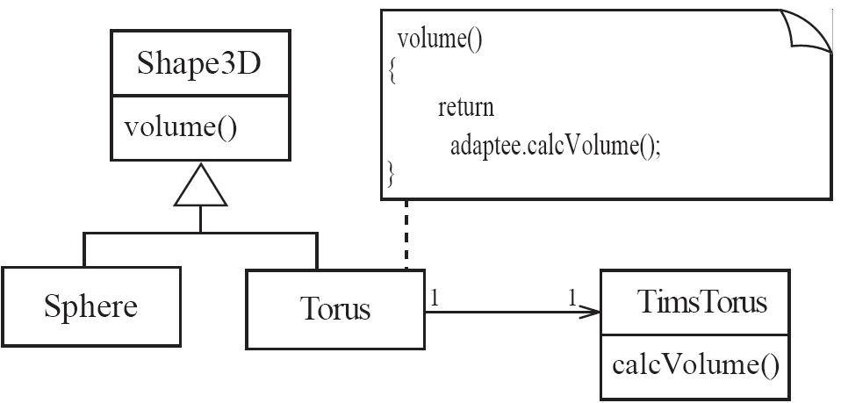
Adapter
Example:
© Lethbridge/Laganière 2005
Chapter 6: Using design patterns

Slide 45
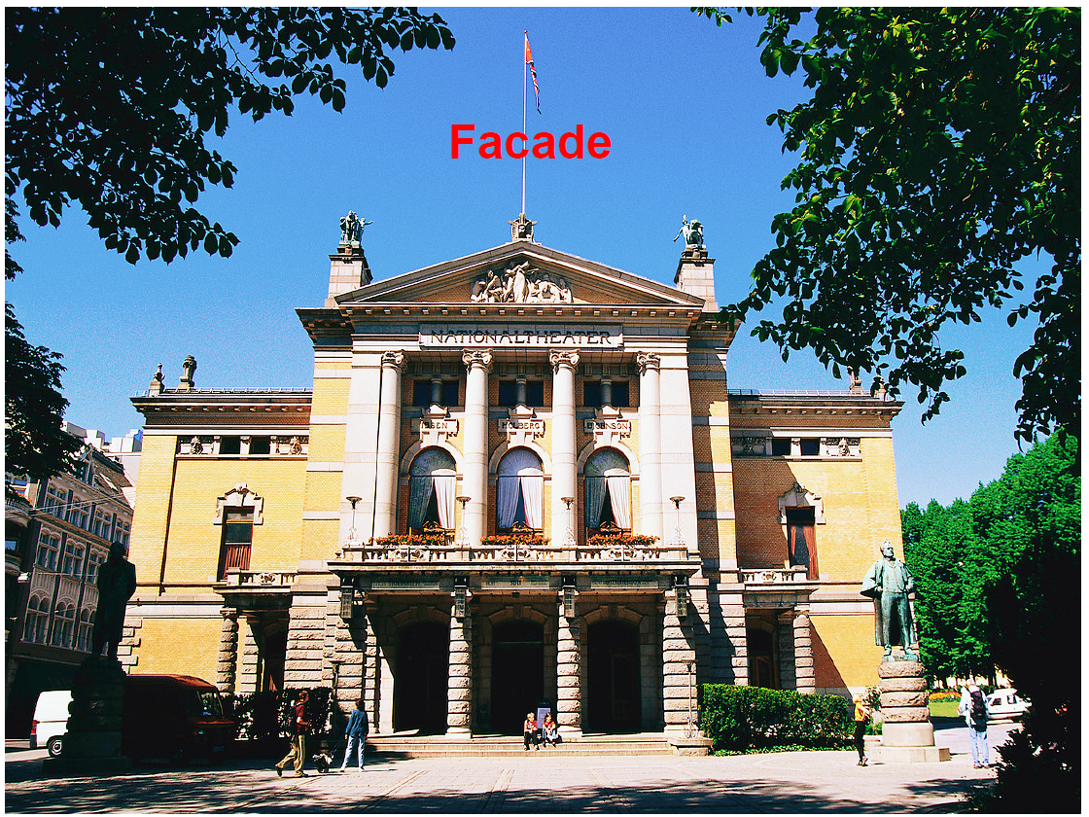
© Lethbridge/Laganière 2005
Chapter 6: Using design patterns

Slide 46
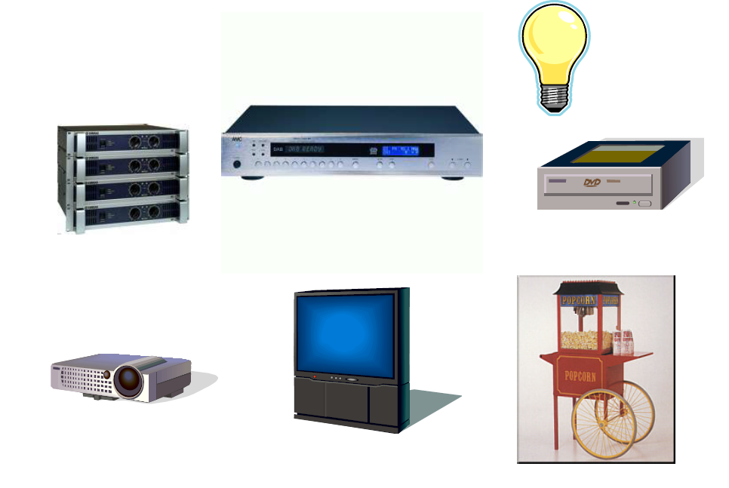
© Lethbridge/Laganière 2005
Chapter 6: Using design patterns

Slide 47
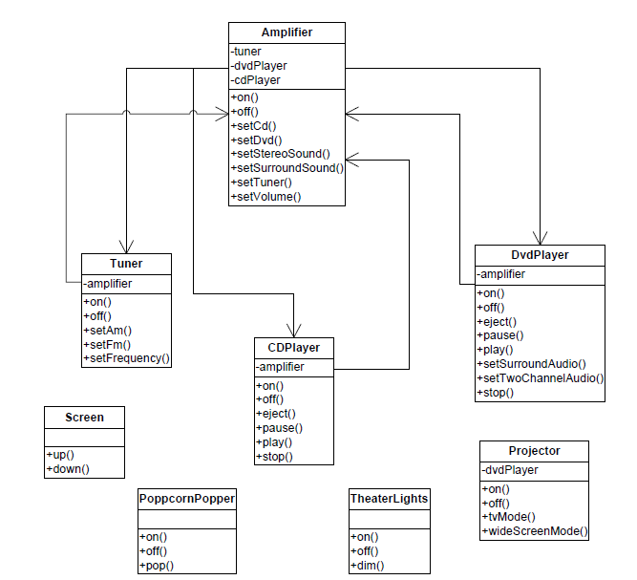
© Lethbridge/Laganière 2005
Chapter 6: Using design patterns

Slide 48
Watching a movie
Turn on the popcorn popper
Start the popper popping
Dim the lights
Put the screen down
Turn the projector on
Set the projector input to DVD
Put the projector on wide-screen mode
Turn the sound amplifier on
Set the amplifier to DVD input
Set the amplifier to surround sound
Set the amplifier volume to medium
Turn the DVD player on
Start the DVD player playing
© Lethbridge/Laganière 2005

Slide 49
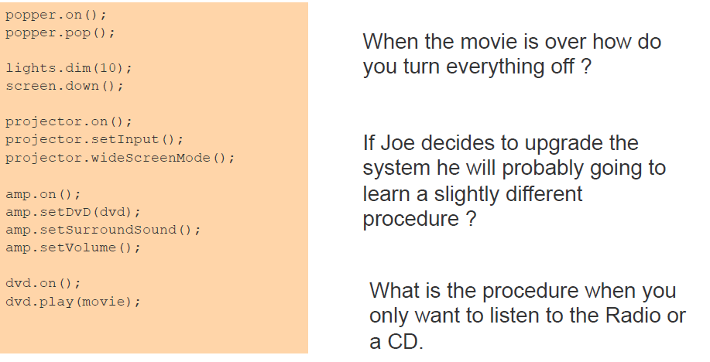
© Lethbridge/Laganière 2005
Chapter 6: Using design patterns

Slide 50
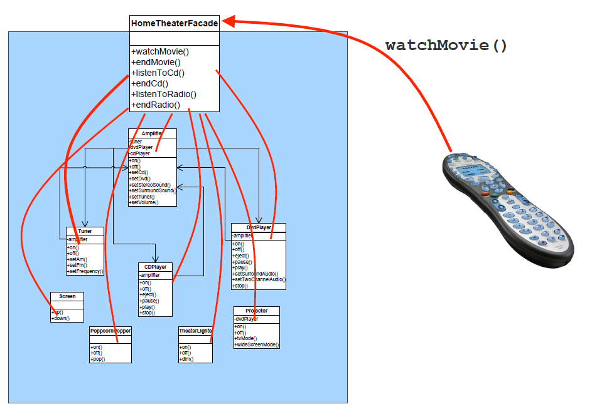
© Lethbridge/Laganière 2005
Chapter 6: Using design patterns

Slide 51
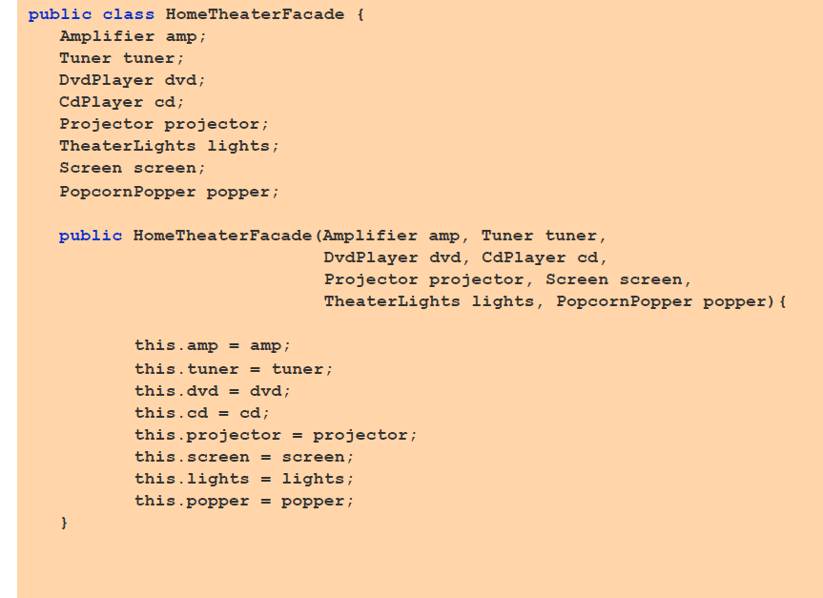
© Lethbridge/Laganière 2005
Chapter 6: Using design patterns

Slide 52
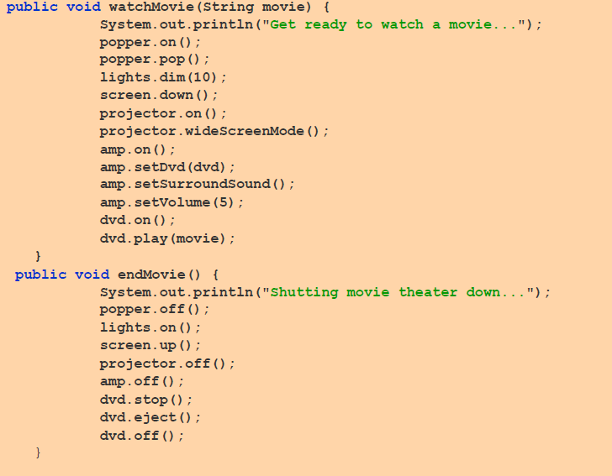
© Lethbridge/Laganière 2005
Chapter 6: Using design patterns

Slide 53
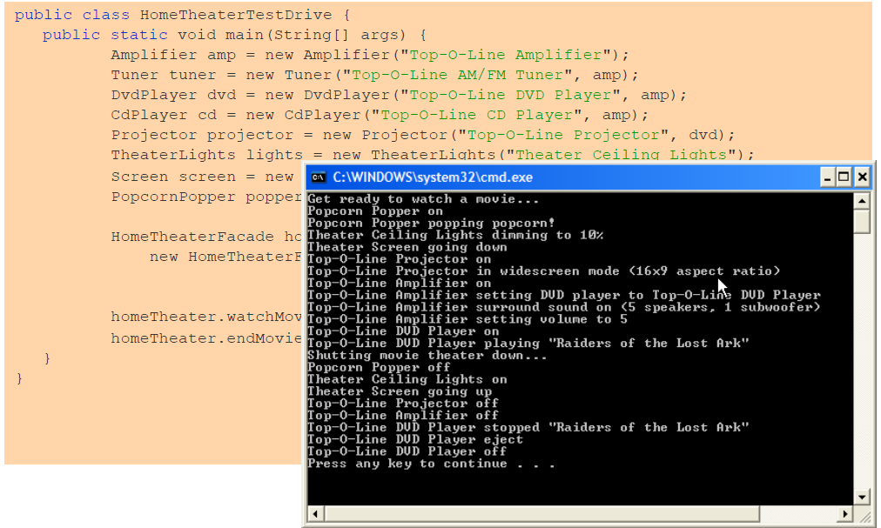
© Lethbridge/Laganière 2005
Chapter 6: Using design patterns

Slide 54
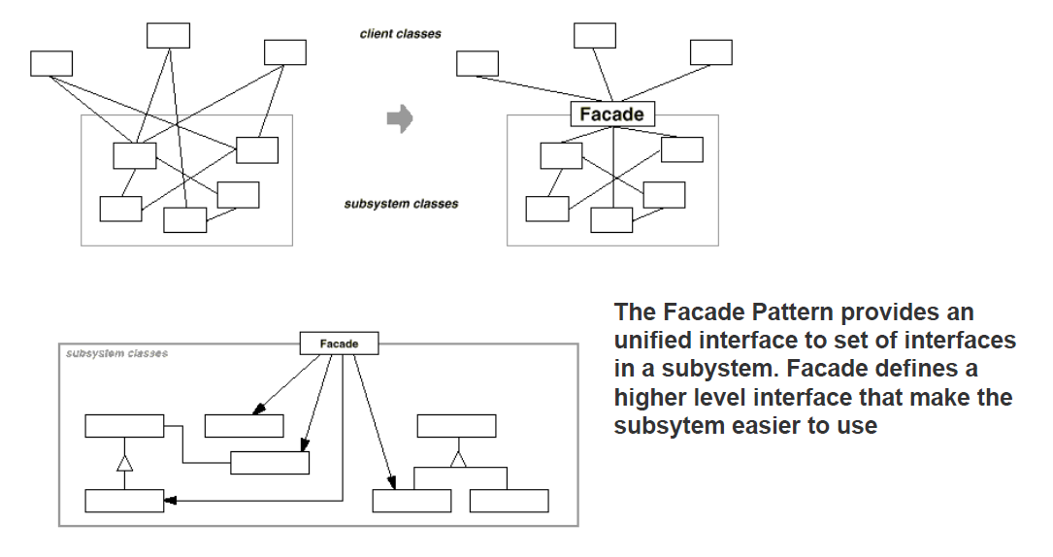
© Lethbridge/Laganière 2005
Chapter 6: Using design patterns

Slide 55
6.9 The Façade Pattern
  Context:
    Often, an application contains several complex packages.
    A programmer working with such packages has to manipulate many different classes
  Problem:
    How do you simplify the view that programmers have of a complex package?
  Forces:
    It is hard for a programmer to understand and use an entire subsystem
    If several different application classes call methods of the complex package, then any modifications made to the package will necessitate a complete review of all these classes.
© Lethbridge/Laganière 2005
Chapter 6: Using design patterns

Slide 56
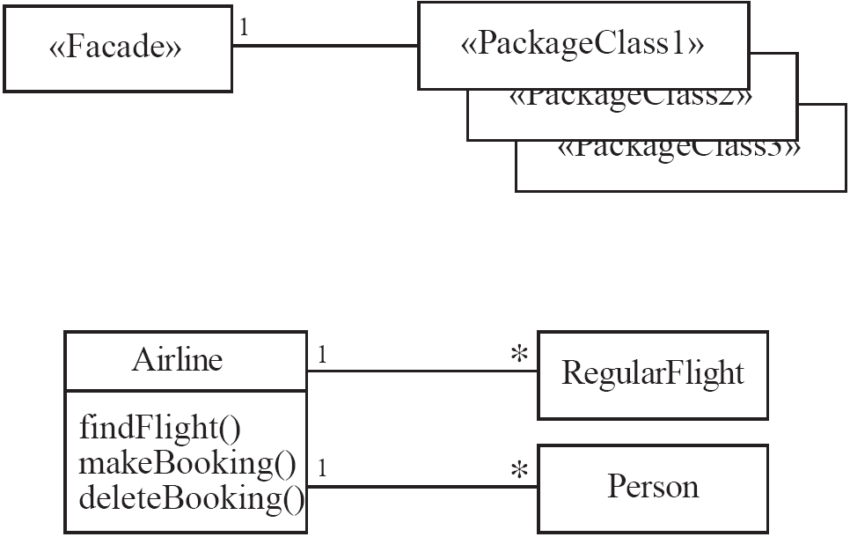
Façade
  Solution:
© Lethbridge/Laganière 2005
Chapter 6: Using design patterns

Slide 57
6.10 The Immutable Pattern
  Context:
    An immutable object is an object that has a state that never changes after creation
  Problem:
    How do you create a class whose instances are immutable?
  Forces:
    There must be no loopholes that would allow ‘illegal’ modification of an immutable object
  Solution:
    Ensure that the constructor of the immutable class is the only place where the values of instance variables are set or modified.
    Instance methods which access properties must not have side effects.
    If a method that would otherwise modify an instance variable is required, then it has to return a new instance of the class.
© Lethbridge/Laganière 2005
Chapter 6: Using design patterns

Slide 58
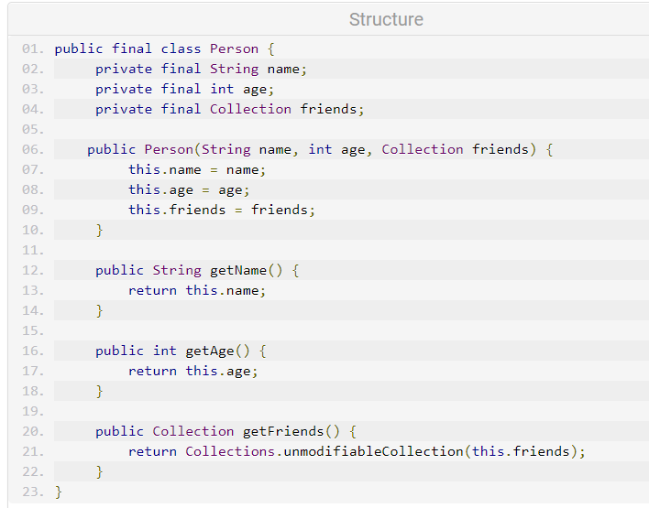
© Lethbridge/Laganière 2005
Chapter 6: Using design patterns

Slide 59
6.11 The Read-only Interface Pattern
  Context:
    You sometimes want certain privileged classes to be able to modify attributes of objects that are otherwise immutable
  Problem:
    How do you create a situation where some classes see a class as read-only whereas others are able to make modifications?
  Forces:
    Restricting access by using the public, protected and private keywords is not adequately selective.
    Making access public makes it public for both reading and writing
© Lethbridge/Laganière 2005
Chapter 6: Using design patterns

Slide 60
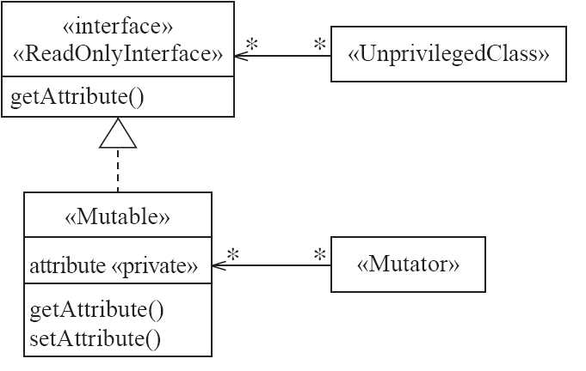
Read-only Interface
  Solution:
© Lethbridge/Laganière 2005
Chapter 6: Using design patterns

Slide 61
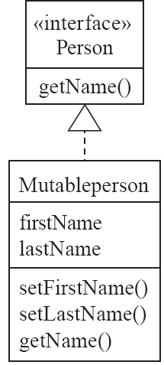
Read-only Interface
Example:
© Lethbridge/Laganière 2005
Chapter 6: Using design patterns

Slide 62
Read-only Interface
Antipatterns:
  Make the read-only class a subclass of the «Mutable» class
  Override all methods that modify properties
    such that they throw an exception
© Lethbridge/Laganière 2005
Chapter 6: Using design patterns

Slide 63
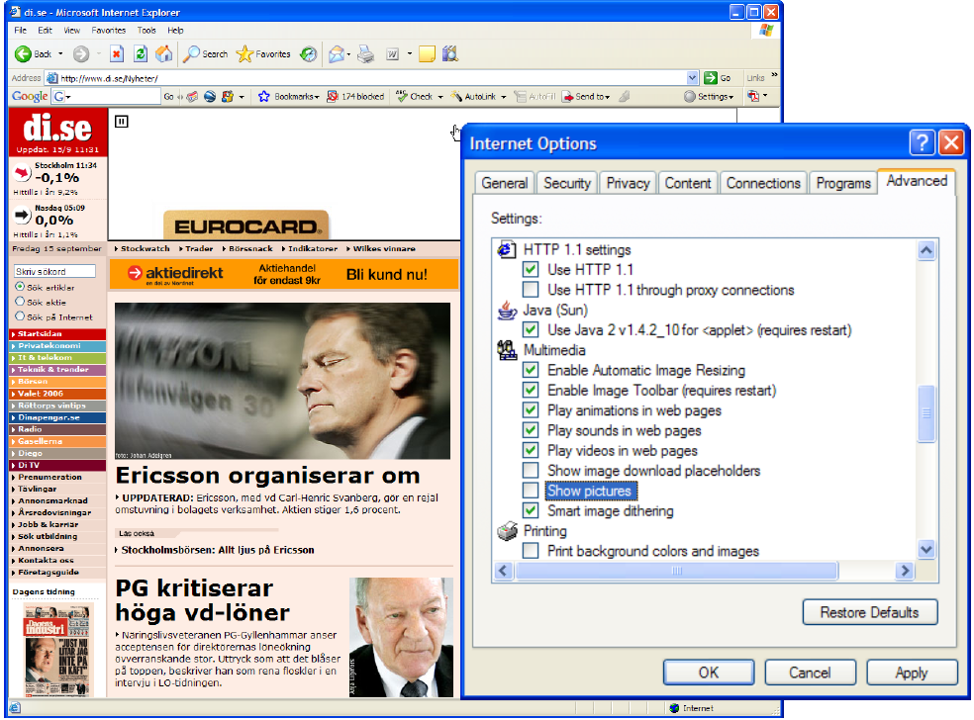
The Proxy Pattern
© Lethbridge/Laganière 2005
Chapter 6: Using design patterns

Slide 64
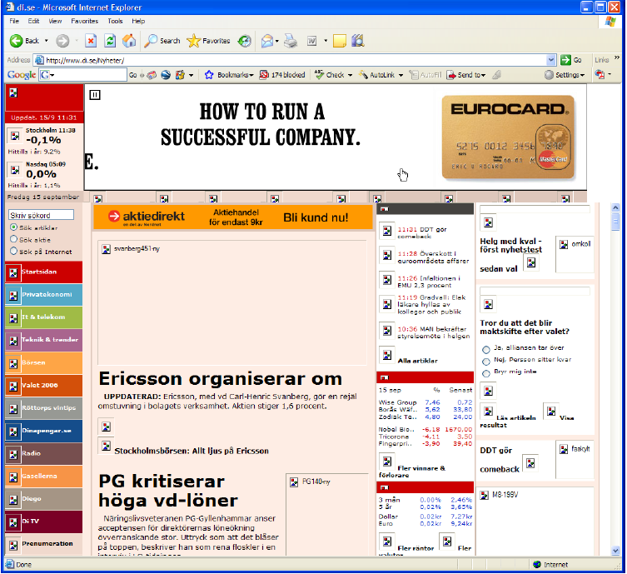
© Lethbridge/Laganière 2005
Chapter 6: Using design patterns

Slide 65
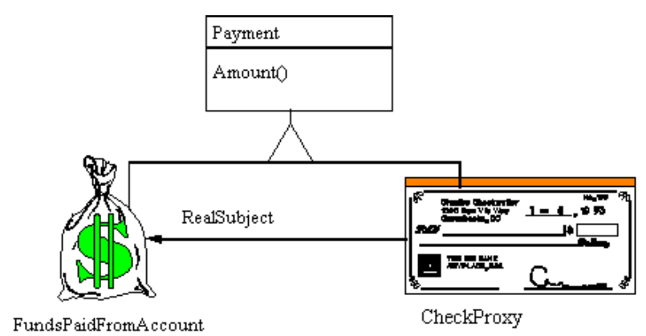
© Lethbridge/Laganière 2005
Chapter 6: Using design patterns

Slide 66
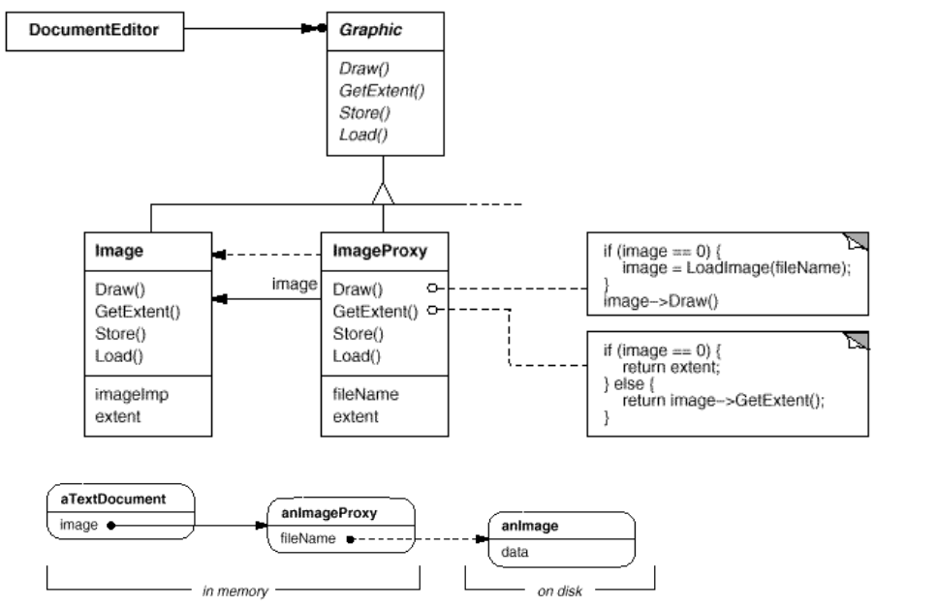
© Lethbridge/Laganière 2005
Chapter 6: Using design patterns

Slide 67
6.12 The Proxy Pattern
  Context:
    Often, it is time-consuming and complicated to create instances of a class (heavyweight classes).
    There is a time delay and a complex mechanism involved in creating the object in memory
  Problem:
    How to reduce the need to create instances of a heavyweight class?
  Forces:
    We want all the objects in a domain model to be available for programs to use when they execute a system’s various responsibilities.
    It is also important for many objects to persist from run to run of the same program
© Lethbridge/Laganière 2005
Chapter 6: Using design patterns

Slide 68

Proxy
  Solution:
© Lethbridge/Laganière 2005
Chapter 6: Using design patterns

Slide 69


Proxy
Examples:
© Lethbridge/Laganière 2005
Chapter 6: Using design patterns

Slide 70

© Lethbridge/Laganière 2005
Chapter 6: Using design patterns

Slide 71

© Lethbridge/Laganière 2005
Chapter 6: Using design patterns

Slide 72

© Lethbridge/Laganière 2005
Chapter 6: Using design patterns

Slide 73

© Lethbridge/Laganière 2005
Chapter 6: Using design patterns

Slide 74

© Lethbridge/Laganière 2005
Chapter 6: Using design patterns

Slide 75

© Lethbridge/Laganière 2005
Chapter 6: Using design patterns

Slide 76

© Lethbridge/Laganière 2005
Chapter 6: Using design patterns

Slide 77

© Lethbridge/Laganière 2005
Chapter 6: Using design patterns

Slide 78

© Lethbridge/Laganière 2005
Chapter 6: Using design patterns

Slide 79

© Lethbridge/Laganière 2005
Chapter 6: Using design patterns

Slide 80

© Lethbridge/Laganière 2005
Chapter 6: Using design patterns

Slide 81
6.13 The Factory Pattern
  Context:
    A reusable framework needs to create objecs; however the class of the created objects depends on the application.
  Problem:
    How do you enable a programmer to add new application-specific class into a system built on such a framework?
  Forces:
    We want to have the framework create and work with application-specific classes that the framework does not yet know about.
  Solution:
    The framework delegates the creation of application-specific classes to a specialized class, the Factory.
    The Factory is a generic interface defined in the framework.
    The factory interface declares a method whose purpose is to create some subclass of a generic class.
© Lethbridge/Laganière 2005
Chapter 6: Using design patterns

Slide 82

The Factory Pattern
Solution
© Lethbridge/Laganière 2005
Chapter 6: Using design patterns

Slide 83

The Factory Pattern
Example
© Lethbridge/Laganière 2005
Chapter 6: Using design patterns

Slide 84
6.15 Difficulties and Risks When Creating Class Diagrams
  Patterns are not a panacea:
    Whenever you see an indication that a pattern should be applied, you might be tempted to blindly apply the pattern.
    This can lead to unwise design decisions .
  Resolution:
    Always understand in depth the forces that need to be balanced, and when other patterns better balance the forces.
    Make sure you justify each design decision carefully.
© Lethbridge/Laganière 2005
Chapter 6: Using design patterns

Slide 85
Difficulties and Risks When Creating Class Diagrams
  Developing patterns is hard
    Writing a good pattern takes considerable work.
    A poor pattern can be hard to apply correctly
  Resolution:
    Do not write patterns for others to use until you have considerable experience both in software design and in the use of patterns.
    Take an in-depth course on patterns.
    Iteratively refine your patterns, and have them peer reviewed at each iteration.
© Lethbridge/Laganière 2005
Chapter 6: Using design patterns

