Slide 1
Object-Oriented Software Engineering
Practical Software Development using UML and Java
Chapter 7:
Focusing on Users and Their Tasks

Slide 2
7.1 User Centred Design
Software development should focus on the needs of users
  Understand your users
  Design software based on an understanding of the users’ tasks
  Ensure users are involved in decision making processes
  Design the user interface following guidelines for good usability
  Have users work with and give their feedback about prototypes, on-line help and draft user manuals
© Lethbridge/Laganière 2005
Chapter 7: Focusing on Users and Their Tasks

Slide 3
The importance of focusing on users
  Reduced training and support costs
  Reduced time to learn the system
  Greater efficiency of use
  Reduced costs by only developing features that are needed
  Reduced costs associated with changing the system later
  Better prioritizing of work for iterative development
  Greater attractiveness of the system, so users will be more willing to buy and use it
© Lethbridge/Laganière 2005
Chapter 7: Focusing on Users and Their Tasks

Slide 4
7.2 Characteristics of Users
Software engineers must develop an understanding of the users
  Goals for using the system
  Potential patterns of use
  Demographics
  Knowledge of the domain and of computers
  Physical ability
  Psychological traits and emotional feelings
© Lethbridge/Laganière 2005
Chapter 7: Focusing on Users and Their Tasks

Slide 5
7.3 Basics of User Interface Design
  User interface design should be done in conjunction with other software engineering activities.
  Do use case analysis to help define the tasks that the UI must help the user perform.
  Do iterative UI prototyping to address the use cases.
  Results of prototyping will enable you to finalize the requirements.
© Lethbridge/Laganière 2005
Chapter 7: Focusing on Users and Their Tasks

Slide 6
Usability vs. Utility
Does the system provide the raw capabilities to allow the user to achieve their goal?
  This is utility.
Does the system allow the user to learn and to use the raw capabilities easily?
  This is usability.
Both utility and usability are essential
  They must be measured in the context of particular types of users.
© Lethbridge/Laganière 2005
Chapter 7: Focusing on Users and Their Tasks

Slide 7
Aspects of usability
Usability can be divided into separate aspects:
  Learnability
    The speed with which a new user can become proficient with the system.
  Efficiency of use
    How fast an expert user can do their work.
  Error handling
    The extent to which it prevents the user from making errors, detects errors, and helps to correct errors.
  Acceptability.
    The extent to which users like the system.
© Lethbridge/Laganière 2005
Chapter 7: Focusing on Users and Their Tasks

Slide 8
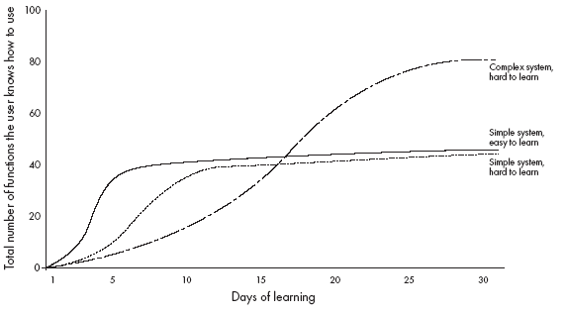
Different learning curves
© Lethbridge/Laganière 2005
Chapter 7: Focusing on Users and Their Tasks

Slide 9
Some basic terminology of user interface design
  Dialog: A specific window with which a user can interact, but which is not the main UI window.
  Control or Widget: Specific components of a user interface.
  Affordance: The set of operations that the user can do at any given point in time.
  State: At any stage in the dialog, the system is displaying certain information in certain widgets, and has a certain affordance.
  Mode: A situation in which the UI restricts what the user can do.
  Modal dialog: A dialog in which the system is in a very restrictive mode.
  Feedback: The response from the system whenever the user does something, is called feedback.
  Encoding techniques. Ways of encoding information so as to communicate it to the user.
© Lethbridge/Laganière 2005
Chapter 7: Focusing on Users and Their Tasks

Slide 10
7.4 Usability Principles
1. Do not rely only on usability guidelines – always test with users.
  Usability guidelines have exceptions; you can only be confident that a UI is good if you test it successfully with users.
2: Base UI designs on users’ tasks.
  Perform use case analysis to structure the UI.
3: Ensure that the sequences of actions to achieve a task are as simple as possible.
  Reduce the amount of reading and manipulation the user has to do.
  Ensure the user does not have to navigate anywhere to do subsequent steps of a task.
© Lethbridge/Laganière 2005
Chapter 7: Focusing on Users and Their Tasks

Slide 11
Usability Principles
4: Ensure that the user always knows what he or she can and should do next.
  Ensure that the user can see what commands are available and are not available.
  Make the most important commands stand out.
5: Provide good feedback including effective error messages.
  Inform users of the progress of operations and of their location as they navigate.
  When something goes wrong explain the situation in adequate detail and help the user to resolve the problem.
© Lethbridge/Laganière 2005
Chapter 7: Focusing on Users and Their Tasks

Slide 12
Usability Principles
6: Ensure that the user can always get out, go back or undo an action.
  Ensure that all operations can be undone.
  Ensure it is easy to navigate back to where the user came from.
7: Ensure that response time is adequate.
  Users are very sensitive to slow response time
    They compare your system to others.
  Keep response time less than a second for most operations.
  Warn users of longer delays and inform them of progress.
© Lethbridge/Laganière 2005
Chapter 7: Focusing on Users and Their Tasks

Slide 13
Usability Principles
8: Use understandable encoding techniques.
  Choose encoding techniques with care.
  Use labels to ensure all encoding techniques are fully understood by users.
9: Ensure that the UI’s appearance is uncluttered.
  Avoid displaying too much information.
  Organize the information effectively.
© Lethbridge/Laganière 2005
Chapter 7: Focusing on Users and Their Tasks

Slide 14
Usability Principles
10: Consider the needs of different groups of users.
  Accommodate people from different locales and people with disabilities.
  Ensure that the system is usable by both beginners and experts.
11: Provide all necessary help.
  Organize help well.
  Integrate help with the application.
  Ensure that the help is accurate.
© Lethbridge/Laganière 2005
Chapter 7: Focusing on Users and Their Tasks

Slide 15
Usability Principles
12. Be consistent.
  Use similar layouts and graphic designs throughout your application.
  Follow look-and-feel standards.
  Consider mimicking other applications.
© Lethbridge/Laganière 2005
Chapter 7: Focusing on Users and Their Tasks

Slide 16
Some encoding techniques
Text and fonts
Icons
Photographs
Diagrams and abstract graphics
Colours
Grouping and bordering
Spoken words
Music
Other sounds
Animations and video
Flashing
© Lethbridge/Laganière 2005
Chapter 7: Focusing on Users and Their Tasks

Slide 17
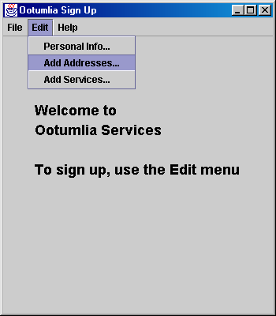
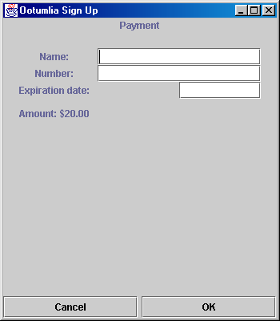
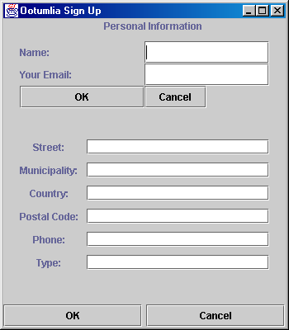
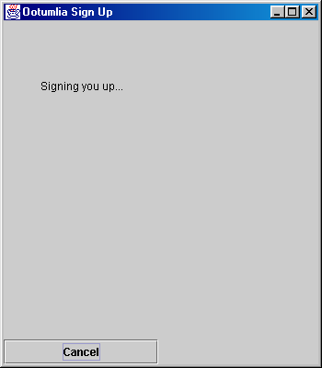
Example
(bad UI)
© Lethbridge/Laganière 2005
Chapter 7: Focusing on Users and Their Tasks

Slide 18
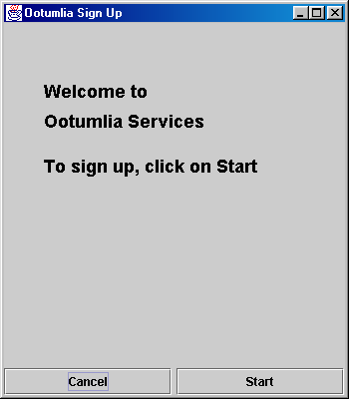
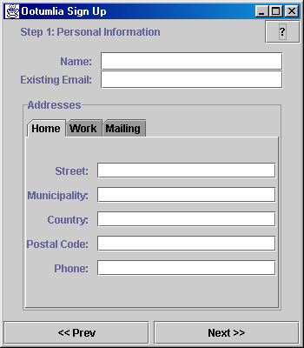
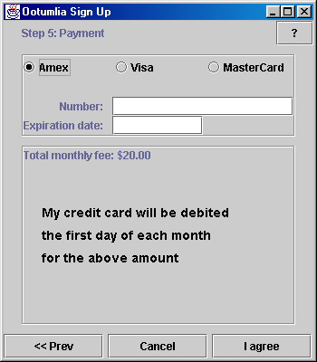
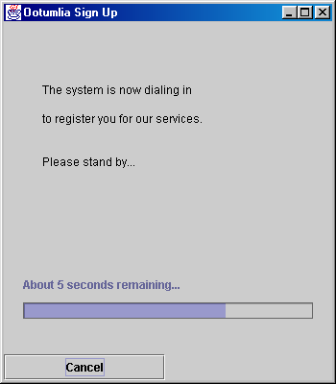
Example
(better UI)
© Lethbridge/Laganière 2005
Chapter 7: Focusing on Users and Their Tasks

Slide 19
7.5 Evaluating User Interfaces
Heuristic evaluation
  1. Pick some use cases to evaluate.
  2. For each window, page or dialog that appears during the execution of the use case
    Study it in detail to look for possible usability defects.
  3. When you discover a usability defect write down the following information:
    A short description of the defect.
    Your ideas for how the defect might be fixed.
© Lethbridge/Laganière 2005
Chapter 7: Focusing on Users and Their Tasks

Slide 20
Evaluating User Interfaces
Evaluation by observation of users
  Select users corresponding to each of the most important actors
  Select the most important use cases
  Write sufficient instructions about each of the scenarios
  Arrange evaluation sessions with users
  Explain the purpose of the evaluation
  Preferably videotape each session
  Converse with the users as they are performing the tasks
  When the users finish all the tasks, de-brief them
  Take note of any difficulties experienced by the users
  Formulate recommended changes
© Lethbridge/Laganière 2005
Chapter 7: Focusing on Users and Their Tasks

Slide 21
7.6 Implementing a Simple GUI in Java
The Abstract Window Toolkit (AWT)
  Component: the basic building blocks of any graphical interface.
    Button, TextField, List, Label, ScrollBar.
  Container: contain the components constituting the GUI
    Frame, Dialog and Panel
  LayoutManager: define the way components are laid out in a container.
    GridLayout, BorderLayout
© Lethbridge/Laganière 2005
Chapter 7: Focusing on Users and Their Tasks

Slide 22
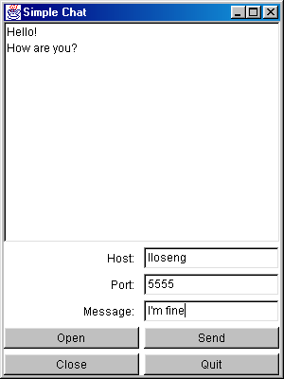
Example
public class ClientGUI extends Frame implements ChatIF
{
private Button closeB = new Button("Close");
private Button openB = new Button("Open");
private Button sendB = new Button("Send");
private Button quitB = new Button("Quit");
private TextField portTxF = new TextField("12345");
private TextField hostTxF = new TextField("localhost");
private TextField message = new TextField();
private Label portLB = new Label("Port: ", Label.RIGHT);
private Label hostLB = new Label("Host: ", Label.RIGHT);
private Label messageLB = new Label("Message: ", Label.RIGHT);
private List messageList = new List();
...
}
© Lethbridge/Laganière 2005
Chapter 7: Focusing on Users and Their Tasks

Slide 23
Example
public ClientGUI(String host, int port)
{
super("Simple Chat");
setSize(300,400);
setVisible(true);
setLayout(new BorderLayout(5,5));
Panel bottom = new Panel();
add("Center", messageList);
add("South", bottom);
bottom.setLayout(new GridLayout(5,2,5,5))
bottom.add(hostLB);
bottom.add(hostTxF);
bottom.add(portLB);
bottom.add(portTxF);
bottom.add(messageLB);
bottom.add(message);
bottom.add(openB);
bottom.add(sendB);
bottom.add(closeB);
bottom.add(quitB);
...
}
© Lethbridge/Laganière 2005
Chapter 7: Focusing on Users and Their Tasks

Slide 24
Example
sendB.addActionListener(new ActionListener()
{
public void actionPerformed(ActionEvent e)
{
send();
}
});
}
public void send()
{
try
{
client.sendToServer(message.getText());
}
catch (Exception ex)
{
messageList.add(ex.toString());
messageList.makeVisible(messageList.getItemCount()-1);
messageList.setBackground(Color.yellow);
}
}
© Lethbridge/Laganière 2005
Chapter 7: Focusing on Users and Their Tasks

Slide 25
7.7 Difficulties and Risks in UI Design
  Users differ widely
    Account for differences among users when you design the system.
    Design it for internationalization.
    When you perform usability studies, try the system with many different types of users.
  User interface implementation technology changes rapidly
    Stick to simpler UI frameworks widely used by others.
    Avoid fancy and unusual UI designs involving specialized controls that will be hard to change.
© Lethbridge/Laganière 2005
Chapter 7: Focusing on Users and Their Tasks

Slide 26
Difficulties and Risks in UI Design
  User interface design and implementation can often take the majority of work in an application:
    Make UI design an integral part of the software engineering process.
    Allocate time for many iterations of prototyping and evaluation.
  Developers often underestimate the weaknesses of a GUI
    Ensure all software engineers have training in UI development.
    Always test with users.
    Study the UIs of other software.
© Lethbridge/Laganière 2005
Chapter 7: Focusing on Users and Their Tasks

