Slide 1

ASSEMBLY LANGUAGE EXAMPLE CODE
Burcu CANBULAT

Slide 2
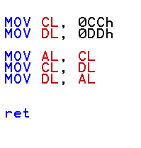
EXAMPLE CODE 1:
Find the output AL,DL and CL of the program in assembly language.

Slide 3
CL | DL | AL
0CCh | 0DDh | -
- | - | 0CCh
0DDh | - | -
- | 0CCh | -
1
2
3
4
MOV is a data transfer command.
0CCh value transferred to CL and 0DDh value transferred to DL.
The value in the CL register is transferred to AL.
CL register gets the value of the DL register.
The AL register passes its value to DL.
1
2
3
4

Slide 4
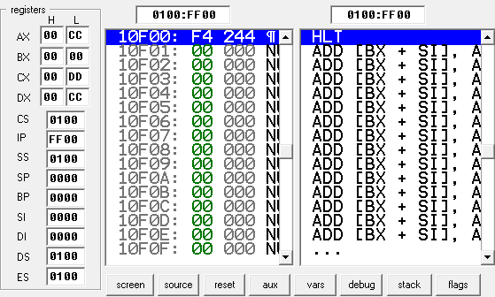
Output:

Slide 5
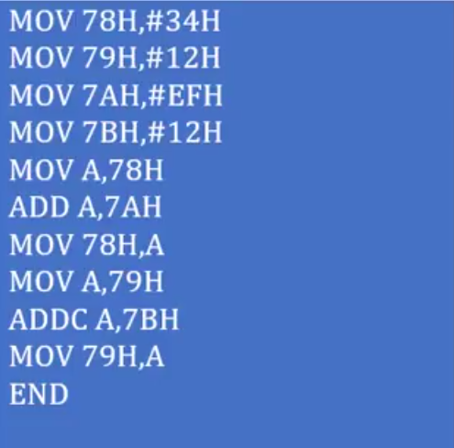
EXAMPLE CODE 2:
Find the output of the program implemented in assembly language.

Slide 6
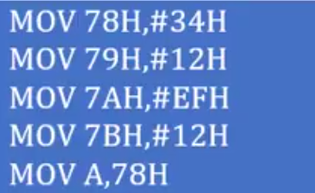
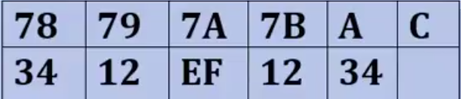
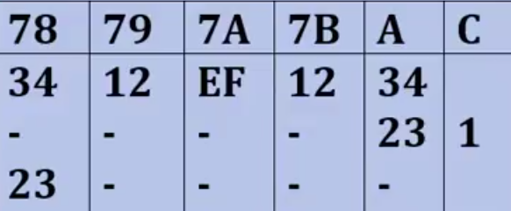

ANSWER:
Line1 | Line2 | Line3 | Line4 | Line5
34 + EF = 123
CARRY

Slide 7
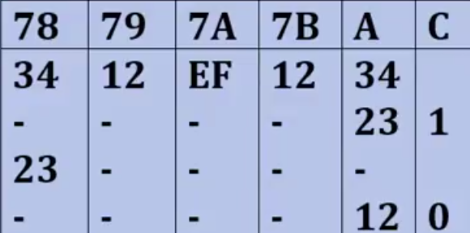

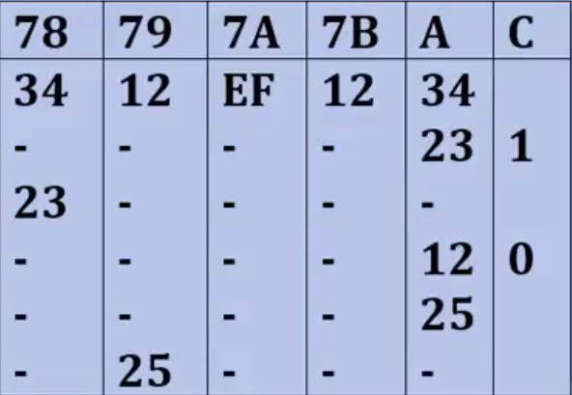


1 + 12 + 12 = 25
OUTPUT : 25

Slide 8

REFERENCE
https://github.com/abbaselmas/aa.bbs.tr
https://www.tutorialspoint.com/assembly_programming/
THANK YOU FOR LISTENING.

