Slide 1

MAGNETIC TAPES

Slide 2


Introduction
Magnetic tape is one of the oldest electronic data storage device. Because of it’s low data accessing rate, it’s not using commonly. But nowadays companies and goverments prefer magnetic tapes to preserve their intelligence.
Movie Tape
Data Tape Archive

Slide 3
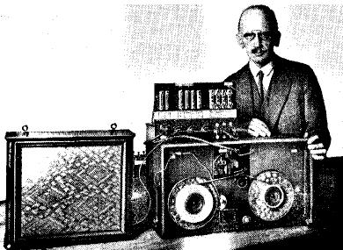
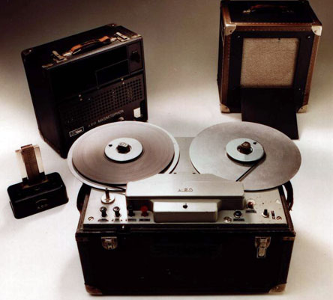
History
Magnetic tape was first developed by a German engineer Fritz Pfleumuer in 1928 based on the invention of the magnetic wire by a Danish engineer Valdemar Poulsen in 1898.
Fritz Pfleumer
In 1932, AEG took up his idea and began manufacture of the machine calling it the Magnetophone.
AEG Magnetophone

Slide 4
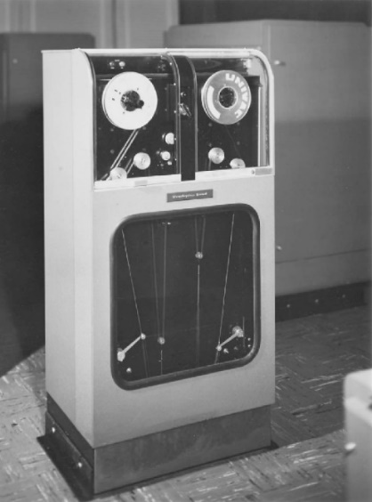
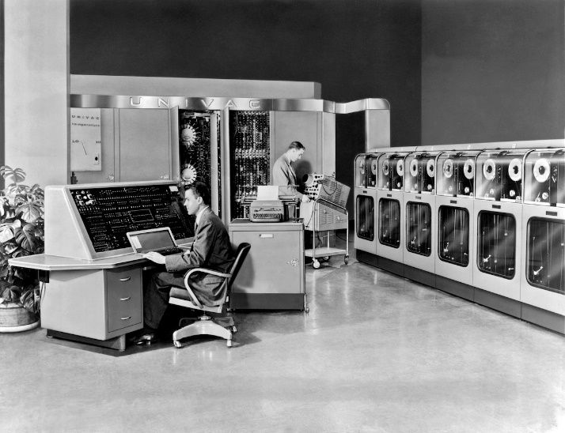
History
UNISERVO I
UNIVAC I
In 1950 the UNISERVO I, first digital tape recorder was developed.
The first modern commercial computer the UNIVAC I, was released in 1951. UNIVAC I, had 10 UNISERVO I tape drives.

Slide 5
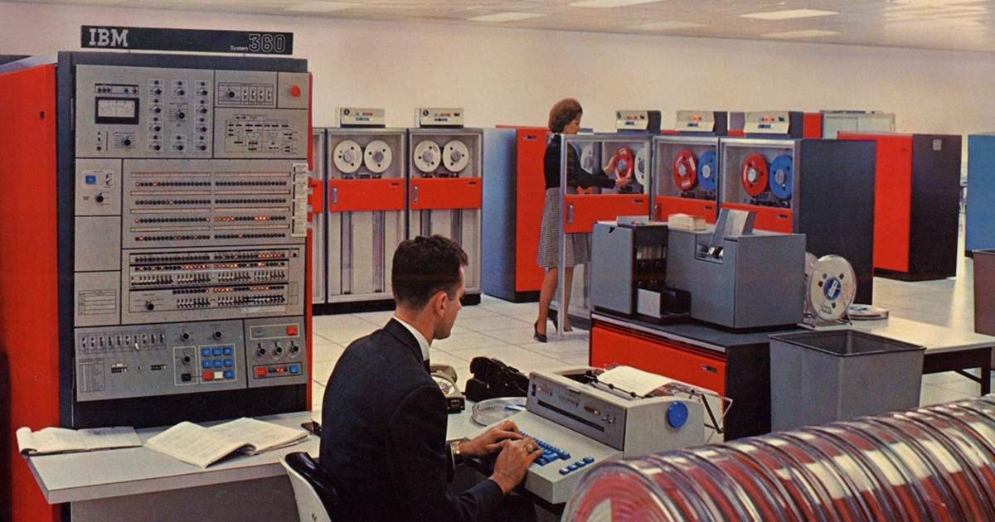
History
The IBM System/360 released in 1964, introduced 9 track tape.

Slide 6
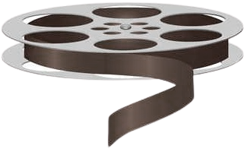
Tape Organization
Frame
1 bit
Track (Channel)
010001000
010000010
010011010
010011100
001000001
010100110
010011111
010011100
0 if # of 1’s in byte is even
1 if # of 1’s in byte is odd
8 bit (1 byte)
Parity bit
Parity Bit
The format has eight data tracks and one parity track in ½’’ width.
Parity bit is used to error checking. If the parity bit rule does not hold when the byte is read,
then the tape has been corrupted.

Slide 7
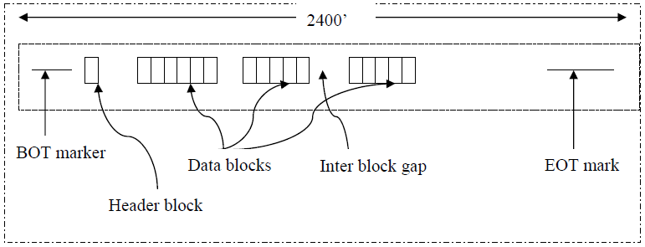
Tape Organization
BOT: Beginning of tape marker
EOT: End of the tape marker
Header block: Describes data blocks
Inter block gap: For acceleration and deceleration of tape
Blocking factor: Number of records per block
Data blocks and records:
Each data block is a sequence of contiguous records.
A record is the unit of data that a user’s program deals with.
For efficiency, the tape drive reads an entire block of records at once.
Unlike a disk, a tape starts and stops.
When stopped, the read/write head is over an interblock gap.
To read a block, the tape uses the interblock gap to accelerate. Then it reads all records in the data block. Then it uses the next interblock gap to decelerate.

Slide 8
Attributes
Type of storage: Magnetic
Data Access: Serial Access. Serial files are read by starting at the beginning and reading through every record until you find the one that you want.
Cost of storage: Tape storage has the lowest unit price per volume.
Capacity: The storing capacity of the magnetic tape is 500MB, 2GB, 10GB, 1TB and more according to it’s types.
Speed: The slowest of all of the storage media from which to access data.
Portability: The magnetic tape itself is fairly small and would fit into a pocket or bag. However, in order to be read, an external tape drive is required. Thus, this form of storage is not considered to be very portable.
Durability: Although data can be saved to and erased from the tape many times, each tape does have a limited life span and eventually the quality of the data storage will decline. However if a tape is only used once for archiving, then it will last many years, typically 30-50 years.
Reliability: As long as it is not damaged, a magnetic tape is very reliable method of data storage.

Slide 9
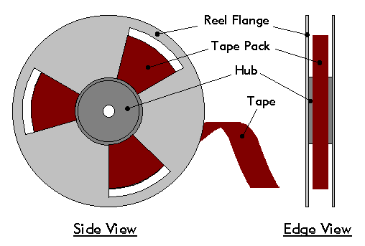
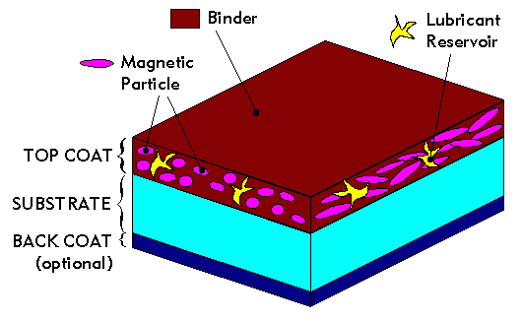
Attributes
Length and width of magnetic tape: The magnetic tape is commonly 732m long by length and 22mm by width.
Magnetic materials: The one side of the tape is coated with magnetic material. The magnetized dot represents 1 and demagnetized dot represents 0. The magnetic material used was initially iron oxide, though chromium and other materials have been used in some tapes.
Frames: The vertical divisions of a tape along with length are called frames.
Channels or tracks: The tape is divided width-wise in rows. These rows are called tracks or channels.
Records and blocks: The group of data stored and arranged in tape is called records. A group of records is called block.
Preservation: Magnetic tapes are packaged in both open-reel and cartridge and cassette formats.

Slide 10
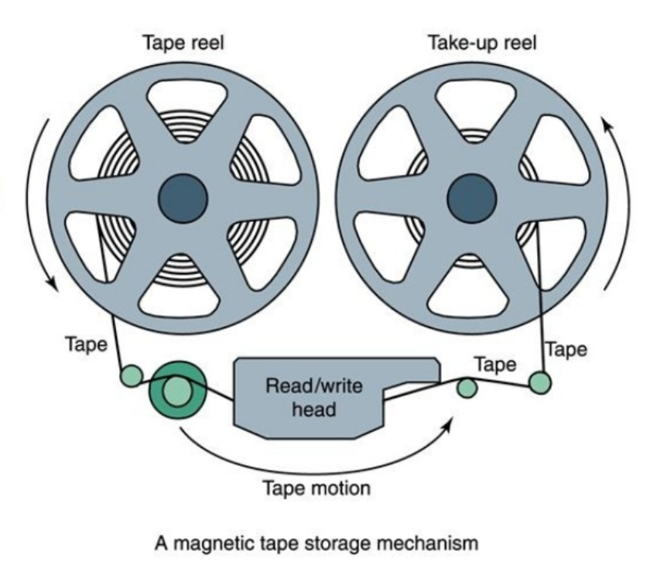
Reading
As the tape passes the head, bits of data are read from or written onto the tape.

Slide 11
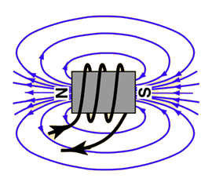
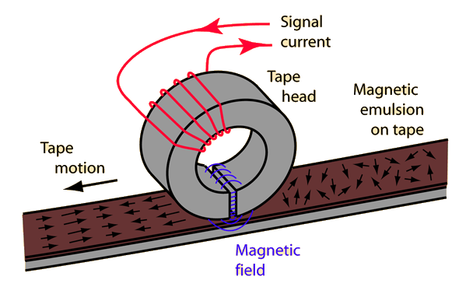
Reading
An electric current in a coil of wire produces a magnetic field similar to that of a bar magnet, and that field is much stronger if the coil has a ferromagnetic core.
Tape heads are made from rings of ferromagnetic material with a gap where the tape contacts it so the magnetic field can fringe out to magnetize the emulsion on the tape. A coil of wire around the ring carries the current to produce a magnetic field proportional to the signal to be recorded. If an already magnetized tape is passed beneath the head, it can induce a voltage in the coil. Thus the same head can be used for recording and playback.

Slide 12
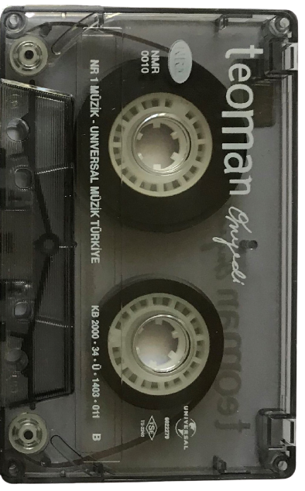
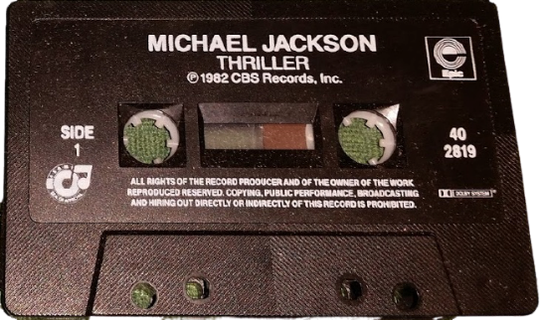
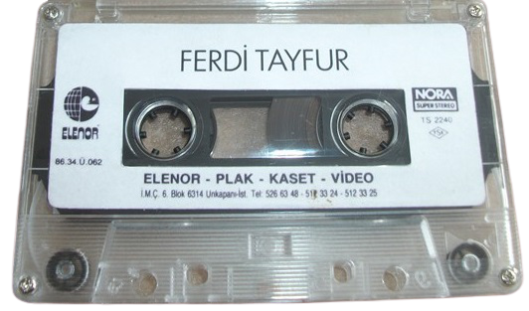
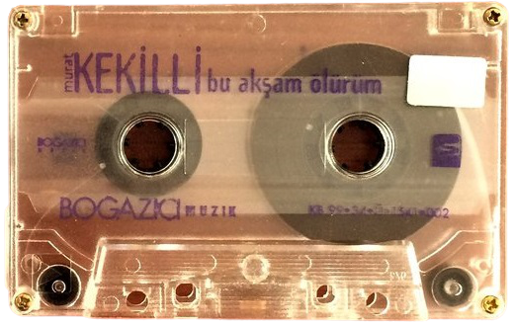
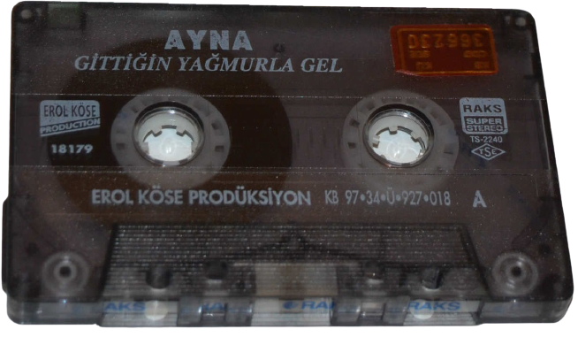
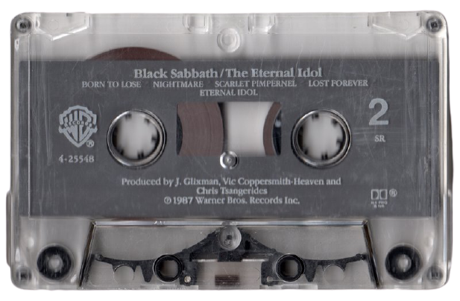
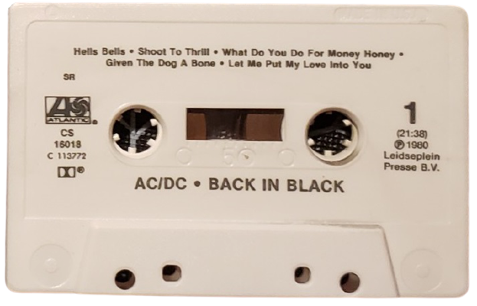
Types: Audio
The Compact Cassette (aka Cassette): Analog magnetic tape recording format for audio recording and playback. It was developed by Philips, and introduced in 1963.
Digital Audio Tape (DAT or R-DAT): Signal recording and playback medium developed by Sony and introduced in 1987.
Digital Compact Cassette (DCC): Magnetic tape sound recording format introduced by Philips and Matsushita in late 1992.
Digital Tape Format (DTF): Magnetic tape data storage format developed by Sony.

Slide 13
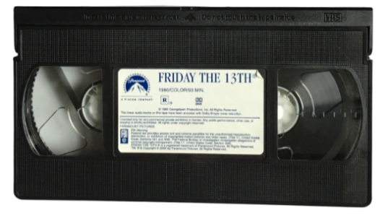
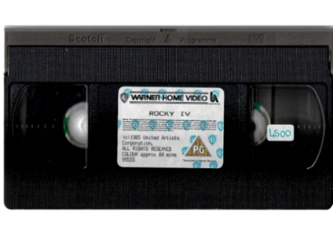
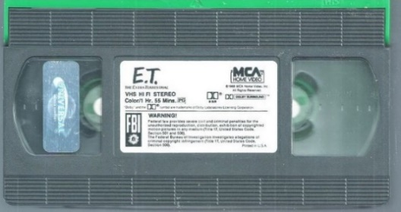
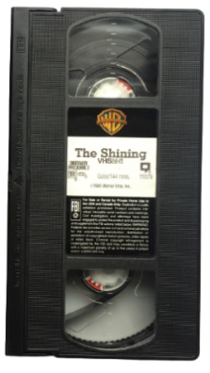
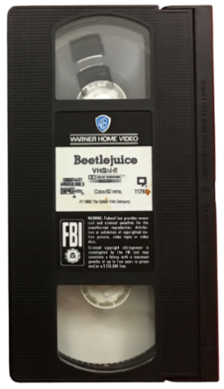
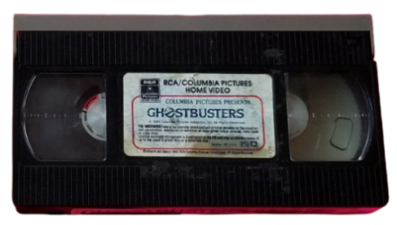
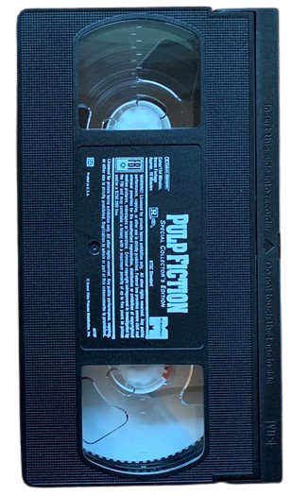
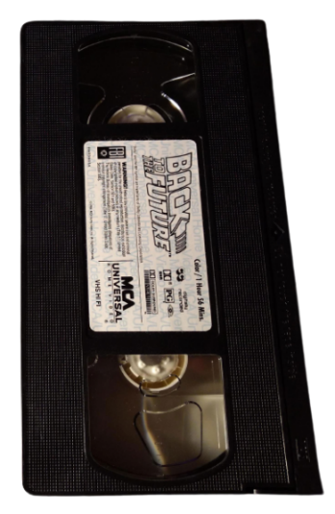
Types: Video
Videocassette: Cartridge containing videotape
VHS: the most successful format for consumer-level analogue video recording on tape cassettes. It developed by JVC in the early 1970s.
U-matic: Analogue recording videocassette format introduced in 1971 by Sony.
Betamax: Consumer level analog recording and cassette format of magnetic tape for video. It was developed by Sony and was released in 1975.

Slide 14
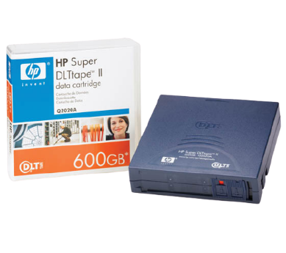
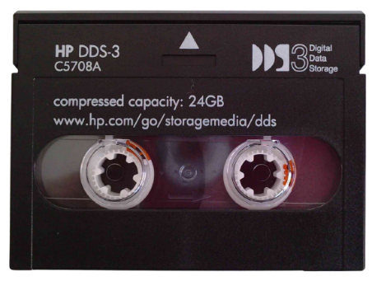
Types: Computer data
The IBM 7340: Hypertape drive introduced in 1961.
Digital Data Storage (DDS): Computer data storage technology that is based upon the digital audio tape (DAT) format that was developed during the 1980s.
Digital Linear Tape (DLT): Magnetic tape data storage technology developed by Digital Equipment Corporation (DEC) from 1984 onwards.
Data8: The 8 mm Backup Format is a magnetic tape data storage format used in computer systems, pioneered by Exabyte Corporation in 1987.
Linear Tape-Open (LTO): Magnetic tape data storage technology developed in the late 1990s.

Slide 15
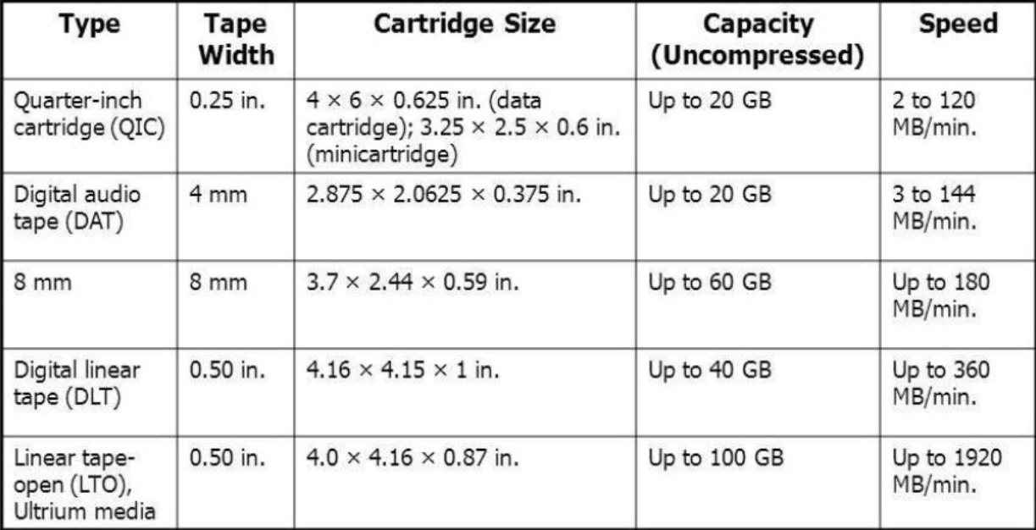
Types and Capacity

Slide 16
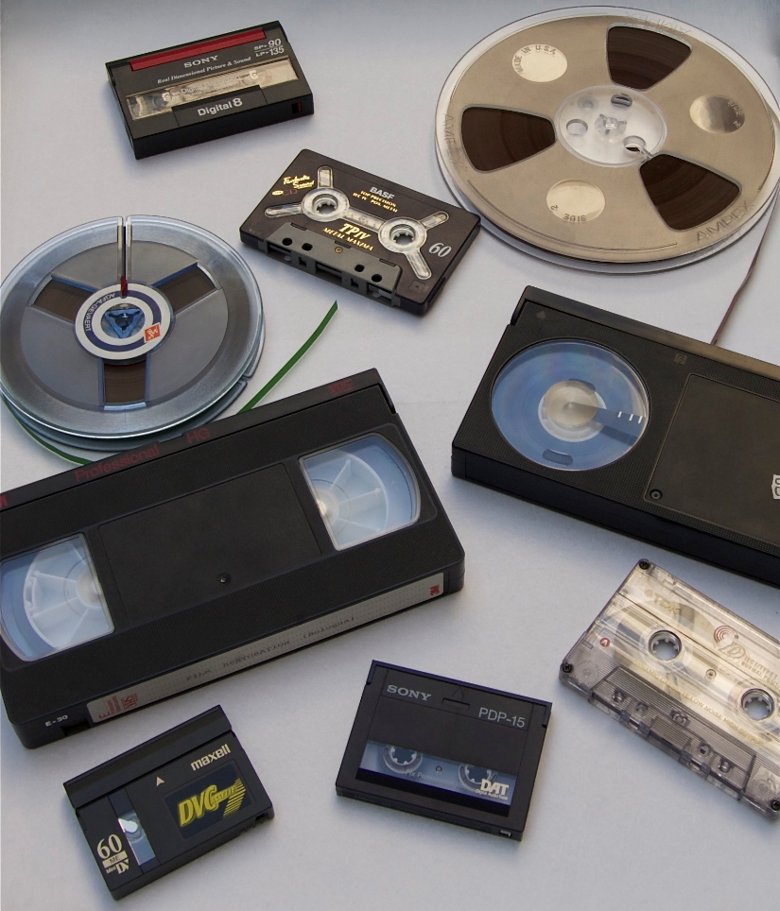
Usage
Data archiving
Data backup
Audio recording
Video recording
Physically large data transfer
Software distribution

Slide 17

Advantages
Storing large amounts data
The cheapest form of storage per bit of stroage
High lifespan (15-50 years)
Storing data offline
Easy to handle and store
Can be erased and reused many times

Slide 18

Disadvantages
Slow data transfer rate
Need speacial equipment to record and read
Data cannot be retrieved randomly because of linear recording
Data may be corrupted if the tape placed near a strong magnetic field
Tape ribbon may get twisted due to warping, resulting in loss of stored data
Dust, dirt and oils are harmful to tape
Vulnerable at high temperature

Slide 19
Tape vs. Disk
ATTRIBUTES | TAPE | DISK
Basic | Used for backup, and storage of less frequently used information (Tertiary Storage). | Used as a secondary storage.
Physical | Plastic thin, long, narrow strip coated with magnetic material. | Several platters arranged above each other to form a cylinder, each platter has a read-write head.
Use | Sequential access. | Random access.
Access | Slower in data accessing. | Fast in data accessing.
Update | Once data is fed, it can't be updated. | Data can be updated.
Data loss | If the tape is damaged, the data is lost. | In a case of a head crash, the data is lost.
Storage | Stores from 20 GB to Terabytes. | From several hundred GB to Terabytes.
Expense | Less expensive. | More expensive.

Slide 20
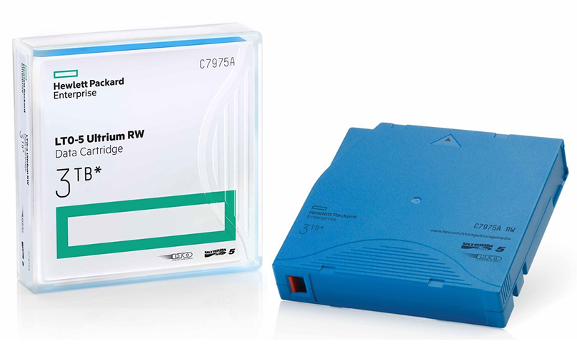
New Technology: LTFS
LTFS, the Linear Tape File System makes accessing tape files easy and similar to accessing disk or flash drives.
The main feature introduced with LTO-5 drives in 2010 and it’s called dual partitioning. The first partition has storage index and metadata information and second partition has the content files.
The index and metadata partition are quickly read by the drive after loading the cartridge without having to scan the entire tape. This provides efficient access to the tape contents.
LTO-5

Slide 21
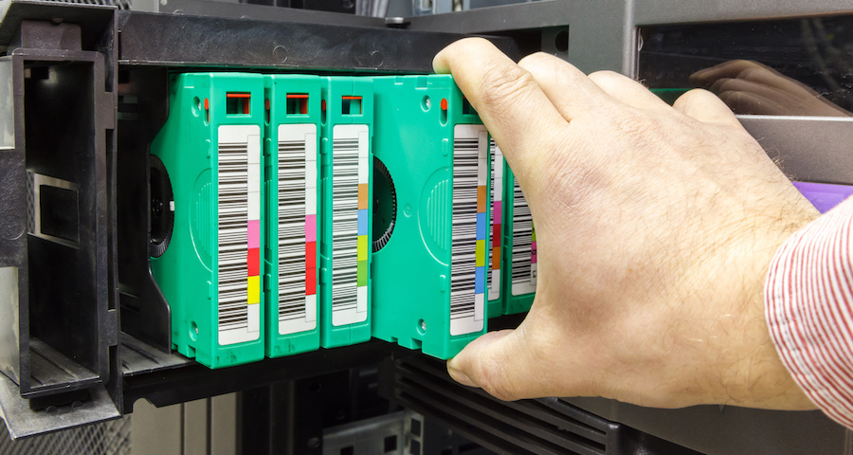
LTFS
It’s an open standard which means it’s available for use by variety of developers and systems.
LTFS should not be used like random access disk because accesses must occur over a linear arrangement of data. If an application tries to update a file, it will be rewritten to the end of tape, resulting in long delays when restoring such files.
Backup Tapes

Slide 22
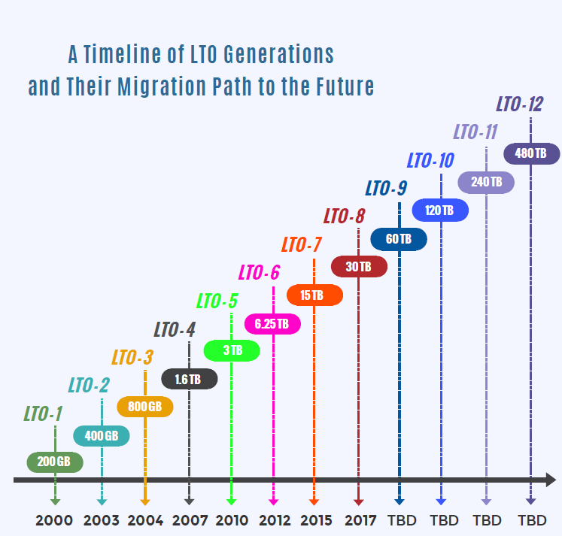
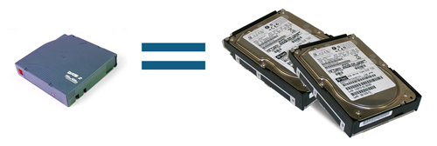
LTFS
LTO technology is continuously updated and licensed by some of the most prominent names in the storage industry. Such as Hewlett Packard Enterprise, IBM and Quantum.
With only one LTO-7, need 2 high performance hard disks to gaining same data transfer rate (300 MB/sec).
LTO-7 = 2 x HDD

Slide 23

Archiving
In 2011, a flaw in a software update caused Google to accidentally delete the saved email messages in about 40,000 Gmail accounts. That loss occurred despite there being several copies of the data stored on hard drives across multiple data centers. Fortunately, the data was also recorded on tape, and Google could eventually restore all the lost data from that backup.
Google’s Tape Library

Slide 24

Summary
The old school magnetic tapes are slow but new LTFS magnetic tapes are faster than hard disks and they have high capacity, including their high lifetime. Due to their offline storage and high performance features, magnetic tapes’ most preferred usage area is data archiving.

