Slide 1
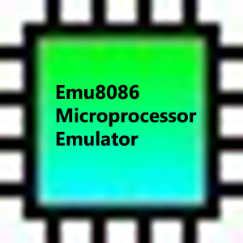
AN ASSEMBLY LANGUAGE EXAMPLE WITH EMU8086

Slide 2
data segment
message db "Enter a word:","$"
word db 10,?,10 dup(' ')
wordEnd db 0
Ends
stack segment
dw 128 dup(0)
ends
Data segment refers to the segment where the variables are defined.
«message»,»word» and «wordEnd» are defined here.
Stack segment indicates where the stack is located. This segment is set automatically by the EMU8086 program.

Slide 3
code segment
start:
mov ax, data
mov ds, ax
mov ah,09h
mov dx,offset message
int 21h
Code segment indicates the section where the program is located.
Segment registers are set automatically by the EMU8086 program
The text in the «message» variable is printed on the screen by interrupt.
Each interrupt has a interrupt number and a function number. Interrupt No:21h Function No: AH=09h

Slide 4
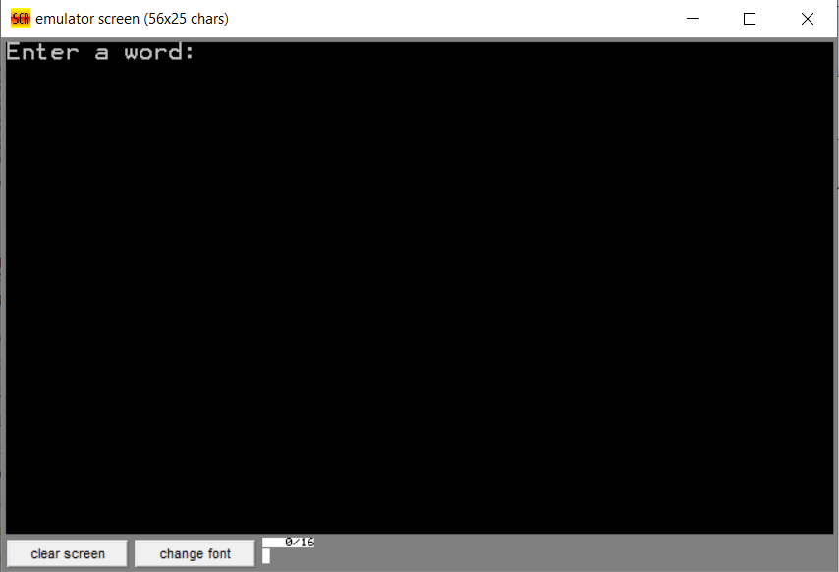

Slide 5
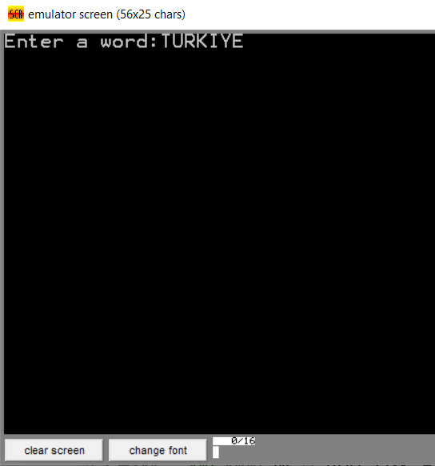
mov dx,offset word
mov ah,0Ah
int 21h
A string is printed on "word" variable with the interrupt.
Interrupt No:21h Function No: AH=0Ah

Slide 6
mov cx,wordEnd-word
lea si,word
It is necessary to use a counter for loop.
The counter is «CX» register.
The value of the «CX» register is calculated.
The address of the «word» variable is assigned to the «SI» register with «LEA» instruction

Slide 7
dongu:
mov dl,[si]
mov ah,02h
int 21h
inc si
mov ah,02h
mov dl,10
int 21h
mov ah,02h
mov dl,13
int 21h
loop dongu
Loop is used to write the letters of the string to the screen.
The beginning of the loop is determined by the «dongu» label, and its end by the «loop» instruction.
With the first interrupt, the character is printed on the screen (Interrupt No:21h Function No: AH=02h)
With the second interrupt, go to the bottom row.(Interrupt No:21h, Function No: AH=02h,DL=10)
With the third interrupt, column count is reset. (Interrupt No:21h, Function No: AH=02h,DL=13)

Slide 8
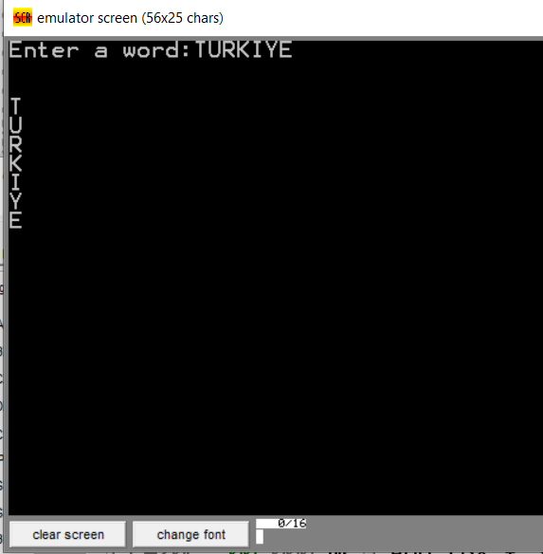

Slide 9
mov ax, 4c00h
int 21h
ends
end start
It is returned to the operating system with the last interrupt. (Interrupt No:21h, Function No: AX=4C00h)
The program is terminated

Slide 10
THANK YOU
FOR
LISTENING…
EREN DEMİR

