Slide 1
CPU (Central Processing Unit)

Slide 2
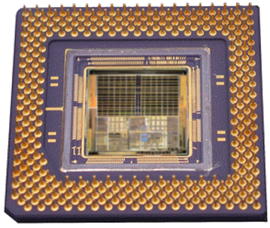
The CPU
The CPU (Central Processing Unit) is the ‘brains’ of the computer.
The purpose of the CPU is to carry out program instructions (each CPU type is designed to understand a specific group of instructions, the instruction set).
On personal computers and small workstations, the CPU is housed in a single chip called a microprocessor.

Slide 3
Components Of a typıcal cpu
There are huge variations in CPU designs but most will share the following key components:
An electronic clock
The control unit
An instruction unit which consists of:
The arithmetic logic unit (ALU)
The floating point unit (FPU
Various registers.
Various buses
The bus management unit

Slide 4
THE CLOCK
An electronic clock regulates the rate at which the CPU runs and synchronizes all the various computer components.
The higher the clock frequency, the more instructions the CPU can execute per second.
The speed of the clock (and therefore the speed of the CPU) is measured in Megahertz (MHz).
Assuming that we have a cpu that runs on 3 Ghz . It is capable of making 3 billion cycles per second and assume that an addition process requires 10 cycles , a cpu can handle 300 million additions in a second.

Slide 5
The Control Unıt
The control unit performs the tasks of:
Fetching instructions from memory
Decoding the instructions
Managing the execution of instructions and the storing of the results
It does this mainly by controlling the links between the other components of the CPU.
It also contains various registers such as:
the Program Counter which stores the memory address of the next instruction.
the Current Instruction register which stores the instruction currently being executed.

Slide 6
The ınstruction unıt
An instruction unit consists of:
The arithmetic logic unit (ALU) which executes basic arithmetic and logical operations on integer data that it is linked to. Examples of such operations include:
Integer arithmetic operations (addition, subtraction)
Logic operations (AND, NOT, OR, XOR)
The floating point unit (FPU) which performs math functions on floating point numbers (non-integer numbers).
Various registers such as the accumulator that are used while instructions are being executed.

Slide 7
BUSES
Buses are sets of tiny parallel wires that carry data between CPU components and between the CPU and external devices and RAM. The three main bus types are:
address buses - used to set which memory address a CPU component is linked to for a read/write operation.
data buses - used to exchange the data between a memory address and the CPU when a read/write operation is carried out.
control buses - used to transfer command codes and return status signals between components of the CPU and external devices.
The bus management unit manages the transfer of data along the external bus connections, including the links to RAM.

Slide 8
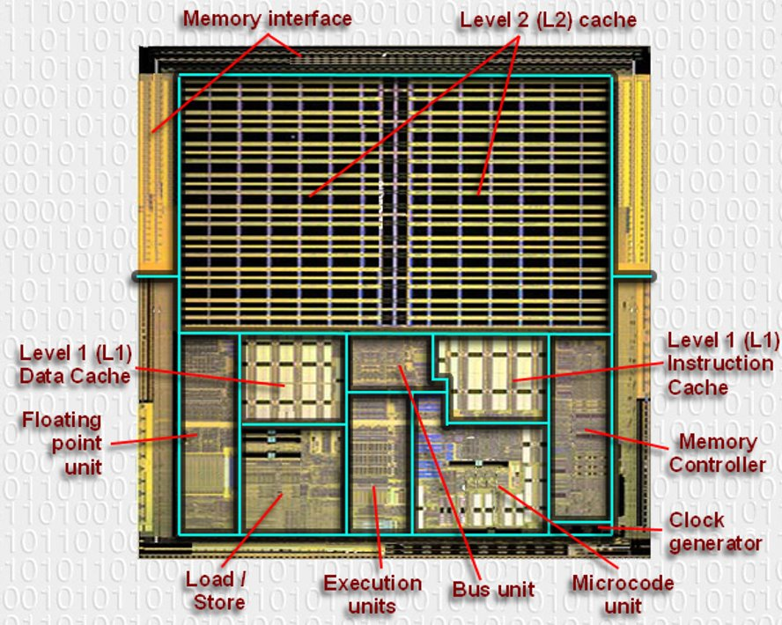

Slide 9
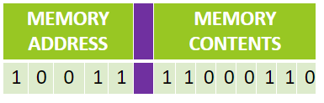
The functions of cpu
1 - The Fetch step:
This involves retrieving a binary instruction from a memory address and storing it in the Current Instruction register.
The memory address of the instruction is stored in a register called the Program Counter (PC) so the CPU can keep track of which instruction is next.
After an instruction is fetched, the PC is updated so the CPU knows the address of the next instruction it has to fetch.

Slide 10
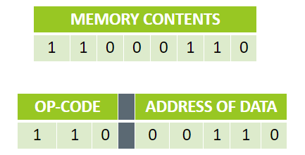
2 - The Decode step:
This involves the CPU identifying the operation code (op-code) part of the instruction which tells it which operation to perform.
If the op-code requires the CPU to act on some data then the second part of the instruction will contain either the data or the memory address where the data is stored.

Slide 11
3 - The Execute step:
In this step the control unit links together the parts of the CPU that are needed to execute the instruction.
If the instruction involved integer arithmetic or logical operations then the arithmetic logic unit (ALU) would be connected to the relevant memory locations
Some types of instructions alter the program counter rather than produce result data. This allows programs to carry out iteration loops and conditional program execution rather than stepping through instructions in sequence.
Some instructions involve an additional write-back step if data is written back to RAM.

Slide 12
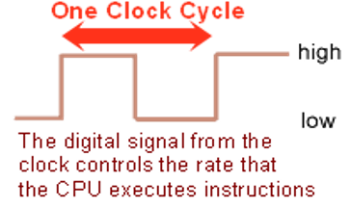
CPU characterisctics and performance
Clock speed:
Although it might seem that a computer is carrying out many tasks simultaneously, the CPU is actually only ever processing one instruction at a time and is constantly switching between programs (sets of instructions).
The speed that the processor executes instructions is controlled by the clock speed and is measured in MHz (megahertz).
The CPU requires a fixed number of clock cycles to perform each instruction.
Summary:
The higher the clock speed, the more instructions the CPU can execute per second, resulting in a faster running computer system.

Slide 13
Cache size:
Cache memory is a small amount of very fast memory that is built into the CPU. Blocks of instructions and data that are in use by the CPU are copied from RAM into cache memory, along with the associated memory addresses.
If the CPU needs to access a memory address it first checks the cache memory to see if there is a match. If there is then it access the contents of the cache version.
Summary:
A CPU with a larger cache memory and more levels of cache memory will have a higher performance than one without cache memory.

Slide 15
Number of Cores:
A multi-core processor is a single computing component with two or more independent actual processors (called "cores").
A dual-core processor contains two cores and a quad-core processor contains four cores. Each core can process instructions independently of the other cores.
The biggest performance gain when using a multi-core processor is when the software has been specifically written to run on multiple cores.
Summary:
A multi-core CPU will have a higher performance than a single-core CPU with the same clock speed.

