Slide 1

VIRTUAL MEMORY

Slide 2
WHAT IS THE VIRTUAL MEMORY?
Virtual memory is a memory management technique where secondary memory can be used as if it is a part of the main memory.
Virtual memory is a very common technique used in the operating systems of computers.

Slide 3
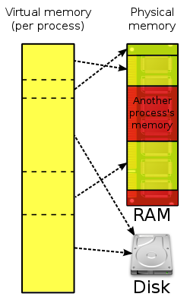
Virtual memory uses hardware and software to allow a computer to compensate for physical memory shortages by temporarily transferring data from random access memory to disk storage.

Slide 4
HOW VIRTUAL MEMORY WORKS?
Virtual memory uses both computer hardware and software to work. When an application is in used, data from that program is stored in a physical address using RAM. More specifically, virtual memory will map that address to RAM using a memory management unit .The operating systems will make and manage memory mappings by using page tables and other data structures. The memory management unit, which acts as an address translation hardware, will automatically translate the addresses.

Slide 5
TYPES OF VIRTUAL MEMORY
There are two ways in which virtual memory is handled: - Paged - Segmented.

Slide 6
PAGING
Paging divides memory into sections or paging files which size is approximately 4 KB. When a computer uses up its RAM, the pages which is not in used are transferred to the section of the hard drive designated for virtual memory using a swap file. When the swap file is needed, it is sent back to RAM using a process called page swapping. This system ensures that the computer’s operating system and applications do not run out of real memory.

Slide 7
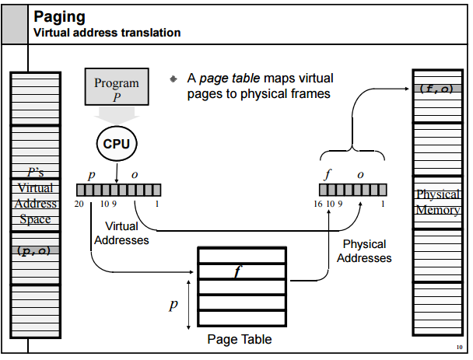
The paging process includes the use of page tables, which translate the virtual addresses that the operating systems and applications use into the physical addresses that the memory management unit uses. Entries in the page table indicate whether the page is in real memory.

Slide 8
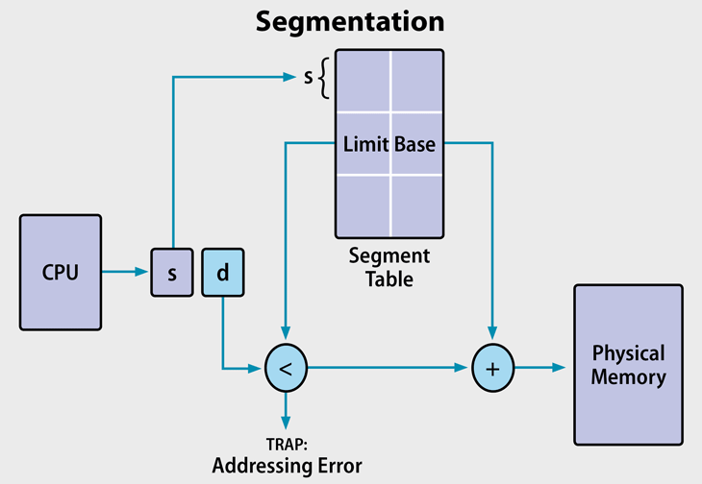
SEGMENTATION
segmentation is a virtual process that creates address spaces of various sizes in a computer system, called segments.

Slide 9
Each segment is a different virtual address space that directly corresponds to process objects. When a process executes, assigns related data into segments for faster processing. The segmentation function maintains a segment table that includes physical addresses of the segment, size, and other data.

Slide 10
Advantages of Virtual Memory
Allows more than one program to be executed at the same time.
Common data or code may be shared between memory.
Offloading tasks from main memory.
Virtual memory increases the overall memory on a system without adding RAM.
Eliminates external fragmentation.
Less input/output is required

Slide 11
Disadvantages of virtual memory
If the system relies to much on virtual memory, it may cause a decrease in performance.
The more virtual memory that’s being used, the less disk space a user has for storage.
Time it takes to read from a magnetic disk is greater than the time to access RAM, therefore swapping should be avoided wherever performance is important.

Slide 12
References
https://www.enterprisestorageforum.com/storage-hardware/paging-and-segmentation.html
https://searchstorage.techtarget.com/definition/virtual-memory#:~:text=Virtual%20memory%20is%20a%20very,(RAM)%20to%20disk%20storage.
https://www.geeksforgeeks.org/virtual-memory-in-operating-system/
https://teachcomputerscience.com/virtual-memory/

