Slide 1
Memory: Introduction

Slide 2
Picture of Memory
You can think of memory as being one big array of data.
The address serves as an array index.
Each address refers to one word of data.
You can read or modify the data at any given memory address, just like you can read or modify the contents of an array at any given index.
16-bit/32-bit
Word
2

Slide 3
Memory Signal Types
Memory signals fall into three groups
Address bus - selects one of memory locations
Data bus
Read: the selected location’s stored data is put on the data bus
Write (RAM): The data on the data bus is stored into selected locations
Control Signals - specifies what the memory is to do
Control signals are usually active low
Most common signals are:
CS: Chip Select; must be active to do anything
OE: Output Enable; active to read data
WR: Write; active to write data
3

Slide 4
Random Access Memory

Slide 5
Random Access Memories
So called because it takes the same amount of time to address any particular part
Types of RAM
Static RAM (SRAM), fast, expensive
Dynamic RAM (DRAM), slow, cheap
How is memory accessed?
Address Lines, Data Lines
Control Signals (R/W, chip select, …)
5

Slide 6
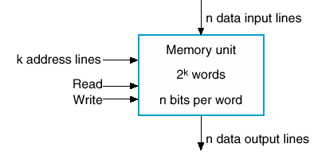
Simple View of RAM
Of some word size n=4,8,16 ….
Some capacity 2^{k}
k bits of address line, k=10,11,..
Has a read line
Has a write line
6

Slide 7
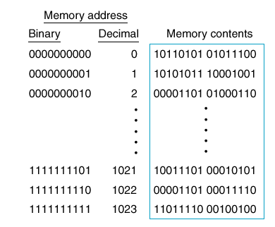
1K x 16 memory
Variety of sizes
From 1-bit wide
Issue is no. of pins
Memory size specified in bytes
1K x 16 bit → 2KB memory
10 address lines and 16 data lines
7

Slide 8
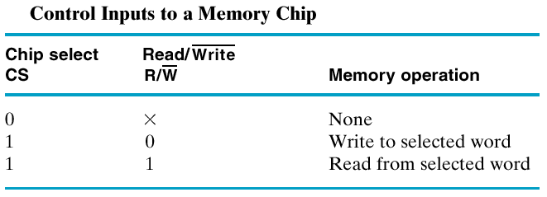
Chip Select and R/W Lines
R/W Lines enable reading/writing
Usually a chip select line is used.
Why?
To enable RAM chip to be accessed.
8

Slide 9
Memory: Writing
Sequence of steps
Setup address lines
Setup data lines
Activate write line (maybe a pos edge)
The write cycle time is the maximum time from the application of the address to the completion of all internal memory operations required to store a word.
9

Slide 10
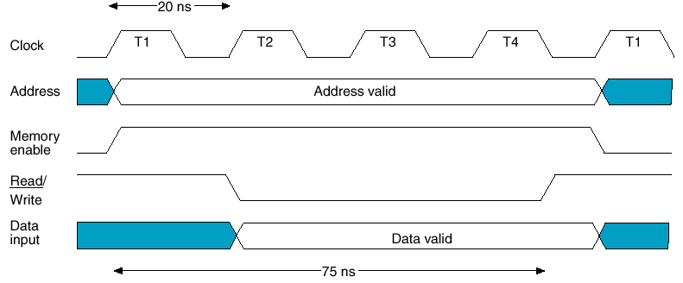
Writing: Timing Waveforms
CPU operates at 50 MHz (20 ns)
4 clock cycles to perform a write
10

Slide 11
Memory Reading
Steps
Setup address lines
Activate read line
Data available after specified amount of time
Read cycle usually is shorter than write cycle.
11

Slide 12
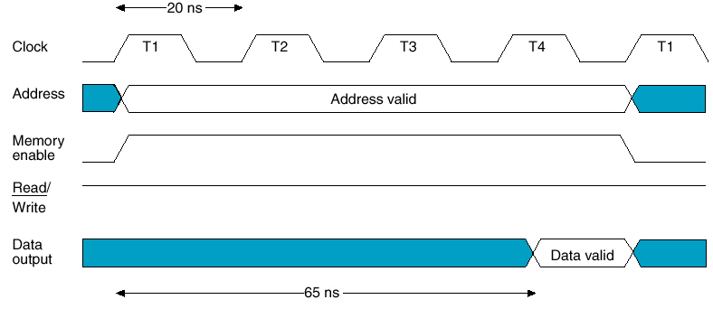
Memory Waveform: Reading
CPU operates at 50 MHz (20 ns)
65 ns required for a read cycle
12

Slide 13
Static RAM

Slide 14
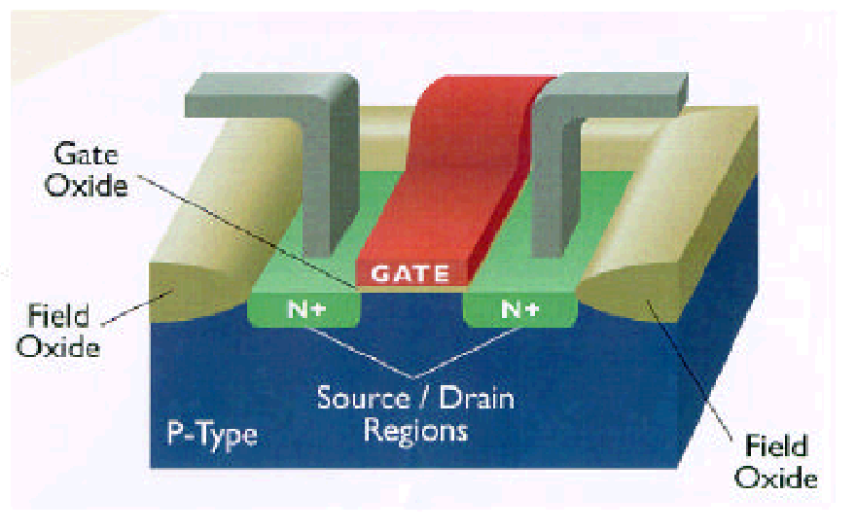
MOSFET: Metal Oxide
Semiconductor
Field Effect Transistor
A voltage controlled device
Dissipates less power
Achieves higher density on an IC
Has full swing voltage 0 > 5V
14

Slide 15
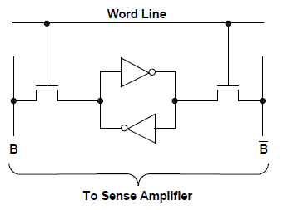
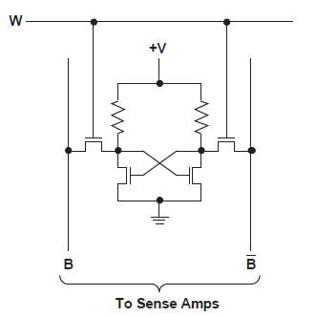
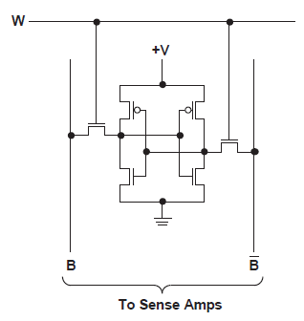
Static RAM: 4T and 6T
Six Transistors to implement a memory cell
15

Slide 16
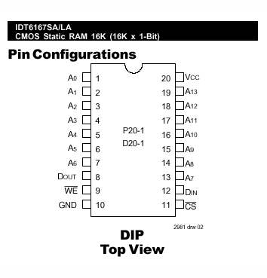
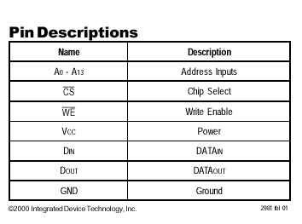
Pin Diagram
16

Slide 17
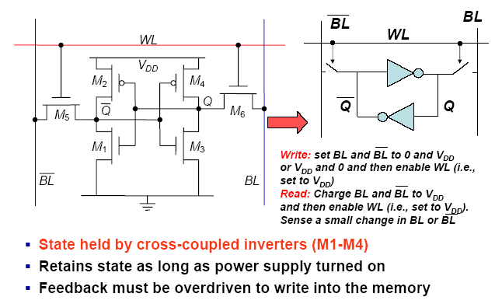
SRAM Cell
VDD
VDD
VDD
GND
VDD
17

Slide 18
Dynamic RAM

Slide 19
Dynamic Memory
Dynamic memory is built with capacitors.
A stored charge on the capacitor represents a logical 1.
No charge represents a logic 0.
However, capacitors lose their charge after a few milliseconds. The memory requires constant refreshing to recharge the capacitors. (That’s what’s “dynamic” about it.)
Dynamic RAMs tend to be physically smaller than static RAMs.
A single bit of data can be stored with just one capacitor and one transistor, while static RAM cells typically require 4-6 transistors.
This means dynamic RAM is cheaper and denser—more bits can be stored in the same physical area.
19

Slide 20
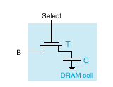
Dynamic RAM
Capacitor can hold charge
Transistor acts as gate
No charge is a 0
Can close switch & add charge to store a 1
Then open switch (disconnect)
20

Slide 21
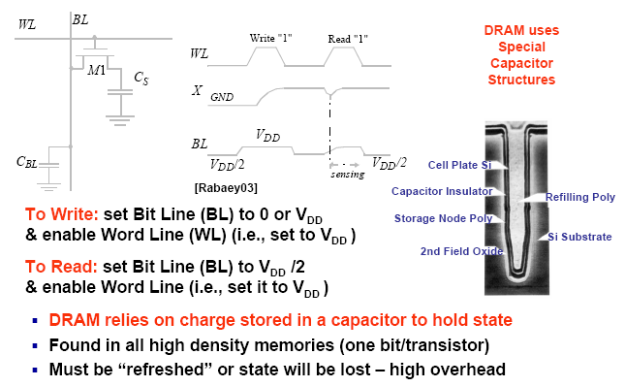
DRAM Cell
21

Slide 22
DRAM read Operations
Precharge bit line to V_{DD}/2.
Take the word line HIGH.
Detect whether current flows into or out of the cell.
Note: cell contents are destroyed by the read!
Must write the bit value back after reading.
22

Slide 23
DRAM write Operations
Take the word line HIGH.
Set the bit line LOW or HIGH to store 0 or 1.
Take the word line LOW.
Note: The stored charge for a 1 will eventually leak off.
23

Slide 24
Dynamic RAM (… continued)
Select
Stored 1
Stored 0
T
To Pump
B
C
DRAM cell
(a)
(b)
(c)
Write 1
Write 0
(d)
(e)
Read 1
Read 0
(f)
(g)
24
Notes:
School of Engineering
24
Warning: (d), (e), (f), and (g) are animated. Each animation is triggered with a mouse click
and goes through two steps at 1 second intervals.

Slide 25
DRAM Characteristics (Why Slow!)
Destructive Read
When cell read, charge removed
Charge must be restored after a read
Refresh
Capacitors are not perfect! there’s steady leakage
Charge must be restored periodically
DRAM are dense (lots of cells) so there are many address lines.
To reduce the physical size of DRAM we can reduce the number of pins by applying the address lines serially in two parts:
Row Address, and then
Column Address
25

Slide 26
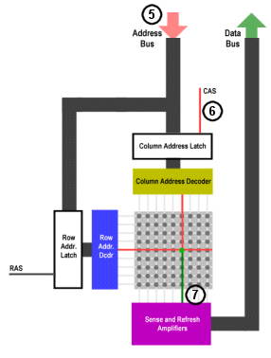
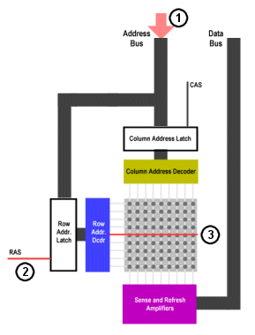
How DRAM Works
A₇A₆A₅A₄A₃A₂A₁A₀
A₇A₆A₅A₄
A₃A₂A₁A₀
26

