Slide 1
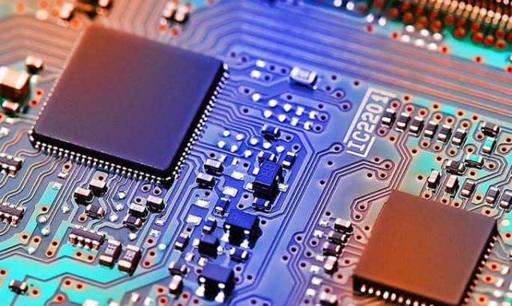
VHDL İrem Deveci 2017556017

Slide 2
What is HDL?
HDL stands for Hardware Description Language. It is a programming language that is used to describe, simulate, and create hardware like digital circuits (ICS). HDL is mainly used to discover the faults in the design before implementing it in the hardware.
Today, there are many HDLs available in the market, but VHDL and Verilog are the most popular HDLs.

Slide 3
What is Verilog?
Verilog is also a HDL (Hardware Description Languages) for describing electronic circuits and systems. It is used in both hardware simulation and synthesis.
The most popular examples of Verilog are network switch, a microprocessor, a memory, a simple flip-flop, etc.

Slide 4
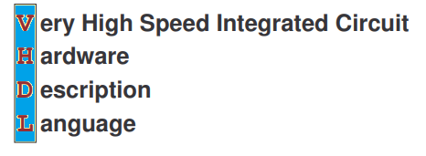
What is VHDL?
VHDL stands for Very High-Speed Integration Circuit HDL (Hardware Description Language). It is an IEEE (Institute of Electrical and Electronics Engineers) standard hardware description language that is used to describe and simulate the behavior of complex digital circuits.
VHDL was developed by the Department of Defence (DOD) in 1980.
The most popular examples of VHDL are Odd Parity Generator, Pulse Generator, Priority Encoder, Behavioral Model for 16 words, 8bit RAM, etc.

Slide 5
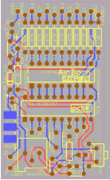
VHDL supports the following features:
Design methodologies and their features.
Sequential and concurrent activities.
Design exchange
Standardization
Documentation
Readability
Large-scale design
A wide range of descriptive capability

Slide 6
Difference between VHDL and Verilog
VHDL | Verilog
It allows the user to define data types. | It does not allow the user to define data types.
It supports the Multi-Dimensional array. | It does not support the Multi-Dimensional array.
It allows concurrent procedure calls. | It does not allow concurrent calls.
A mod operator is present. | A mod operator is not present.
Unary reduction operator is not present. | Unary reduction operator is present.
It is more difficult to learn. | It is easy to learn.

Slide 7
Why VHDL?
VHDL is used for the following purposes:
For Describing hardware
As a modeling language
For a simulation of hardware
For early performance estimation of system architecture
For the synthesis of hardware

Slide 8
Advantages of VHDL | Disadvantages of VHDL
It supports various design methodologies like Top-down approach and Bottom-up approach. | It requires specific knowledge of the structure and syntax of the language.
It provides a flexible design language. | It is more difficult to visualize and troubleshoot a design.
It allows better design management. | Some VHDL programs cannot be synthesized.
It allows detailed implementations. | VHDL is more difficult to learn.
It supports a multi-level abstraction
It strongly supports code reusability and code sharing.
It provides tight coupling to lower levels of design.

Slide 9
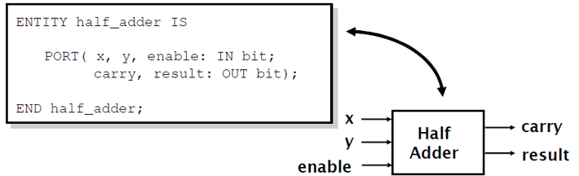
Basic Elements of VHDL
1. Entity
The Entity is used to specify the input and output ports of the circuit. An Entity usually has one or more ports that can be inputs (in), outputs (out), input-outputs (inout), or buffer.
An Entity may also include a set of generic values that are used to declare properties of the circuit.

Slide 10
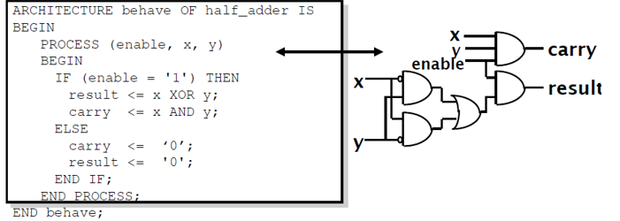
2. Architecture
Architecture is the actual description of the design, which is used to describe how the circuit operates. It can contain both concurrent and sequential statements.
3. Configuration
A configuration defines how the design hierarchy is linked together. It is also used to associate architecture with an entity.

Slide 11
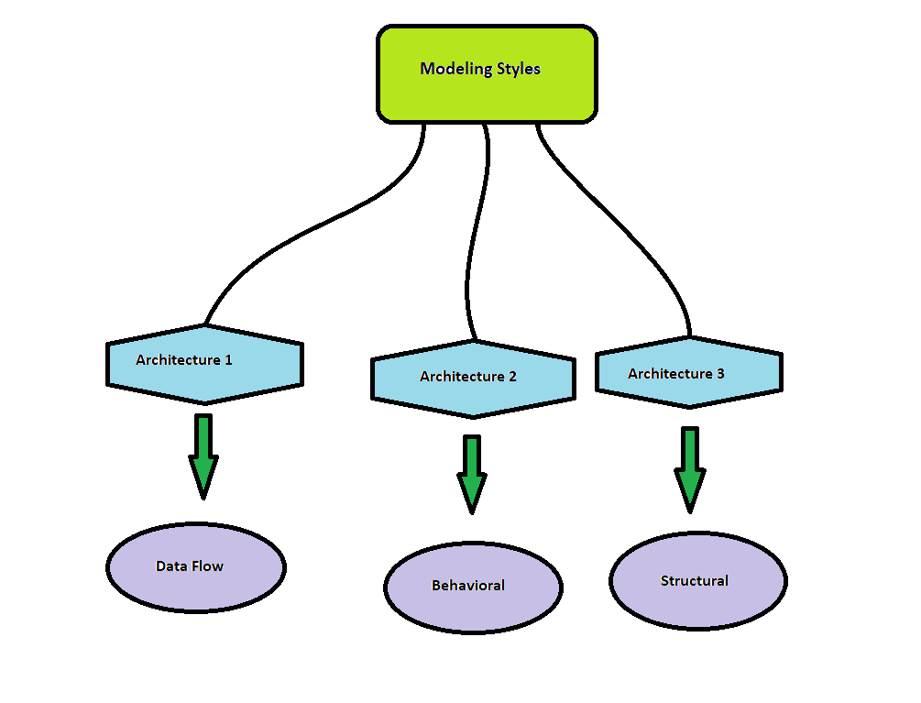
Types of Modeling styles in VHDL

Slide 12
1.Data flow modeling
Data flow modeling can be described based on the Boolean expression. It shows how the data flows from input to output. It works on Concurrent execution.
2. Behavioral modeling
Behavioral modeling is used to execute statements sequentially. It shows that how the system performs according to the current statement.
Behavioral modeling may contain Process statements, Sequential statements, Signal assignment statements, and wait statements.
3. Structural modeling
Structural modeling is used to specify the functionality and structure of the circuit.
Structural modeling contain signal declarations, component instances, and port maps in component instance.

Slide 13
VHDL Objects
VHDL uses the following three types of objects:
1. Constants
Constant is an object which can only hold a single value that cannot be changed during the whole code.
2. Variables
A variable also holds a single value of a given type. The value of the variable may be changed during the simulation by using variable assignment operator.
Variables are used in the processes and subprograms.
3. Signals
Signals can be declared in architecture and used anywhere within the architecture.
Signals are assigned by the assignment operator "<=".

Slide 14
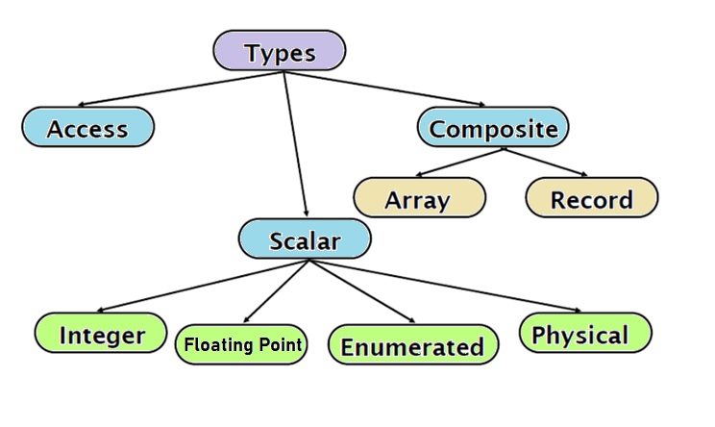
Data Types in VHDL
Data Types are the abstract representation of stored data.
There are the following data types in VHDL

Slide 15
1. Scalar Types
Integer Integer data types are the set of positive and negative whole numbers.
Floating point Floating point data types are the set of positive and negative numbers that contain a decimal point.
Enumeration Enumeration data type is used to increase the readability of the code.
Physical Physical data type describes objects in terms of a base unit, multiples of base unit, and a specified range.
2. Composite Types
Arrays Arrays are used to hold multiple values of the same types under a single identifier
Record Records are used to specify one or more elements, and each element has a different name and different type.

Slide 16
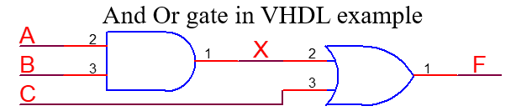
VHDL Operators
VHDL Operators are used for constructing the expressions.
There are the following types of operators in VHDL:
1. Logical Operators
Logical Operators are used to control the program flow. When the logical operators combined with signals or variables, then it is used to create combinational logic.
VHDL supports the following logical operators:
and
or
nand
nor
xor
xnor
not

Slide 17
2. Relational Operators
In VHDL, relational operators are used to compare two operands of the same data type, and the received result is always of the Boolean type.
VHDL supports the following Relational Operators:
= Equal to
/= Not Equal to
< Less than
> Greater than
<= Less than or equal to
>= Greater than or equal to
3. Arithmetic Operators
Arithmetic Operators are used to perform arithmetic operations. These operators are numeric types, such as integer and real.
VHDL uses the following Arithmetic Operators:
+ Addition
- Subtraction
* Multiplication
/ Division

Slide 18
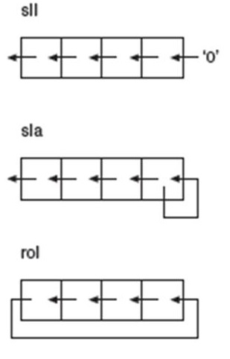
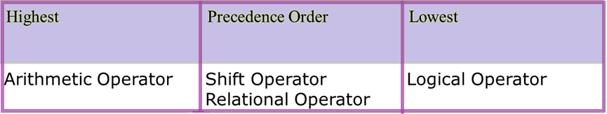
& Concatenation
mod Modulus
rem Remainder
abs Absolute Value
** Exponentiation
4. Shift Operators
In VHDL, shift operator is used to perform the bit manipulation on the data by shifting and rotating the bits of its first operand right or left.
VHDL supports the following Miscellaneous Operators:
Sll shift logical left
Srl shift logical right
Sla shift arithmetic left
Sra shift arithmetic right
Rol rotate left
Ror rotate right

Slide 19


References
http://www.uco.es/~ff1mumuj/h_intro.htm
https://www.tutorialspoint.com/vlsi_design/vlsi_design_vhdl_introduction.htm#:~:text=VHDL%20stands%20for%20very%20high,DoD)%20under%20the%20VHSIC%20program.
https://www.slideshare.net/yayavaram/presentation-vhdl
https://en.wikipedia.org/wiki/VHDL
Thank you for listening

