Slide 1
-WHAT IS THE ASSEMBLY LANGUAGE?

Slide 2
Assembly language (or assembler language), is any low level programming language in which there is a very strong correspondence between the instructions in the language because assembly depends on the machine code instructions, every assembly language is designed for exactly one specific computer architecture. Assembly language may also be called symbolic machine code.

Slide 3
-WHAT IS THE MACHINE CODE?

Slide 4
Machine language, or machine code, is a low-level language comprised of binary digits (ones and zeros). Machine language is often confused with assembly language but there are some differences between the assembly and machine language.What is the difference?

Slide 5
WHAT IS THE ASSEMBLER?
Software tools are needed for editing assembling linking and debugging assembly language programs.
An assembler is a program that converts source code programs written in assembly language into objects files in machine language.

Slide 6
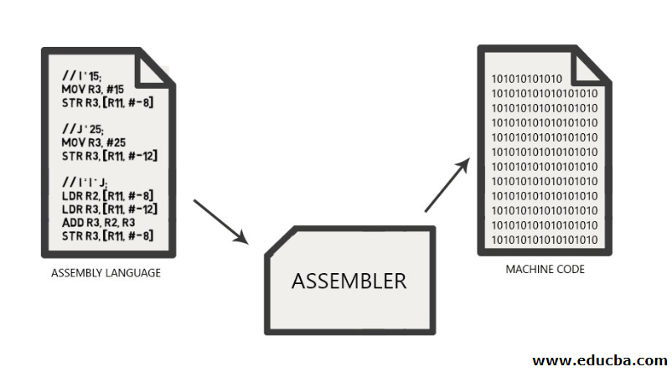

Slide 7
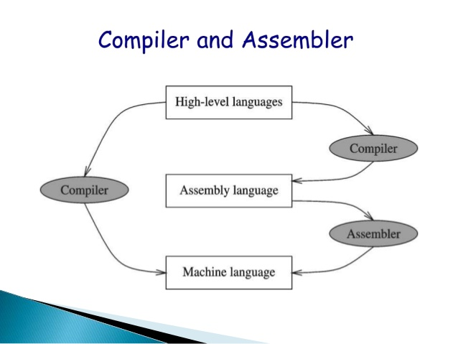

Slide 8
INSTRUCTIONS AND MACHINE LANGUAGE
Each command of program is called an instructs
Computers only deal with binary data,hence the instructions must be binary format
The set of the instructions makes up the computer’s machine language.This is also referred to as the instruction set.

Slide 9
INSTRUCTION FIELDS
Machine language instructions usually are made up of several fields.Each field specifies different information for the computer.The major two fields are:
Opcode field which stands for operation code and şt specifies the particular operation that is to be performed.
(each operation has it unique opcode)

Slide 10
Operands field which specify where to get the source and destination operands for the operation specified by the opcode.
(The source of operands can be a constant,the memory or one of the general-purpose registers.

Slide 11
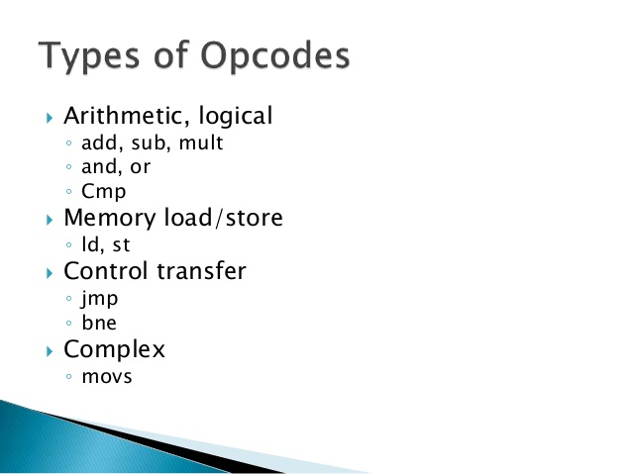

Slide 12
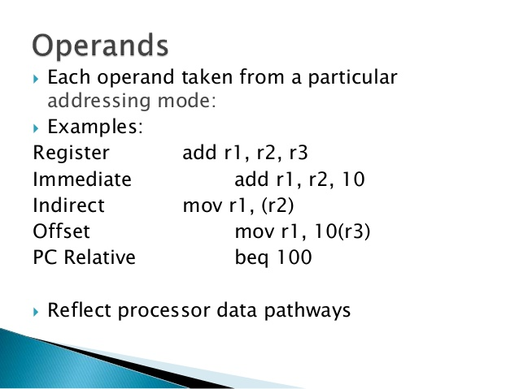

Slide 13
WHY LEARN ASSEMBLY LANGUAGE
1)Accessibilty to hardware system
Assembly language is useful for implementing system software also useful for small embeded system applications
2)Space and Time efficiency
Understanding sources of program inefficiency
Tuning program performance
Writing compact code

Slide 14
Advantages of Assembly Language
It is the only programming language that your processor can successfully implement.
They are used in the writing of computer viruses because they take up very little space..
As time passes and people become computer users consuming instead of producing, the privilege of knowing this language increases.

Slide 15
Disadvantages of Assembly Language
Learning the language takes a long time and effort.
Programs written consist of more lines than other languages.
You may not understand after a while which lines of your program are doing what
Because it is a difficult and complex language to understand. Therefore, it would be a good solution to add comment sections at the end of the codes.

Slide 16
WHAT IS THE APPLICATION OF ASSEMBLY LANGUAGE?
Assembly language is used when speed and reliability are overriding factor like small footprint real time operating systems.
By using assembly language programmers can maximize on speed to a level it is easy to weite than machine code programs

Slide 17
It allows the programmer access to registers or instructions that are not usually provided by a high level language.
Assembly language also directly correlates which machine instructions the only way to get closer to the machine is to write binary or hex code.

Slide 18
THANK YOU FOR LISTENING.

