Slide 1
ROM
ROM,ROM TYPES & ROM DESIGN

Slide 2
WHAT IS ROM?
ROM, which stands for read only memory, is a memory device or storage medium that stores information permanently. It is also the primary memory unit of a computer along with the random access memory (RAM). It is called read only memory as we can only read the programs and data stored on it but cannot write on it. It is restricted to reading words that are permanently stored within the unit.
It is a non-volatile memory and so the data is retained even when the power is switched off.

Slide 3
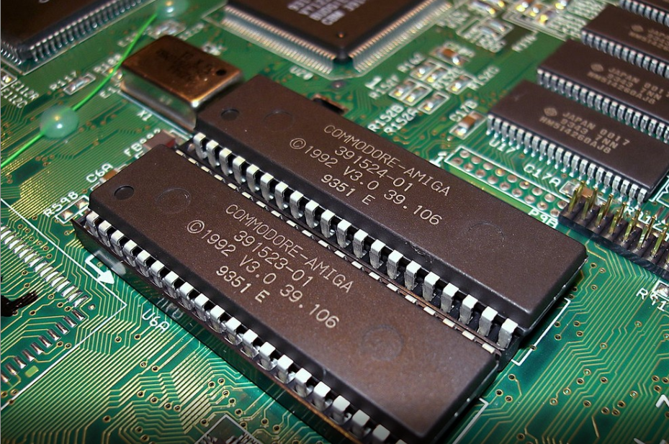
It contains the basic instructions for what needs to happen when a computer is powered on.

Slide 4
TYPES OF ROM
1) Masked Read Only Memory (MROM)
2) Programmable Read Only Memory (PROM)
3) Erasable and Programmable Read Only Memory (EPROM)
Electrically Erasable and Programmable Read Only Memory (EEPROM)
5) FLASH ROM

Slide 5
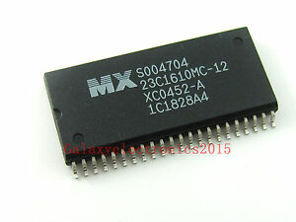
1) Masked Read Only Memory (MROM)
It is a hardware memory device in which programs and instructions are stored at the time of manufacturing by the manufacturer. So it is programmed during the manufacturing process and can't be modified, reprogrammed, or erased later.
The MROM chips are made of integrated circuits.

Slide 6
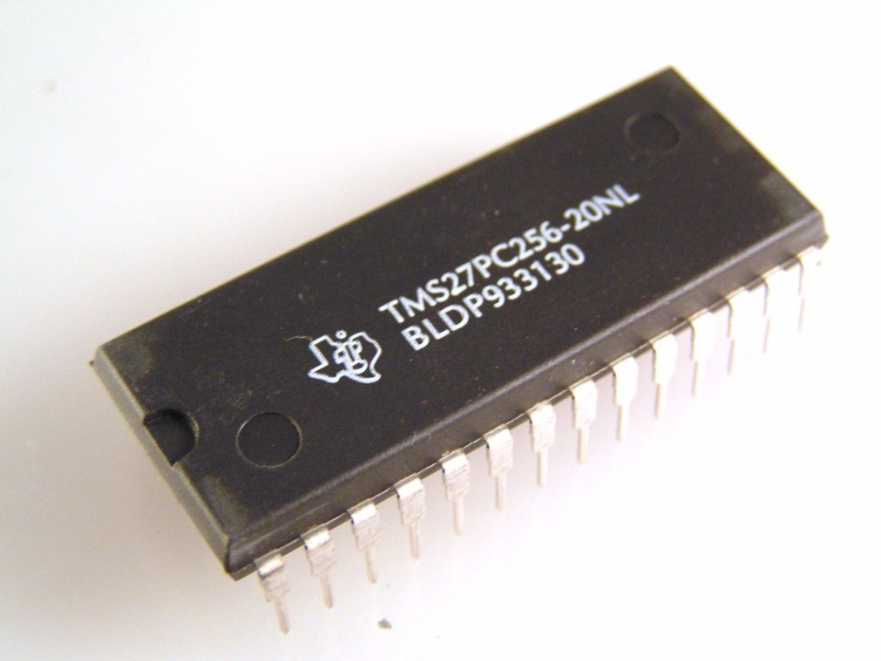
2)Programmable Read Only Memory (PROM)
The process of programming a PROM is called burning the PROM
There are small fuses in a PROM chip which are burnt open during programming.
The data can be programmed only once and cannot be altered. So it is called one- time programming device.

Slide 7
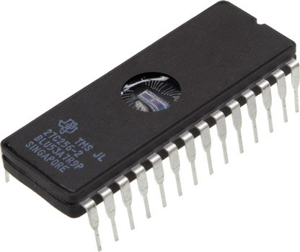
3) Erasable and Programmable Read Only Memory (EPROM):
EPROM is a type of ROM that can be reprogramed and erased many times. The method to erase the data is very different; it comes with a quartz window through which a specific frequency of ultraviolet light is passed for around 40 minutes to erase the data.
So, it retains its content until it is exposed to the ultraviolet light. You need a special device called a PROM programmer or PROM burner to reprogram the EPROM.

Slide 8
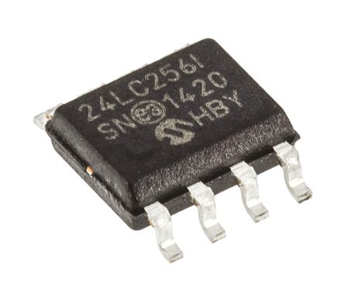
4) Electrically Erasable and Programmable Read Only Memory (EEPROM):
This type of memory can be erased and reprogrammed only by using an electrical charge.
It is erased and programmed electrically i.e. it uses electrical signals instead of ultra violet rays
The use of EEPROM allows the computer system to update the BIOS without the need to open the computer system or remove any chips.

Slide 9
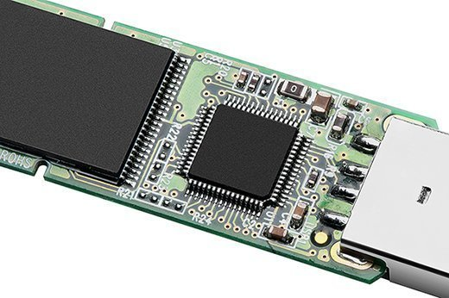
5) FLASH ROM:
It is an advanced version of EEPROM. It stores information in an arrangement or array of memory cells made from floating-gate transistors. The advantage of using this memory is that you can delete or write blocks of data around 512 bytes at a particular time.
Whereas, in EEPROM, you can delete or write only 1 byte of data at a time. So, this memory is faster than EEPROM.

Slide 10
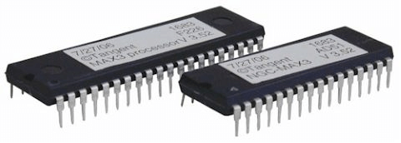
HOW DOES ROM WORK?
ROM chips contain a grid of columns and rows to turn on or off.
ROM uses a diode to connect the lines if the value is 1. If the value is 0, then the lines are not connected at all.

Slide 11
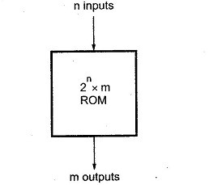
ROM DESIGN
BLOCK STRUCTURE OF ROM
The address of a binary number refers to one of the addresses of n variables. So, the number of possible addresses with 'n' input variables is 2ⁿ .An output word has a unique address, and as there are 2ⁿ distinct addresses in a ROM, there are 2ⁿ separate words in the ROM. The words on the output lines at a given time depends on the address value applied to the input lines.

Slide 12
Let us consider 64 x 4 ROM. The Read Only Memory consists of 64 words of 4 bits each.
This means that there are four output lines and particular word from 64 words presently available on the output lines is determined from the six input lines.
There are only six inputs in a 64 x 4 ROM because 2⁶ = 64, and with six variables, we can specify 64 addresses or minterms.

Slide 13
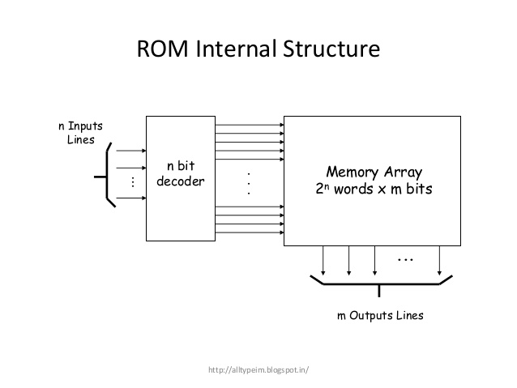
INTERNAL STRUCTURE OF ROM:
The internal structure comprises two basic components: decoder and OR gates. A decoder is a circuit that decodes an encoded form (such as binary coded decimal, BCD) to a decimal form. So, the input is in binary form, and the output is its decimal equivalent. All the OR gates present in the ROM will have outputs of the decoder as their output

Slide 14
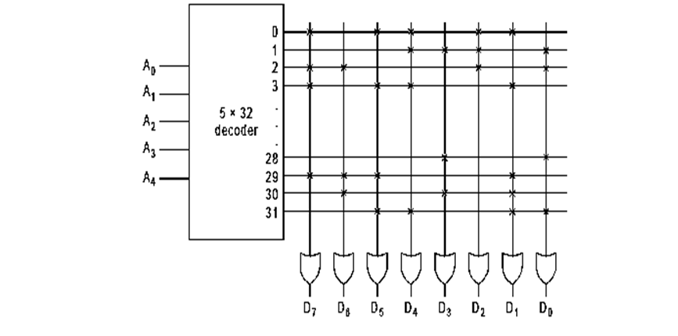
The 32x8 ROM consists of 32 words of bit size 8.
There are 32 distinct words stored which may be available through eight output lines.

Slide 15
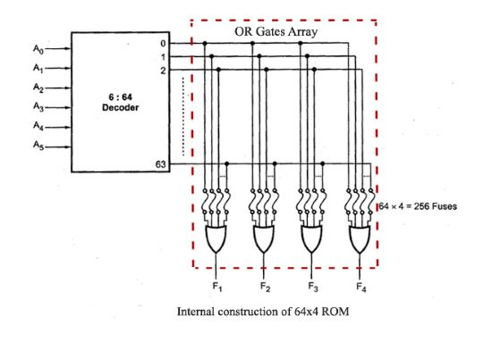
This ROM consists of 64 words of 4 bits each.The six input variables are decoded in 64 lines by means of 64 AND gates and 6 inverters.
The 64 outputs of the decoder are connected through fuses to each OR gate. Only four of these fuses are shown in the diagram, but actually each OR gate has 64 inputs and each input goes through a fuse that can be blown as desired.

Slide 16
REFERENCES
https://teachcomputerscience.com/ram-rom/
https://computer.howstuffworks.com/rom.htm#pt5
https://www.eeeguide.com/read-only-memory/

