Slide 1
MAGNETIC DISK
Mustafa BOLEKEN
2016556012

Slide 2
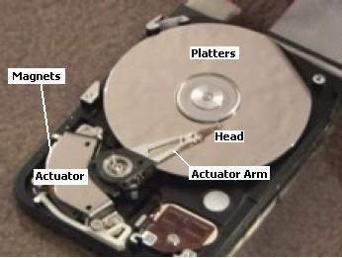
WHAT IS MAGNETIC DISK?
Primary computer storage device.
A magnetic disk is a storage device that uses a magnetization process to write, rewrite and access data.
It is a primary computer storage device.

Slide 3
How IS IT WORKS?
WRITE MECHANISM
-> Writes binary data by magnetizing small areas or zones of the disk.
-> Current through the coil produces magnetic field.
-> Corresponding magnetic pattern is recorded on the surface.
READ MECHANISM
->It reads data by detecting current pulses induced in a coil.
->Bits could be read back as a time sequence of pulse (one) or no pulse (zero).

Slide 4
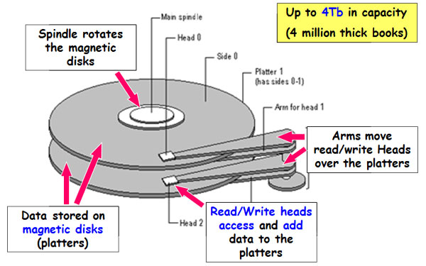
MAIN components of a magnetic disk
Magnetic Disk has four key components inside its casing: Platters, The Spindle, The Read/Write Arm and Actuator.

Slide 5
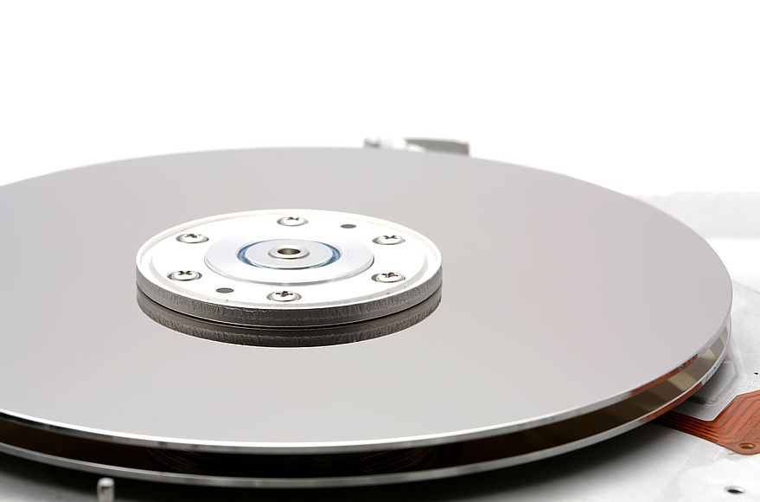
MAIN components of a magnetic disk
Platters
The platters are the circular discs inside the hard drive where the 1s and 0s that make up your files are stored.
The Spindle
The spindle keeps the platters in position and rotates them as required.

Slide 6
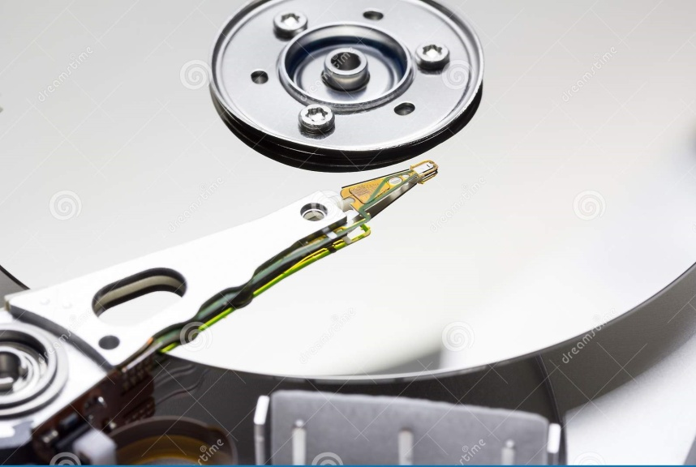
MAIN components of a magnetic disk
The Read/Write Arm
The read/write arm controls the movement of the read/write heads, which do the actual reading and writing on the disk platters by converting the magnetic surface into an electric current.
Actuator
The actuator or head actuator is a small motor that takes instructions from the drive's circuit board to control the movement of the read/write arm and supervise the transfer of data to and from the platters. It's responsible for ensuring the read/write heads are in exactly the right place at all times.

Slide 7
Characteristics
Fixed-head Disk
One read-write per track.
Heads are mounted on a fixed ringed arm that extends across all tracs.
Movable-head Disk
One read-write head.
Head is mounted on an arm.
The arm can be extended or retracted.

Slide 8
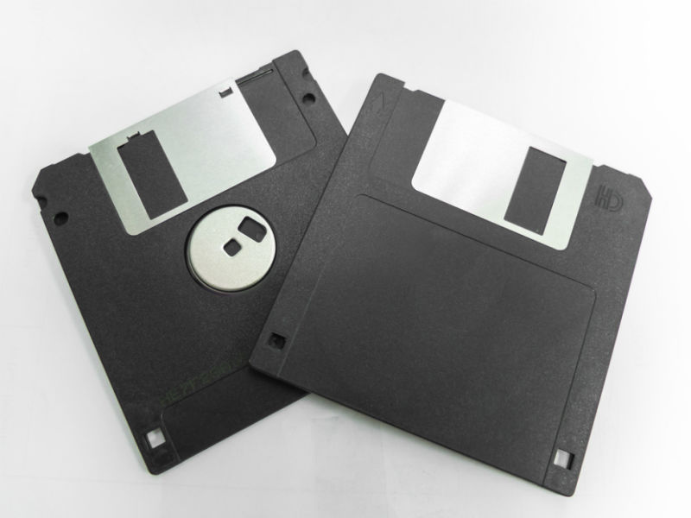
Characteristics
Non-removable Disk
Permanently mounted in the disk drive.
Removable Disk
Can be removed and replaced with another disk.
Floppy disks are example of removable disks.

Slide 9
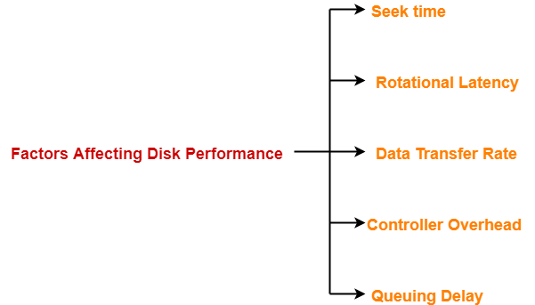
Disk Performance Parameters

Slide 10
The end Thanks for Listening me

