Slide 1

Traffıc lıghts wıth fsm usıng vhdl
Oguzhan Dılber

Slide 2
What ıs a fınıte state machıne ? And why use ıt ?
A finite-state machine (FSM) is a mechanism whose output is dependent not only on the current state of the input, but also on past input and output values.
Whenever you need to create some sort of time-dependent algorithm in VHDL, or if you are faced with the problem of implementing a computer program in an FPGA, it can usually be solved by using an FSM.
State-machines in VHDL are clocked processes whose outputs are controlled by the value of a state signal. The state signal serves as an internal memory of what happened in the previous iteration.

Slide 3
logıc

Slide 4
ımplementatıon
The syntax for declaring a signal is
type <type_name> is (<state_name1>, <state_name2>, ...); signal <signal_name> : <type_name>;
Using the state signal, the finite-state machine can then be implemented in a process with a Case statement. The Case statement contains a When statement for each of the possible states, causing the program to take different paths for every state. The When statement can also contain code which should be executed while in that particular state. The state will then typically change when a predefined condition is met.

Slide 5
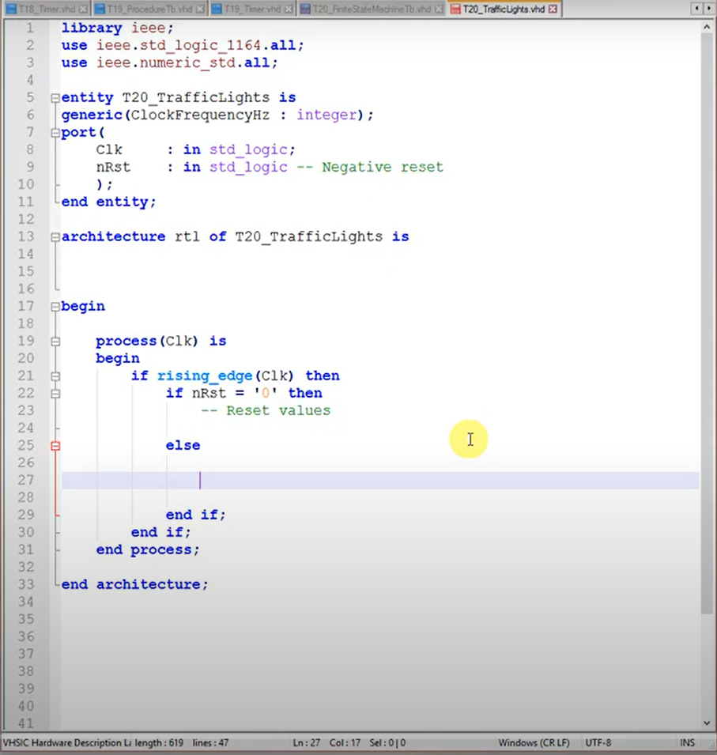
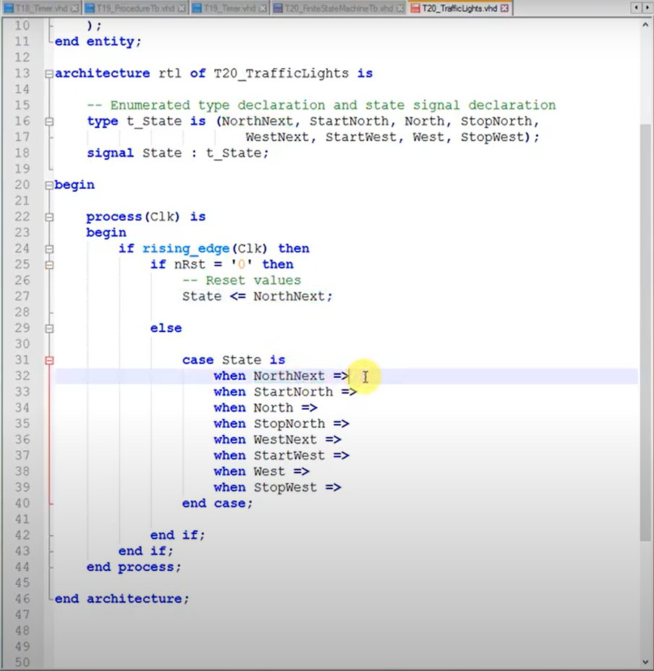

Slide 6
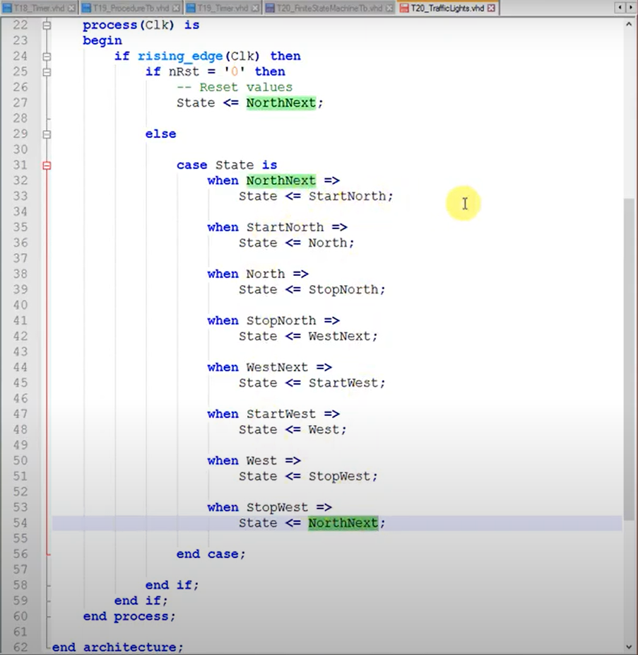
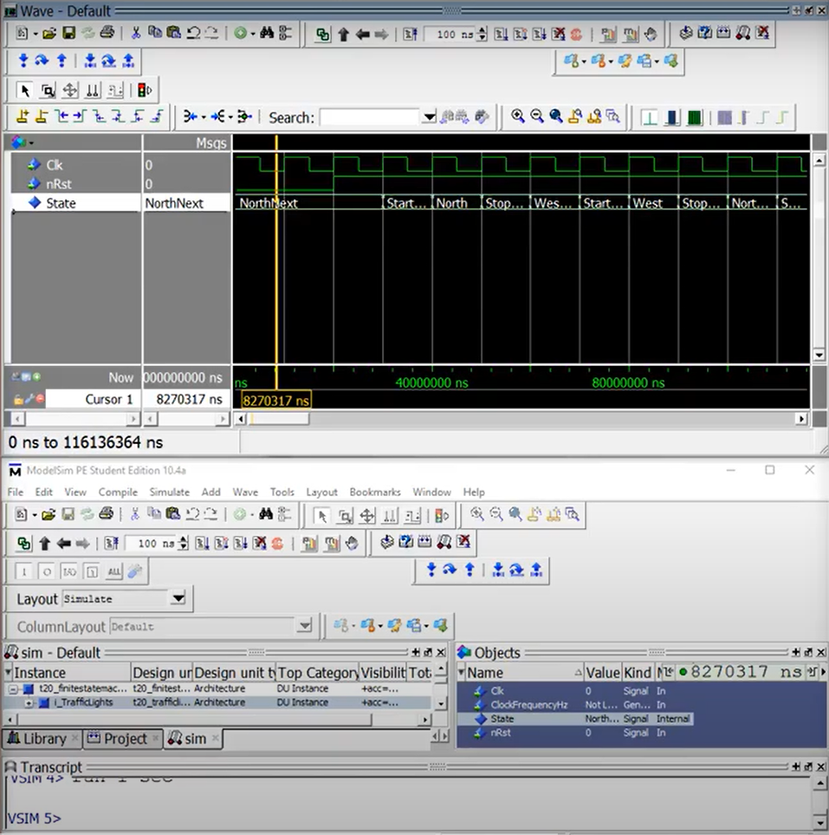

Slide 7
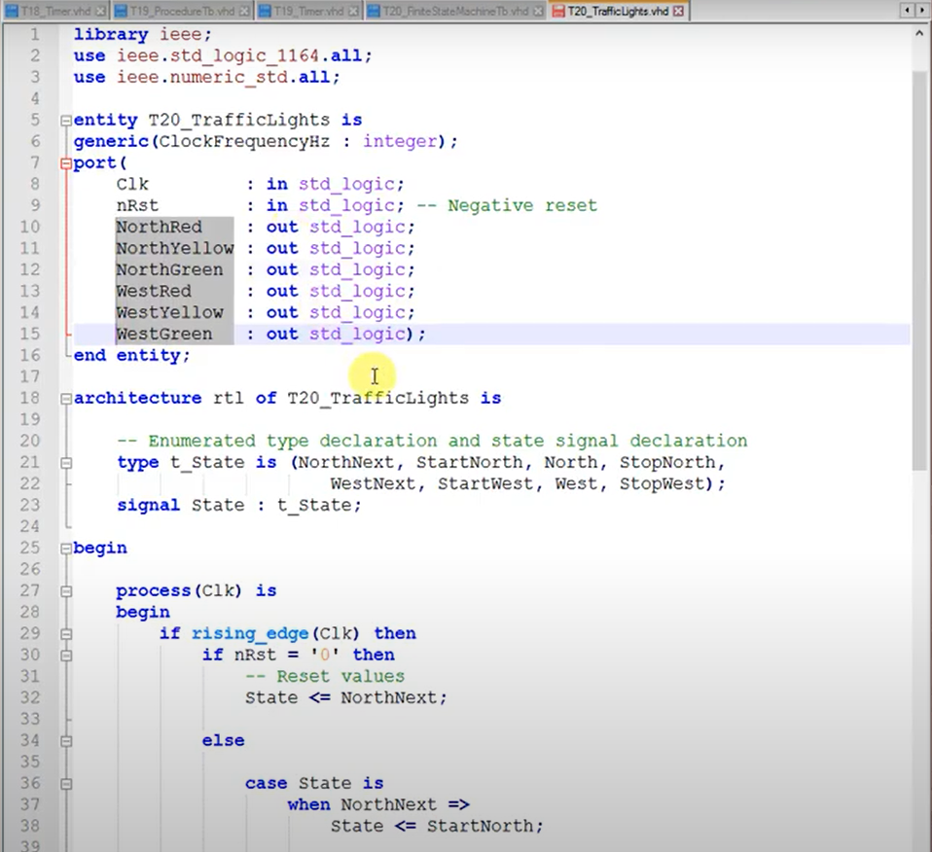

Slide 8
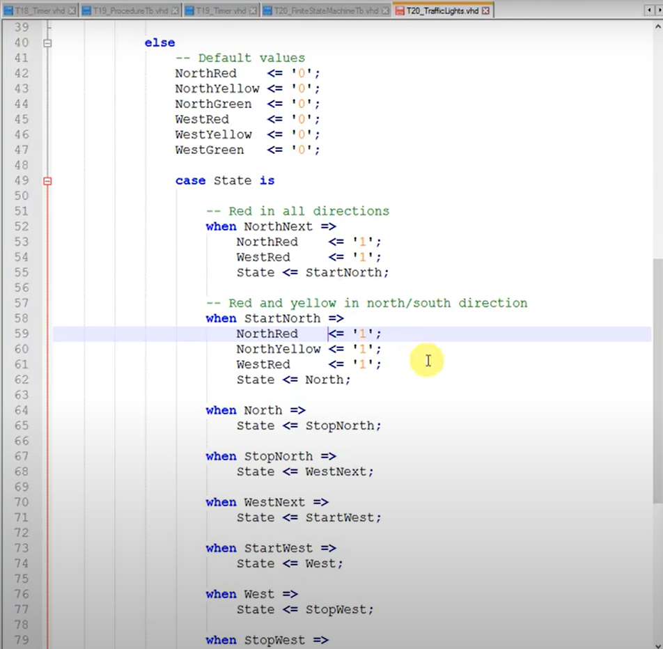
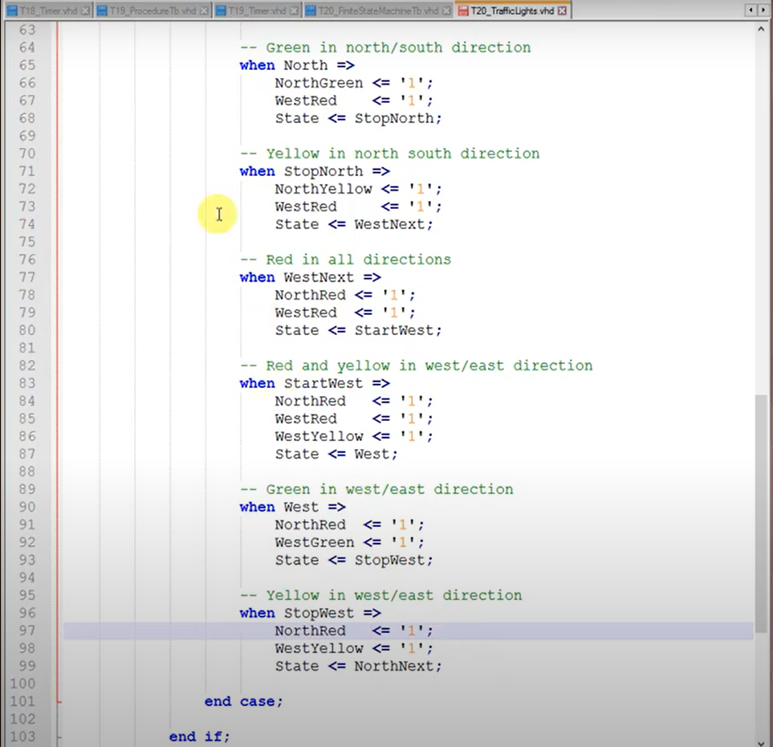

Slide 9
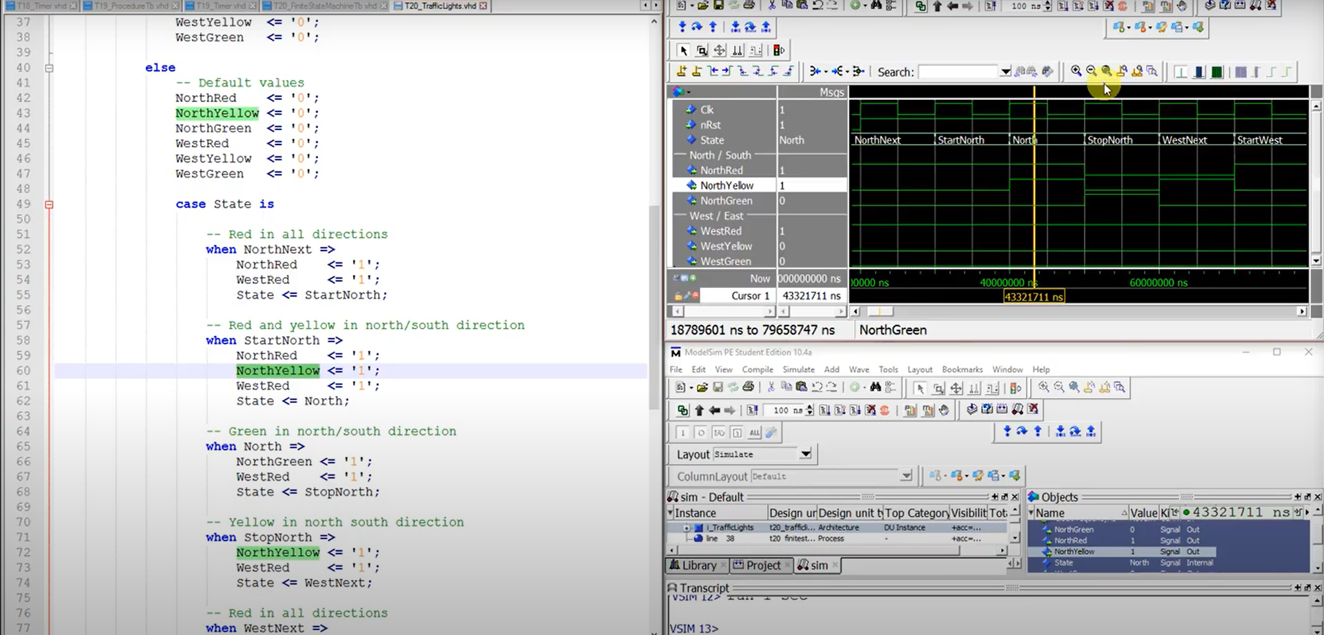

Slide 10
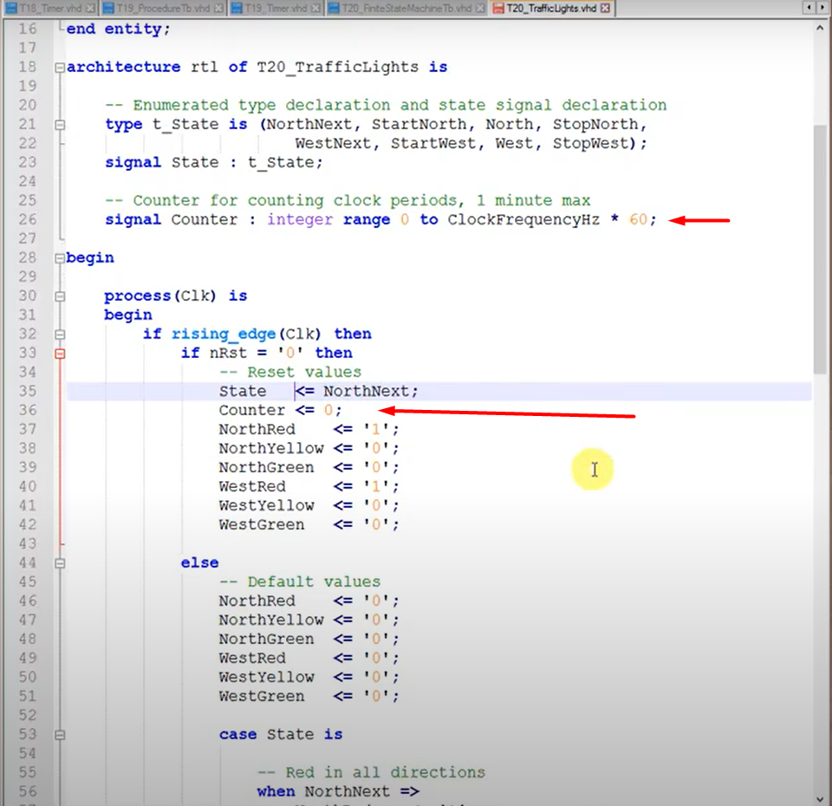
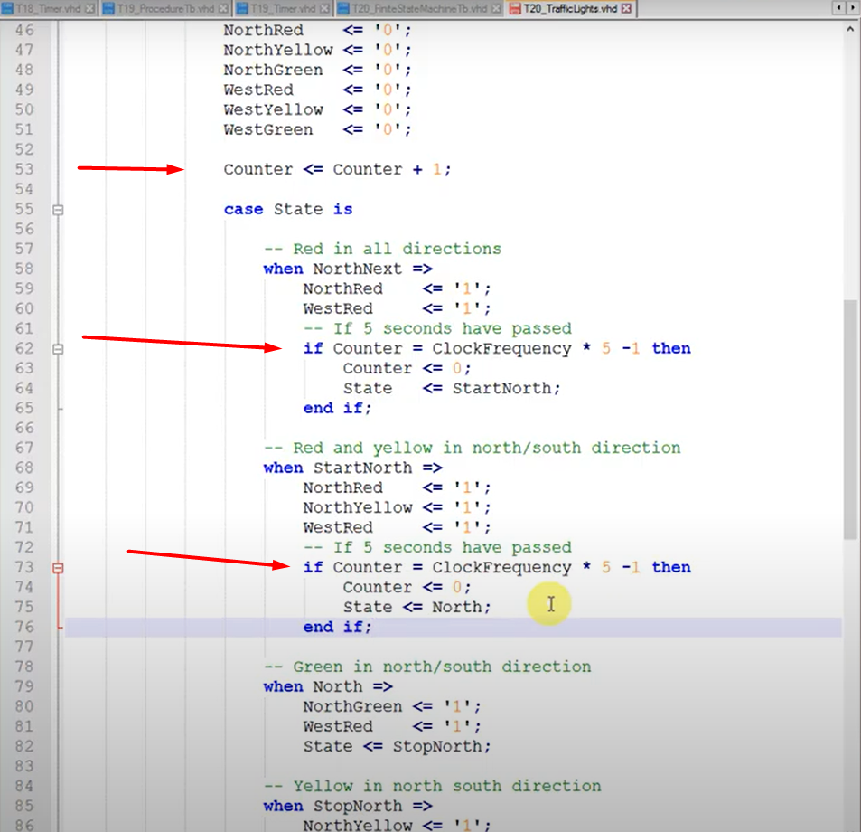

Slide 11
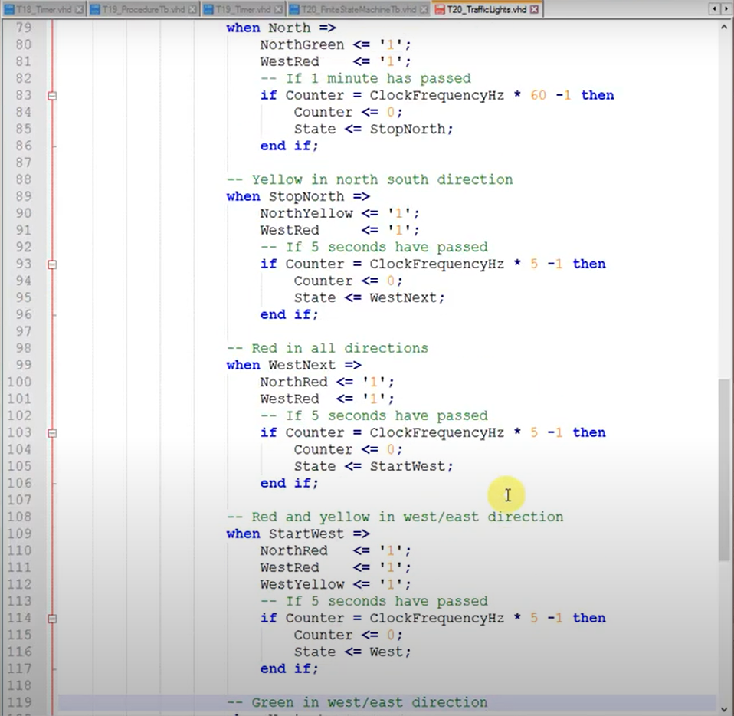
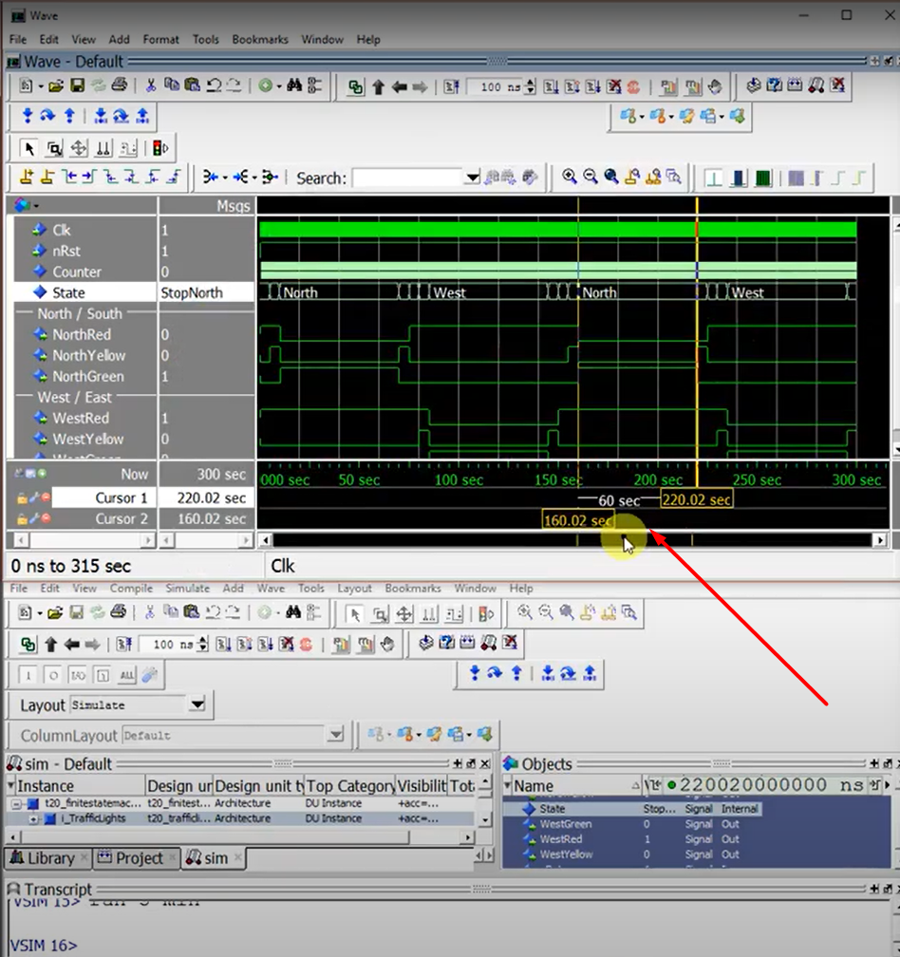

Slide 12
source
For source codes and more information :
https://vhdlwhiz.com/finite-state-machine/

